Slide 1
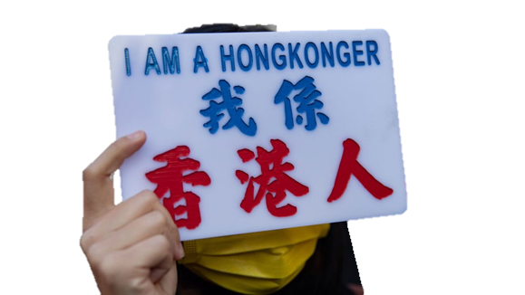
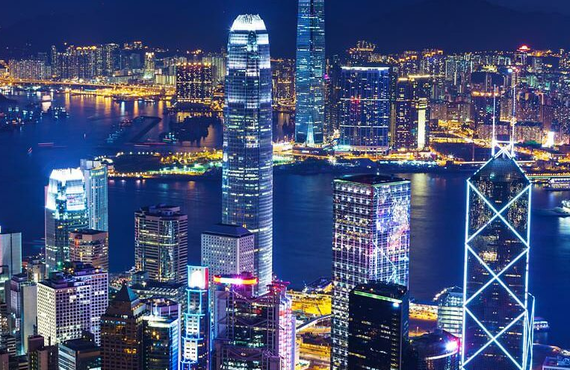
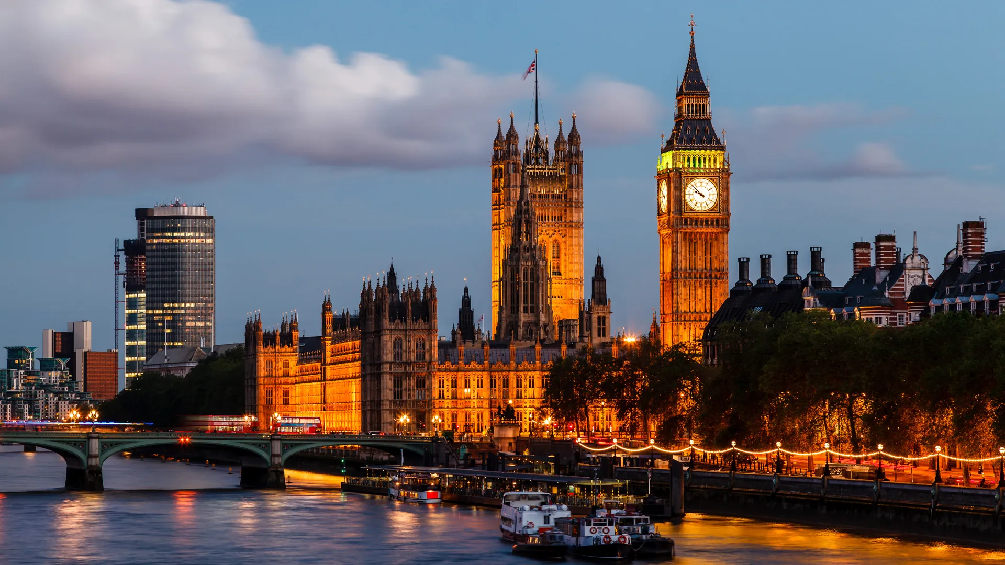
When Migrants Become Influencers Via Social Media
Radicalization and the Use of Social Media Among Hong Kong Immigrants
Dr Carmen Yau (Email: C.yau@gold.ac.uk)
Lecturer in Social Work /Research Lead for the Wellbeing Research Hub
Goldsmiths, University of London

Slide 2
Abstract
In this session, Carmen uses Hong Kong immigrants in the UK as a case study to explore the use of technology and social media in immigrant communities. She starts by contextualizing the homesickness and well-being of immigrants. She will talk about how Hongkongers are using social media to build solidarity, radical welcoming and manifestations of sanctuary. She concludes by highlighting the use of social media for research and practice.

Slide 3
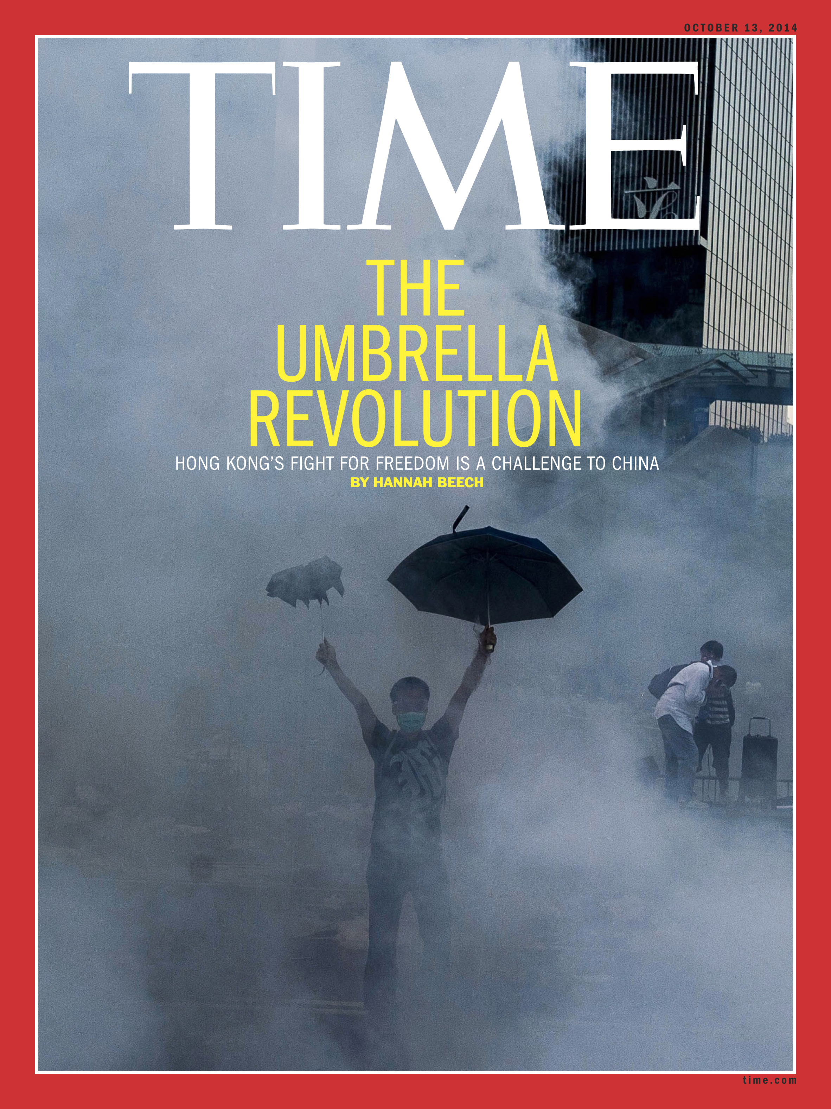
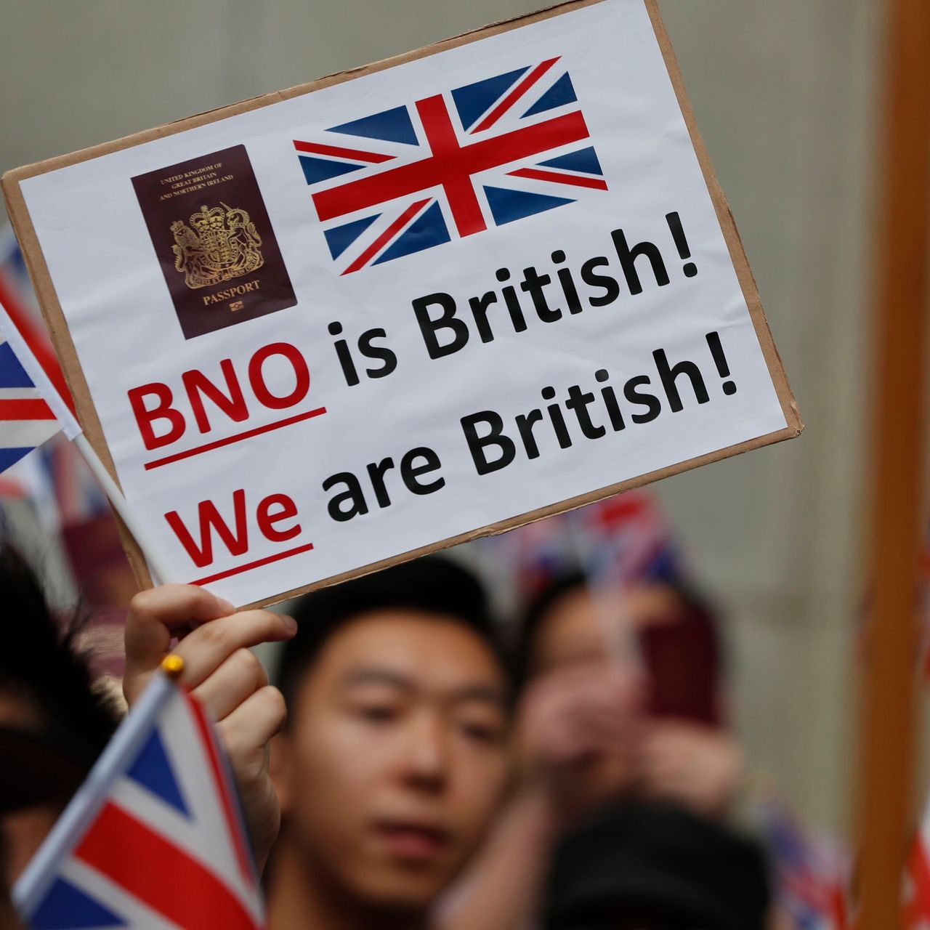
Hong Kong Exodus
1980s
300,000+ citizens
1984 The Sino-British Joint Declaration
1990s
60,000+ citizens /year
1989 The Tiananmen Square incident
2010-2020s
2014 The Umbrella Movement began
2020 Beijing-imposed National Security Law
2020 Lifeboat Scheme - BN(O) Route
Allow British Nationals (Overseas) (BN(O)) status holders to relocate to the UK to live, work, and potentially apply for citizenship after obtaining settled status.

Slide 4
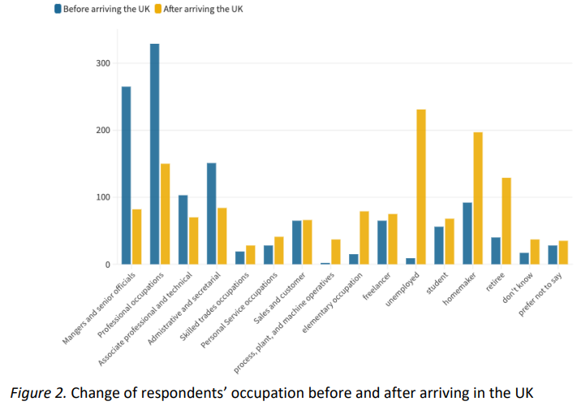
Untapped Talent Pool Profile of Hong Kong Migrant (Yue, 2023)
Change of Respondents’ Occupation
Age & Gender
57.6% Middle Age (30-49)
Gender Ratio: Female>Male
Education Level
78.4% Tertiary education
29.7% Master’s degree or above
Family Structure
72.2% Married or cohabiting with partners
31.0% Have two or more children
23.3% Having only one child
(N=1,310)

Slide 5
Wellbeing of HK Migrants
Physical & Psychological Wellbeing
Social relationships
Self and social Identity
Social citizenship
Finance & Employment
Housing & Accommodation
Political Involvements
Vote in UK (51.7% )
No change in the degree of concern of HK politics (57.7% )
Mental health
Prevalence: Anxiety (15.0% ); Depression (10.9% )
Moderately (6.6%); severe level (2.8%)
Help-Seeking Experiences
Insensitivity & Judgemental Experiences
Confusion on diagnosis
Identity Adaptation:
Hongkonger, British Hongkonger, British
Immigrant Guilt:
Tension between Leavers and Stayers
Low financial wellbeing:
Pension issues in HK
Saving to Draw on
Employment adaptation
High Rate Of Social Isolation (38.9%)
limited family support & non-kin social ties
(Yue, 2023)

Slide 6
Homesickness & Well-being of Immigrants (Acilar, 2024)
Homesickness occurs during a time of change and is a natural response to loss and adjustment. It can cause feelings of stress or anxiety, caused by the separation from people and places that you know.
Homesickness Symptoms
Feelings of grief, depression and anxiety
Feeling isolated, lonely or withdrawn
Loss of confidence
Lack of concentration
Disturbed sleep
Preoccupied thoughts of home

Slide 7
London Hong Kong Welcome Programme
Through the Local Welcome Hong Kong Fund, over £200,000 was allocated to seven key Local Authorities in the capital:
The London Borough of Hackney
The London Borough of Haringey
The London Borough of Kingston
The London Borough of Richmond
The London Borough of Sutton
The London Borough of Tower Hamlets
The London Borough of Waltham Forest.
Applications for the Hong Kong Empowerment Fund are now open.
The Fund is established to support Hong Kong Civil Society in London to deliver integration support to the Hong Kong British National (Overseas) (BN(O)) community.
Groups and organisations have been granted:
Welcoming Hongkongers H.O.M.E. Project
Kingston BEATS
Project TEMP
Hong Kong Aid
UK Welcomes Refugees
Hearth Talk.
Growth grants: up to £15,000
Collaboration grants: up to £50,000
Close on 27 March 2024

Slide 8
Use of Social Media
Sanctuary is a place of refuge and protection. It doesn’t even have to be a place it could be someone that makes you feel safe and protected.
Build Solidarity
Radical Welcoming
Manifestations Of Sanctuary
We Are Social and Meltwater Digital 2023 Report
Hong Kong emerged as the third market with the most social media users as of the beginning of 2023, a report found. This went up from 6.68 million users in 2022, which made up 88.1% of the city’s total population.
Radical Welcoming
A practice of putting extraordinary effort and emphasis on making people feel welcome
(Alang, Letcher, Mitsdarffer, et al., 2024)
Solidarity is an awareness of shared interests, objectives, standards, and sympathies creating a psychological sense of unity in groups or classes.

Slide 9
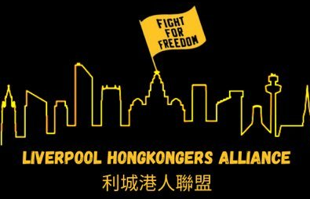
Build Solidarity
Radical Welcoming
Manifestations Of Sanctuary

Slide 10
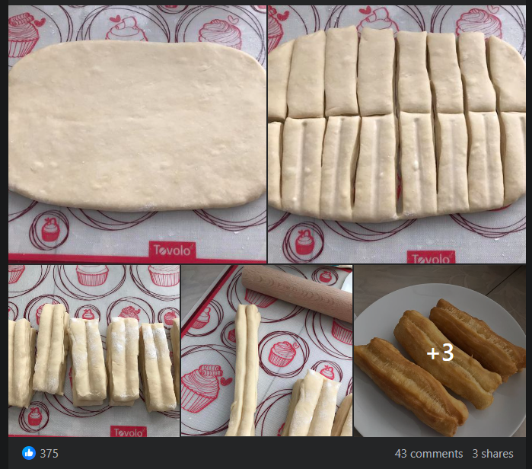
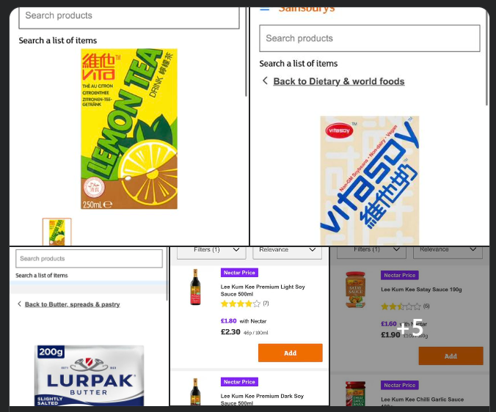
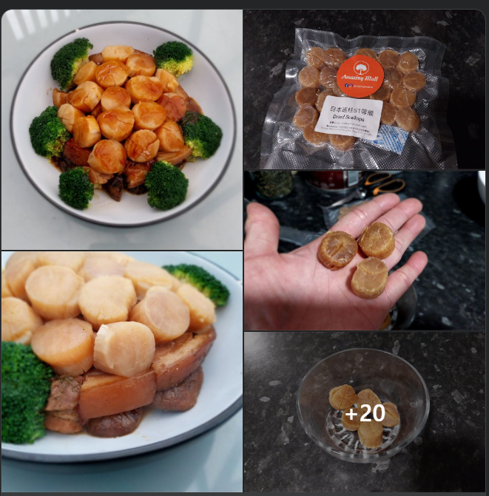
Building Solidarity via Food
Experiments with Local Ingredients
Shopping Tips
Food is
culture,
habit,
craving, and
identity.
- Jonathan Safran Foer
Online Store & Instruction
Immigrant Entrepreneurs’ Culinary

Slide 11
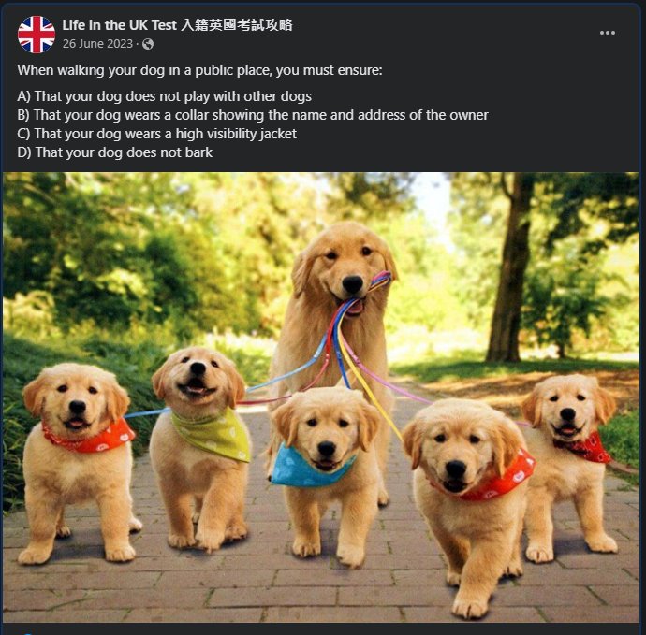
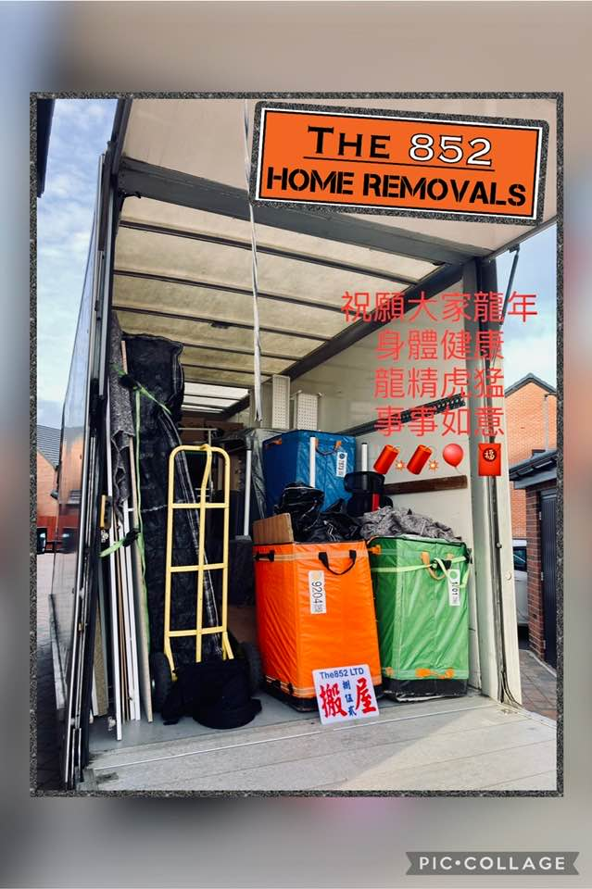
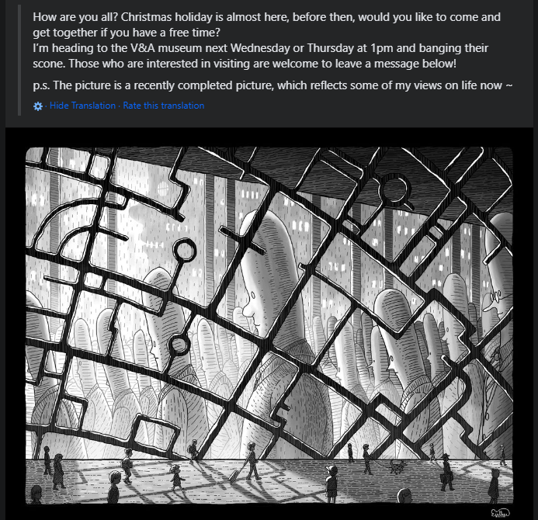
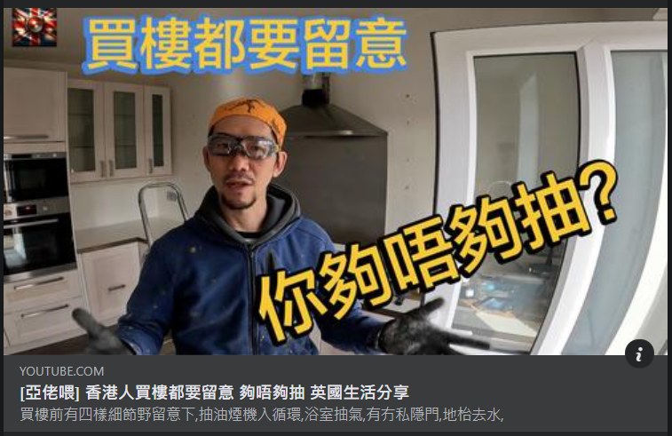
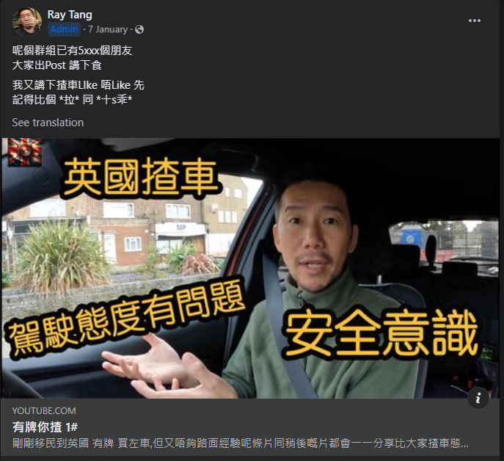
Radical Welcoming
Resources on Visa & Licencing
Support in Settling In UK Life
Social Meetups

Slide 12
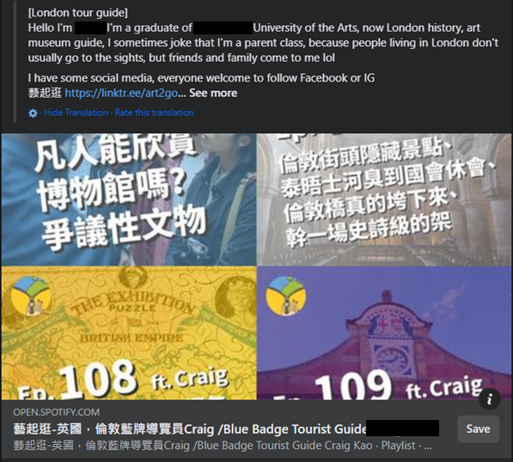
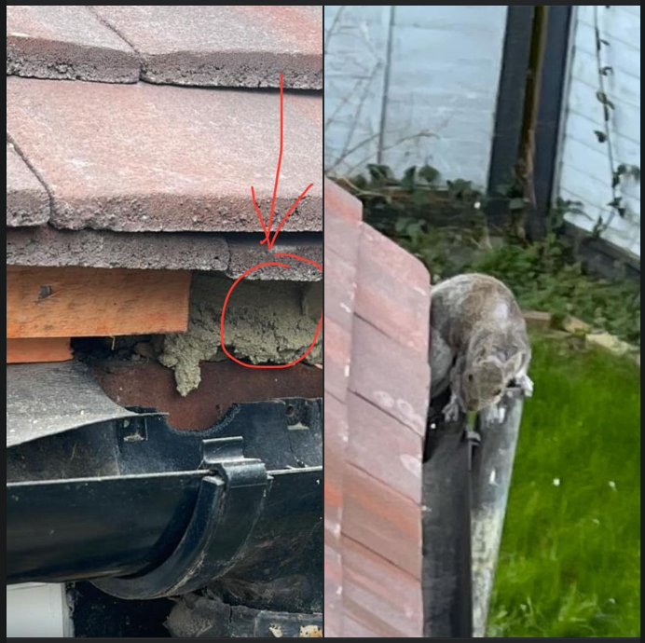
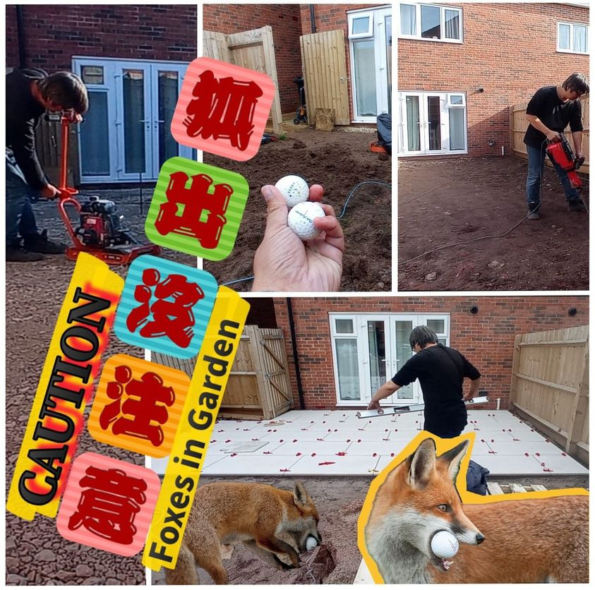
Manifestations Of Sanctuary
Career Development
Adapting UK Life
Ecology of UK Hongkongers

Slide 13
Strategic Use of Social Media
Traditional social networking sites Examples: Facebook, LinkedIn, X (formerly Twitter), Threads
Image-based social media Examples: Instagram, Pinterest, Snapchat, TikTok (photo mode)
Video-based social media Examples: Instagram Reels, TikTok, YouTube Shorts
Livestream social media Examples: Facebook Live, Instagram Live, TikTok Live, Twitch, YouTube
Private community platforms Examples: Discord, Facebook Groups, Patreon, Slack
Discussion forums Examples: Reddit, Quora
Used for: Connecting directly with customers in specific areas, communities, or interest groups.
Used for: Broadcasting live video to many viewers at once
Used for: Asking and answering questions, networking, and forming communities around niche- and interest-based topics
Used for: Visual storytelling, brand-building, and social commerce.
Used for: Sharing short-form video content (usually between five seconds and ninety seconds long)
Used for: Creating communities, with the possibility of requiring registration or other screening measures for new members.

Slide 14
References
Alang, S.M., Letcher, A.S., Mitsdarffer, M.L., et al. (2024). The Radical Welcome Engagement Restoration Model and Assessment Tool for Community-Engaged Partnerships. Health Promotion Practice, 0(0). doi:10.1177/15248399231223744
Acilar, A. (2024). Exploring the Associations Between Acculturative Stress, Well-Being, Life Satisfaction, and Social Media Use Among Turkish Refugees in Norway. In Advancements in Socialized and Digital Media Communications (pp. 231-248). IGI Global.
Yue, Pak Hong (2023) A Study Report on Hong Kong Migrants Recently Arrived in the UK. Available at : https://livrepository.liverpool.ac.uk/3171386/1/A%20Study%20Report%20on%20Hong%20Kong%20Migrants%20Recently%20Arrived%20in%20the%20UK.pdf [Access on 12 March 2024]

