Slide 1

Massage Your Pressure Points: Self-care and Mindful Stress Management
Dr Carmen Yau (Email: C.yau@gold.ac.uk)
Lecturer in Social Work /Research Lead for the Wellbeing Research Hub
Goldsmiths, University of London

Slide 2
Sources of Occupational Stress
Individual Factors
Burnout
Compassion Fatigue
Organization Factors
Heavy Workload
Role conflict/ambiuity
UK Context
Cost-of-living concerns
Social work ‘on brink of a collective breakdown’
Job Stress/Tension
Secondary Traumatic Stress
Vicarious Traumatization
Lack of support
Unsafe work conditions
Low salary
COVID-19 mental health

Slide 3
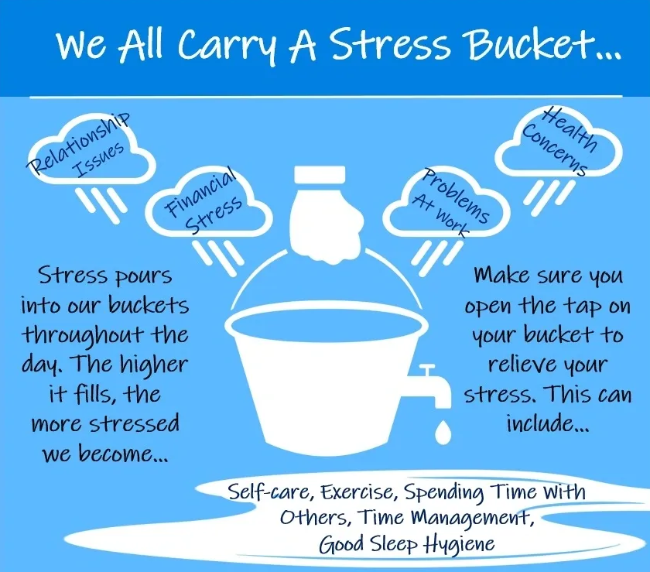
Occupational Stress & Wellbeing Among Social Workers
Health and social care sectors have among the highest levels of stress-related sickness absence in the country (Health and Safety Executive, 2020)
50%+ health-related sickness absence days lost relates to stress, depression, and anxiety.
Social work is one of the most stressful occupations in the UK (Ravalier, 2019; Ravalier et al., 2021).
The success rate of finding children’s shelters is compromised due to the high turnover rate of social workers (Flower et al., 2005).

Slide 4
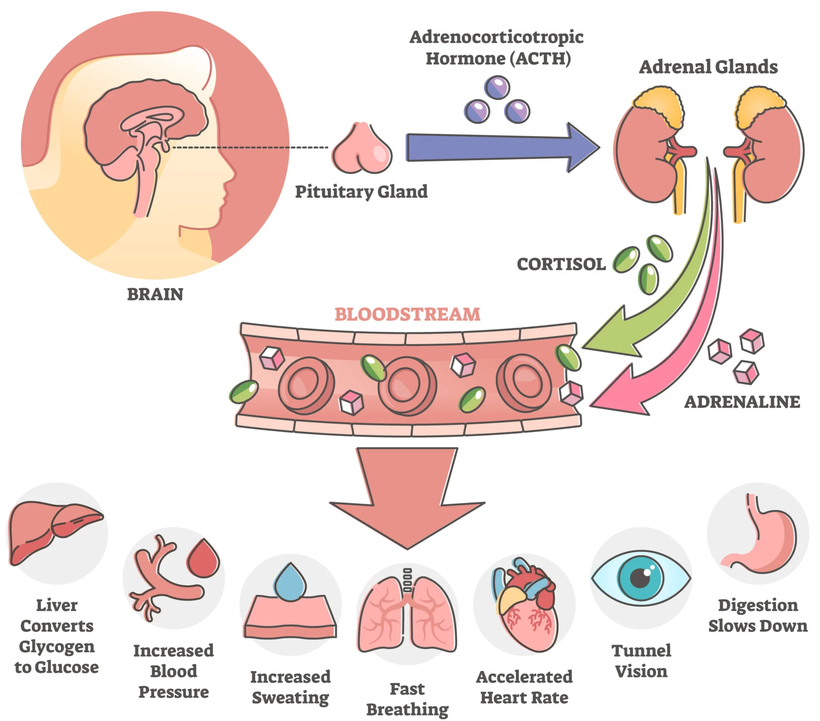
Fight or Flight
Response
Chronic stress
is defined as that which lasts over an extended period of time.
Cardiovascular Disease
Metabolic Syndrome (e.g. Type 2 diabetes)
Physiological outcomes
(Marmot et al., 1991; Rosengren et al., 2004; Chandola et al., 2006)

Slide 5
Cognitive Model of Stress
Stimulus/
Events
Response/
Actions
Evaluation/
Interpretation
Behaviours
Thoughts
Fight or Flight
Response
More/less time at work
Procrastination
Negotiate and argue
Stress-relief mechanisms (e.g. smoke or drink)
Sleep disturbance
There is too much to do.
There’s not enough time.
It’s out of control.
I can’t cope.
Muscle tense
Headaches
Difficulty concentration
Sweating

Slide 6
ABC Model
C
B
A
A: Situation/Trigger
E.g. A classmate repeatedly talks over me in a class
C: Consequence
Physical: what does that think do to my body?
Emotional: How does that thinking make me feel?
Behavioural: how your respond?
B: Belief &
Automatic thoughts
E.g. Gosh, that classmate definitely dislike me
E.g.
Physical: heart beat faster, my body heats up. Face go red.
Emotional: Annoyed.
Behavioural: I interrupt the classmate and say, “sorry, but you……..” and ……..
Negative automatic thoughts
Dysfunctional assumptions
Core Belief

Slide 7
Rational Emotive Behaviour Therapy (REBT)
A
B
D
E
Situation
Where were you?
What were you doing?
Belief & negative automatic thoughts
What thought or image went through your mind?
What makes you belief the thought is true?
What makes you belief the thought is false?
Dispute
What thought or image went through your mind?
Dispute the Beliefs to find which are dysfunctional—
What is the evidence that my belief is true?
In what ways is my belief helpful or unhelpful?
What helpful/self-enhancing belief can I use to replace each self-defeating or dysfunctional belief?
Effective new belief & Actions
What helpful/self-enhancing new belief can I use to replace each self-defeating or dysfunctional belief?
What are my new feelings?
C
Emotion or Feelings

Slide 8
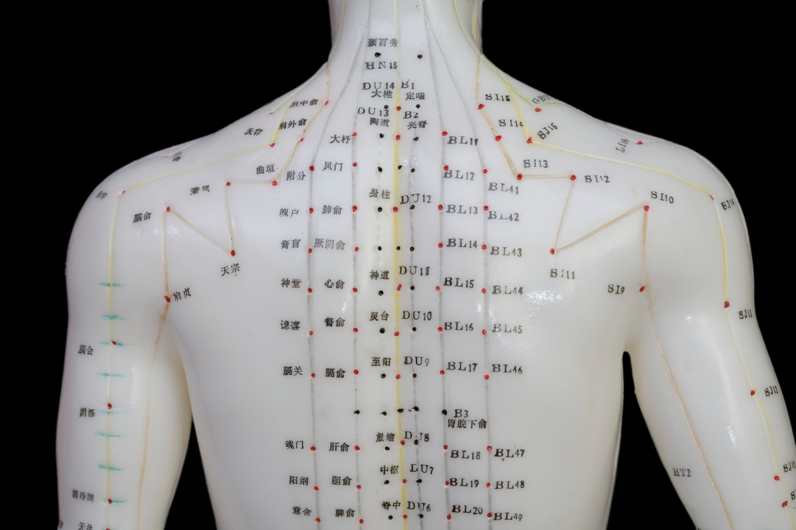
Introduction of Acupuncture
Acupuncture is based upon an understanding of the body being composed of a network of physiological pathways called “meridians” or “channels” that connect internally with the viscera, and distribute around the body, intersecting in a manner that resembles a subway map.
Physiological substances “qi” and “blood” move through this network which is in the image of rivers and streams. Along these meridians are “hollows” where qi pools. These hollows, also called acupuncture points, can be stimulated to cause effects locally and distally along the meridian, and in the internal viscera.

Slide 9
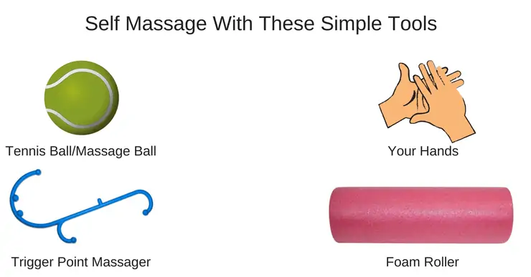
Basic Self-massaging Techniques
Stress-related Massages
  Eyes fatigue & Headaches
  Irritable Bowel Symptom
  Mood Changing Points
What is Tapping?
Tapping, also known as EFT (Emotional Freedom Technique), is a powerful stress relief technique. Tapping is based on the combined principles of ancient Chinese acupressure and modern psychology.
Self-massaging Tools

Slide 10
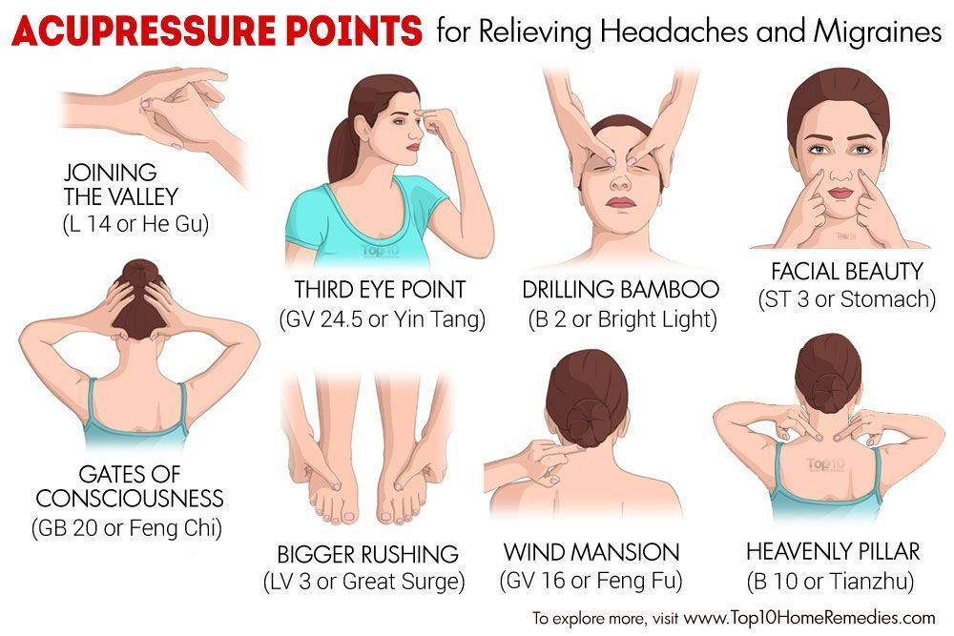

Slide 11
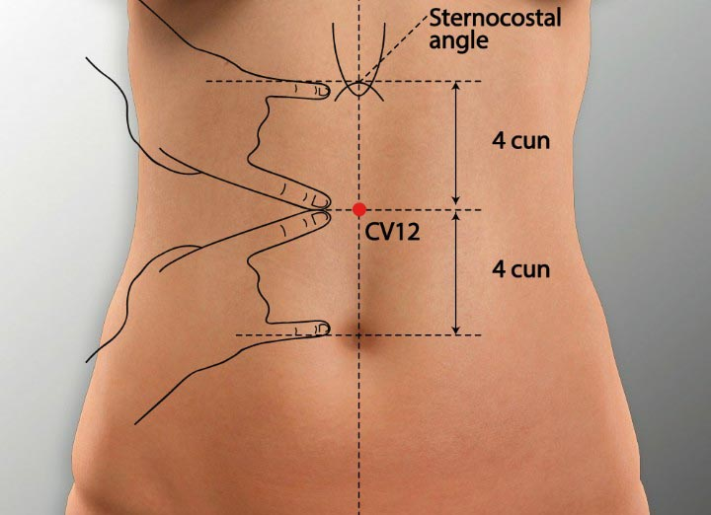
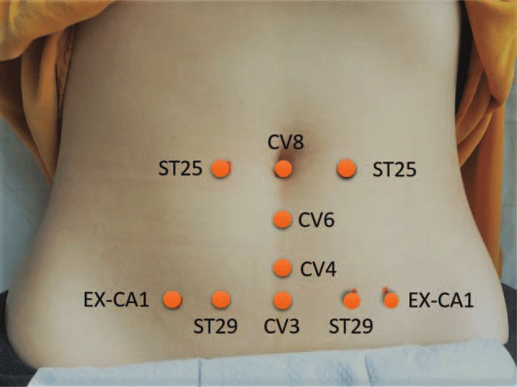
Irritable Bowel Symptom

Slide 12
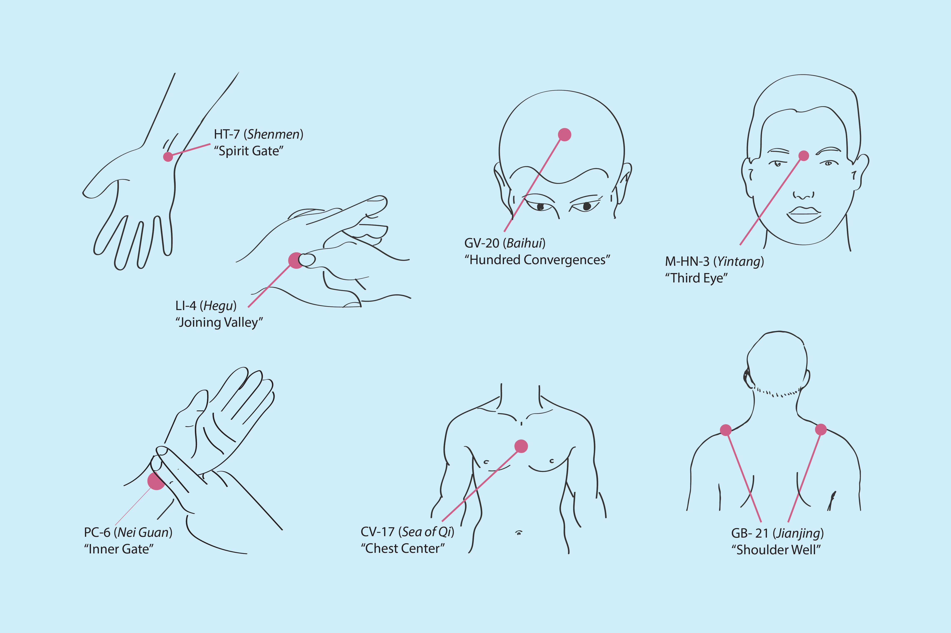
  Mood Changing Points

Slide 13
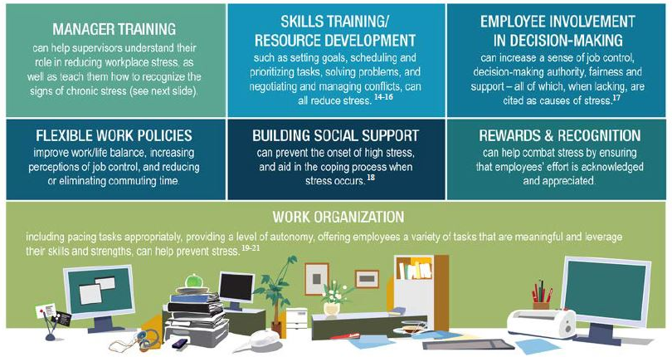
Conclusion: A Comprehensive Approach to Addressing Workplace Stress

Slide 14
Abstract
Occupational stress and wellbeing issues are among the biggest causes of sickness absence in the UK, with the Social Work and Social Care sectors having among the highest levels of stress and mental health sickness absence of all professions in the UK (Ravalier et al., 2023). Literature have shown these sickness absences are stressed-related with depression, anxiety and other health issues like cardiovascular disease, metabolic syndrome or diabetes (Chandola et al., 2006; Niedhammer et al., 2020; Rosengren et al., 2004). Thus, high levels of occupational stress and a hectic working environment have a negative impact on the quality of health and social services. For instance, the success rate of finding children’s shelters is compromised due to the high turnover rate of social workers (Flower et al., 2005).
There is an increasing wealth of evidence demonstrating that body-mind intervention benefits the psychological and physical health of individuals, it also helps to cultivate a supportive group culture where individuals gain a sense of solidarity and self-efficacy.
This session aims to provide psychoeducational training to facilitate social workers to learn boost their self-efficacy, awareness of self-care and “body-mind” stress management. The key learing outcome will be:
  To understand the body and mind related to stress at work (e.g. Tension headaches irritable bowel symptoms, high blood pressure etc.)
  To learn how mindfulness facilitates their reflection and self-efficacy: Cognitive stress management to facilitate positive reflective and constructive actions at work
  To learn basic self-massaging techniques: to learn some acupuncture points and skills to manage their stress responses
  This session is to explore the possibility and benefit to alleviate occupational stress among social workers.

