Slide 1

Gender & Sexuality in Social Work
Dr Carmen Yau (Email: C.yau@gold.ac.uk)
Lecturer in Social Work /Research Lead for the Wellbeing Research Hub
Goldsmiths, University of London

Slide 2
Human Sexuality as a Critical Subfield in Social Work (McCave, Shepard & Winter, 2014)
Reasons
Problems
A lack of understanding of any major aspect of one’s culture or identity
Fail to establish culturally competent practice as an ethical standard within the profession
(NASW, 2008).
Experience interactions with clients regarding sexuality as overly personal, sensitive, and uncomfortable.
Ultimately, the effectiveness of services to clients may be compromised
Education
Practice
Research
The curriculum is not inclusive of LGBTQ content
“Problem-focused/ Negativity of Sexuality
Lack knowledge and co-production with communities
(Holley, Tavassoli, & Stromwell, 2016; Swislow, 2015).

Slide 3
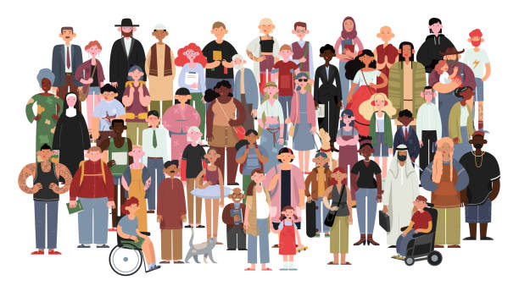
Human Sexuality as a
Critical Subfield in Social Work
  NASW (2008) specifically states
  in the Ethical Standard 1.05,
  “Cultural Competence and Social Diversity,” that social workers are ethically bound to “…understand the nature of social diversity and oppression with respect to …sex, sexual orientation, gender identity or expression ...marital status…”
  (para. 30).

Slide 4
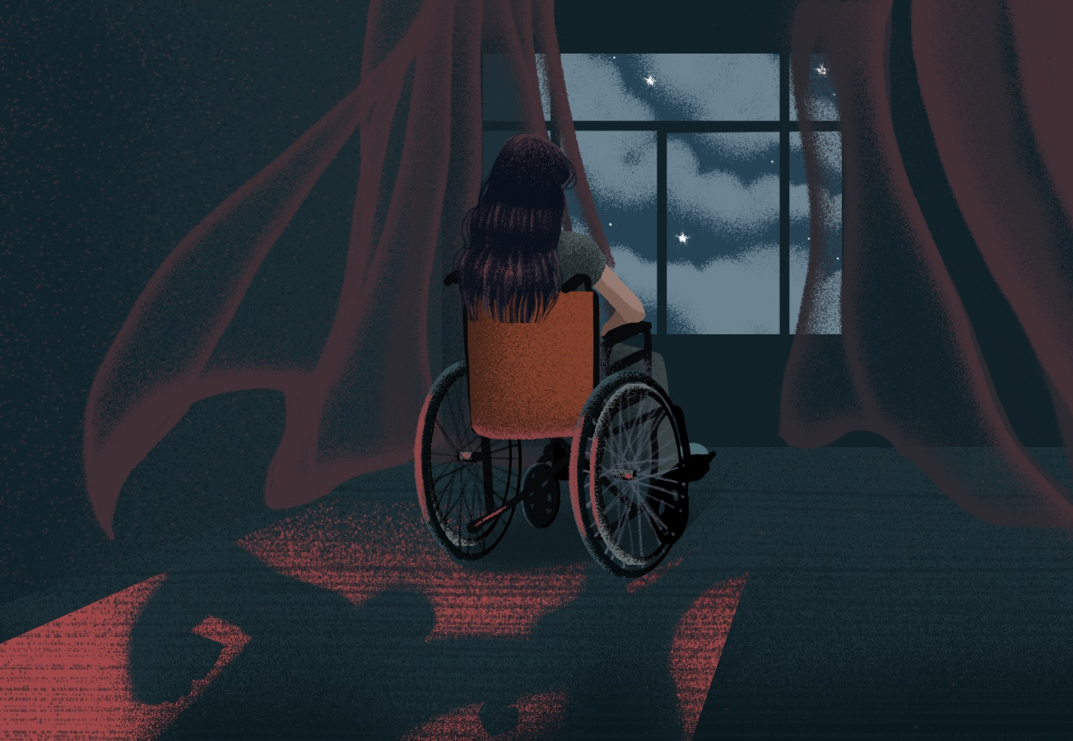
Reflection of our Practice Patterns (Myers & Milner, 2007)
Gender and sexuality issues framed as “problems” to be solved by helping professionals
Social workers unknowingly perpetuate the cycle of sexual oppression by delivering services that are based on erroneous assumptions and personal judgments, or avoiding such topics all together.
Social work’s response to human sexuality mirrors the larger cultural norms and values on sexuality, which favours social control rather than the field’s stated emphasis on self-determination.
Case Sharing:
Jenny and her “doting parents”
500+ LGBTQ youth in the child welfare system described “negative stereotypes and beliefs about LGBTQ people” as the “number one barrier” to positive child welfare services
(Woronroff, Estrada, & Sommer, 2006, p. 2).

Slide 5

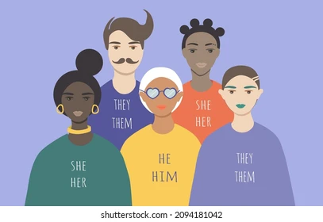


Gender, Sexual, and Relationship Diversity (GSRD)
Sexual Orientation
Gender Identity & Expression
WHO (2006) suggests Human Sexuality is …
a central aspect of being human throughout life and encompasses sex, gender identities and roles, sexual orientation, eroticism, pleasure, intimacy and reproduction.
Sexuality is experienced and expressed in thoughts, fantasies, desires, beliefs, attitudes, values, behaviours, practices, roles and relationships. While sexuality can include all of these dimensions, not all of them are always experienced or expressed.
Sexuality is influenced by the interactions of biological, psychological, social, economic, political, cultural, ethical, legal, historical, religious and spiritual factors. (para. 6)
Sexual Fetishes & Kinks
Relationship Diversity

Slide 6
Do you know these terms?
Sexual Orientation
Gender Identity & Expression
Heterosexual
Cisgender
Homosexual
Bisexual
Transgender
Expression: Cross-dresser
Non-binary
Expression: Drag Queen/King
Asexual
Pansexual/Demisexual
Sexual Fetishes & Kinks
Relationship Diversity
A Sexual Fetish: A way of pleasuring that must be part of the sexual experience for sexual gratification.
A Kink: A sexual interest a partner may pursue because it excites them.
Monogamy
Polyamory
non-consensual non-monogamy /Infidelity
Swinging
E.g. Age play, Foot play, Impact play, Role play, Stigmatophilia/ piercings, Urophilia /water sports, Voyeurism/exhibitionism
Open relationship
Solo-ness and singledom

Slide 7
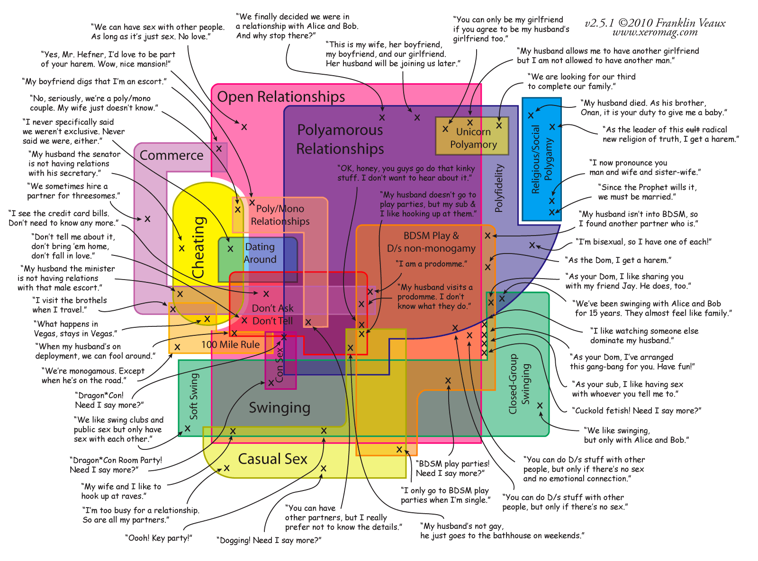
The Venn Diagram of Polyamory

Slide 8
Social Work Dealing with GSRD
“High incidence of mental health disorders among lesbians and gay men” and that “lesbian, gay, and bisexual youths were five times more likely to attempt suicide than their heterosexual peers” (Pelts, Rolbiecki, and Albright, 2014, p. 132)
Sexual issues
Clients in social work practice
Health and
Mental Health
(Davison & Huntington, 2010)
Sexuality and Disability
(Friedman, Arnold, Owen, & Sandman, 2014; Kattari, 2014)
Sexual Violence
(Gavey & Senn, 2014; Martin, Macy, & Young, 2011; Zoldbrod, 2015)
Sexuality Across
the Lifespan
(Schwartz, Diefendorf, & McGlynn-Wright, 2014)
The use of direct payments for sex could make social workers' jobs tougher and endanger council funding for disabled people.
Young people are using pornography to inform their sexual experiences. (Lim et al., 2016)
The effects of polygamy on children and adolescents

Slide 9
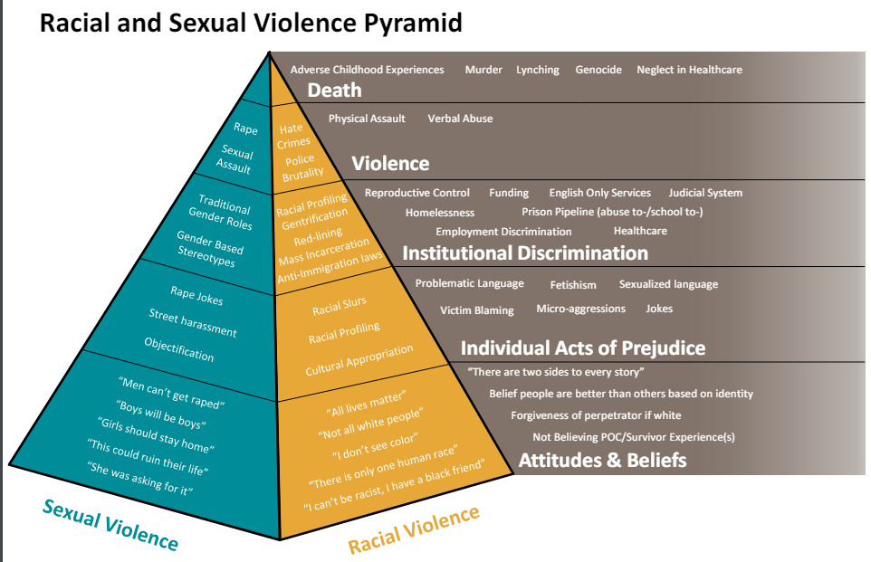
Intersectionality of Gender & Sexuality
Racial and Sexual Violence Pyramid
“Systems of oppression give greater social power to some people over others based on race, gender, sexual orientation, ability, and other aspects of identity. Working towards a future without sexual violence means that advocates, survivors, and communities
need to respond to a complex and
layered reality that centers the
needs of those survivors most
marginalized, silenced,
and unseen.”
Source:
California Coalition Against Sexual Assault

Slide 10
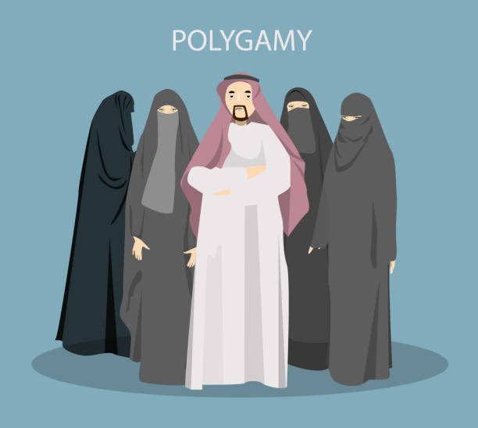

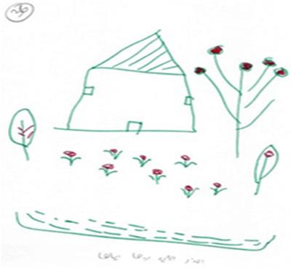
The Experience of Mothers in Polygamous Families (Gadban & Goldner, 2020)
80 Israeli Arab mothers living in polygamous families who use social services, domestic violence agencies, and health centres.
A family drawing can shed light on family dynamics such as physical intimacy or distance, the emotional tone in the home setting, aspects of closeness, isolation, rejection, and dominance among different family members
Although most of the drawings communicated the experience realistically through the use of houses and human figures and attempted to depict a normative life, their drawings also revealed negative feelings of loneliness, helplessness, confusion, and internal distress.

Slide 11
Competency-based Approach
Biopsychosocial model
Account for diversity in biology, psychology and social context
Anti-oppressive practice
Recognizes the impact of culture, key social institutions, political systems, and relationships in the perpetuation of social inequality (Dominelli, 2002).
Trauma-informed practice
Minimize the risk of revictimization, triggering, or retraumatization.
Respect boundaries and demonstrate knowledge and awareness (Auteri, 2015).
Understand the complex dimensions that inform our understanding of sexuality (Berry & Berry, 2013; Russell, 2012)
Adapting language and using a non-judgmental attitude

Slide 12
Conceptual Framework of Sexual Well-being for Women with Physical Disability
Nery-Hurwit, 2022
Physical factors
Physical function and conditions,
Therapeutic aids
Preparation for sex
Body positioning
Intrapersonal factors
Knowledge
Affect
Identity
Body image
Empowerment and agency
Feelings of desire
Perception of partner satisfaction
Environmental factors
Social support
Diversity
Access to information
Attitudinal barriers
Relationships and partner opportunity
Communication with health care provider
Partner communication
Opportunity for relationships
Partner qualities
Intimacy
Stigma
Devaluing
Desexualization
Fetishization
Stranger fascination

Slide 13
Postmodern-informed Approach
Its proponents argue that it offers a dynamic, collaborative enhancement to anti-oppressive models, keeping the goal of social justice intact (Cocker & Hafford-Letchfied, 2014).
With its concern for social justice, social work should attend to how multiple, intersecting discourses construct and maintain privilege and, by definition, marginalization (Rossiter, 2005). A
Social work maintains heteronormative discourses, failing to challenge dominant assumptions about gender and sexuality. (Hicks, 2008)

Slide 14
Sexual Citizenship of
People with Disabilities
Disabled young people are sexual beings, and deserve equal rights and opportunities to have control over, choices about, and access to their sexuality, sexual expression, and fulfilling relationships throughout their lives. (Sonali, 2017)
Consequences:
lower levels of sexual knowledge / sex education;
Inadequate sex health support;
Inaccessibility to good sex and relationships;
Lack of sexual safety against exploitation and violence;
Lack of learn about sexual rights, sexual identity, and sexual expression.

Slide 15
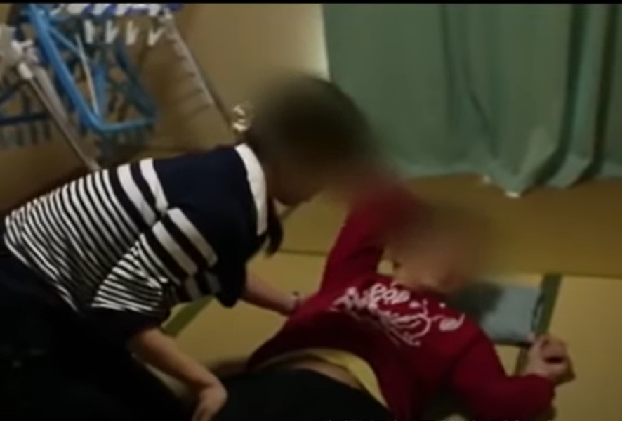
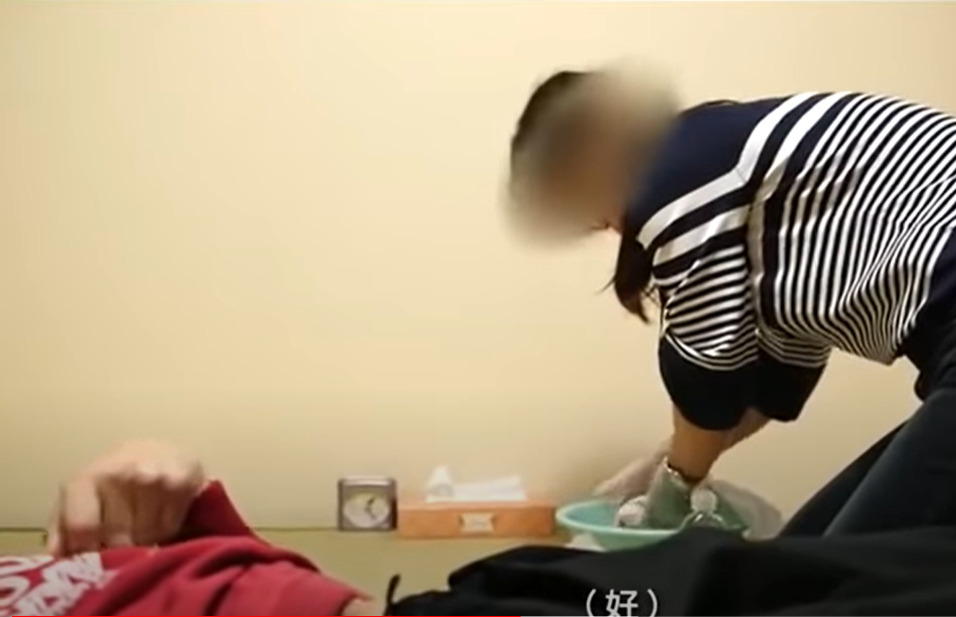
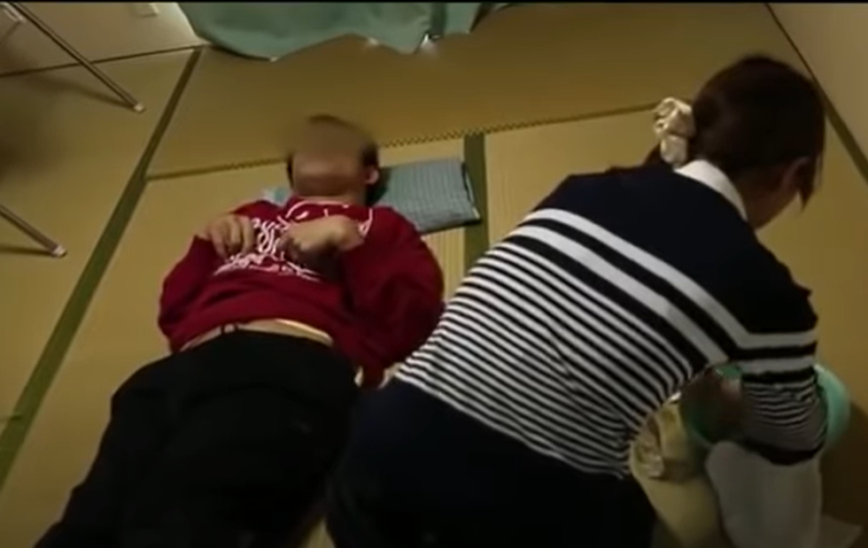
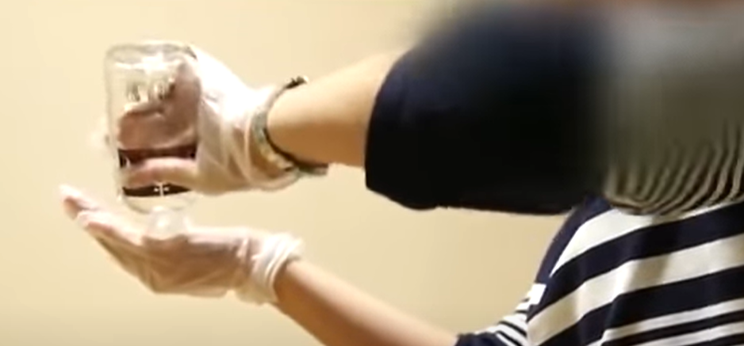
White Hands in Japan
- the delivery health call-girl services

Slide 16
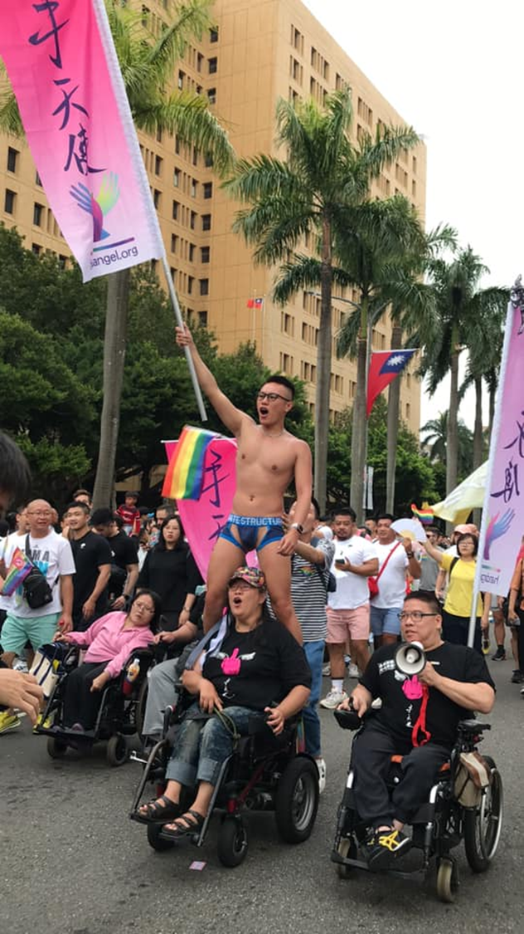
Sex Volunteer Service - HandAngels
“Hand Angel” is an organization devoted to promoting sexual rights. Founded in early 2013 by a group of gay men, we initially only intended to provide services for gay men with severe disabilities.
Among the 30 volunteers at Hand Angel, there are LGBT, heterosexuals, sex workers, social workers, long-term care professionals, office workers, university professors, parents and students.
As of April 2023, we’ve provided 50 times of services, among which 6% are female and 94% are male.
Sex Volunteer Service (2013-2023 April)
1 time for a transgender service receiver,
4 times for bisexual service receivers ,
9 times for homosexual service receivers
36 times for heterosexual service receivers

Slide 17
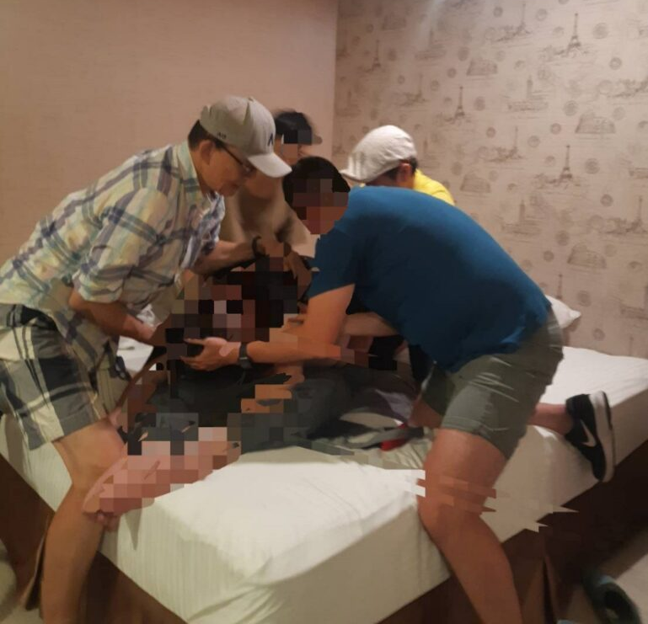
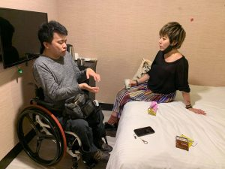
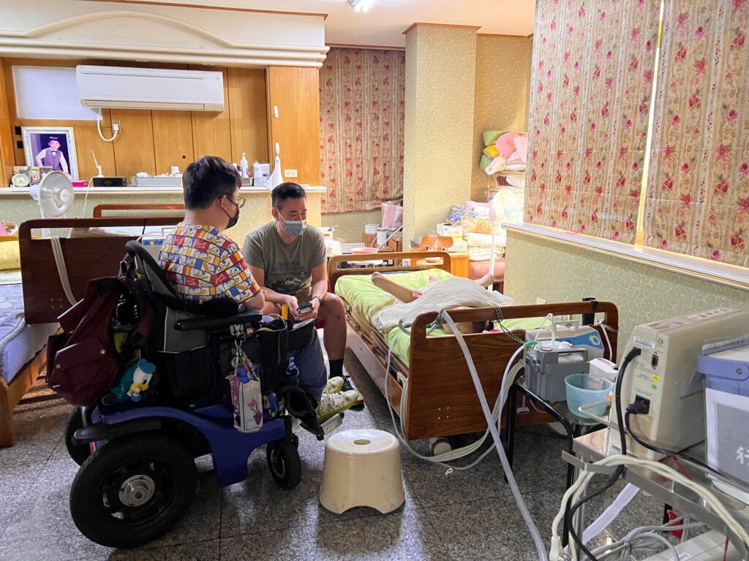

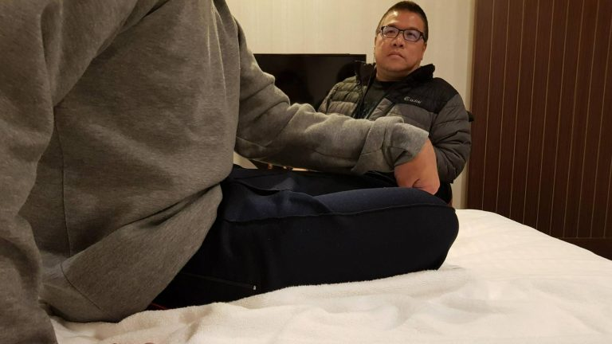
Application Submission
Needs Assessment
Volunteer Briefing & Prep
Service Implementation
Debriefing Interview

Slide 18
Good Practice Across GSRD
Reflexive work and training
Examine the dominant understanding of gender, sexuality, and relationships in your cultural and/or community contexts
Reflexively engage with your own position in relation to GSRD
Environment
SPACE -– to have training and self-reflection around GSRD, and other intersections.
Practice
Respect clients’ gender, sexuality, and relationship style, and be open to the diversity of ways in which they may, or may not, self-identify and/or practise these.
Be aware that not all supervisors will necessarily have expertise on GSRD issues. In such cases it can be useful to access additional formal and/or peer supervision on top of your regular supervision, in relation to a particular client or client group
Become aware of your implicit biases, and the structural inequalities in your wider society, and reflect on these in training and perhaps through contemplative practice (Barker, 2015; Berila, 2016).
Ensure online and offline materials reflect GSRD, e.g. posters on waiting room walls, magazines, books, images on website, etc.
Ensure any forms for clients include all possible GSRD options where relevant, including options beyond ‘male’ and ‘female’, and that they do not make normative assumptions (e.g. that a client will be sexual, or will have only one partner).

