Slide 1
Contemporary Social Work in Digital Era
Dr Carmen Yau (Email: C.yau@gold.ac.uk)
Lecturer in Social Work
Research Lead for the Wellbeing Research Hub
Goldsmiths, University of London

Slide 2
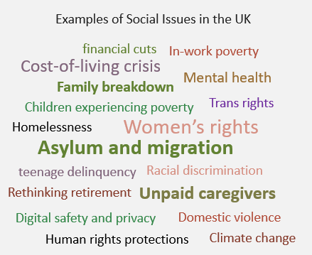
Contemporary Issues in the Digital Era
Comtemporary Issues – refer to current and relevnt topics or challenges that societies, individuals, or the world face in the present time. These issues are subject to ongoing debate, analysis, and action as they have a significant impact on people’s lives and the overall state of the world.
COVID-19 pandemic crisis – intensification and amplification of social problems. (Casquilho-Martins, Belchior-Rocha, & Moro, 2022)
Web 3.0 Technology Revolution - characterized by decentralization, ubiquity and artificial intelligence.

Slide 3
Contemporary Social Work Context
Micro Level Individual Wellbeing
(OECD, 2020; WHO, 2020)
Meso Level
Issues in Families (UNICEF, 2022)
Macro Level
Issues facing Britain (Statista Research Department, 2024)
Physical Well-being -unhealthy life habits, lesser physical activity, longer computer screen time, more irregular sleep patterns and less healthy diets
59% of parents struggling with mental health
2019 - Present
Brexit
66% have been negatively affected by the rising cost of living
2020 - Present
COVID-19 Pandemic
1 in 3 struggling to see a health care professional as services are stretched
Mental health issues: the risk of an exacerbation of substance abuse and addictions, prevalence of anxiety, depression and PTSD
2022 - Present
Russian invasion of Ukraine
Energy Crisis
1 in 5 parents on low incomes are skipping meals to pay for childcare
Financial Wellbeing: unemployment, low-paid and insecure work, new forms of work, homeless
Half have already cut back on their electricity and gas usage with 1 in 10 unable to properly heat their home as winter approaches
2024
Economy/Cost of Living Crisis
Health & Social Services
Immigration

Slide 4
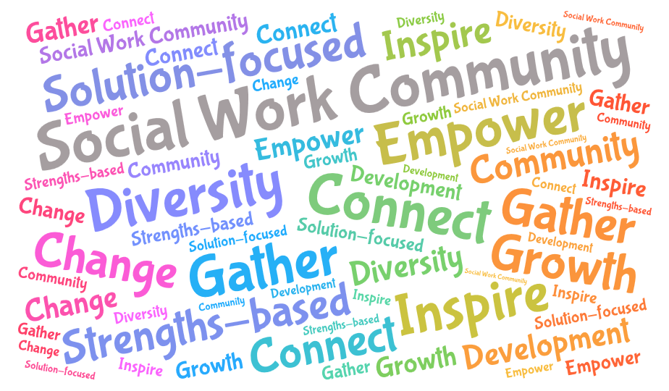
The Root of Social Work
Social work aims to promote social development, attending to human rights and social justice, supported by ethical principles, theoretical frameworks, specific practice environments and indigenous knowledge (IFSW, 2014)
Evidence-Based Practice
Welfare Economics
Cross-Disciplinary Collaboration
Emancipatory Practice
Knowledge of communities
Cultural Humility
Values & Ethics
Anti-Oppressive & Anti-discriminatory Practice
Co-design solutions
Empowerment & Justice
Professional Integrity
Impact Evaluation

Slide 5
Confusion & Anxiety about
New Technologies are
Part of the Process of Change

Slide 6
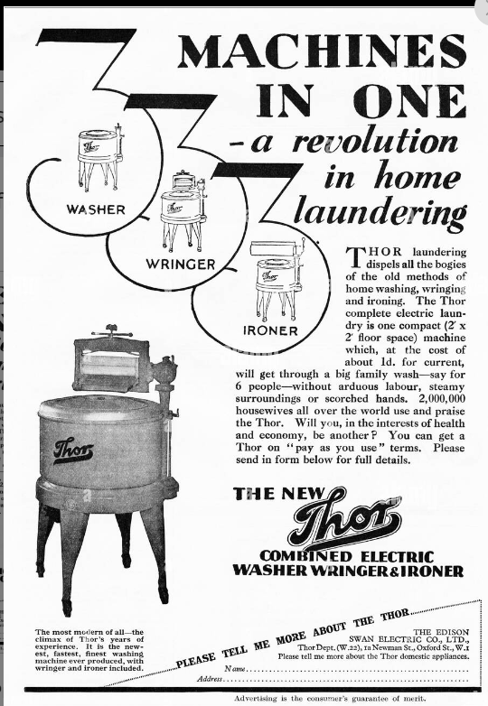
1920s Ad
Emancipatory innovation for housewives and mothers

Slide 7
Digital Practice in Social Work
Nature Of Social Work Practice
Expand Social Work’s Ability
To address compelling social justice issues and enhance leadership
Communication
Screening
Communication via text/email
Video conferencing
To enhance social work education and training via online course and innovative pedagogy
Reinforce relationship-based practice: new ways to interact and communicate
Assessment
Self-guided assessment
Automated assessment
Intervention
Web-based interventions
Sourcing and signposting
Evaluation and monitoring
Use of encrypted electronic records: to search, gather, and manage information about clients
(Mupedziswa et al., 2021)

Slide 8
Practitioner Competence & Professionalism Technology Adoption
Five Stages of The Adoption Process
Awareness
First exposed to an innovation but lacks information about the innovation.
Persuasion
interested in the innovation and actively seeks related information/details.
Decision
takes the concept of the change and weighs the advantages/ disadvantages of using the innovation and decides whether to adopt or reject the innovation.
Technology adoption is the process by which people or organizations accept and use new technologies. It involves learning and adapting to new technologies. Technology adoption is affected by performance expectancy, effort expectancy, facilitating conditions, and social influence.
Implementation
employs the innovation to a varying degree. determines the usefulness of the innovation and may search for further information about it.
Confirmation
finalizes their decision to continue using the innovation. to seek reassurance that the decision and implementation are beneficial.

Slide 9
Everett Rogers’s book Diffusion of Innovations (1962) dives into the characteristics of each of the five adopter categories within the technology adoption life cycle:
Laggards
Early adopters
Use a judicious choice of adoption to help them maintain a central communication position.
Late Majority
Tend to be focused on "traditions", the last to adopt an innovation
Show little to no opinion leadership;
Limited financial liquidity/resources
Innovators
Willing to take risks,
Risk tolerance allows them to adopt technologies that may ultimately fail.
Approach an innovation with a high degree of scepticism and after most of the society has adopted the innovation.
Little opinion leadership; little financial liquidity/resources
Early majority
Adopt an innovation after a varying degree of time that is significantly longer than the innovators and early adopters.
Seldom hold positions of opinion leadership in a system
Have the highest degree of opinion leadership among the adopter categories.
Have financial liquidity, are social and have the closest contact with scientific sources

Slide 10
The technology adoption curve is a bell curve model that describes how different people react to, adopt, and accept new innovative products and technologies.

Slide 11
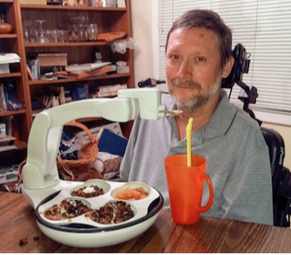
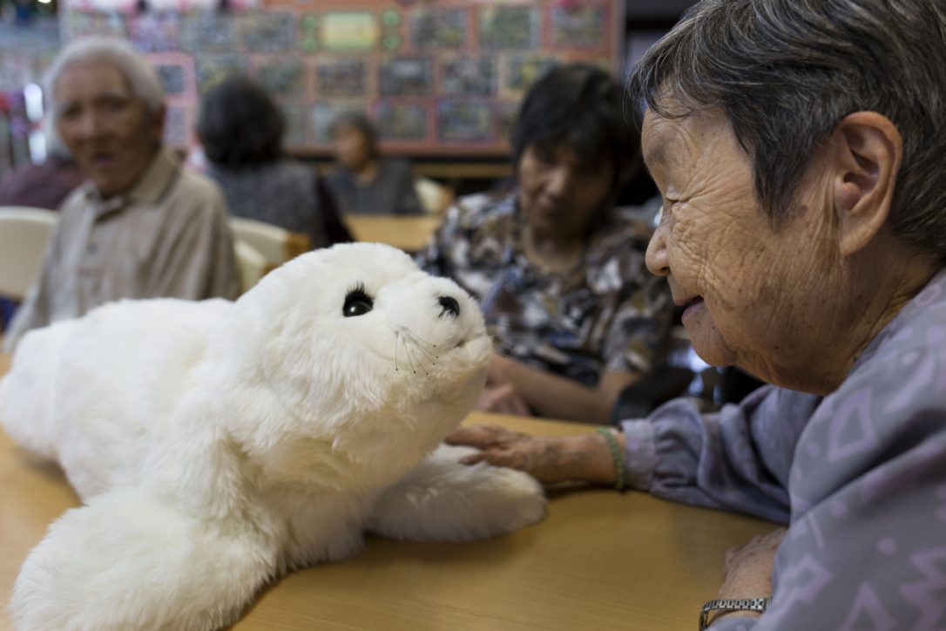
AI & Robotics in Social Care
Physical assistance robots (PAR)
Some PARs have been designed to operate independently from the care workforce and others to support them to undertake physical tasks associated with performing their care role.
Socially assistive robotics
Companion robots have the ability to help people through individual non-contact assistance in convalescence, rehabilitation, training and education.
Cognitive assistance robots (CARs)
These can support users in performing cognitive tasks with the potential to support people with dementia, Alzheimer’s disease and other cognitive impairments.
Chatbots -as part of their customer interface, to aid carers in monitoring and managing care services, identify at an early-stage signs for professional intervention and support.

Slide 12
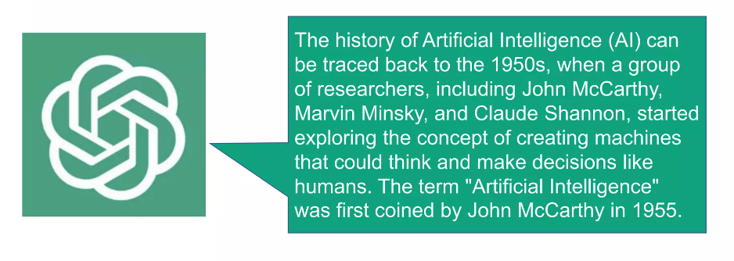
ChatGPT is an artificial intelligence (AI) chatbot that uses natural language processing to create humanlike conversational dialogue. The language model can respond to questions and compose various written content, including articles, social media posts, essays, code and emails.
Generative
Pre-trained
Transformer

Slide 13
How Social Workers Use ChatGPT To Help With Report Writing
https://www.youtube.com/watch?v=RhquZ1HJxgY (5 mins)

Slide 15
AI Coaching on Social Work & Communication Skills
Working with target groups in the social domain requires a lot of knowledge and experience. You are constantly in conversation with people in difficult situations, where there is a lack of overview.
You advise, listen, guide, and direct, while constantly keeping an eye on the relationship, to trust and set boundaries where necessary.
All simulations from the Social Work domain have been developed and validated with experts from the field. This ensures that theory is applied in practice.
Themes
Leadership & Management
Human Resources
Collaboration
Coordination
Diversity & Inclusion
Shared decision making
Motivational Interviewing
Social Work

Slide 16
Community-Based Robot Design for People with Dementia & their Caregivers
Based on the results of the six-month long community design process, the researchers identified a number of characteristics and design guidelines for robots to support dementia caregivers and people with dementia:
Robots should help redirect conversations when repetitive questioning becomes burdensome
Robots should be integrated into everyday objects that the people with dementia are already familiar with.
Robots should be able to adapt to new situations and to the behaviour of the person with dementia.
Robots should be able to learn from end-users, and customize and personalize their interaction and responses.
Robots should have human-like features that would help build trust.
Robots should interact with humans via voice activation --much like a smart speaker.

Slide 17
Core Ethical Challenges and Solutions
Informed consent and client autonomy
Duty to explain the potential benefits and risks of services as part of the informed consent process
Social workers should assess clients’ capacity to provide informed consent and, when using technology to communicate, verify the identity and location of clients
Confidentiality & Transparency
Duty to ensure that the AI software they are using is properly encrypted and protected from data breaches
Use applicable safeguards (such as encryption, firewalls, and passwords) when using electronic communications
Client Misdiagnosis/ Abandonment
Supplement their ai-generated assessments with their own independent assessments and judgment
To respond to their messages and postings in a timely fashion
Plagiarism and Algorithmic bias
Use chatgpt to produce content that may be useful in grant applications, program evaluations, advocacy efforts, and fundraising appeals.
Algorithms used to assess clients and develop interventions and treatment plans will incorporate significant bias
Develop policies and procedures detailing how they would inform clients regarding breaches of confidentiality

Slide 18
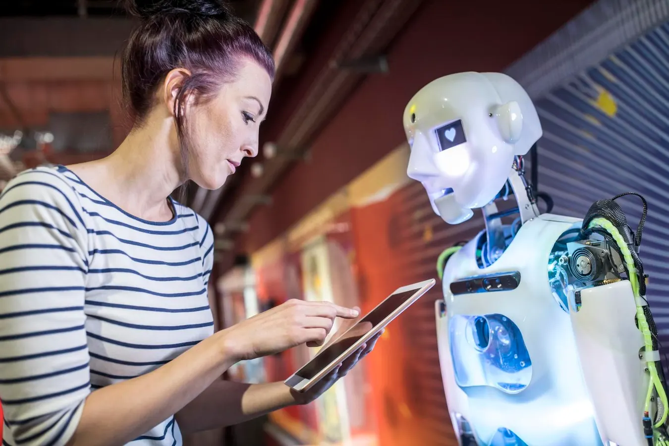
Q&A
“Some people call this artificial intelligence,
but the reality is
this technology will enhance us. So instead of artificial intelligence, I think we’ll augment our intelligence.”
—Ginni Rometty
Dr Carmen Yau (Email: C.yau@gold.ac.uk)
Lecturer in Social Work /Research Lead for the Wellbeing Research Hub
Goldsmiths, University of London

Slide 19
Reference
Casquilho-Martins, I., Belchior-Rocha, H. and Moro, S. (2022) ‘Unfolding Social Work Research to Address the COVID-19 Impact: A Text Mining literature Analysis’, The British journal of social work, 52(7), pp. 4358–4377. Available at: https://doi.org/10.1093/bjsw/bcac025.
IFSW (2014) ‘Global Definition of Social Work j International Federation of Social Workers’, available online at: https://www.ifsw.org/global-definition-of-social-work/ (accessed March 12, 2024).
Mupedziswa, Rodreck, Modie-Moroka, T., Malinga, T., Mupedziswa, R, 2021. Social work education in Botswana amid the COVID-19 pandemic: Reflections, strategies and lessons 11, 161–174.
OECD (2020b) Beyond Containment: Health Systems Responses to COVID-19 in the OECD, Paris, OECD Publishing.
WHO (2020) ‘Maintaining essential health services: Operational guidance for the COVID-19 context: Interim guidance’, available online at: https://apps.who.int/iris/handle/10665/332240 (accessed March 12, 2024).

Slide 20
Contemporary Social Work in Digital Era
Dr Carmen Yau

Slide 21
Abstract
The talk starts with an overview of challenges facing social workers and helping professionals in the post-covid, fast-changing, digital-saturated context. A transformative shift in professional education and practice is vital to addressing the key issues effectively and reinforcing social justice and societal success. In this talk, we explore an intersectional approach and the use of digital tools as key components of contemporary social work. Digital literacy and the use of technology should be integral to practitioner competence and professionalism in the future. The talk concludes with recommendations on tackling complex risks, ethics and practical challenges in contemporary social work.

