Slide 1



Intersections
Of Disability
In Sinophone
Cultures
Dr Carmen Yau
Lecturer In Social Work
& Lead Of Wellbeing Research Unit
Goldsmiths, University Of London
AI-generated Image

Slide 2
Abstract
Dr. Carmen Yau will also talk about the intersectionality of disabled women in Chinese communities. She will start by sharing her work on domestic and partner violence against disabled women. She will further explore the agency of disabled women to navigate abusive relationships. She will also share her recent work on a photovoice to unearth the story of disabled women being carers, which facilitates policy change to recognize the entitlement and welfare of disabled carers.

Slide 3
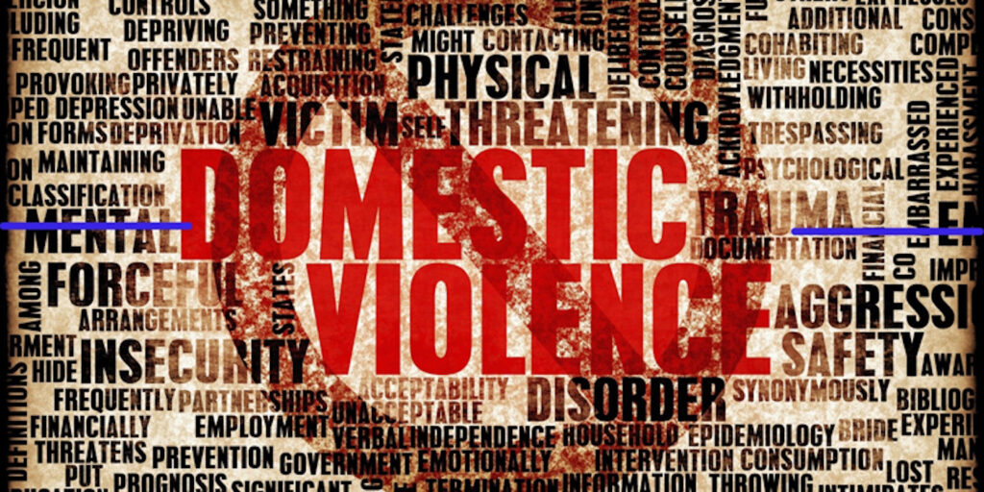
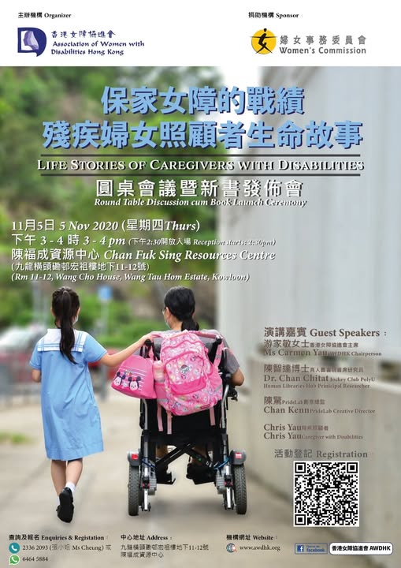
Yau, C. (2023). Gender-based Violence Against Women with Disabilities: Prevalence and Experience. In Zhang, W., Bjørnstøl, E., Peng, D., Wei, G., Liu, H. & Liu, Y. (Eds.), Disability, Sexuality and Gender in Asia. UK: Routledge.
Yau, C. (2018). Prevalence of Violence and Trauma Against Chinese Female with Disabilities. Paper presented at the Conference on Disability, SOGIE and Equality in Asia, Japan.
Yau, C. (2017). Case Study on Partner Violence Against Women with Physical Disabilities. Paper presented at the Conference on Disability & Gender Equality in Asia, Korea.
Yau, C., Cheung, S., & Wong C.Y. (2020). The PhotoVoice of Caregivers with Disabilities. Hong Kong: Association of Women with Disabilities Hong Kong. ISBN: 978-988-75042-1-4

Slide 4

Violence Against Women is
"any act of gender-based violence that results in, or is likely to result in, physical, sexual, or mental harm or suffering to women, including threats of such acts, coercion or arbitrary deprivation of liberty, whether occurring in public or in private life“ (World Health Organization, 2017)

Slide 5
Domestic Violence
Domestic Violence
Against WwD
Physical Abuse x 2
Forced sexual activities x 3
Intended negligence
Social segregation
Prohibited use of medical aids
Financial abuse
Invasion of privacy
Intimate partner violence
refers to behaviour by an intimate partner or ex-partner that causes physical, sexual or psychological harm, including physical aggression, sexual coercion, psychological abuse and controlling behaviours.
(WHO, 2024)

Slide 6
Sexual Violence
Sexual Violence Against WwD
The global prevalence of sexual violence against women with disabilities is 60-80% while half of them were having such experience for more than ten times (UN Women, 2015)
Sexual violence is "any sexual act, attempt to obtain a sexual act, or other act directed against a person’s sexuality using coercion, by any person regardless of their relationship to the victim, in any setting. It includes rape, defined as the physically forced or otherwise coerced penetration of the vulva or anus with a penis, other body part or object, attempted rape, unwanted sexual touching and other non-contact forms."(WHO, 2024)
intercourse
Unwanted sexual contacts
Women with sensory impairment - difficulties in identifying the predators or call for help (Opoku et al., 2016).
Verbal sexual acts without consent

Slide 7
Background
Incidence of Violence & Women with Disabilities
Incidence of Violence & Women with Disabilities (Salthouse, 2016).
  More diverse, more severe & more prolonged
  Greater number of perpetrators
  40% more like to be victims than non-disabled women
  70% of us are victims at some time in our lives
  20 % forced into unwanted sexual acts
  25% of reported rape victims
  Sexual victimization x 4 times more likely
In-depth interviews were conducted with a total of 30 disabled women with 1- 22 years of experiences in abuse (Hague, Thiara, & Mullender, 2011)
Hague, G., Thiara, R., & Mullender, A. (2011). Disabled Women and Domestic Violence: Making the Links, a National UK Study. Psychiatry, Psychology and Law, 18(1), 117-136, DOI: 10.1080/13218719.2010.509040
Salthouse, S. (2016). Mainstream & targeted measures to reduce violence against women with disabilities. Presented at RI Global Word Congress, Edinburg. Retrieved 16 October 2017 from https://www.slideshare.net/MarcoMuscroft/a069-reducing-violence-against-disabled-women

Slide 8

A Mixed-method Study On GBV Against Chinese Disabled Women (Yau, 2023)
Details | Quantitative Approach (N=80) (Summer and Autumn in 2018)
Goal | The Landscape: To Understand the disability-related and socio-demographic characteristics of women with disabilities, the nature and experience of violence as well as their coping strategies.
Inclusion/ exclusion Criteria | Age/Sex: 18+/Female Ethnicity: Chinese Residency: HK, Taiwan, China, Asian cities.
Data Collection & Analysis | Applied online survey method (Chan and Holosko 2016; Chan 2018) Questionnaire was developed based on a survey conducted by The Hong Kong Women’s Coalition on Equal Opportunities in 2013 (HKWCEO 2013) Analysis: : SPSS
N=80

Slide 9
Prevalence & Predators (Yau, 2023)
 | Domestic Violence |  | Sexual Violence |  | Sexual Harassment
Prevalence | 30% | 24/80 | 5% | 4/80 | 34% | 27/80
Frequency | 10+ Times | 58% | 1-3 times | 50% | 4-6 times | 48%
Did not seek help | No | 66% | No | 100% | No | 85%
Place | Home | 96% | Home | 50% | Public Area Internet | 59% 30%
Relation with Predator(s) | Mother Father | 46% 38% | Intimate Partner | 50% | Strangers | 70%

Slide 10
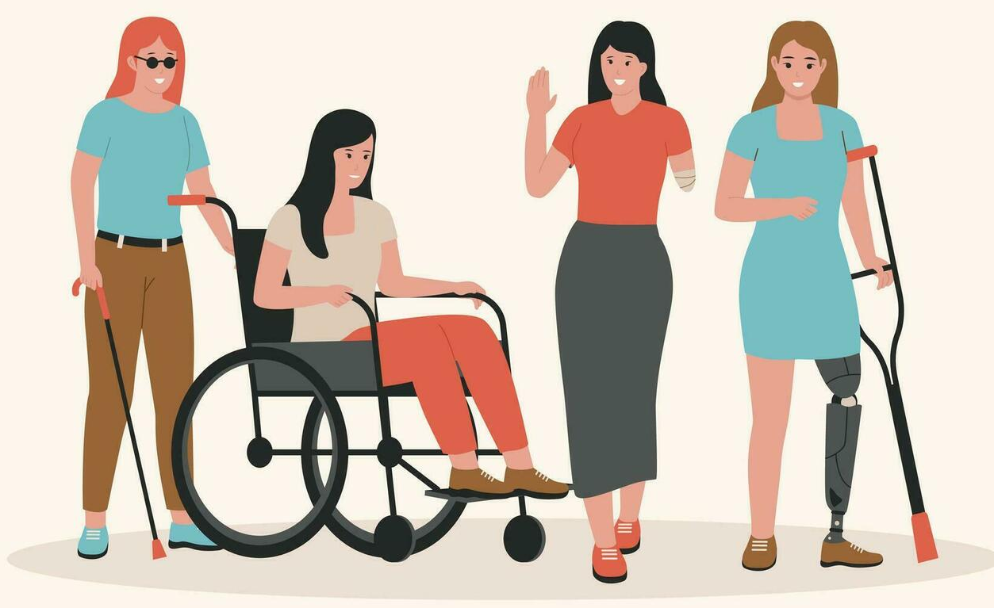
A Mixed-method Study On GBV Against Chinese Disabled Women (Yau, 2023)
Details | Qualitative Approach (N=4) (Autumn in 2019)
Goal | The Portrait: To understand their lived experience related to interpersonal violence and their perceptions of their life and prominent factors affecting their decisions of seeking help or not.
Inclusion/ exclusion Criteria | Age/Sex: 18+/Female Ethnicity: Chinese Residency: HK, Taiwan, China, Asian cities. Willing to share their experience in partner violence.
Data Collection & Analysis | Two phases biographical narrative inquiry approach (Clandinin and Rosiek, 2007) Narration Phase: participants have an opportunity to provide full extensive narration of their experience and life stories; Conversation Phase: an in-depth semi-structured interview with the researcher Analysis: Thematic Analysis /coding under the framework of “Cycle of Violence”
Chinese Disabled Survivors (N=4)

Slide 11
Disabled Women’s Experiences with Partner Violence (Yau, 2023)
Types of Abuse | Behaviours | Quotes
Physical Abuse Physical assault, restriction of mobility, limited food/water; | head was banged repeatedly on floor Holding down and stamping on her body Ignore of Medical Needs | Yan: “I did not see it as a violence issue in the first incident. After numerous times of being dragged to the street corner and beaten, I realised it was violence when I saw my head bleeding”.
Sexual Abuse Unconsent sex acts, harassment, unprotected sex, engagement of fetishes; | Rape and sexual assaults (sometimes in front of children) Held down on the floor to have sex Forced sex when she was in pain, bruised, or when bones had been broken | Penny: “women are unfairly treated by men since they were born. He could do whatever he wanted as I had no choice. He raped me at his sister’s empty home during a date. I did not know how to respond. I just forced him to be responsible and marry me… Since then, he forced me to cooperate in rough sex. He then started to complain that I couldn’t satisfy him sexually…he said I was like a corpse in bed. He said he felt like necrophilia. These words were very hurtful, but I couldn’t tell my friends and family members.”

Slide 12
Disabled Women’s Experiences with Partner Violence (Yau, 2023)
Types of Abuse | Behaviours | Quotes
Psychosocial Abuse Create family tension, parenting stress, restricted social life, surveillance; | Negative judgement on body image and womanhood Neglect & Social Isolation Hurt what you care most Create stressful social situation | Yan shared: “he said the marrying me was a remarkable thing for me because no one would be willing to marry a disabled person like me. However, disability is part of me. If he looks down on me due to my disabilities and considers that I should be grateful for being married to him, I feel I am being demeaned in this relationship.”
Finance Abuse Unconsent use of money, ownership of disability allowance, loan and debts issues;restriction/overload work and employment; | Unconsent of bank savings Taking control of her finances Need to give him monthly allowance to maintain his “dignity as a man” Need to pay/give money for his use in celebrations or festival occasions. Need to purchase his luxury items as “gifts” or token of appreciation of his caregiving. | Sue shared: “We both have a fulltime job. All my salary goes to the family “survive”…including paying the mortgagee, electricity…..food ..and even the education fees for the children. His salary goes to his fancy watches, designer clothes and even expensive toys for our kids”
Disability-specific Abuse Stigma, humiliation, withdraw medical services and support, “superiority complex” | Name calling and humiliation Neglecting and unwilling to cover medical expenses including assessment, operations and treatment, disposable medical equipment and items. | Penny shared: “I am confined at home after major surgery on my leg. My ex-husband unwelcomed my children, siblings or friends to visit me. I am also not allowed to leave home and was dependent on the security guard of my apartment building to purchase food and daily supplies.”

Slide 13
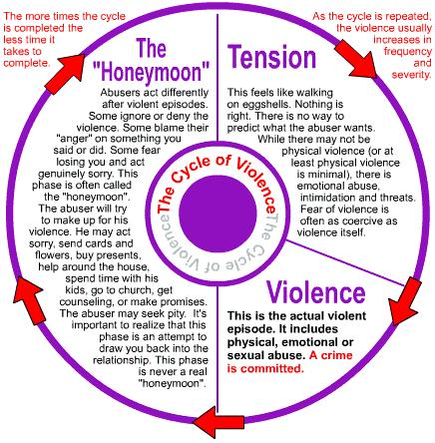
Contributing Factors
In “Cycle Of Violence” (Yau, 2023)
Show remorse
after violence
Compensate by continuing caregiving
Unable to breakup due to responsibility
Ignorance and discouragement of family and friends
Caregiving Pressure
Financial Burden
Struggling for Power
Use of Alcohol or other substances
Poor communication
Failure of negotiation

Slide 14
Chinese Sociocultural Context
Makes Domestic Violence Against Disabled Women So Difficult To Tackle
Confucian Patriarchy and Filial Piety
Stigma Against Disability
Economic Dependency
In Chinese society, disability is often associated with shame, weakness, or karma, leading to social exclusion.
Many disabled women in China rely financially on their families due to high unemployment rates and discrimination in the job market.
Traditional Confucian values emphasize male authority and family hierarchy, making it difficult for women, especially disabled women, to challenge domestic violence.
Families may view a disabled woman as a burden, making her more vulnerable to mistreatment.
Economic dependency makes it nearly impossible for them to leave abusive relationships.
Filial piety (孝, xiào) stresses obedience and harmony within the family, discouraging victims from reporting abuse as it might be seen as disrespecting elders or disrupting family unity.
The lack of independent living options forces many disabled women to stay in abusive households.

Slide 15
Chinese Sociocultural Context Makes Domestic Violence Against Disabled Women So Difficult To Tackle
Lack of Legal Protection and Enforcement
China passed its first Anti-Domestic Violence Law in 2016, but enforcement remains weak.
Lack of Support Services
Shelters for domestic violence survivors are few and often inaccessible for women with disabilities.
Limited Awareness and Advocacy
Domestic violence, especially against disabled women, is rarely discussed in mainstream media.
Many police and social workers see domestic violence as a "private family matter", discouraging intervention.
Legal and social services are not always accessible to disabled women, due to physical barriers, lack of sign language interpreters, or lack of information in accessible formats.
Many domestic violence hotlines lack trained staff to assist disabled women, particularly those with sensory or cognitive impairments.
Disability rights and feminist movements in China face government restrictions, limiting advocacy efforts.

Slide 16

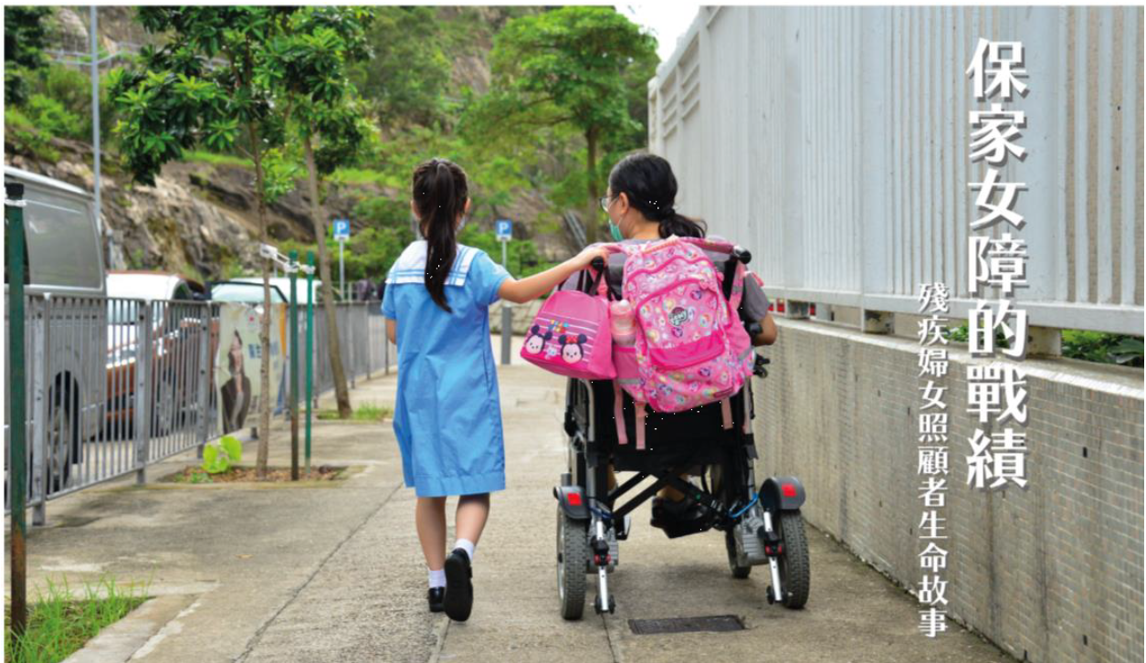

The Home-making Shero
Life Stories of Caregivers with Disabilities

Slide 17
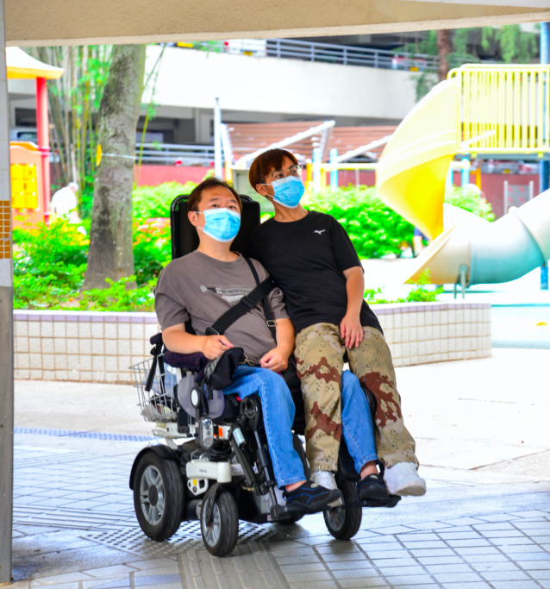
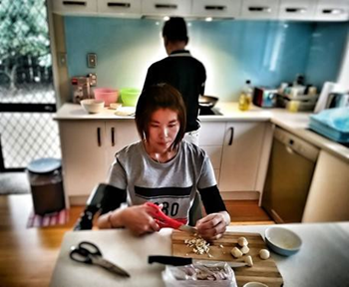

Slide 18
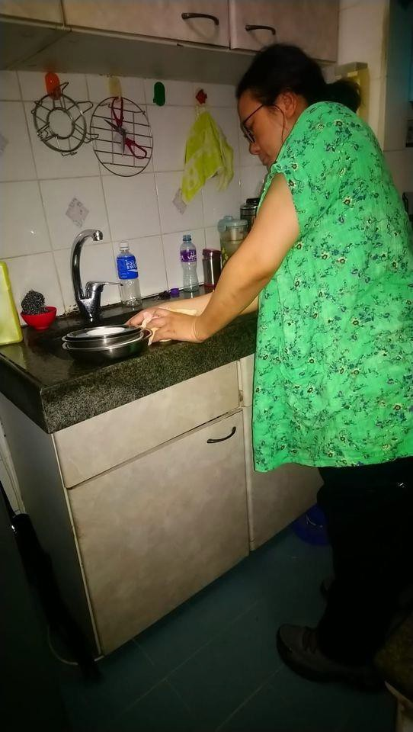
Q1: What is the nature in their caregiving relationship?
Family Position & Roles
I am the CEO housewife. I have to prepare travel medicine for everyone (i.e. family members). (LK, 11 Jul 2019).
All I can do for you (i.e. mother) is: to cook an extra portion of rice so you can take a break. When you feel wondering, To accompany you walk around so you don’t feel bored; To be your delivery girl when you run out of grain, oil and groceries at home... (A.L., 24 Jun 2019)
I spend a lot of time every day at home. I take care of the home and clean. My youngest daughter said I am a neat freak. My son said I have OCD. I love to be clean and neat. That’s why I never stop with my cleaning and swiping. (C. L. 5 Jul 2019)
Emotional Support
Social Engagement
  Comfort can be a hug, a pat on the shoulder. Although I can’t offer these body gesture of comforts, I can give to those who need me are: a pair of ears, a mouth, a pack of tissues 🤧 (W.L. 27 Jun 2019)
  # It is a blessing to be taken care of my mother(S.C., 24 Jun 2019)
  Five years ago, I went to the war (i.e. the protest) all alone in a wheelchair. Today, I finally brought my family and other friends alongside, and I protected them, (C.H., 20/06/2019)
  The desire to light a bright lamp (i.e. an enlightenment to be critical and judgemental) for my parents. It turned out to be so difficult to change their minds, but at least I tried my best. (W.L 5 Jul 2019)

Slide 19
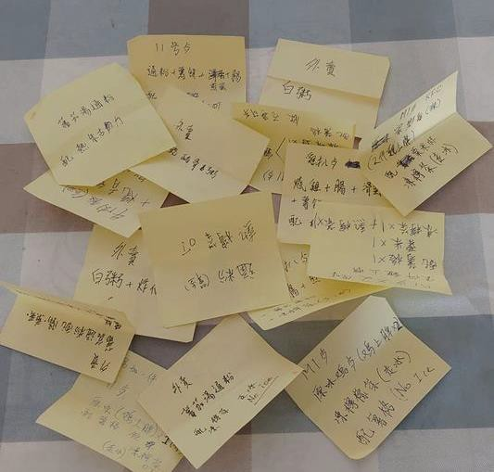
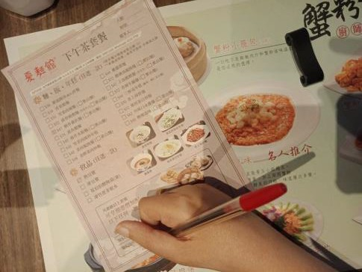
Q1: What is the nature in their caregiving relationship?
Language & Communication Support
I used to go out to dinner with my “Sister” (i.e. support worker). I always had to order a meal for two of us, and today this restaurant has a menu in only one language (i.e. in Chinese). It must be a headache for a non-Chinese outsider like her. Thus, there is not much options if you do not eat pork as a Muslim. Therefore, let me help you to choose. I seldom hold a pen to write, but I’m doing it for you. I only read the menu with no pork for her. Anyway, I know her for a while, I know nearly 90% of her preferences. (E.M. 1 Jul 2019)
Internet & Communication Technology
“Papa” and “Mama” are my ex-students of my computer class ten decades ago. Their children have immigrated to foreign countries. Whenever there is a problem with their computer and iPad, they seek my help. Recently, their computer has problems regularly and I am always the one who repair. Today, I simply built them a new computer. Also, I taught Mama to play a new game on the iPad. They are very happy, I feel very satisfied. (C.L. 29 Jun 2019)
When I overcame various difficulties, such as financial issues and physical fitness. I thought I could finally go to Japan to participate in the event, but I realized almost all Japanese live events needs to participate in the lottery!! Unfortunately, I cant set up multiple accounts like other wives, and I had to accept the fate of not being selected. Every time I try to purchase the tickets, I have to get up earlier than those who goes to school or work. I grab my wheelchair and leave home in the early morning (C.H. 8/7/2019)

Slide 20
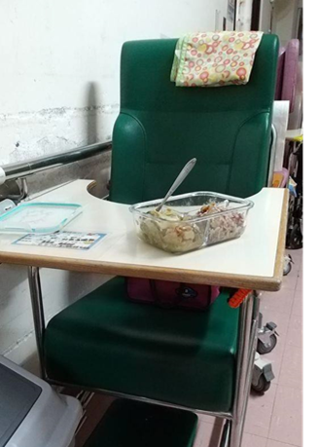
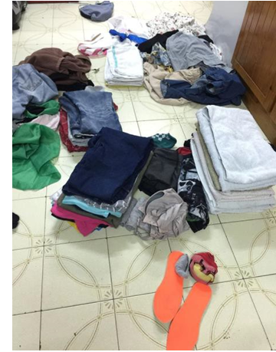
Q2: What are the challenges when they are caregivers?
Unrecognized Caregiver Identity
In your childhood, there is someone to take care of you on my behalf. However, I still insist to take you home every week. I did it for the past three years without an absence., and I was grateful to have you in my life. Because I am disabled, people who help me are able-bodied. They witness my abilities and prove to them that no matter I’m a able or disabled, I am a responsible mother, and I cannot push my duties to others. Everyone has their responsibilities. I do what I can. (C.T., 21 Jun 2019) My mother has been in the nursing home for nearly ten years, and I have been with her in the nursing home for ten years. I go everyday even it is a raining day. However, the care home tied up my mother without my consent. My mother had a panic attack overnight! I was very heartbroken! But I was helpless. I am a disabled person. I am unable to take my mother home to take care of her. When my mother began to live in the nursing home, I thought it would be a few months time that I had to visit her daily to facilitate her adaptation. I would be able to regain my freedom and return to my own way of life. But I never thought that this accompanionship has been more than ten years. It seems like my mother settled in the nursing home and I myself followed her into the nursing home. (S.Y. 13 Jul 2019) Today, my elderest son said he wants to eat chicken cartilage, My elder daughter wants chicken wings. My youngest daughter wants fish and vegetable. How about their mother? Mother forgot her needs. (C. L., 22 Jun 2019)

Slide 21
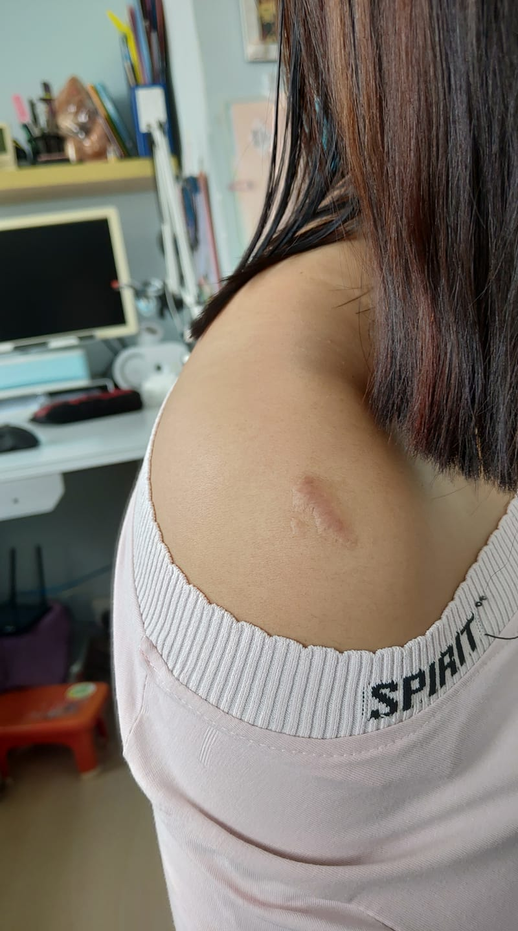
Q2: What are the challenges when they are caregivers?
Inaccessible Environment
The rounte to home is blocked unexpectedly. I had to walk a long way around. Sometimes I think wheelchair always can go with ramps, why we have to go a long way around whenever the road is blocked, why can’t we have a shortcut? Right, the world is not fair. We need to be taken care but the society doesn’t care about us. We can only depend on ourselves (F.W., 15 Jun 2019) That day, I was so guilty that I can’t accompany her to the hospital (because the ambulance is not wheelchair accessible) (E.M., 20 Jul 2019)
Lack of Resources
The government may take care of the vulnerable groups, but for middle case family like mine, we got no help. I can only blame myself for not being born in a wealthy family. I can’t not walk. Power wheelchair is luxurious, but it is essential to me. I am so glad that I manage to save $50,000 to cover it on my own. I will not live long like most people. However, my biggest fear is watching my parents to grow old. Who would be willing to unpaid take care of this troublemaker (me) for the rest of their life? (F.W 7 Jul 2019) Today, I made a dinner with eel. As my caregiver is on leave, I stood up from the bath chair to get the dried ingredients from the top of the range hood. (C.W., 4 AUG 2019)

Slide 22

Q2: What are the challenges when they are caregivers?
Unrecognized Adult Identity
When I was a child, I always have to follow their shoes when we go out. Now I’m a grown up. I realized my parents treat me as a forever child. What they do not understand is that shoes of a child is used to walk their own life path (W. L., 22 Jun 2019)
Inseparable Caregiver Roles
This meal is a caregiver's dinner. Every night, as I have to take 8 hours to get home, it's tiring to come home! Should I go to bed right after having the dinner, I would have gastroesophageal reflux. There was a night I nearly die for this situation in the middle of the night. (S.Y. 22 Jun 2019) After taking the vacuum to a home in Fanling, then I have drop by Taiwai to hand it over to my helper. Then, I have to return to Fanling to take care of my nephew (C.W., 30 Jul 2019) I am “my husband's wife", “my mother's daughter", “my neice's aunt", and as a “NGO’s member“. How am I able to 🙄🙄 balance my social & volunteer activities / interests 🔵🔴 ⚪, receiving and giving family care? I am just a half-human. Yes, I am a half-human because I am a muscle atrophy patient who needs to be cared for ~ Sometimes tired 😴 (A.L., 15 Jun 2019)

Slide 23
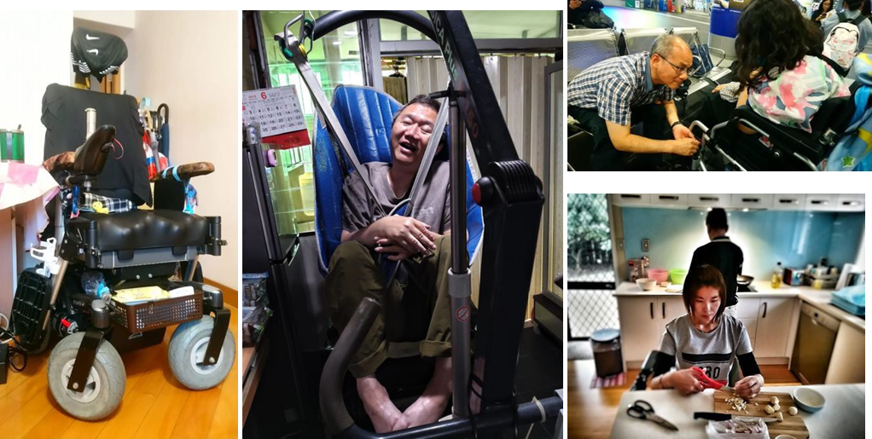


Q3: How to facilitate them to play their role as a caregiver?
Effective Use of Assistive Equipments
I can drive for shopping, doing grocery, paying bills, delivering takeaway. I installed a basket under my wheelchair. Also, I extended my controller. This chariot is part of my body. Definitely, it needs some decorations 🤗🤗🤗 (A.L. 18 Jun 2019) | I can’t take a chopping knife, then I use a fruit knife and sessors to cut food. (AL. 15 Jun 2019) | My PA is off today. I managed to transfer him (i.e., quadriplegic husband) with the hoist all by myself. (C.W., 17 Jun 2019) | The footstep of my wife’s power wheelchair is broke in the journey. I have to use a string to tie it up as emergency repair (R.W. 27 Jun 2019)

Slide 24
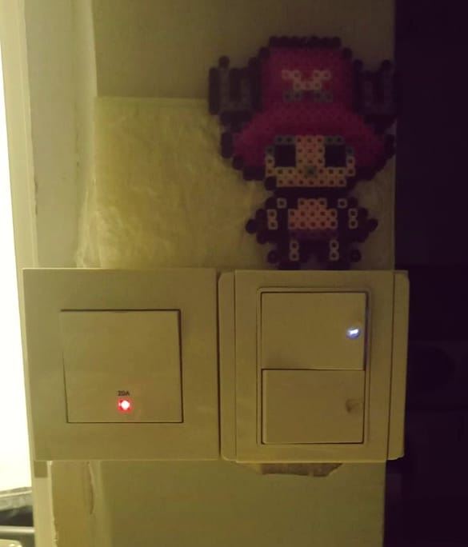
Q3: How to facilitate them to play their role as a caregiver?
Open & Effective Communication
Tonight, I told my helper that I wish to put a sticker to cover the light on the light switch so that I can sleep in the dark. This little lights made me can’t sleep. When my helper told me that she was in fear of sleeping in the dark. These little lights keep her peace in the dark. I felt so touched that she tried so hard to adapt my lifestyle. I’m thinking of buying a night lamp for her tomorrow. (E.M., 11 Jul 2019) My helper is responsible to cook, I am responsible for shopping. We work together as she is one of my caregivers. Mutual respect makes a happy good relationship. (S.C., 10 Jul 2019) Plan for this week’s housework. Me and my husband to overview the housework. The goal is to let everyone knows each other’s schedule. We release the timetable every two weeks. Just like a work rota. (L.K., 17 Jun 2019

Slide 25
Q3: How to facilitate them to play their role as a caregiver?
Sustainable Backup Care
I have to go to Macau for a one-week“business trip”. My mother worries that I come along with my PA. Therefore, we paid an extra bed fee for her so she can take turns with my PA。Every morning, I have to get up at 7am, she gets up to help me and assist my PA. She aims to relieve some caregiving tasks from my PA (E. M., 12 June; 2019)
Capacity Building & Networking
We make desserts and crafts together. Mom and I enjoy the process of making. We found lots of fun and build our bonding. We find satisfaction when we complete a piece of work together. (S.C. 23 Jun 2019) Because sports training can enhance my peace of my mind and patience. I wish to learn more skills and strategies. I alao want to be active so that my health will not deteriorate rapidly (A.L. 12 Jul 2019). My family members are aging. Although my health deteriorated progressively, I started to cook for them and my another half. I learnt to cook different cuisines, particularly Japanese style. In the beginning, I didn’t read a cooking recipe and messed up the steps. I made people have diarrheal, but now I’m more experienced in cooking. (C.H. 20 Jun 2019)

Slide 26
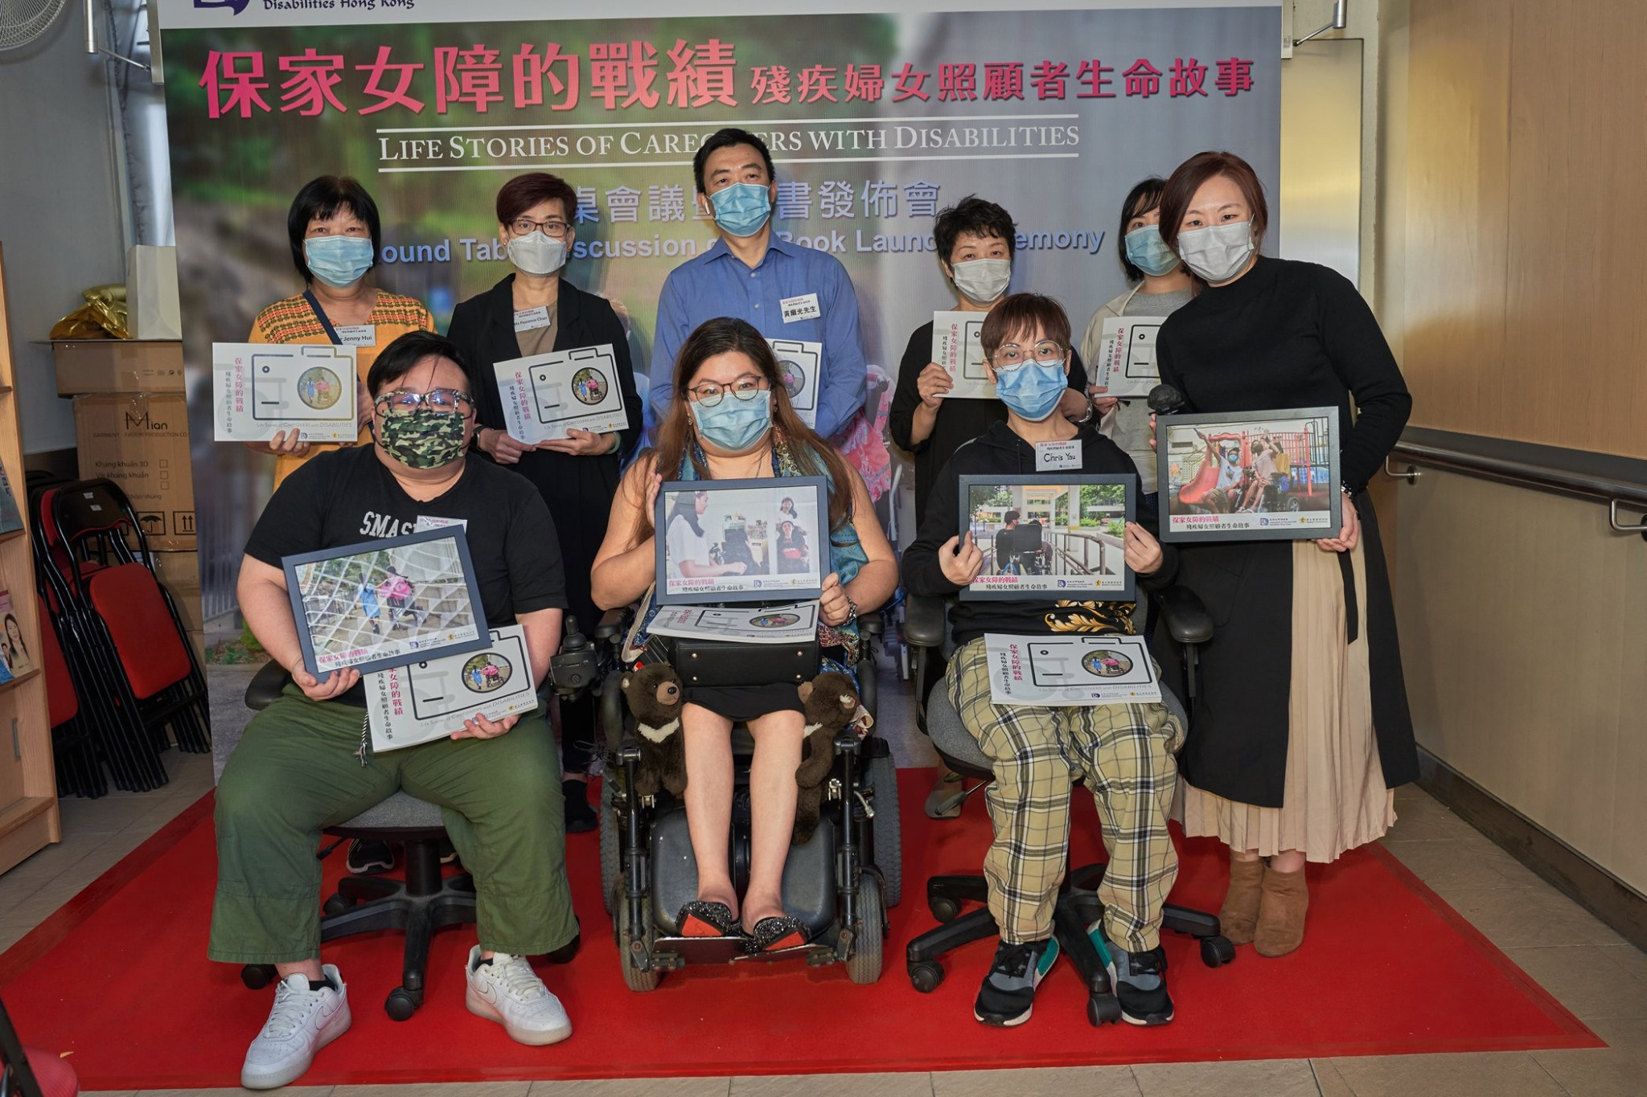
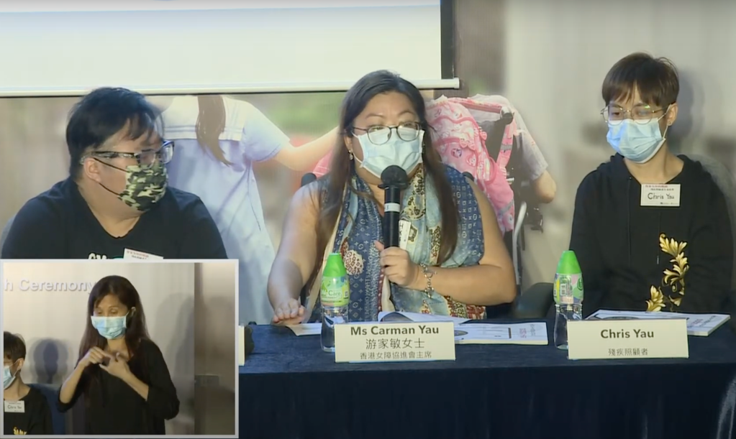
Discussion
Intersectional identity of disabled caregivers are not being recognized
Disabled caregivers are lack…
Caregiving relationship is a co-living relationship – mutual support and respect in the power dynamic.
knowledge and skills as an effective caregiver.
financial and social resources

Slide 27
Recognition of disabled caregivers. Update Career’s policy and include welfare and support for disabled caregivers.
Financial and technical support for disabled caregivers to equip proper assistive tools and kkowledge to play their roles as a caregiver.
Tailor holistic assessment and support plan for disabled caregivers to ensure sustainability care in the community.
I do not want to send my elderly mother to care home. Because when I was a child, my mother did not put me in an insatitution due to my disability. For this reason, how can I send her to care home because she is getting old?
By Participant S.Y.
Recommendation

Slide 28
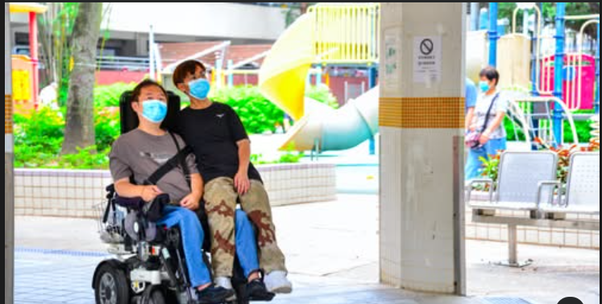
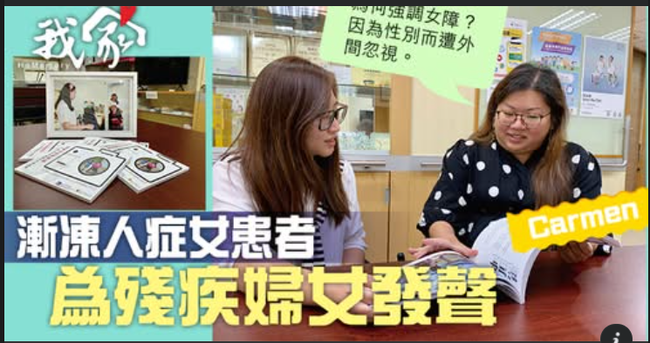
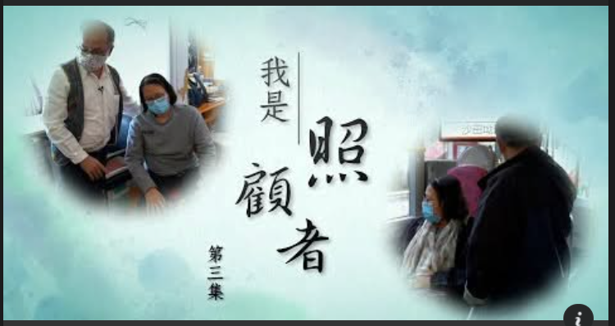
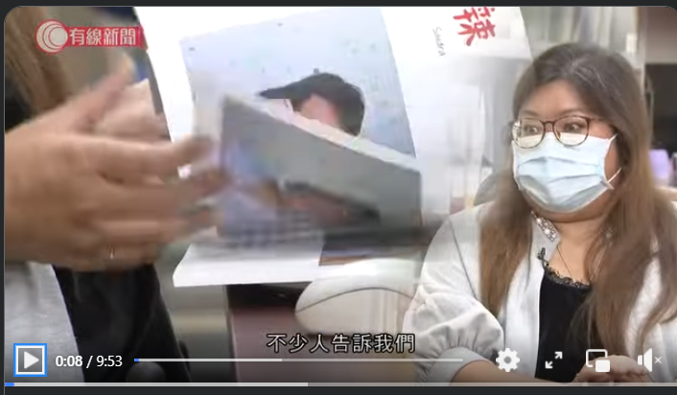
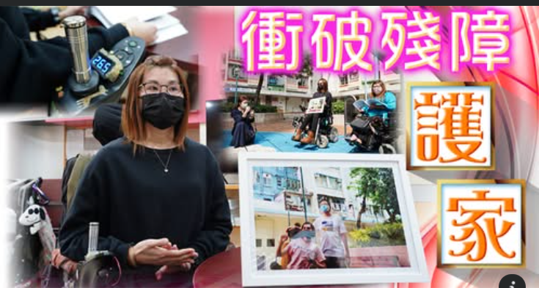
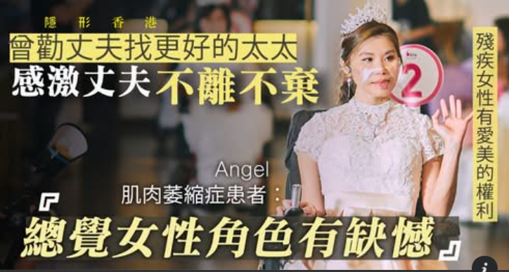
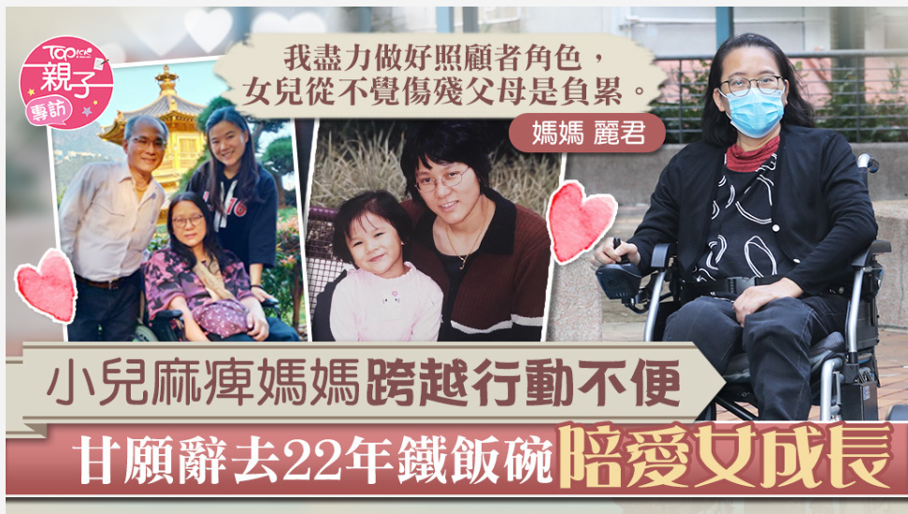
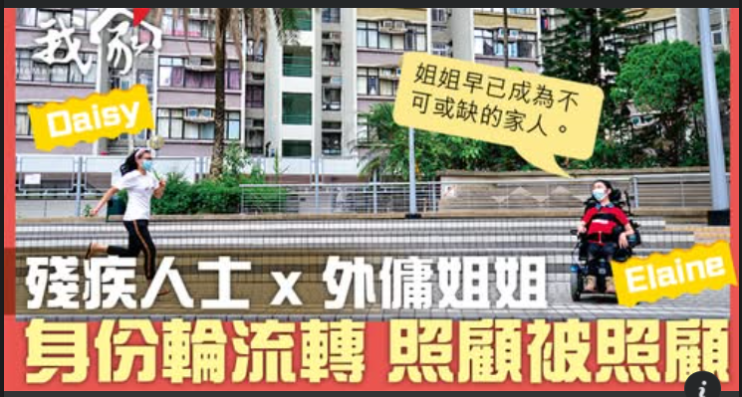
10+
Media Coverage

Slide 29
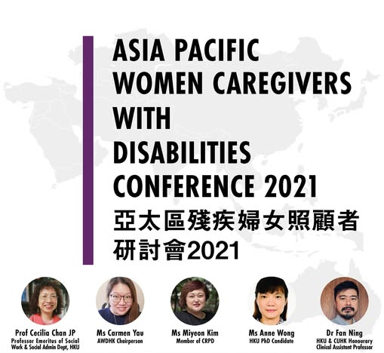
The symposium was attended by a number of important disability rights movements, feminist movements, and social welfare organisations, including the Study Unit of the Labour and Welfare Bureau, the Hong Kong Council of Social Service, and 8 Social Services for Women and Disabled Community.
In September 2021, the EOC submitted its views on carer support and residential care services for persons with disabilities to the Legislative Council Panel on Welfare Services, putting forward several proposals to improve carer support.
The recommendation is that the assessment of the suitability of a disabled carer should not be based on his/her physical disability. Their suitability and eligibility should be based on the ability to cover these caring duties, with or without assistance.

Slide 30
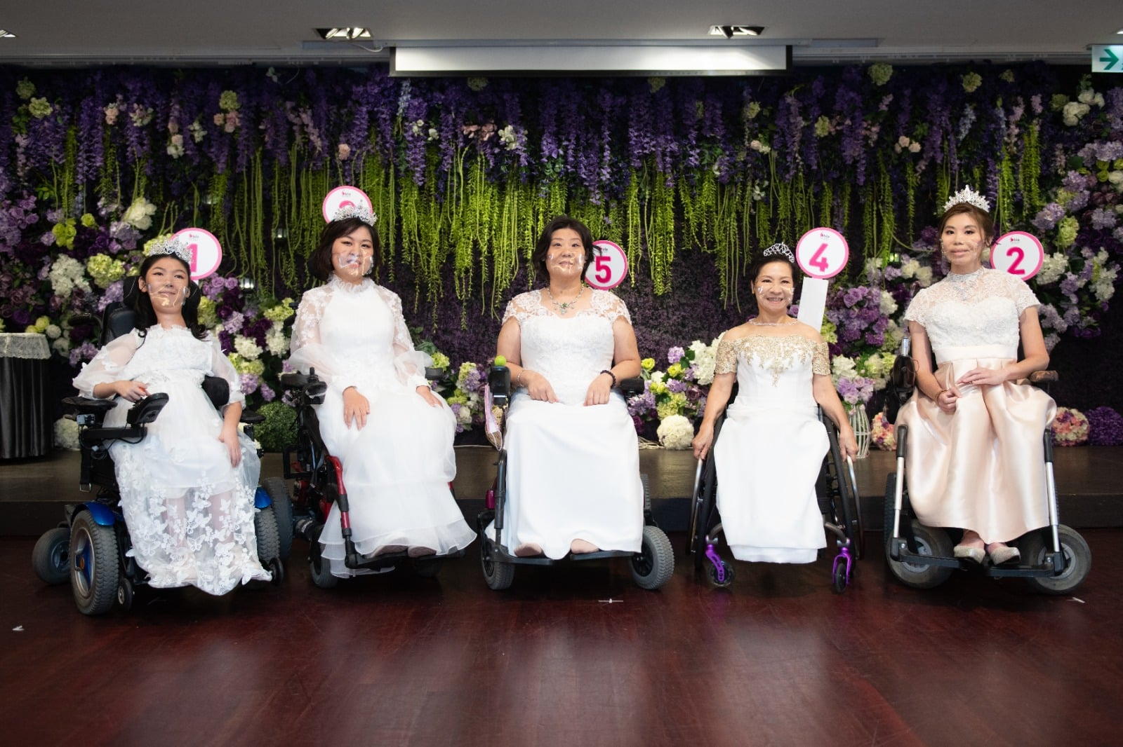

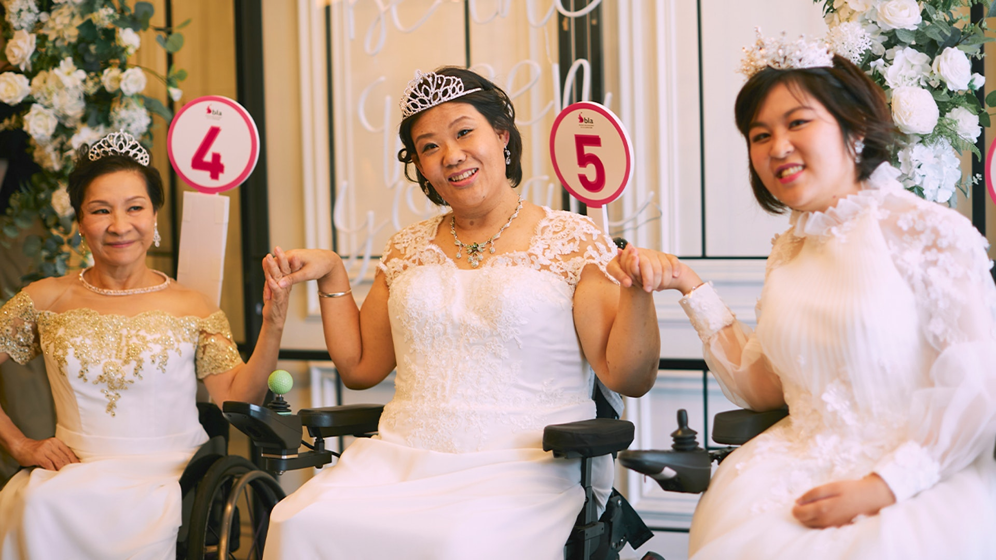
“Be a One-Day Queen”
Collaboration with Business Lady Association

Slide 31

A Question To Myself,
As a Disabled Advocate,
As a Research/Academics,
Am I reinforcing the oppressive norm against women with disability?
In some way, I am echoing with ableism and heteropatriarchy
Search For The Resistance

Slide 32
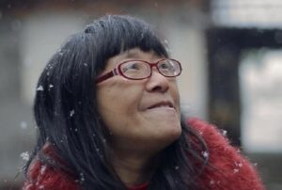
I Crossed Half of China to Sleep with You
Actually, to sleep with you or to be slept with is almost the same,
nothing more than that the force of the collision of two bodies,
nothing more than this force urges the flower to blossom,
nothing more than this flourish makes us mistakenly think that
life rebirth.
Across China, everything can happen.
Volcanoes are erupting, rivers are drying up.
Political prisoners and refugees being ignored.
Deer and cranes are held at gun point.
I ran through bullets to sleep with you.
I condensed innumerable nights into one dawn to sleep with you.
I summoned the innumerable selves into one “self” to sleep with you.
Of course, sometimes the butterflies will lead me astray,
Considering these compliments as spring showers,
Considering the village cluttered with narrow lanes as my hometown,
and they are
the indispensable reasons for me to sleep with you.
Yu Xiuhua
A Chinese poet has cerebral palsy
resulting in speech and mobility difficulties. In 1995, when Yu was 19, she entered an arranged marriage organised by her mother.
Yu Xiuhua's poetry includes themes of her love, affection, life sentiment, her disability and the closed village she cannot escape.
She wrote many love poems. Her poems are filled with the complex meaning of love and the calling, the disillusionment of love and the realization.

Slide 33
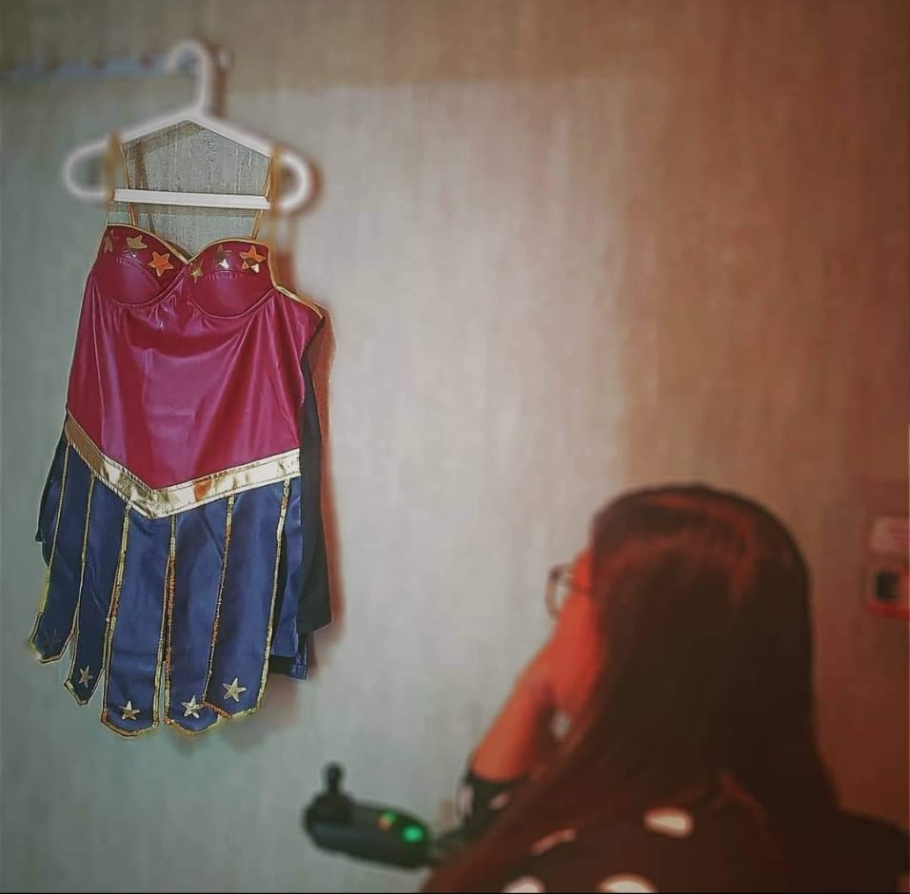

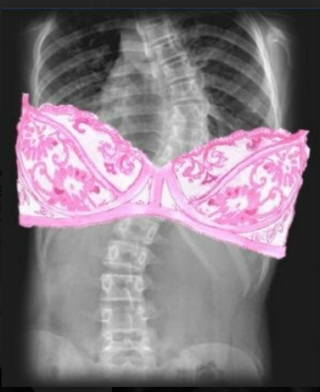

Narrative project
Sugar’s Erotica

Slide 34
As a disabled Chinese woman,
the social order dictates my failure to be a woman.
Therefore, my effort is not to become a “normal woman”.
My effort is to change the rules of the game,
because we are born to be “super women”.

Slide 35
Intersections
Of Disability
In Sinophone
Cultures
Dr Carmen Yau
Lecturer In Social Work
& Lead Of Wellbeing Research Unit
Goldsmiths, University Of London
AI-generated Image

Slide 36
About Carmen
Dr Carmen Yau is a full-time Lecturer in Social Work and the Lead of the Wellbeing Research Unit at the Goldsmiths, University of London. She is a certified sexuality educator. She is also a Mental Health First Aid Champion awarded by the MHFA England. Carmen is a multi-award-winning advocate in the community of the disabled. In 2024, she won the Disability 100 as the most influential disabled individual in the UK. In 2021, she was nominated for the UN Women’s Rise and Raise Others Award as an acknowledgement of achievements that she has made supporting and inspiring women and girls all over the world. In 2020, She was the third-place winner in Tatler’s Hot List of “Sixteen Women Fighting for Fairness in Asia”.

