Slide 1
Celebrate what it means to be ‘Bangladeshi’?
Bangladeshis - who are we?
Why are such a special and unique bunch of people?
Celebrate our very ‘British’ story?

Slide 2
#Motherland #WhoAmI? #WhereIsHome? #TouristInBangladesh #MigrantInBritain #Londoner #Muslim #British #Bangladeshi #MultipleHomes #MultipleIdentities

Slide 3

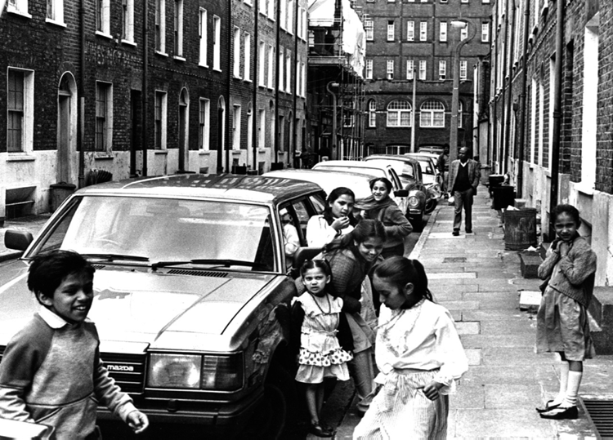
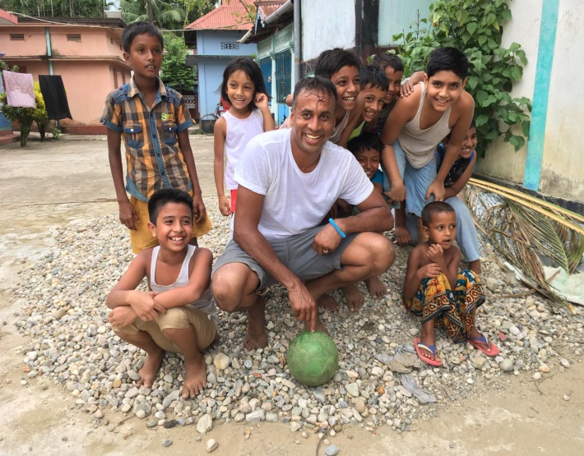
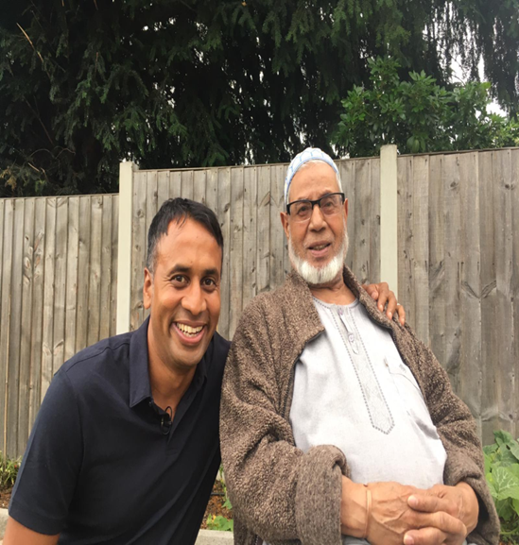
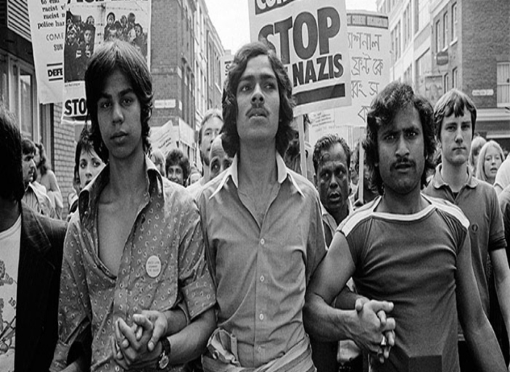
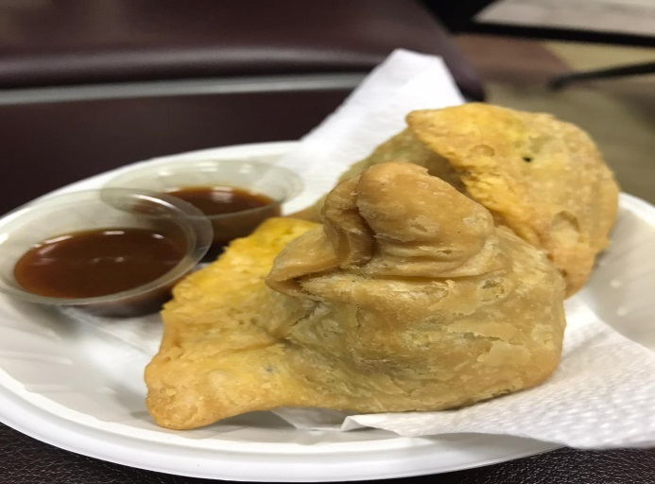
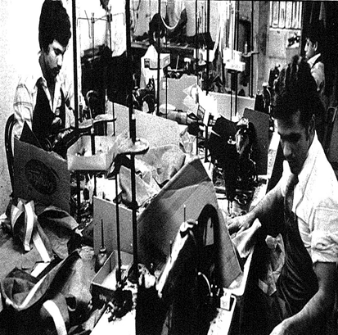
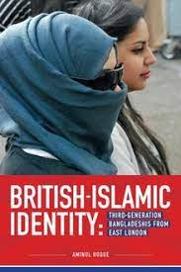
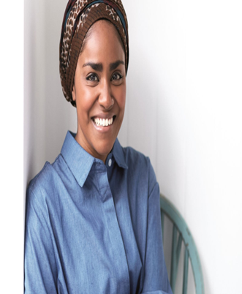
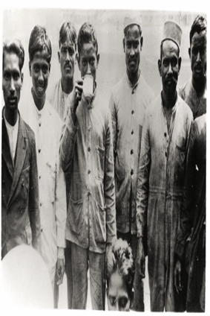
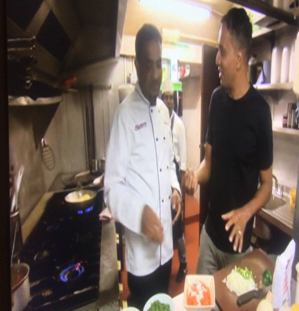
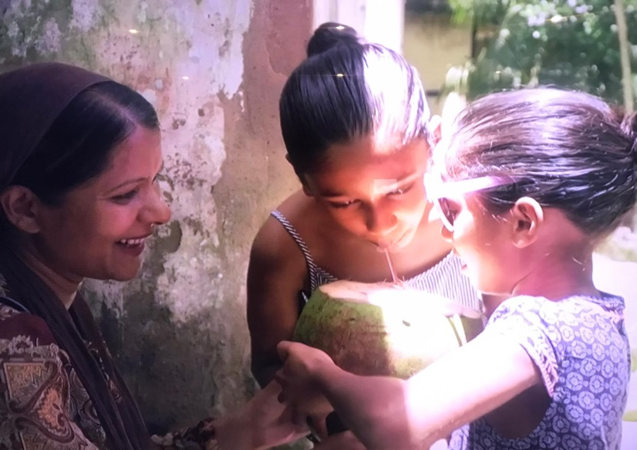

Slide 4
The legacy of 1971…
‘We should all remember the events of 1971 where we witnessed the absolute worst of humanity, but also saw the triumph of resistance, struggle and democratic rule. But we need to also learn our lessons from such a tragedy and ensure a future where violence, massacres and bloodshed is seldom an option’.

