Slide 1

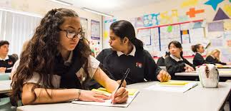
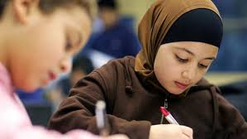
Do we really know who our students are? Understanding, implementing and embedding a culturally responsive pedagogy in our everyday practice
Dr Aminul Hoque

Slide 2
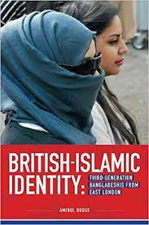
My chapter is informed by…
My own ethnographic research with young Bangladeshis from London of secondary schooling age
Current work with Goldsmiths’ students & my anti-racist work with the National Education Union (NEU)
Draws on empirical research (both UK based and global) that advocates a culturally responsive pedagogy
Provides insight into some of the everyday ‘lived experiences’ of discrimination, exclusion and alienation that many BAME students from disadvantaged backgrounds live through
Offers some practical ways that educators can ensure that such students remain engaged and enthused in their education
Argues that ‘faith’ is an important ‘fund of knowledge’ & ‘identity’ for many Muslim pupils

Slide 3
Key questions
1. Do we really know who our students are? Do/ should we care?
2. Are we aware of the wider social, community and cultural issues that many of our students are living through?
3. How do we get to know our students and ensure that their views, interests, lived experiences, aspirations inform and guide our pedagogical practices?

Slide 4
Culturally responsive pedagogy
In light of neoliberal reforms to education, there is a need to revert back to a more inclusive and collaborative form of education where the line between the school and the community is blurred and where the complex cultural, linguistic, ethnic, gender and religious identities of our pupils are explored within the curriculum. As a teaching philosophy, a culturally responsive pedagogy is premised on the idea that valuing culture is central to learning. Educators cannot trivialise or pay token attention to the cultural world and lived experiences of their pupils, and instead take time to understand their pupils and their sociocultural worlds, listen to them as well as valuing and maintaining their cultural identities and heritage within pedagogical practices. Such an approach empowers pupils intellectually, socially, emotionally and politically (Hoque, 2015b, 2018; Lucas and Villegas 2013; Nieto 2000).

Slide 5
Strategies
Incorporate and value students’ funds of knowledge in classroom pedagogy
Decolonise the curriculum
Adopt a critical and reflexive approach to teaching

Slide 6
Research and draw a family tree Grow vegetables from around the world Play traditional non-European sports | Write about a local (unknown) person from the local black and minority ethnic community. #BlackLivesMatter
Ask pupils to become heritage researchers. | Provide a wide range of literature from across the globe.
Go for a “walk” in the local area – get to know your community. | Take a reflexive approach to teaching.

Slide 7
References
Hoque, A (2020) ‘Research to reflect on: developing a culturally responsive pedagogy’. National Education Union NEU. https://neu.org.uk/media/11431/view
Hoque, A & Keelan, A (2020) A Very British History: British Bangladeshis. BBC4, Jan 2020.
Hoque, A (2018) ‘Third-generation British-Bangladeshis from east London: complex identities and a culturally responsive pedagogy’, British Journal of Sociology of Education, 39:2, 182-196, DOI: 10.1080/01425692.2017.1406335
Hoque, A (2015a) British-Islamic Identity: Third-Generation Bangladeshis from East London, London: IOE/ Trentham Press
Hoque, A (2015b) ‘Knowing our students’ identities: British Bangladeshis in east London schools’. Race Equality Teaching 33(1): 16-21
Lucas, T., and A. M. Villegas (2013) ‘Preparing Linguistically Responsive Teachers: Laying the Foundations in Preservice Teacher Education’, Theory into Practice 52: 98–109.
Nieto, S. (2000) ‘Placing Equity Front and Center: Some Thoughts on Transforming Teacher Education for a New Century’, Journal of Teacher Education 51: 180–18

