Slide 1

Aminul Hoque

Slide 2
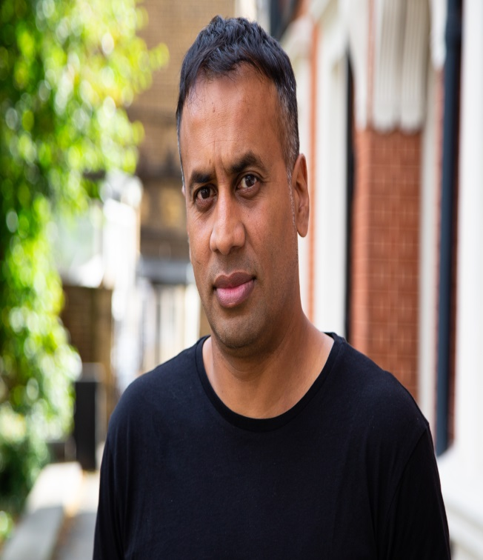
About me
Dr Aminul Hoque MBE, @BrIslam2015
Lecturer/ researcher in Education, Goldsmiths College
PhD – 2011
Key research interests: identity, youth cultures, multiculturalism, race, migration studies, Islamic feminism
Key publications: British-Islamic Identity: Third Generation Bangladeshis from East London (2015)
Presenter for A Very British History: British Bangladeshis, BBC4, Feb 2020
Londoner, dad, gardener, football-mad

Slide 3
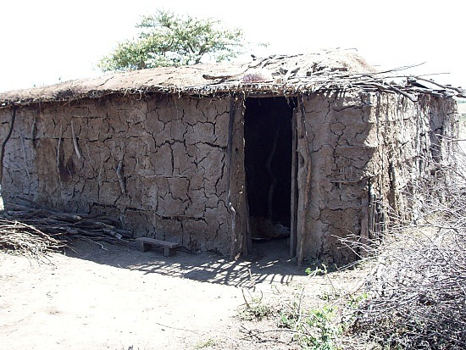
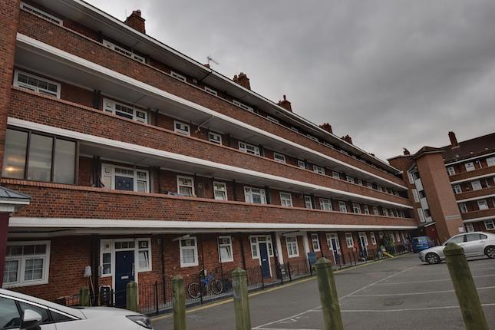
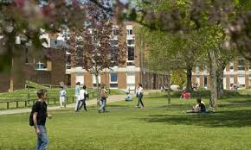



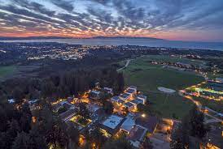

Estate life
Mudhut
Intrepid traveler
'
Sussex
Suburbia
California

Slide 4

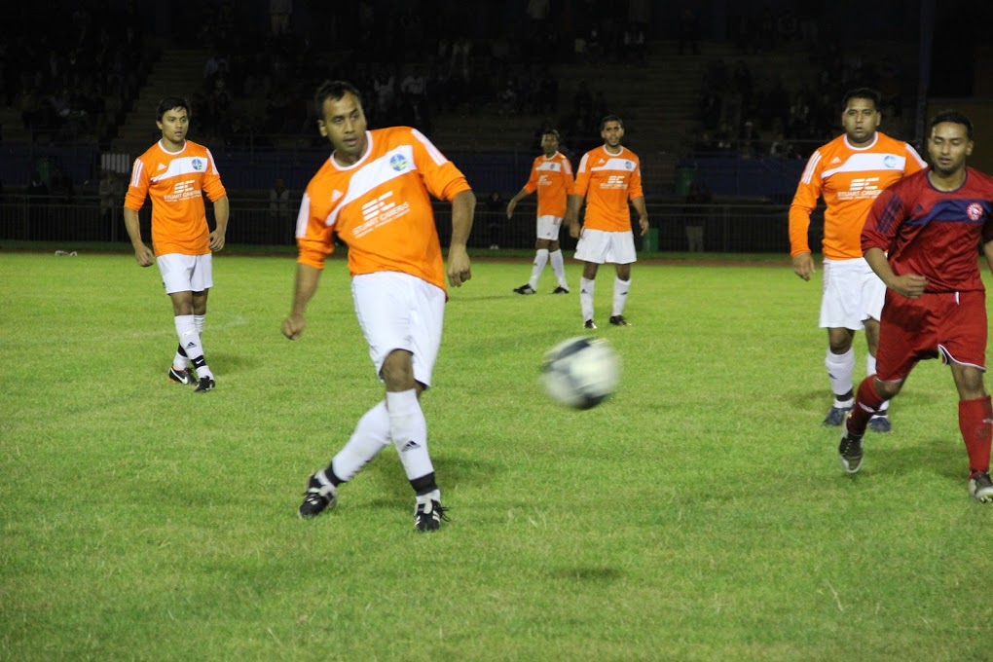


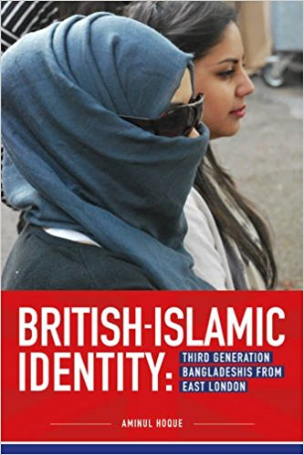





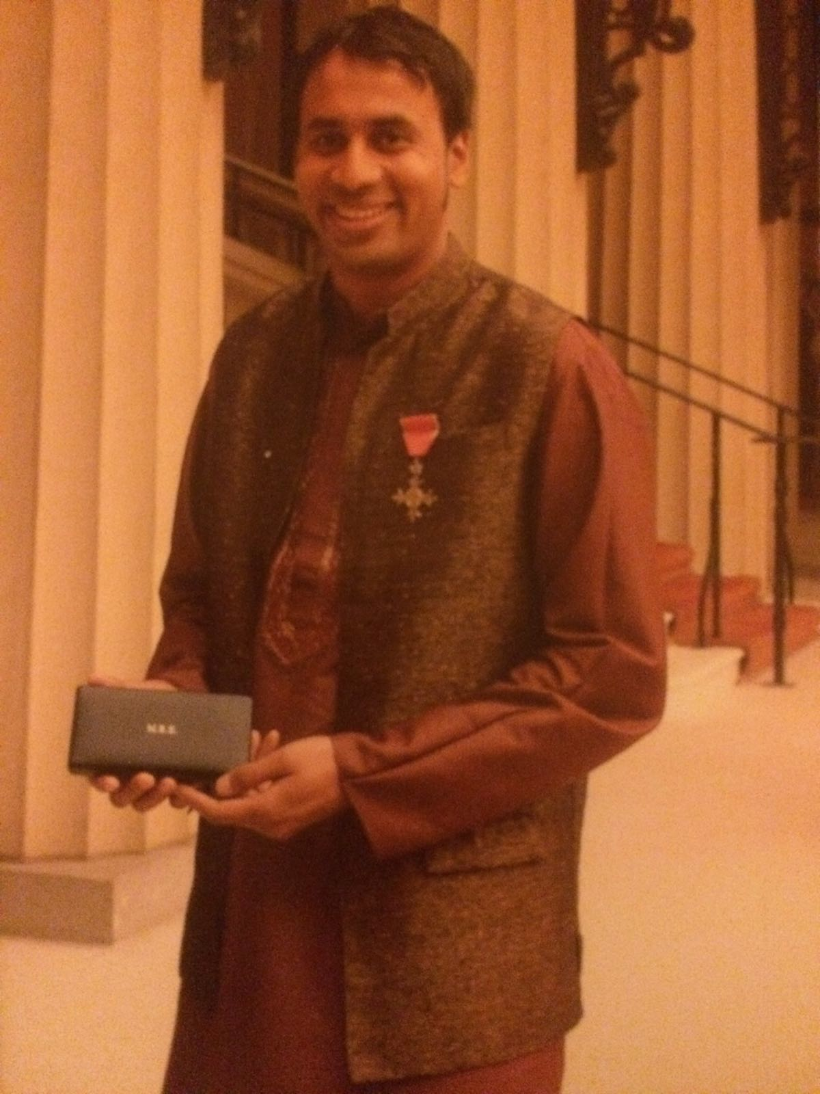



Slide 5
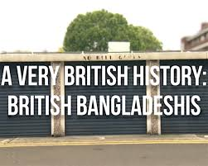
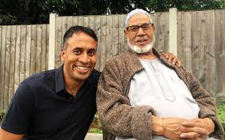
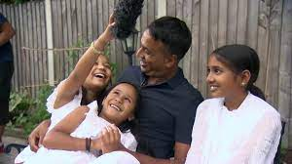
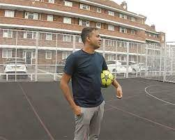
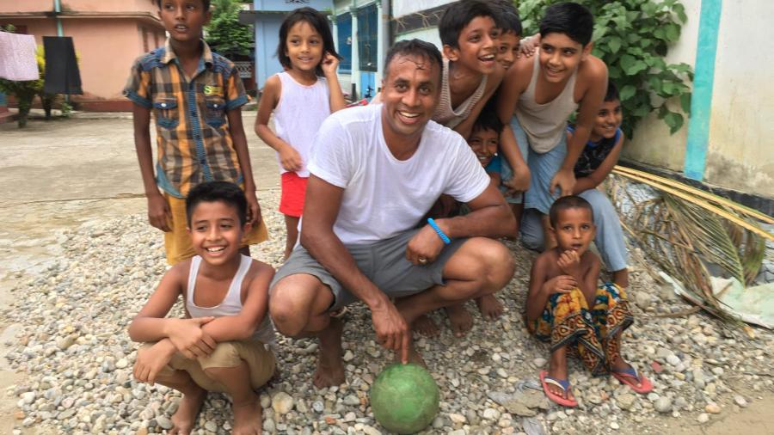
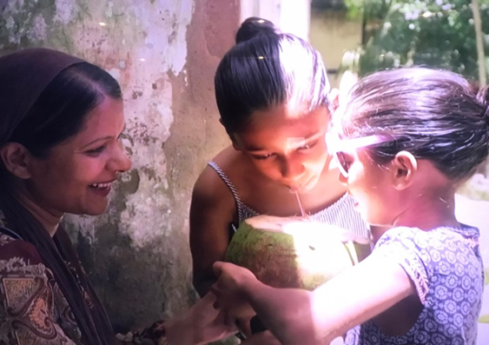
A Very British History: British Bangladeshis, BBC4, Feb 2020
https://www.bbc.co.uk/programmes/p082bnt8

Slide 6
About the doc…
The migration histories of British Bangladeshis
Highlighting important issues of racism, housing, 1971 War, the role of women etc.
Celebrates the many contributions Bangladeshis have made to wider British society
Gave a platform for our ancestors to tell THEIR stories
Going back to the ‘motherland’ with my British-born children
Positive international attention to our wonderful British Bangladeshi community

Slide 7
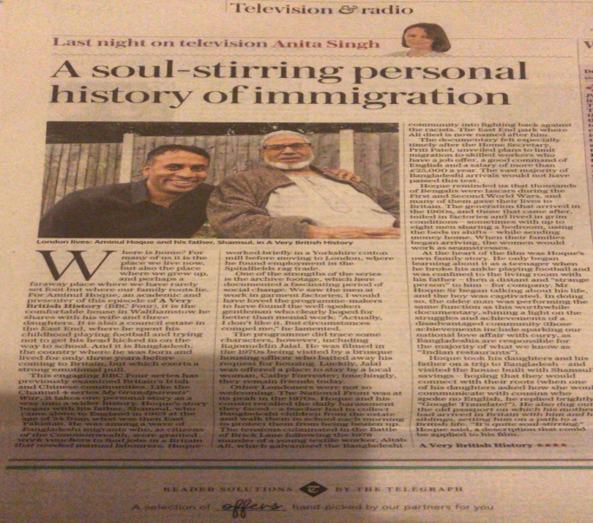
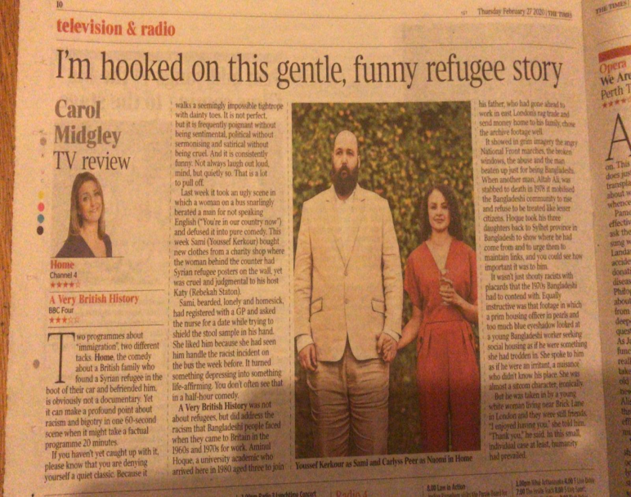
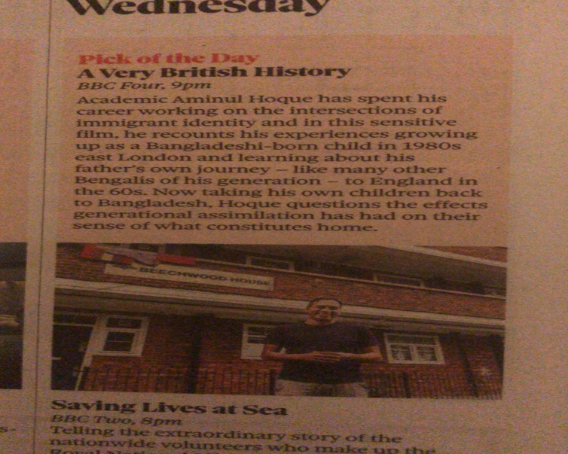
‘Pick of the day’ @Telegraph, @guardian, @thetimes
‘Critic’s choice’ @theipaper
‘Soul-stirring’ @Telegraph

Slide 8
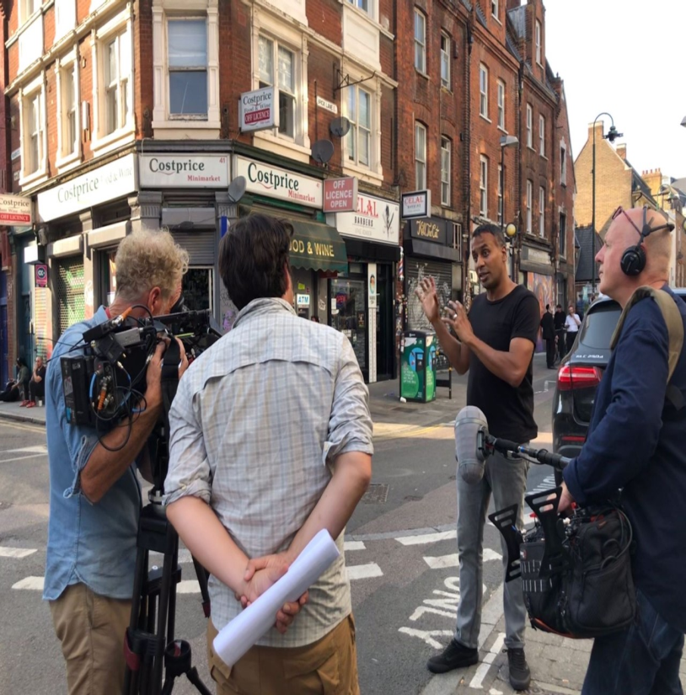
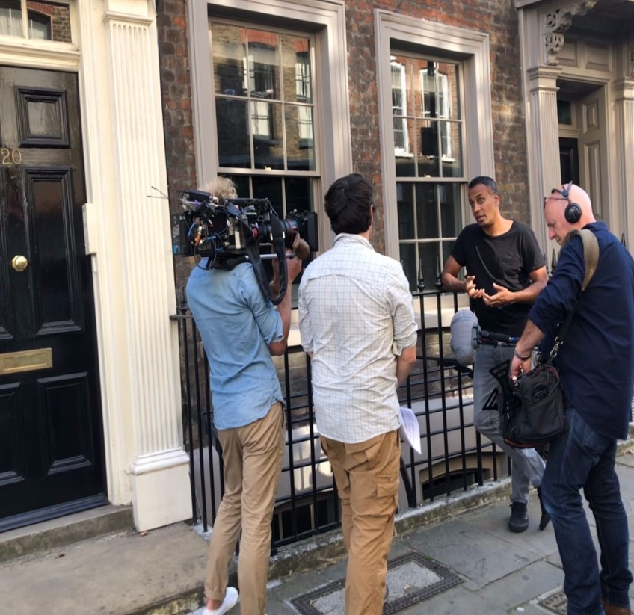
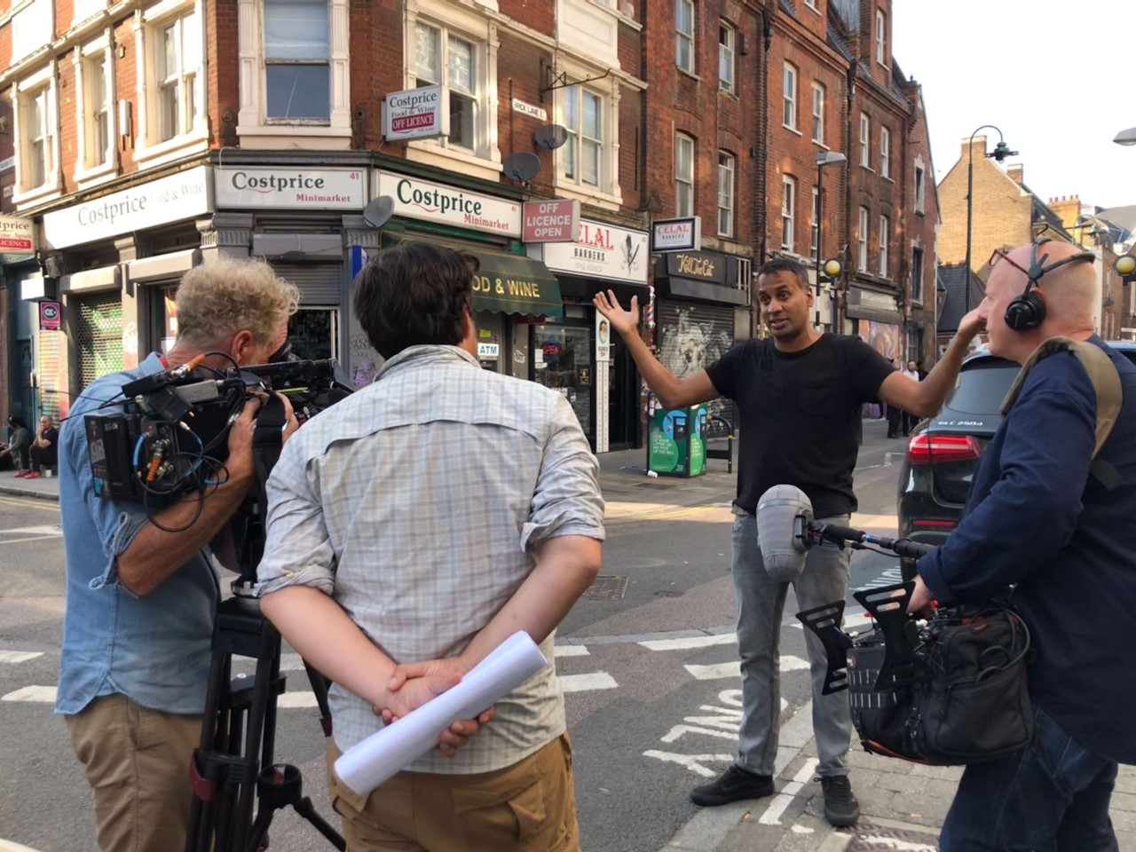
Searching for Secrets: London. Smithsonian Channel, USA, June 2021

Slide 9


Books… Enjoy what you do…..
Literature…. Family…….
Reading… Community……
Travelling… Football ……..

Slide 10

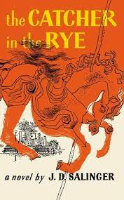
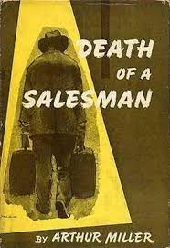
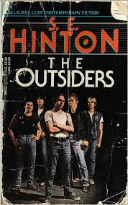
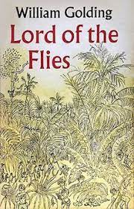
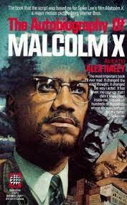


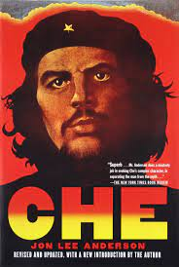


Slide 11

♯AskQuestions
♯Travel
♯BroadenYourHorizons
♯Watch&ReadTheNews
♯PositiveIdentity
♯Confidence
#The power of networking
♯Listen, be humble, reflect, learn

Slide 12
Good luck.
All the best.
Stay in touch
E: a.hoque@gold.ac.uk
Twitter: @BrIslam2015

Slide 13
Questions?

