Slide 1
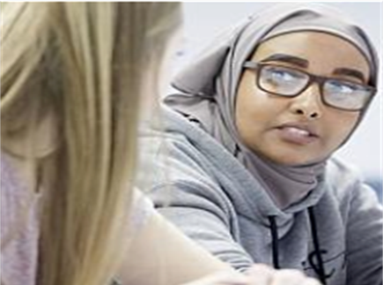


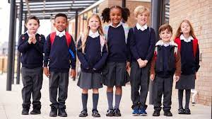
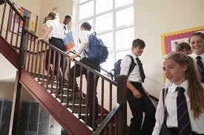
Do we really know who our students are? Understanding, implementing and embedding a culturally responsive pedagogy in our everyday practice
Dr Aminul Hoque MBE
Goldsmiths College, University of London

Slide 2
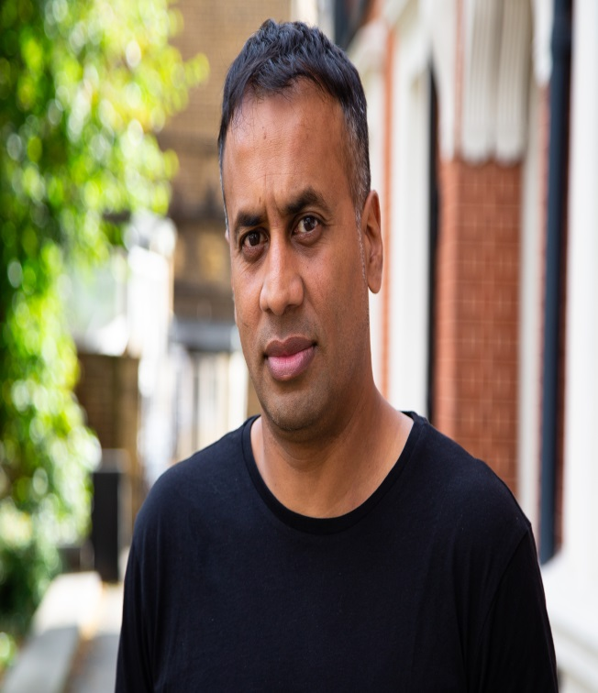
About me
Dr Aminul Hoque MBE, @BrIslam2015
Lecturer/ researcher in Education, Goldsmiths College
PhD – 2011
Key research interests: identity, youth cultures, multiculturalism, race, migration studies, Islamic feminism
Key publications: British-Islamic Identity: Third Generation Bangladeshis from East London (2015)
Presenter for A Very British History: British Bangladeshis, BBC4, Feb 2020
Londoner, dad, gardener, football-mad

Slide 3
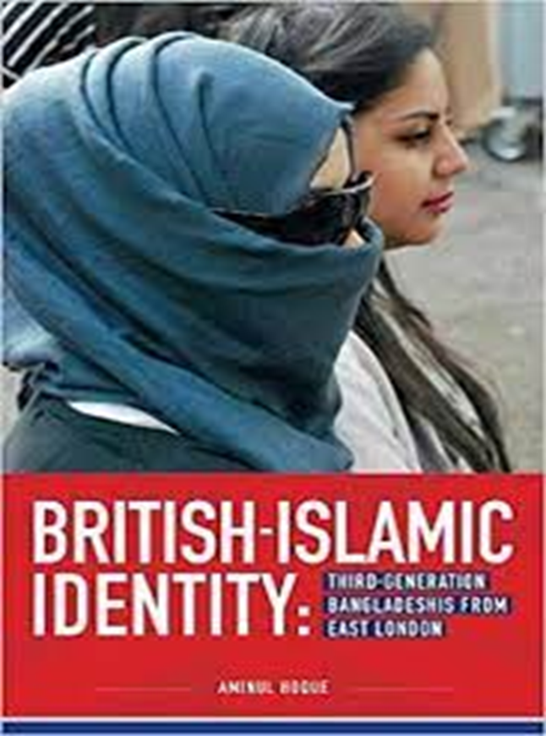
Structure of today’s talk/ workshop
Draw on my own ethnographic research with young Bangladeshis from London, current work with Goldsmiths’ students & my anti-racist work with the National Education Union (NEU)
Unpack what we understand by the term ‘culturally responsive pedagogy’
Provide insight to some of the everyday ‘lived experiences’ of exclusion and alienation that many BAME students from disadvantaged backgrounds live through
I will offer some practical ways that educators can ensure that such students remain engaged and enthused in their educational journeys

Slide 4
Key questions
1. Do we really know who our students are? Do/ should we care?
2. Are we aware of the wider social, community and cultural issues that many of our students are living through? Is this our responsibility?
3. How do we get to know our students?
4. How do we ensure that our pupils views, interests, lived experiences, aspirations inform and guide our pedagogical practices?

Slide 5
No right or wrong answers…
What is teaching?
What is ‘education’?
HOW do we teach? (think about key skills required for teaching, characteristics, support, infrastructure required for effective/ meaningful teaching)
Is there an ‘end’ goal for educators? If so, what is it?
Who are the key stakeholders in an individual’s educational journey?

Slide 6
Educational/ Teaching Philosophy
John Dewey (1859-1952) – child-centred approach, focus on the ‘experience’ of children, connecting the wider socio-cultural world of the child with the classroom, making education meaningful.
Paulo Freire (1921-1997) – education as a dynamic, two-way, humanistic process, building positive relationships with people, understanding them, dialogue is important, raising the consciousness of people.
Antonio Gramsci (1891-1937) – challenging the wider social structure (status quo) through counter-hegemonic education, raising the social and moral consciousness in people, focus on social justice and equity.
bell hooks (1952-2021) – empowering students, education as a free space for exploring ideas, anyone can learn.
Bernard Crick (1929-2008) – purpose of education is to make people better ‘citizens’.
Rabindranath Tagore (1861-1941) – education is about expression, creativity & self-realization.
Frank Furedi (1947 - present) – ‘politics’ should be left out of education. Teachers should just ‘teach’!

Slide 7
Culturally responsive pedagogy
In light of neoliberal reforms to education, there is a need to revert back to a more inclusive and collaborative form of education where the line between the school and the community is blurred and where the complex cultural, linguistic, ethnic, gender and religious identities of our pupils are explored within the curriculum. As a teaching philosophy, a culturally responsive pedagogy is premised on the idea that valuing culture is central to learning. Educators cannot trivialise or pay token attention to the cultural world and lived experiences of their pupils, and instead take time to understand their pupils and their sociocultural worlds, listen to them as well as valuing and maintaining their cultural identities and heritage within pedagogical practices. Such an approach empowers pupils intellectually, socially, emotionally and politically (Hoque, 2015b, 2018; Lucas and Villegas 2013; Nieto 2000).

Slide 8
The term ‘culturally responsive pedagogy’ taps into various kinds of knowledge and lived experiences of pupils as a means of making classrooms and curricula more inclusive and refers to a ‘dynamic or synergistic relationship between home/ community culture and school culture’ (Ladson-Billings (1995: 467).

Slide 9
Students/ pupils/ young people do not leave their sociocultural worlds and identities behind once they enter the school gates – and nor should they!
(Bullock Report, 1975)

Slide 10
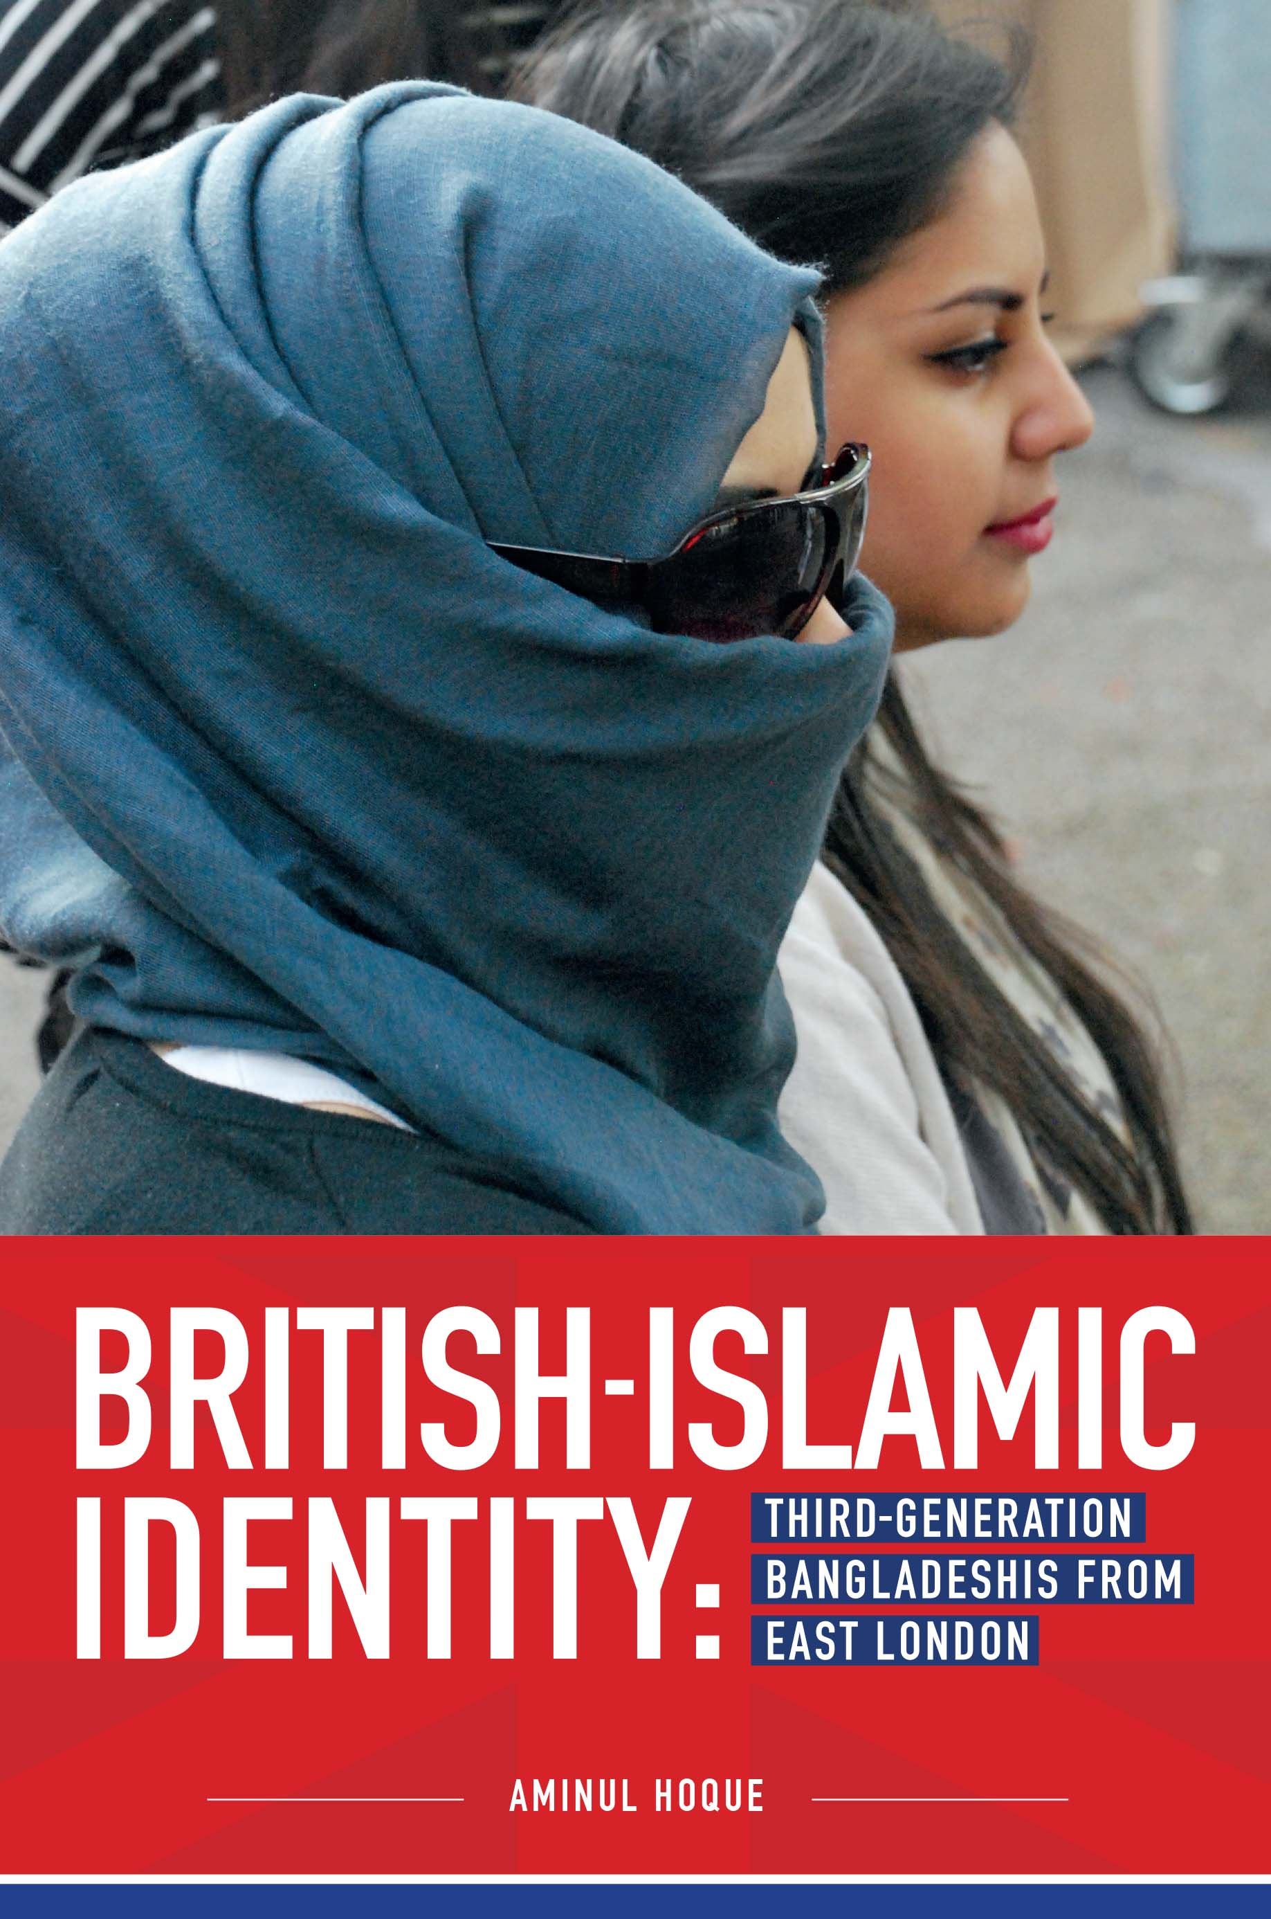
Earlier research
2004-2010 – ethnographic research focused on identities of British-born Bangladeshis from east London in community, cultural, educational settings. Involved multiple in-depth life history interviews and participant observations.
Recent research
2015-16 - Group & in-depth one-to-one interviews with young Bangladeshi Muslims of their schooling experiences, advocating a more culturally responsive pedagogy.

Slide 11
The importance of mother tongue
Adnan (aged 15) speaks about his experience of how his ‘home’ language is not ‘valued’ and ‘welcome’ at school: ‘I get told off all the time by this one teacher for speaking Bengali with my boys at school. He said it was rude. But sometimes I find it more comfortable speaking Bengali’.
Adnan also talks about how his mother is marginalised from the schooling process because she cannot speak English:
‘My mum is really involved in my schooling life and encourages and supports me at home. But she cannot speak English at all. She always attends every parents evening at school and always feels left out and confused because she is unable to understand my teachers who speak English with her. Often, I act as an interpreter. Even the Bengali teachers speak English with my mum, which I find very odd.’

Slide 12
‘Funds of knowledge’ (Moll et al, 1992)
Moll et al (1992) developed the idea of ‘funds of knowledge’ for teachers as a way of connecting the homes and cultures of their pupils (Mexican pupils living around the border region of Mexico/ USA) with the classrooms.
Iqbal’s (2019) study of British Pakistani boys from Birmingham and their experiences in state schools found that the religion of Islam was a key defining feature in the lives of these boys. The study reiterated the central premise of today’s talk - that educators cannot teach children effectively if they lack an understanding of their students’ cultures and lives (especially those from minority and disadvantaged backgrounds), and if they don’t build meaningful relationships with their families.

Slide 13
Case study – Fatima, aged 15, female, Bangladeshi, from London. Wants to become a teacher. ‘My typical week’.
I love my family and my very close-knit Bangladeshi community. My culture and community mean a great deal to me, although it can be sometimes overwhelming – the private is nearly always public. I have a large family. I am the second oldest of 5 siblings. My parents are amazing and super-supportive, but are always busy managing the house. My father grew up in Bangladesh and cannot speak much English. He is always working all sorts of hours in a grocery store. My mum is a housewife and also has a disability which means that my older sister and I have to help out a lot at home. It is chaotic at home, but I love it. I share a room with 2 of my sisters, and we are constantly fighting for the one working laptop that we have. My grandparents also live with us and frequently I have to take them for hospital appointments because I can speak English. And often, either myself or my older sister have to drop my younger siblings off to school and pick them up. My day starts at 6.30am because I have to get them ready for school and then rush to school myself. And then often, I’m rushing back afterwards for the pick up. Oh did I also tell you that I am online for Arabic classes everyday between 5-7pm, and I have a part-time weekend job. I am always ‘running’ and ‘juggling’.

Slide 14
1. How is such a ‘personal’ narrative of your pupils useful to you as educators?
2. What barriers/ challenges/ opportunities can you identify?
3. What ‘funds of knowledge’ does Fatima have?
4. Is it important that our curriculum is relevant to the lives of our pupils, reflecting their social worlds?

Slide 15
Key studies…
Viewed as an important agency of socialisation, it is argued that the school plays a crucial role in constructing the fluid identities of young people, shaping and reshaping who they are, and therefore it needs to be a safe space where young people can discuss and debate facets of their individual and collective identity important to them.
In-depth research in London (Archer, Hollingworth, and Mendick 2010), Manchester and Peterborough (Royal Society for the encouragement of Arts, Manufactures and Commerce 2010, 2012) has shown that when there is a physical and ideological disconnect between the school and the community, it becomes very difficult to engage, inspire and motivate the students of that school to learn.

Slide 16
Strategies
Adopt an additive and positive view of pupils, as opposed to a deficit one.
Develop a horizontal model of education premised on dialogue, interest, experience and humanity.
‘Decolonise’ the curriculum, resources and mind-set.
Educators to develop an open, transparent, critical and reflexive approach to education and teach with a sociopolitical consciousness (social pedagogy).

Slide 17
Can people in this room share your own teacher stories as to how you have adopted a culturally responsive pedagogy in your everyday teaching?
How have you got to know your students and the wider community?
How have you managed to integrate the culture and identities of your pupils within classroom teaching?

Slide 18
A culturally responsive pedagogy: Some practical suggestions
1. There must be ‘buy in’ from management/ hierarchy.
2. Get to know your students. Listen and talk to your pupils. Give them space to tell you ‘their’ stories. Tell them your story also.
3. Activities, readings, sports, curriculum, discussions to reflect diverse student population.
4. Continuous staff training.
5. Take a ‘walk’ in the community (events, read local papers, gov data, etc).
6. As a teacher, if you don’t understand something about your pupils, ask them to tell you about it! Be non-judgemental and don’t just fall back on your own prejudices and bias. Take a reflexive approach.
7. Encourage parental/ family/ community engagement in the child’s learning.
8. Make the ‘national’ curriculum a ‘relevant’ one.

Slide 19
The debate continues…….
Stay in touch
Dr Aminul Hoque
Department of Educational Studies
Goldsmiths, University of London
E: a.hoque@gold.ac.uk
Twitter: @BrIslam2015

Slide 20
Questions?

Slide 21
References
Archer, L., Hollingworth, S., & Mendick, H (2010) Urban Youth and Schooling, Maidenhead: Open University Press.
Bullock, A (1975) A Language for life. The Bullock Report. London: Her Majesty’s Stationery Office.
Hoque, A (2020) ‘Research to reflect on: developing a culturally responsive pedagogy’. National Education Union NEU. https://neu.org.uk/media/11431/view
Hoque, A & Keelan, A (2020) A Very British History: British Bangladeshis. BBC4, Jan 2020.
Hoque, A (2018) ‘Third-generation British-Bangladeshis from east London: complex identities and a culturally responsive pedagogy’, British Journal of Sociology of Education, 39:2, 182-196, DOI: 10.1080/01425692.2017.1406335
Hoque, A (2015a) British-Islamic Identity: Third-Generation Bangladeshis from East London, London: IOE/ Trentham Press.
Hoque, A (2015b) ‘Knowing our students’ identities: British Bangladeshis in east London schools’. Race Equality Teaching 33(1): 16-21
Iqbal, K (2019) ‘British Pakistani boys, education and the role of religion: In the land of the Trojan Horse, Abingdon, Oxon: Routledge.
Ladson-Billings, G (1995) ‘Towards a theory of culturally relevant pedagogy’, American Education Research Journal, 32(3): 465-491. DOI: https://doi.org/10.3102/00028312032003465
Lucas, T., and A. M. Villegas (2013) ‘Preparing Linguistically Responsive Teachers: Laying the Foundations in Preservice Teacher Education’, Theory into Practice 52: 98–109
Moll, Luis, C., Amanti, C., Neff, D., & Gonzàlez, N (1992) ‘Funds of knowledge for teaching: Using a qualitative approach to connect homes and classrooms’, Theory into Practice, 31(2): 132-141. DOI: https://doi.org/10.1080/00405849209543534
Nieto, S. (2000) ‘Placing Equity Front and Center: Some Thoughts on Transforming Teacher Education for a New Century’, Journal of Teacher Education 51: 180–187
RSA. (2010) The RSA Area Based Curriculum: Engaging the Local. www.thersa.org
RSA. (2012) The RSA Area Based Curriculum in Peterborough. an Independent Evaluation by Professor David James. www.thersa.org

