Slide 1
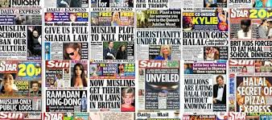
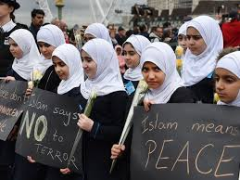
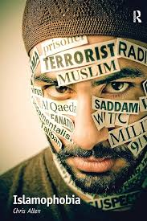
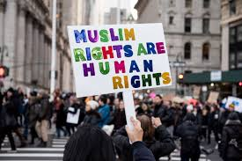
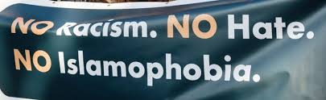
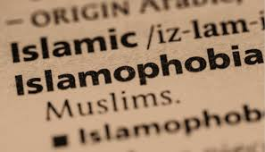
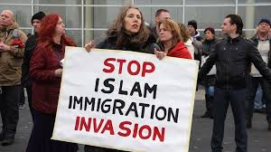
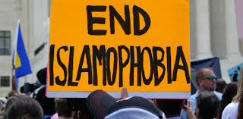
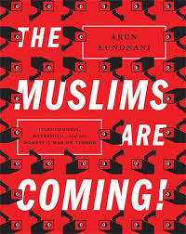
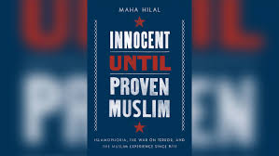
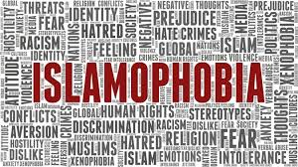

Slide 2
The image constructed of Muslims is of a distinctive ‘other’ different to that of the civilised West - barbaric and intolerant religious zealots, unable to govern themselves, are cunning, weak, primitive. A crucial way some Westerners, especially the political and economic elite, understand themselves. Such an ideology helps maintain existing systems of political domination and subordination. ‘This is how WE are, and this is how THEY are…’.

Slide 3
‘Islamists are bullying Britain into submission [and that the influence of] Islamist cranks and leftwing extremists [can be found] in our judiciary, our legal profession and our universities’. (Suella Braverman, Feb 2024)
‘I don’t actually believe that the Islamists have got control of our country, but what I do believe is they’ve got control of Khan and they’ve got control of London… He’s actually given our capital city away to his mates.’ (Lee Anderson, Feb 2024)
‘More than 50% of Tory members in poll say Islam is a ‘threat’ to British way of life’ (Feb 2024)
‘Absolutely ridiculous that people should choose to go around looking like letterboxes.’ (Boris Johnson, 2018)
‘Islam hates us’ (Donald Trump, 2016)

Slide 4
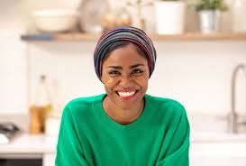
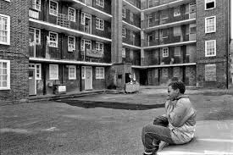
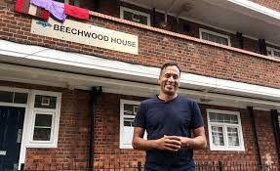
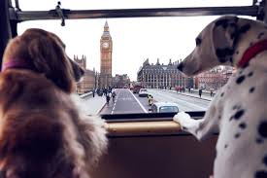
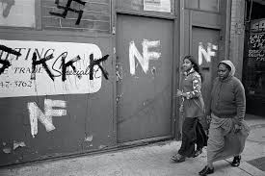
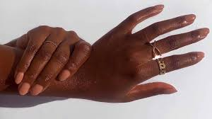
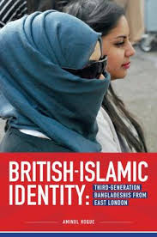

Slide 5
I’ve always been called ‘names’ and ‘labelled’ and ‘represented’ as the ‘other’ – as a way of belittling, excluding, discrimination, of hurting me, of putting me in my ‘place’, of making me feel less than I am (deficient, less worthy, second-class) – ‘smelly’, ‘greasehead’, ‘fish’, ‘Bongho’, ‘Paki’, ‘Black’, ‘Terrorist’ – exemplified by the repeated experience of being told to ‘go back to where you come from’, which has recently changed to, ‘these are OUR values, and if you don’t like them, go and live somewhere and with others where you do feel comfortable and who share your values’

Slide 6

I am a bit more practising [religiously] than some of the other girls in my immediate friendship circle. So when the terrible Paris attacks happened in 2015, one of my teachers stopped our group in the playground, looked specifically at me and said ‘I hope that there is widespread condemnation within the Muslim community towards those barbaric attacks’. I was shocked and also felt victimised. Why was he directing those comments towards me? What had I done? (Ayesha, aged 15)

Slide 7
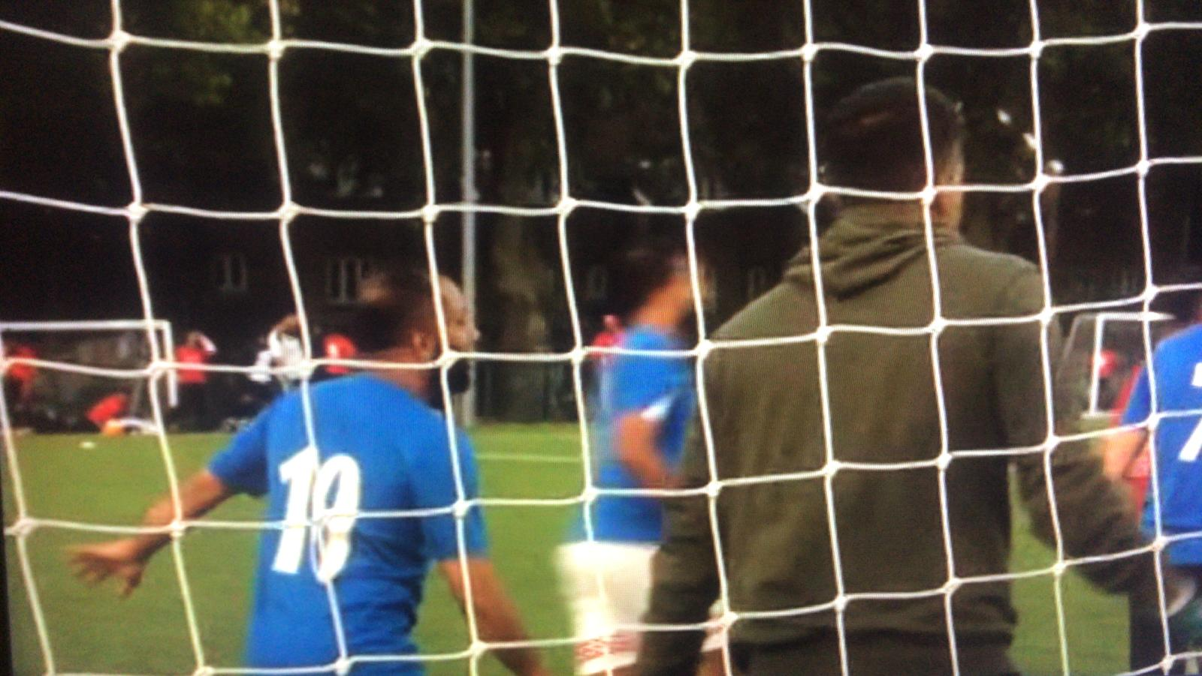
‘This documentary reminds us that we are a normal, hard-working British community. We have fears, hopes, anxieties just like everyone else. We also drink Costa Coffee, watch Netflix and follow our football team passionately’ (Hoque quoted in Cox, 2020)

Slide 8
