Slide 1
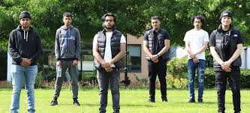

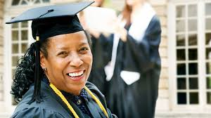
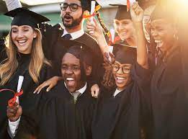

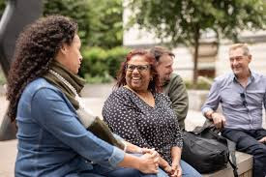
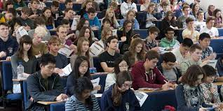

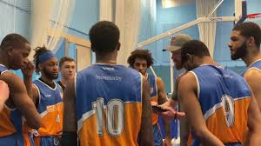
The transformation power of education

Slide 2
Structure of today’s talk
Open, honest insights/ discussions about life at university and what you can expect?
Prepare you mentally and physically in regards to managing expectations at university
Is university for me? Why am I attending?
Opportunity for Q&A at the end

Slide 3
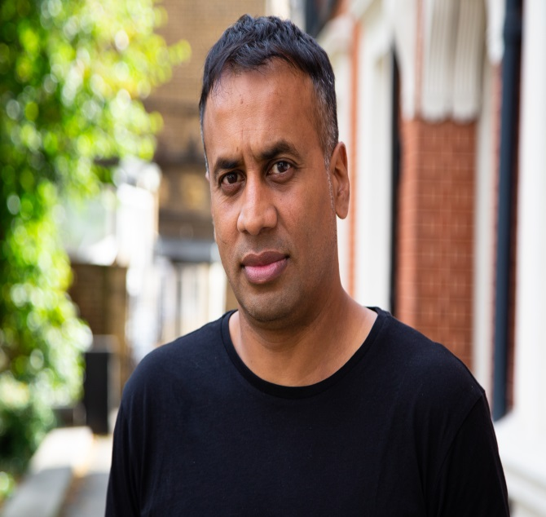
About me
Dr Aminul Hoque MBE, @BrIslam2015
Lecturer/ researcher in Education, Goldsmiths College
PhD – 2011
Key research interests: identity, youth cultures, multiculturalism, race, migration studies, Islamic feminism
Key publications: British-Islamic Identity: Third Generation Bangladeshis from East London (2015)
Presenter for A Very British History: British Bangladeshis, BBC4, Feb 2020
Londoner, dad, gardener, football-mad

Slide 4
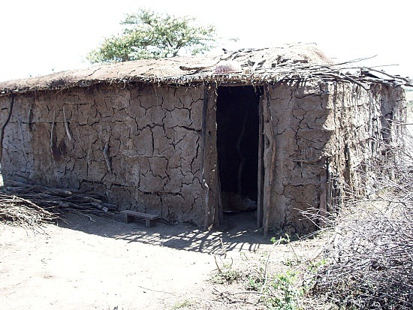
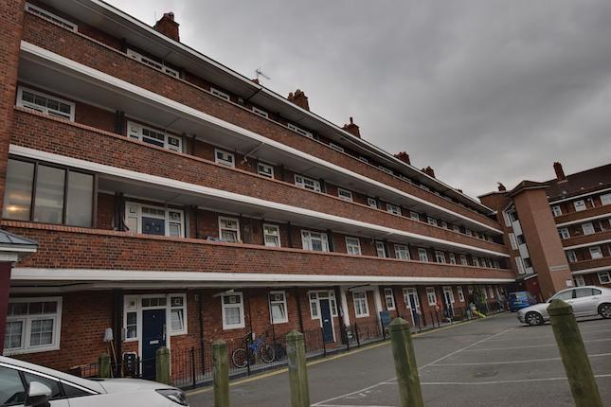

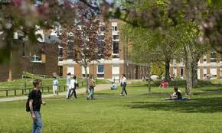

Estate life
Mudhut
Intrepid traveller
'
‘white’
Sussex
Suburbia

Slide 5
My own experience of university
Fun. Sociable. Intellectually challenging. HARD WORK! Sports and societies. Opportunity to ‘see’ the world. Expensive but ABSOLUTELY worth it. Making friends. Confidence. Developed my thinking, writing and critical skills. Discussions of interesting topic areas. Goes by VERY quickly!

Slide 6
What is the purpose of university?
Four crucial questions to consider:
What is my idea/ vision of university?
What is the purpose of university?
Why do I want to attend? What is my ‘end game’?
Am I suited for university?

Slide 7
Purpose of university
It will:
Provide you with knowledge, insights, expertise in a particular field/ subject area
Expand and challenge your own intellectual, personal, social development
Give you confidence and ‘mastery’ in a particular field
Develop your creative, writing, analytical, reading, organisational, interpersonal skills
Give you confidence to ask important questions
Make you more ‘employable’; build a ‘career’; increase confidence
Make you ‘think’ more critically about yourself, the wider world around you and your role within it – will allow you to be true to yourself and make informed, practical choices about ‘life’
Allow you membership to an elite group of thinkers/ people across the globe!
Gives you a qualification – a degree – a piece of paper that demonstrates that you have the knowledge, discipline, patience, intelligence to have completed a degree
Give you depth of understanding about the wider world and how you can contribute to making it a better place

Slide 8
Significance of university
Education – develops your mind. Knowledge is something that is unique, personal and your own. No one can take it away from you!
Social, fun, some of the best years of your life!
Some of your best friends for life will be the very people you meet in your lecture halls, canteens, seminar rooms, conferences, library, sports teams etc
You may end up not pursuing a career in your degree area – but that’s ok!

Slide 9
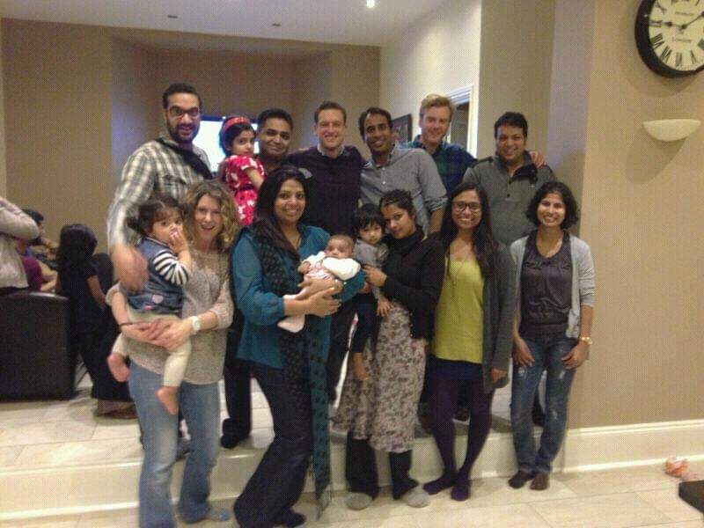
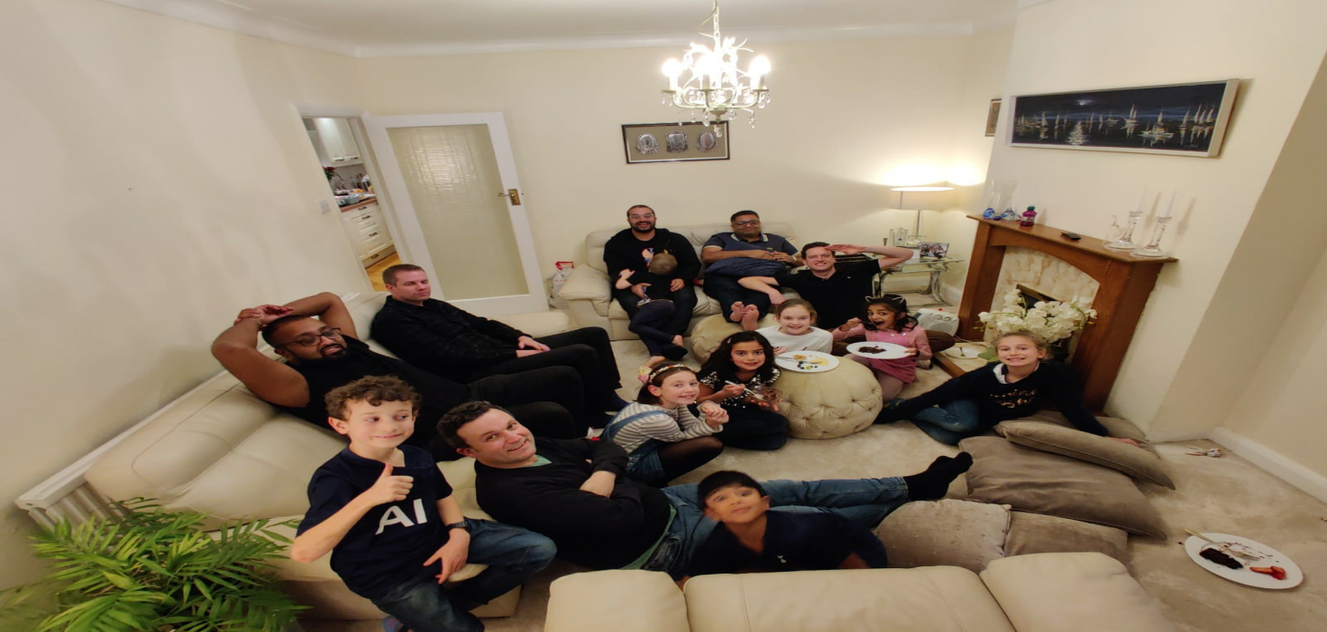
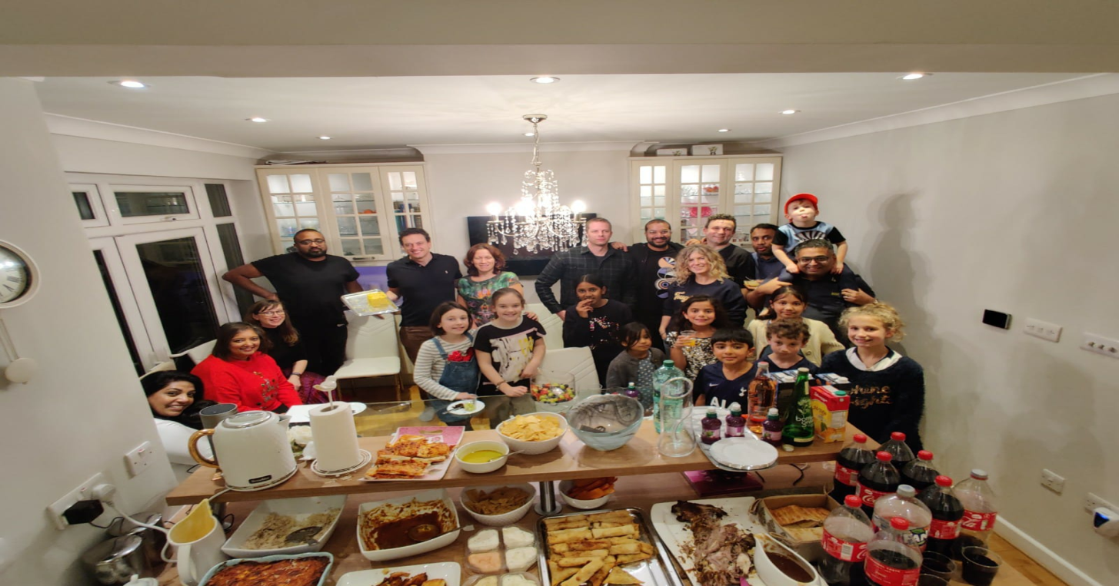

Slide 10
What can you expect?
HUGE campus feel OR a more isolated departmental feel
Lots of students (thousands!!) from a variety of backgrounds: age, language, race, gender, religion, social class, geography etc – most will be just like you – excited and nervous!
You will get to meet lots of new, interesting and fun people
Large lectures!
Work placements/ experience
Opportunity to see the world!
Flexible timetable – so can still work, socialise, family engagements, volunteering commitments etc
Compulsory: attend lectures and seminars, hand in written work to deadlines, exams, individual and group presentations, work placements
‘Optional’: joining sports and other societies organised by Student Union, participating in wider social events, going for a post-lecture coffee/ hot chocolate with your classmates, going to the library, communicating with your new friends via social media/ Whatsapp…
Hard work and READING!!!!

Slide 11
Read….
Read, read, read, read, read, read, read, read, read, read, read, read, read, read, read, read, read, read, read, read, read, read, read, read, read, read, read, read, read, read, read, read, read, read, read, read, read, read, read..

Slide 12











Slide 13









Slide 14


Theory to help us understand and navigate the world….
#BLM – race, inequality, policing
#SarahEverard – gender, feminism, masculinity
#MeghanGate – mental health, power, race
#Brexit
#InstitutionalRacism/ Policing/ ‘gangs’

Slide 15
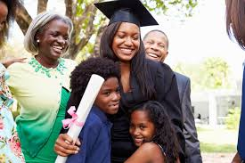
As a mature student, is university for me?
Adaptability
Ability to multitask
Disciplined and determined
Wisdom, perceptive and life experience
‘Perhaps’ have more time, or not?
May want to fulfil a life long-ambition
A new start/ new career?
Role modelling to children/ grandchildren/ community
Confidence to ask questions and forge friendships

Slide 16
So you decide that you want to go university, what next?
Speak to your nearest and dearest – time, money and sacrifice
Self-audit (am I ready?)
Start writing a personal statement
Speak to friends, family who have been to university
Do some research on potential courses - UCAS guidance for mature students - https://www.ucas.com/undergraduate/mature-undergraduate-students#:~:text=Don't%20worry%20about%20whether,NEC%20(National%20Extension%20College).
Access courses, foundation degrees, work experience etc
Student finances for mature students - https://www.gov.uk/guidance/student-finance-information-for-mature-students
Goldsmiths University guide for mature students - https://www.gold.ac.uk/ug/mature-students/?gad_source=1&gclid=EAIaIQobChMI69O55PTahgMVtZtQBh0jLwCZEAAYAyAAEgKDVPD_BwE & https://www.gold.ac.uk/study/contact/#d.en.2039143

Slide 17
What is a personal statement for?
An Admissions Tutor will be thinking…
Can this person get up in the morning and come to class?
Will they participate in seminar discussions?
Are they really interested in the subject they are applying for?
Can this person write essays?
What will this person bring to the degree in terms of experience?
What can I learn about this person that I won’t know from his/ her grades?
https://www.ucas.com/undergraduate/applying-university/writing-personal-statement/how-write-personal-statement UCAS guide for for writing personal statements

Slide 18
Career paths
Educational administration and student services/student support/careers/recruitment
Museums and galleries
Youth & community work
Journalism and the media
Charities and NGOs in the UK and abroad: education; healthcare
Law conversion course
MA in a related area – E.g. Culture, Language & Identity at Goldsmiths
Teaching, after a PGCE
Occupational Therapy
Speech and language therapy
Educational psychology
Psychotherapy
Social work- links with the Goldsmiths MA Social Work
Probation
Paramedic
Adult education including TEFL

Slide 19

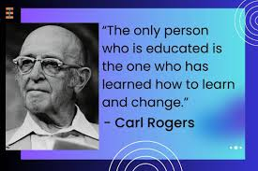

Slide 20
The impact that our students have on us – we learn humanity from each other!
20.1.2023
Good morning Rose
How lovely it was to catch up yesterday. Thank you so much for your kind words of comfort and blessings. I am very humbled. My father was a kind, strong and courageous man who helped so many people and touched so many lives. We all miss him dearly as he has left a void in all our lives. My children especially miss their grandparents and I also miss their presence. But I know that both of my parents are reunited in heaven and also smiling down on us and looking out for us and this warms my heart. May they both rest in peace. Thank you so much for your kind words. Bless you.
You are a gifted student who is very well organised and works very hard. These are key skills that you will need to guide you through the next few months.
Have a lovely weekend.
Best wishes
Aminul

Slide 21
Good luck.
All the best.
E: a.hoque@gold.ac.uk
Twitter: @BrIslam2015

Slide 22

Questions?

