Slide 1

‘Counterculture 2.0: Grotesques of Transgression after Trump'
Dr. Guy Stevenson
Notes:
TALK BASED ON A BOOK I’M WRITING + SHORT COURSE (general public).
LOOKS TO THE 1960s TO EXPLAIN OUR DIVISIONS OVER RACE/GENDER/SEXUALITY TODAY (ID POLITICS)
BOOK + COURSE COME OUT MY RESEARCH INTO THE 1960s LITERARY COUNTERCULTURE (THE BEAT GENERATION, ROCK N ROLL, VIETNAM PROTESTS, HIPPIE COMMUNES).
THE WAY THAT THOSE CULTURAL MOVEMENTS REFLECTED AND AFFECTED THE WORLD AROUND THEM.
THE WORLD THAT CAME AFTER THEM – OUR IDEAS ABOUT PROGRESS.
THE WAY THEY SHAPED OUR STRANGELY AND NEWLY DIVIDED AGE.

Slide 2
“WE ARE IN A CULTURE WAR. IF THE REPUBLICANS DON’T TOUGHEN UP AND GET SMART AND GET STRONG AND PROTECT OUR HERITAGE AND PROTECT OUR COUNTRY, I THINK THEY’RE GOING TO HAVE A VERY TOUGH ELECTION”
Donald Trump, Interview with Real Clear Politics 2020
“POLITICS IS DOWNSTREAM FROM CULTURE”
Andrew Breitbart (mantra + mission statement for his news website Breitbart, adopted by Steve Bannon when he took over as owner, before organising Donald Trump’s 2016 election campaign)
“THE CONQUEST OF CULTURAL POWER COMES BEFORE POLITICAL POWER”
Antonio Gramsci, Prison Notebooks, 1926 (Marxist response to Fascist Control)

Slide 3
My AIMS
Learn about the transition from hard fought battles for Civil Rights to the assimilation of their tenets into the mainstream; and the backlash against them in 2016.
Learn about the Right’s presentation of itself as FREE SPEECH COUNTERCULTURE.
Learn about confusion, anger, disagreement over politics of identity by going back to the decade when they took centre stage in Western politics.

Slide 4
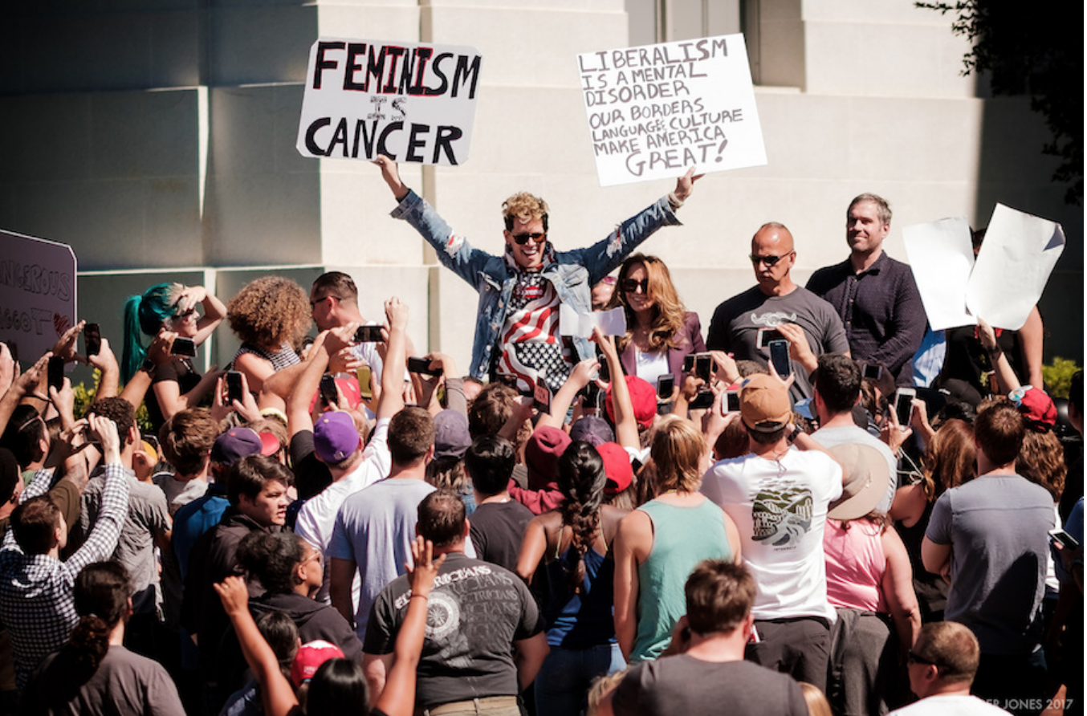
MILO YIANNOPOLOUS
- 2017 “Free Speech Week”, University of California, Berkeley
Response to “No Platforming” of Trump supporting conservative speakers

Slide 5


Slide 6
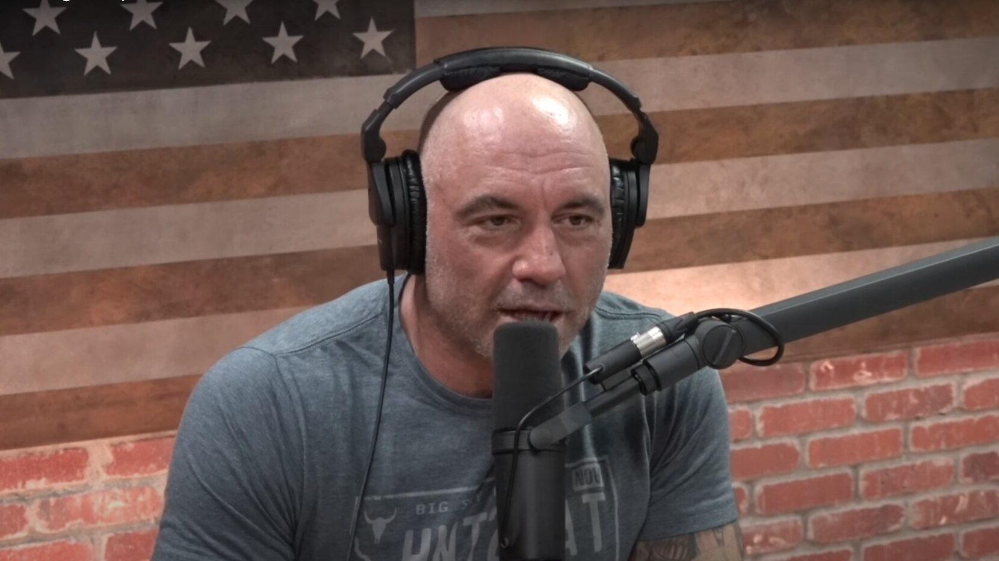
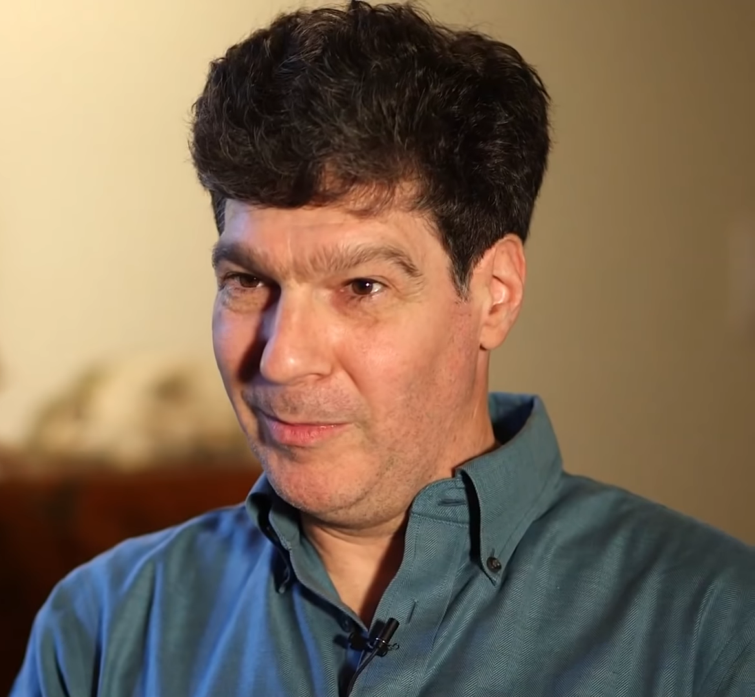
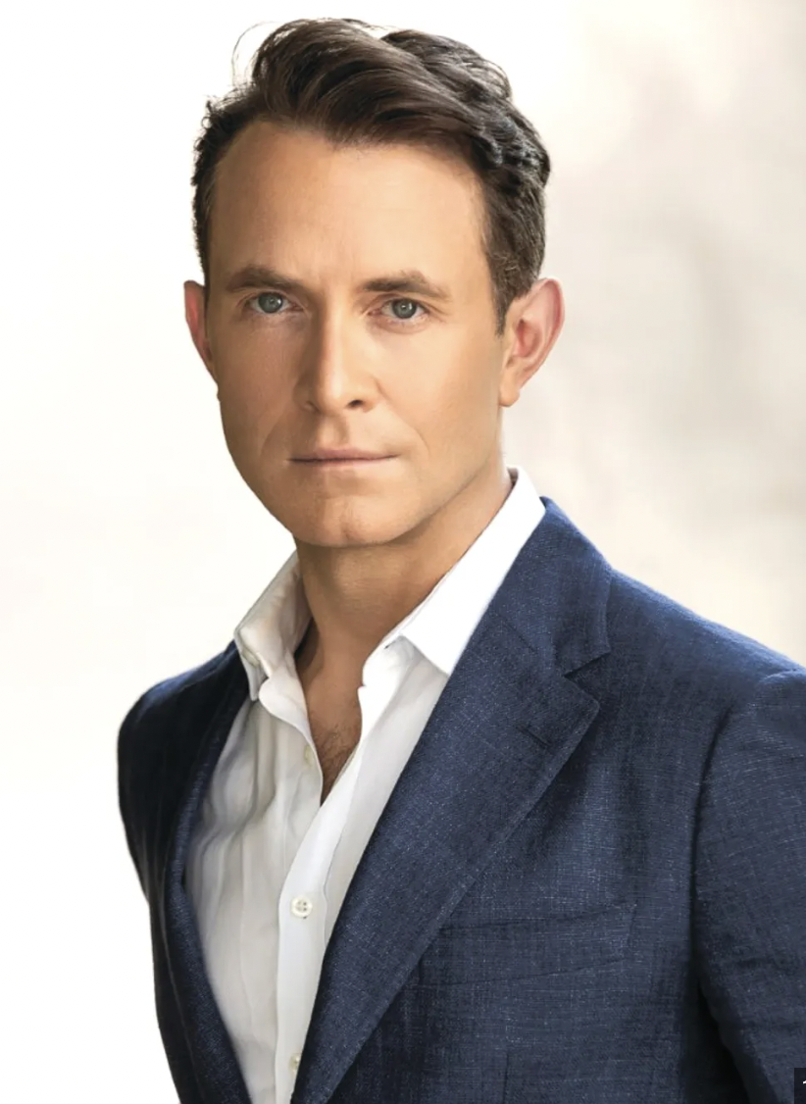
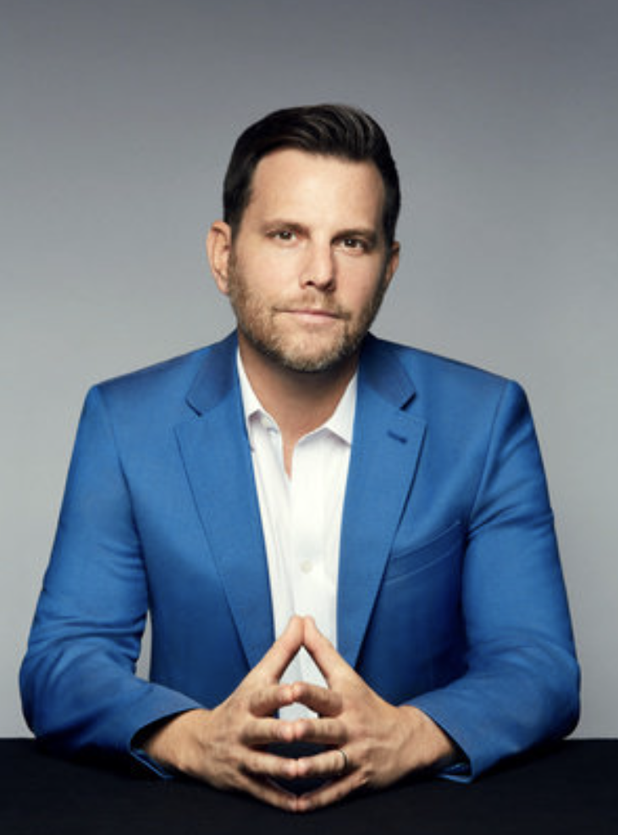
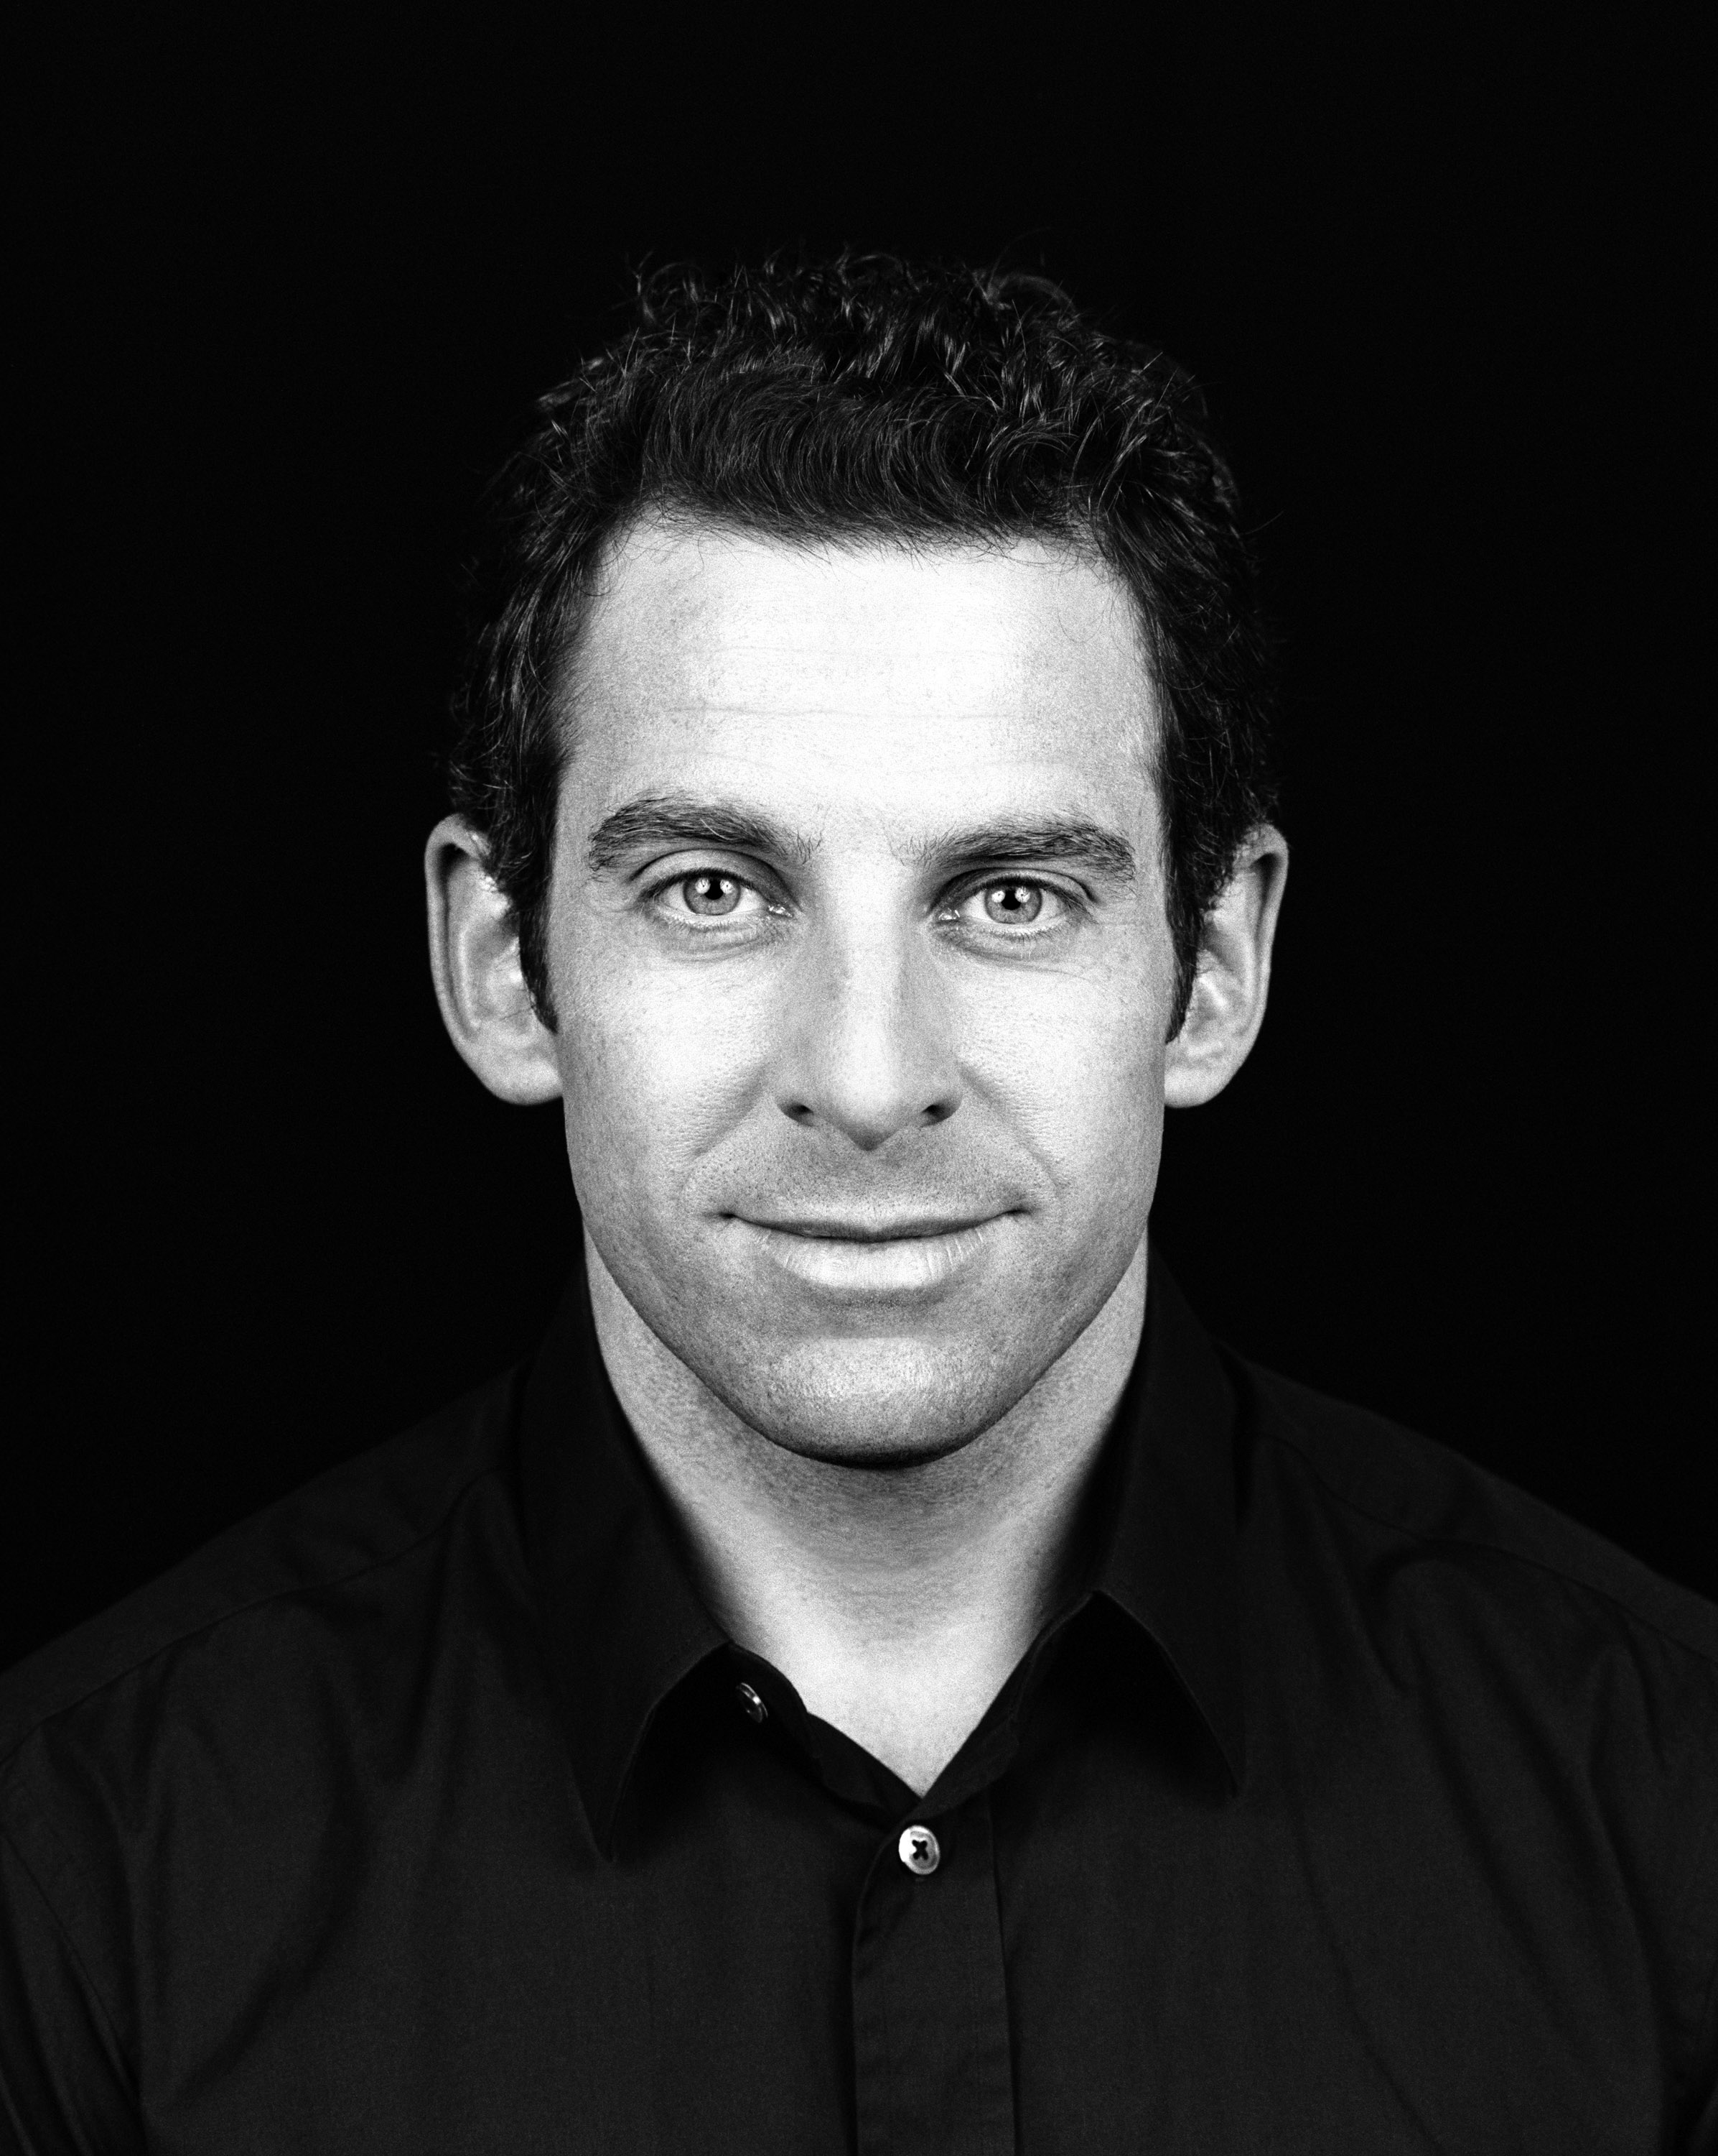
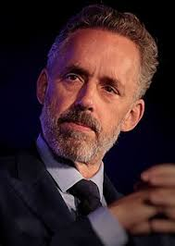

Slide 7
OPEN LETTER TO HARPERS’ BAZAAR JULY 7 2020
‘resistance must not be allowed to harden into its own brand of dogma or coercion’
(signed by Noam Chomsky, J.K. Rowling, Cornel West, Margaret Atwood)

Slide 8


trans activists vs. "tRANS EXCLUSIONARY r ADICAL fEMINISTs”

Slide 9
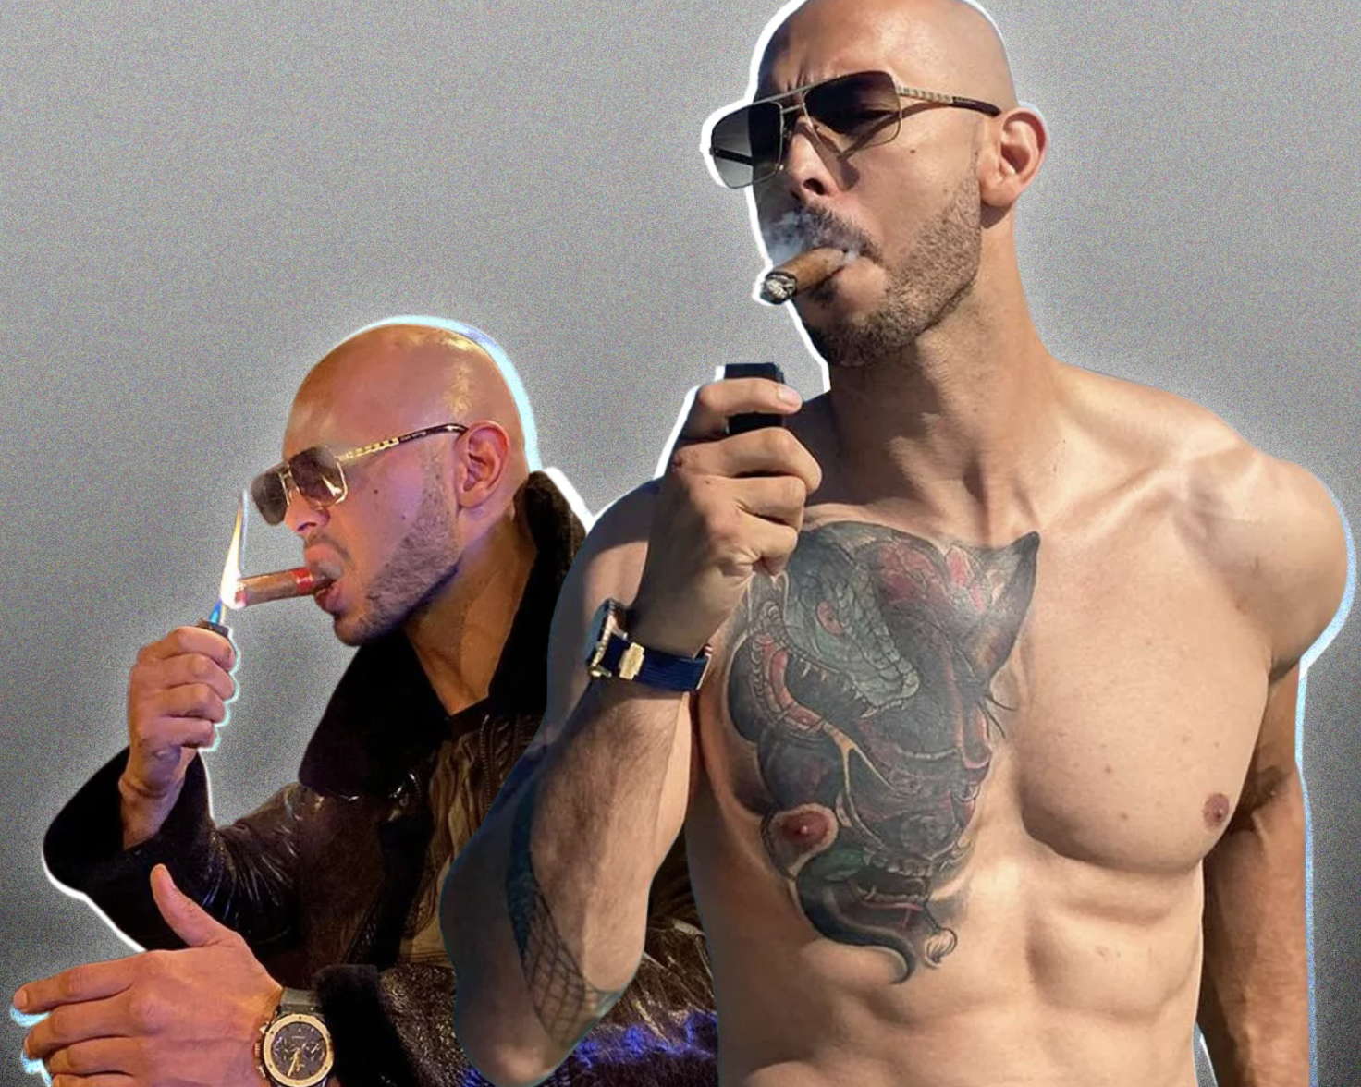
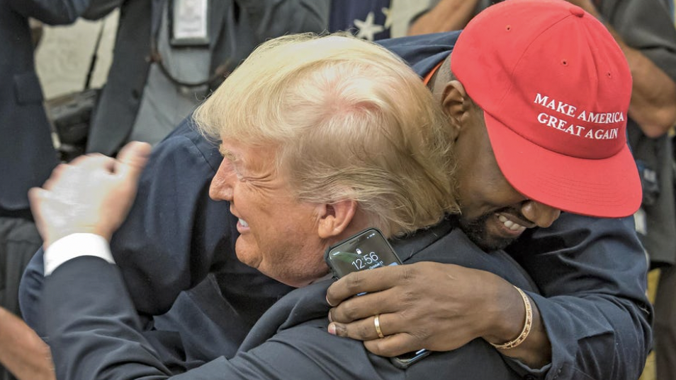
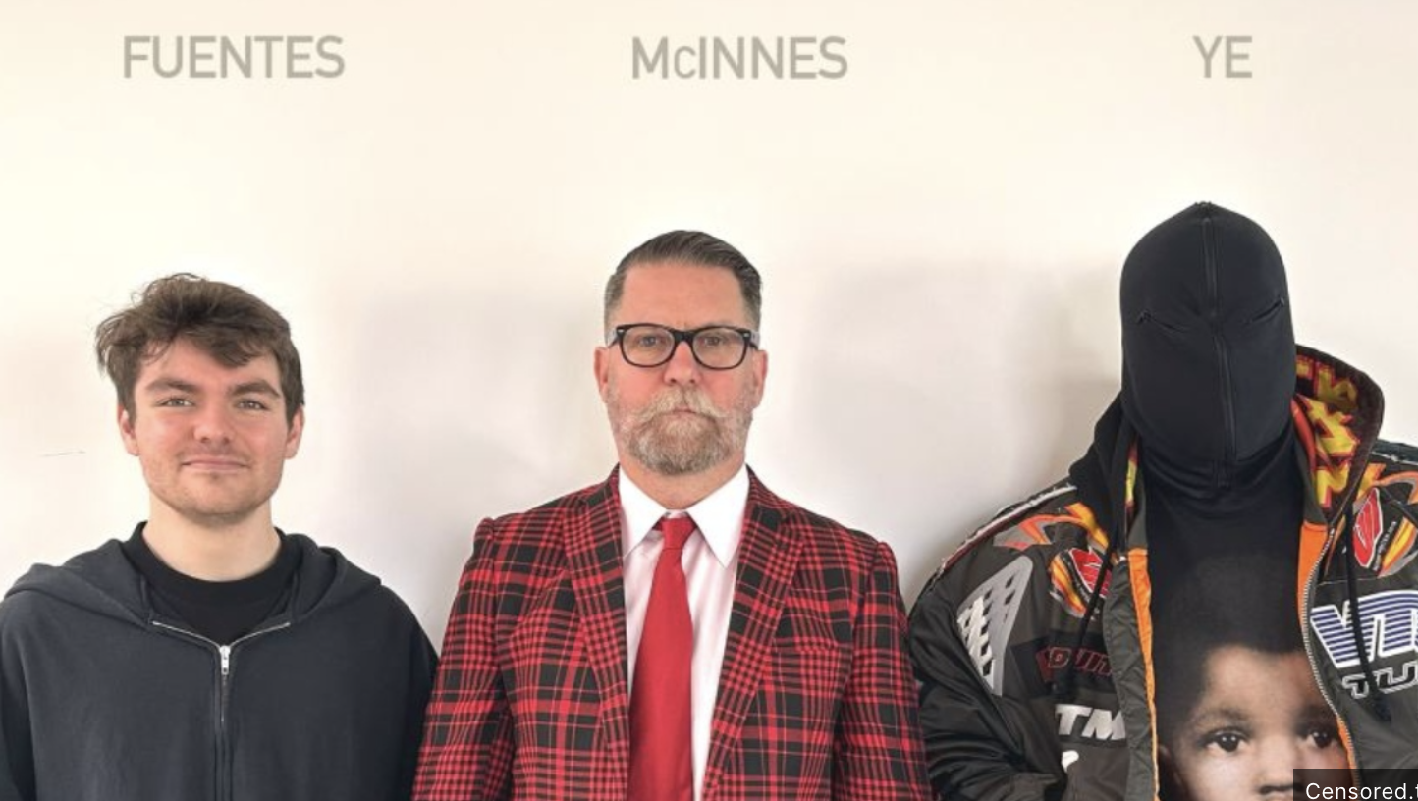

Slide 10
My questions
– How have we got here? How have we ended up in a place where rancour around race, gender and sexuality permeates everything?
– How have we gone from Trump’s populist nationalist revolt against ‘wokeness’ to ugly battles between feminists and Trans activists?
– To a black, liberal rapper joining forces with a racist crypto-fascist?

Slide 11
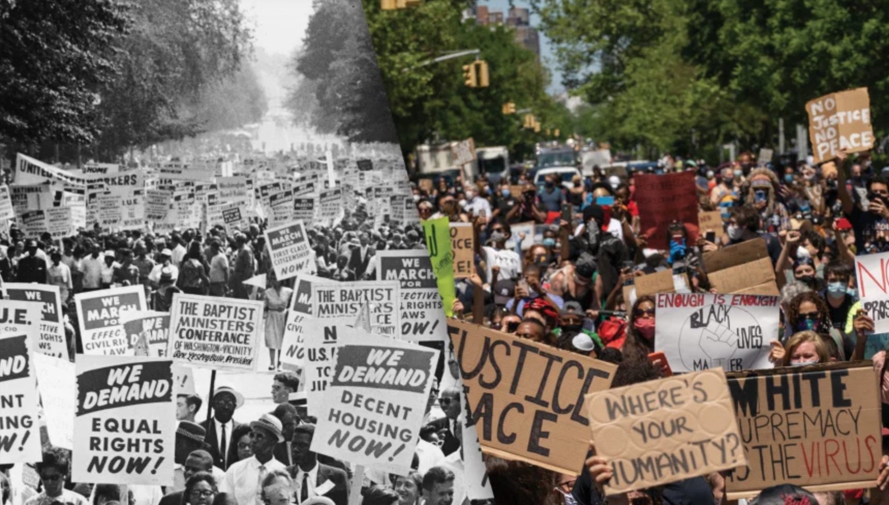
Civil rights → black power → black lives matter

Slide 12
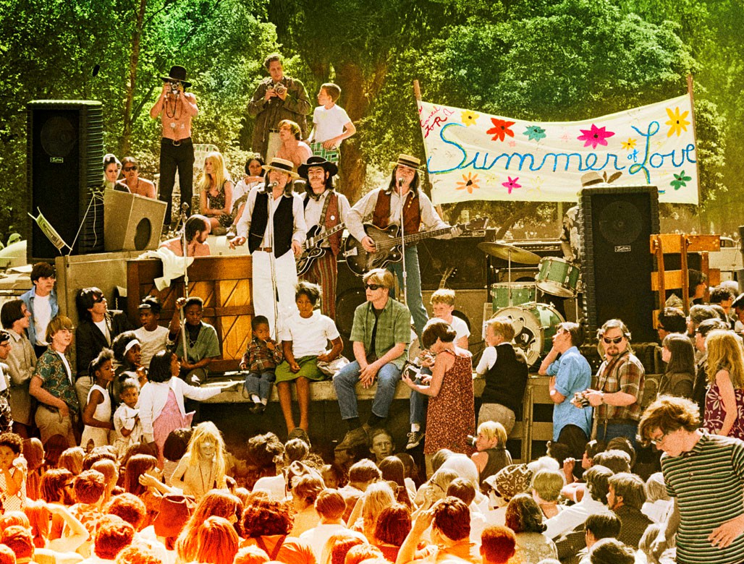

Slide 13
3 STAGES OF REVOLUTION
1950s Bohemian Personalism
– liberating self through the artistic expression of the ‘unspeakable’
2. 1960s Counterculture & Civil Rights
– liberating self through spiritual existence
– liberating self by refusing segregation
3. 1970s Women’s Liberation
– shift in countercultural logic, from emancipatory alone, to emancipatory and openly proscriptive.
– freedom of self based on fixed political tenets, and involving analysis and condemnation of other views

Slide 14
structure
SPIRITUAL ELITISM
WORDS AS VIOLENCE
EXPANDING BIGOTRY
COMPASSIONATE DOUBLE STANDARD

Slide 15
1. SPIRITUAL ELITISM (THE COUNTERCULTURE)

Slide 16
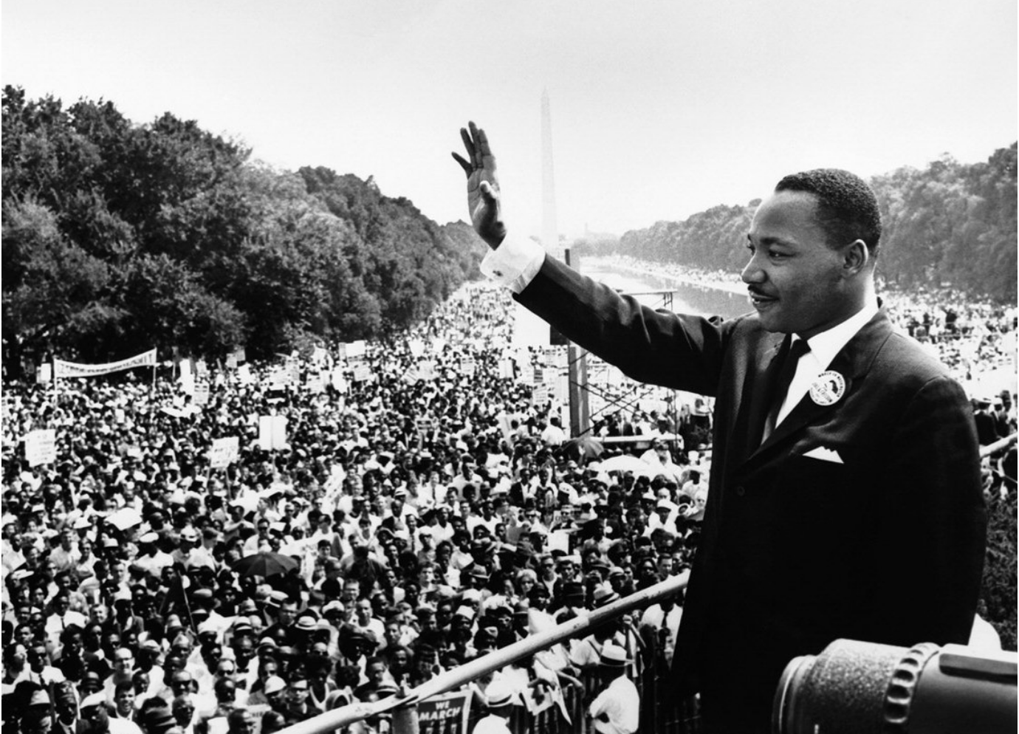
RACE

Slide 17
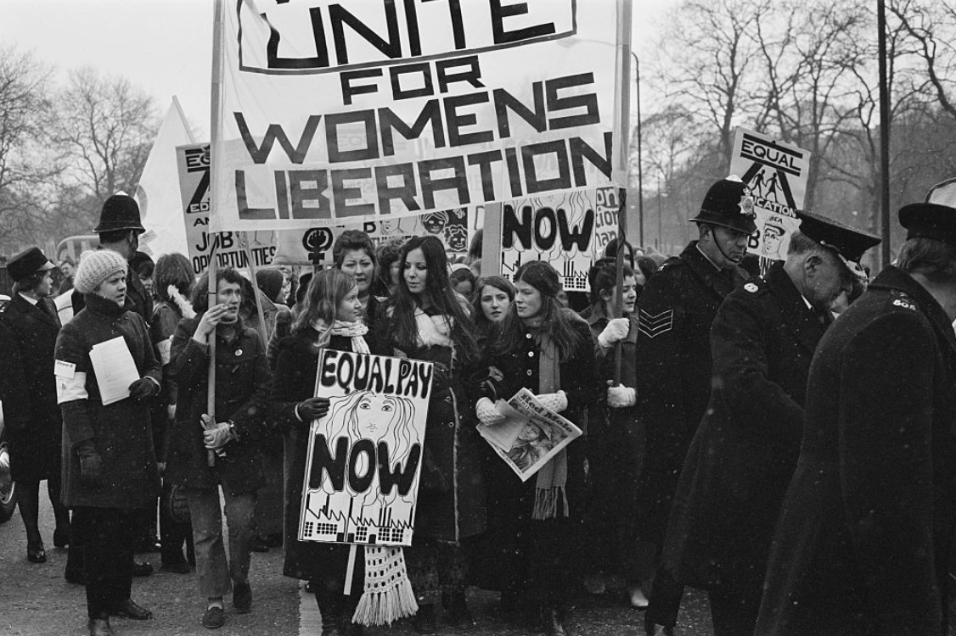
GENDER

Slide 18
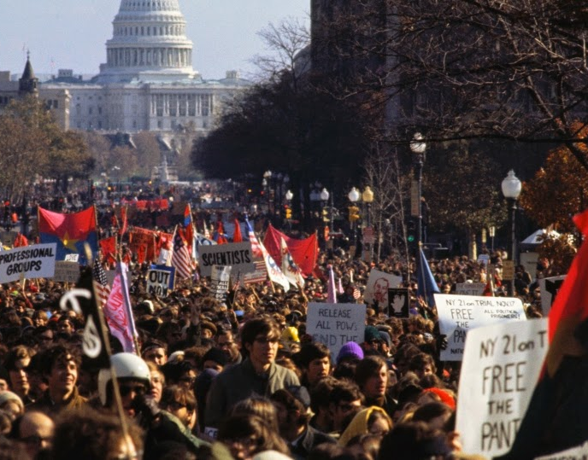
WAR + IMPERIALISM

Slide 19
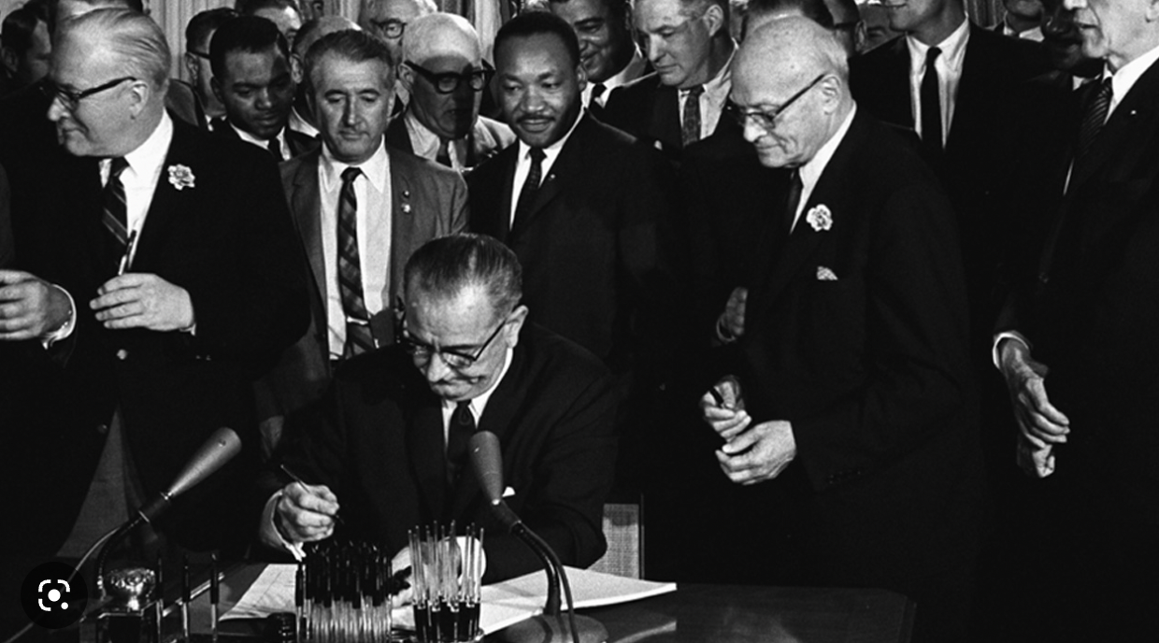
LYNDON B JOHNSON SIGNING THE CIVIL RIGHTS ACT 1964 (ending segregation) ; FOLLOWED BY THE VOTING RIGHTS ACT 1965 (ending race-related impediments to voting)

Slide 20
But they also saw the birth of a new kind of elitism.
To do with who was authentic and who wasn’t.
Who was awake to their true selves, and able to break free of the system that oppressed them, and who remained asleep.
Existentialist inspired – trend for Soren Kierkegaard.
Jung-inspired – trend for psychoanalysis.
Nietzsche inspired.

Slide 21
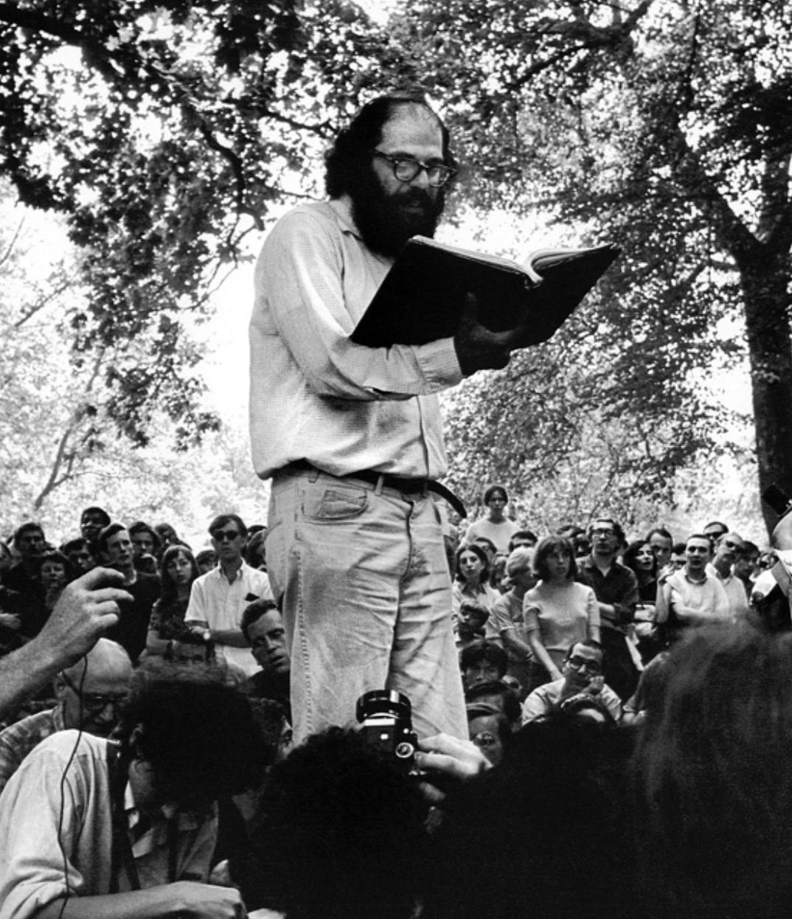
IN LITERATURE
– The influential, Romantic vision of ‘The Beat Generation’.
– Allen Ginsberg (left), Jack Kerouac.
– Yearning for a purer America, free from industrialization, from puritanical, bourgeois values.
– A vision that divided the country into: the saintly few, beaten down and beatific enough to see clearly and the square, 9 to 5 majority, spiritually impoverished by conformity. .

Slide 22
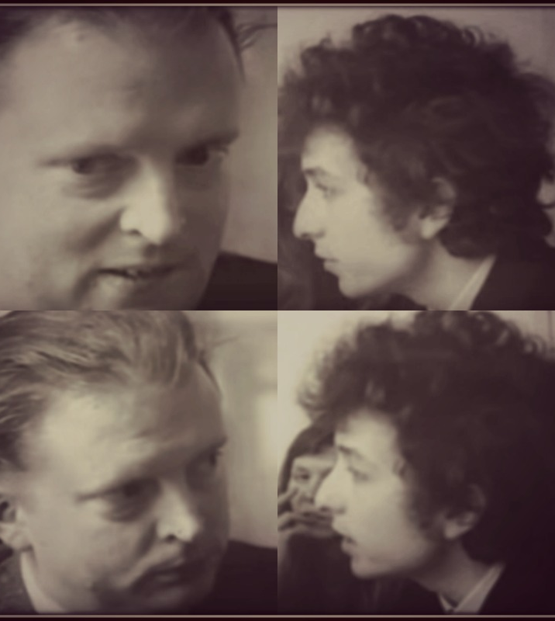
IN MUSIC
– Politically conscious (Beat influenced) folk music of Bob Dylan.
– Celebrated as political voice of his generation aged only 19.
– Set a precedent for leftist politics as a game old ‘squares’ couldn’t understand.
‘‘I know more about you just by looking than you ever know about me … I could tell you, but you wouldn’t really understand” (Dylan to Time Magazine, left)

Slide 23
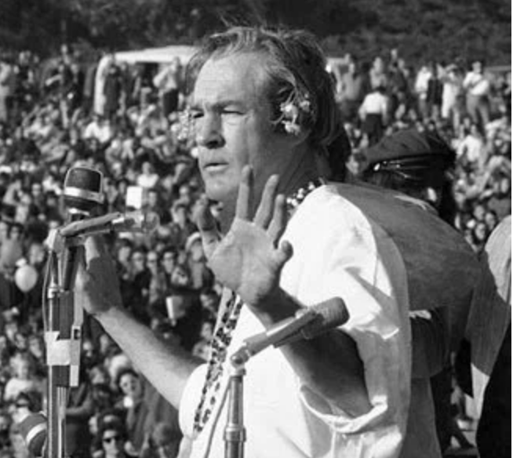
IN LIFESTYLE
– Timothy Leary (High Priest of LSD): ‘Turn on, tune in, drop out’.
– Struck-off Harvard scientist on a religious mission to wake the next generation up through acid.
– Big influence on the mass migration of young bohemians out of conventional society, onto communes (100,000).
The LSD awoken few vs. the sleeping masses, trapped in the nightmare of ‘old men’s politicking’.

Slide 24
States of mind inherited from:
1. Small politically engaged bohemian art movements of the early 20th century (DADAISTS, FUTURISTS, VORTICISTS)
2. Radical Politics (MARXIST ATTEMPT TO RAISE THE CONSCIOUSNESS OF THE MASSES)

Slide 25
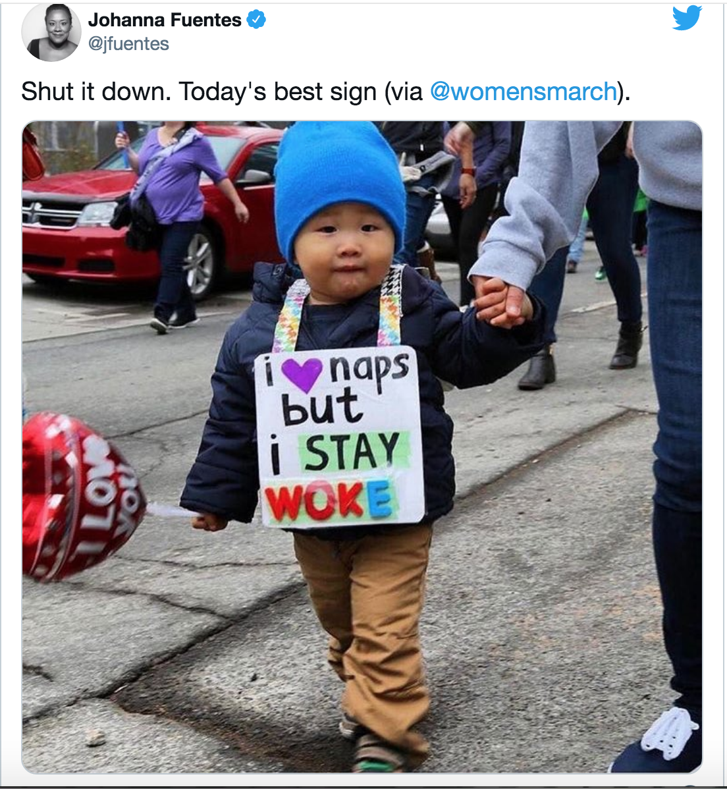

Slide 26
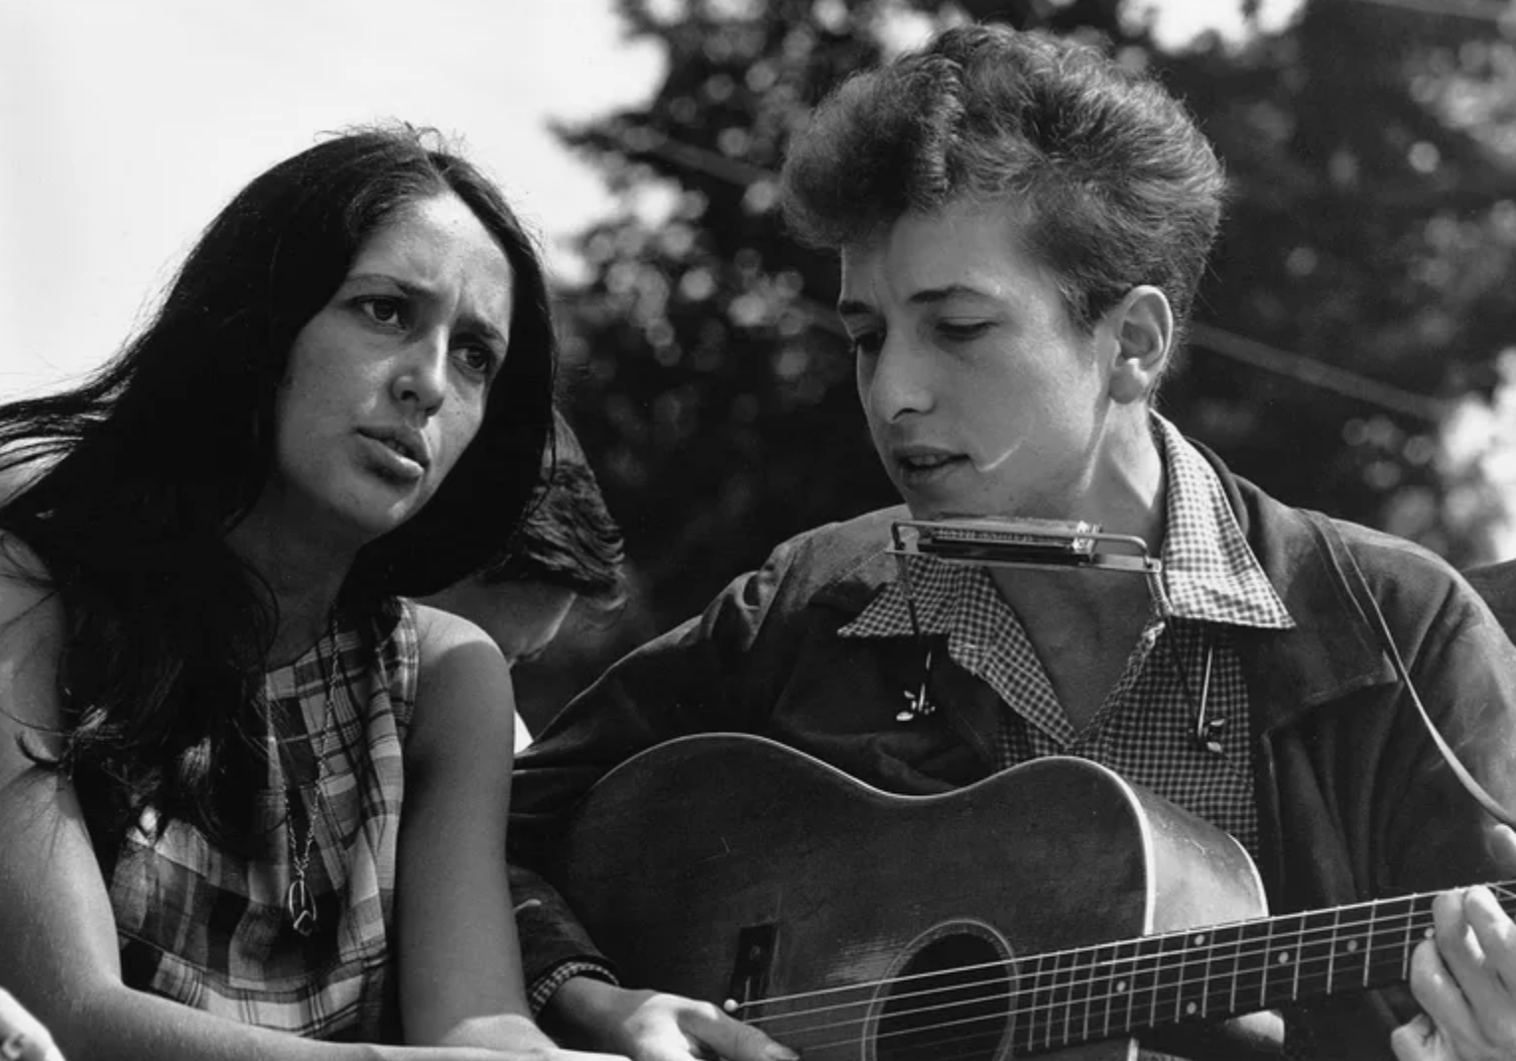

Slide 27
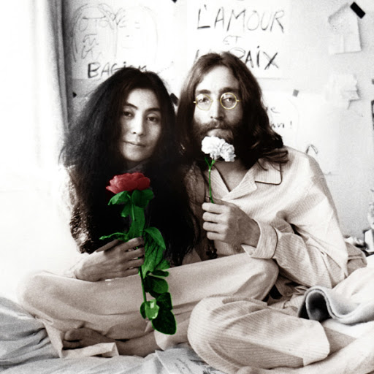

Slide 28
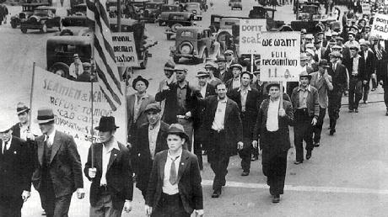
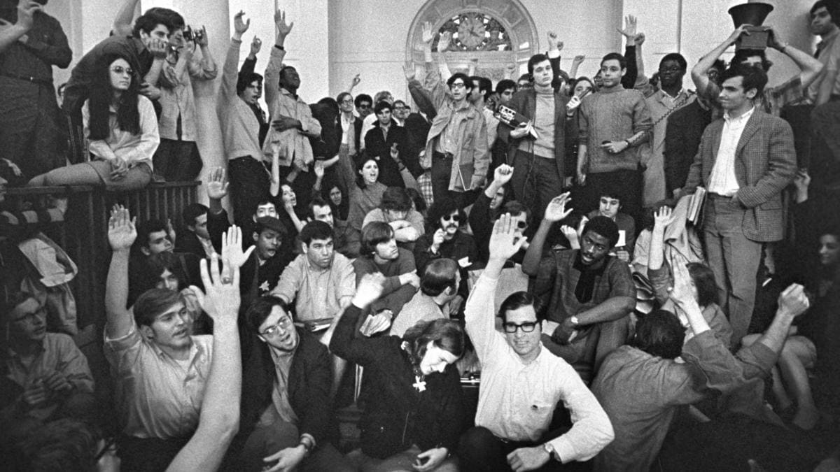
For the 1st time, Left wing struggle was presented less in terms of class and more in terms of youth.
Less working men’s union.
More student union.
Encapsulated by the Marxist sociologist C. Wright Mills counselling a shift in focus from ‘Victorian Marxism’ to ‘the cultural apparatus’.

Slide 29
The emphasis on youth brought change and captured the media’s attention.
But it alienated exactly the demographic leftist politics had evolved to protect.
Working class men and women who were put off progressive political ideas in the 1960s by their association with Woodstock, the Summer of Love, and rebellious Rock Music.
With Free Love and Communal living rather than Material Class Conditions.

Slide 30
It also gave impetus to Conservatism
To Nixon in 1970s, to Reagan in 1980s
And to Trump in 2016
Trump’s populist right movement.
“Look at the liberals! They claim to care about ordinary working people, but all they really care about is keeping up with fashion and looking virtuous”.

Slide 31

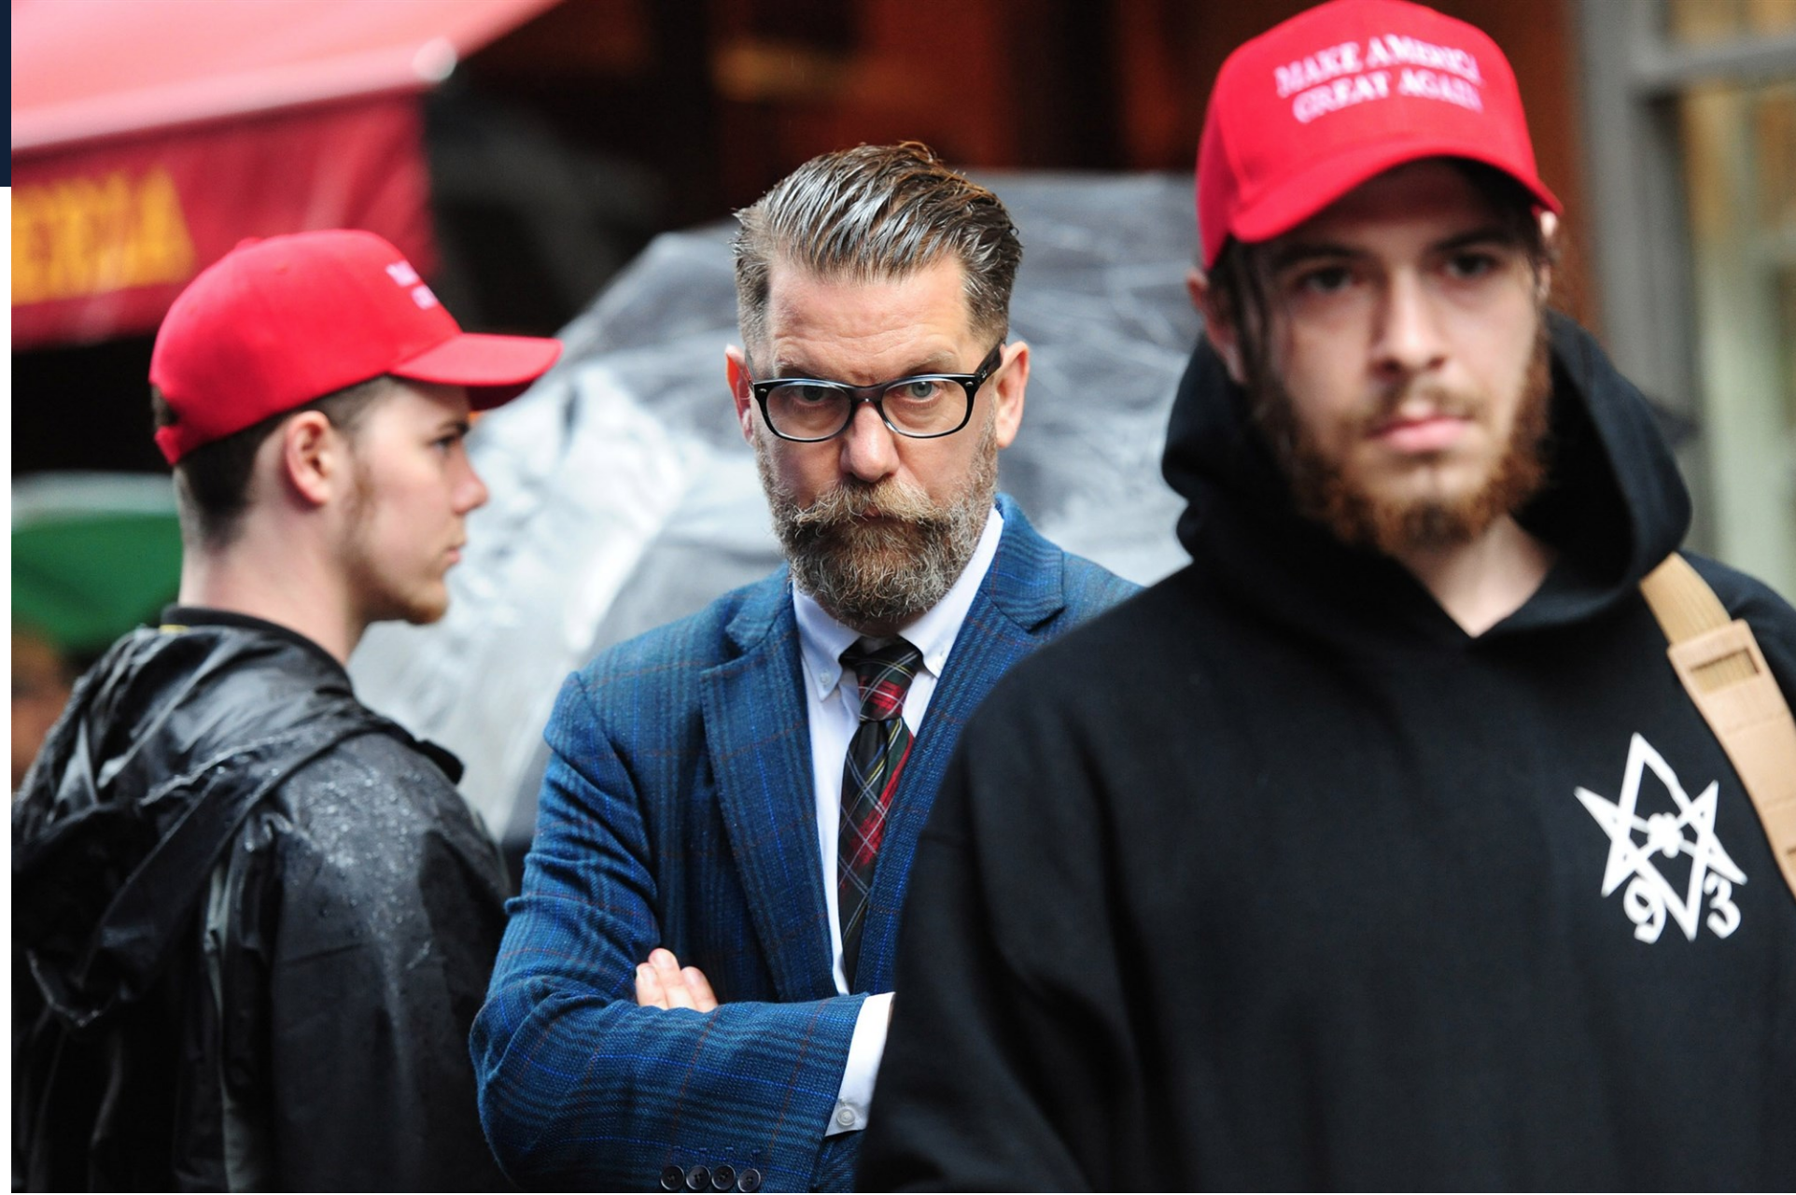
– Alt Right Red Pilling, Socratic Method, Kanye West
– All part of the right’s rebranding as transgressive, rebellious, provocative not safe
ALL SIDES TRAPPED IN A MANIA TO PROVE THAT THEY’RE ENLIGHTENED + THE REST ARE DUPED

Slide 32
2. WORDS AS VIOLENCE (FEMINISM)

Slide 33
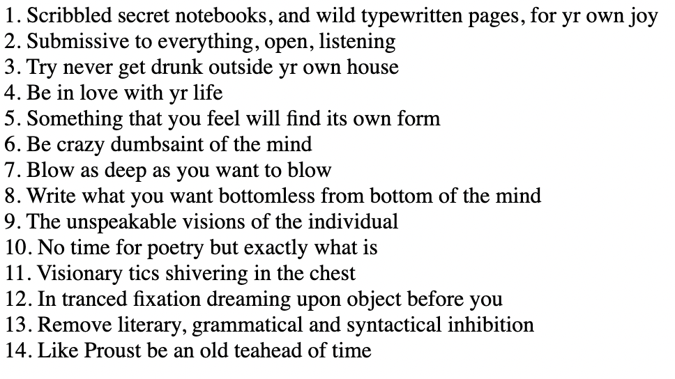
Jack Kerouac, ‘Belief and Technique for Modern Prose’, http://www.english.upenn.edu/~afilreis/88/kerouac-technique.html

Slide 34
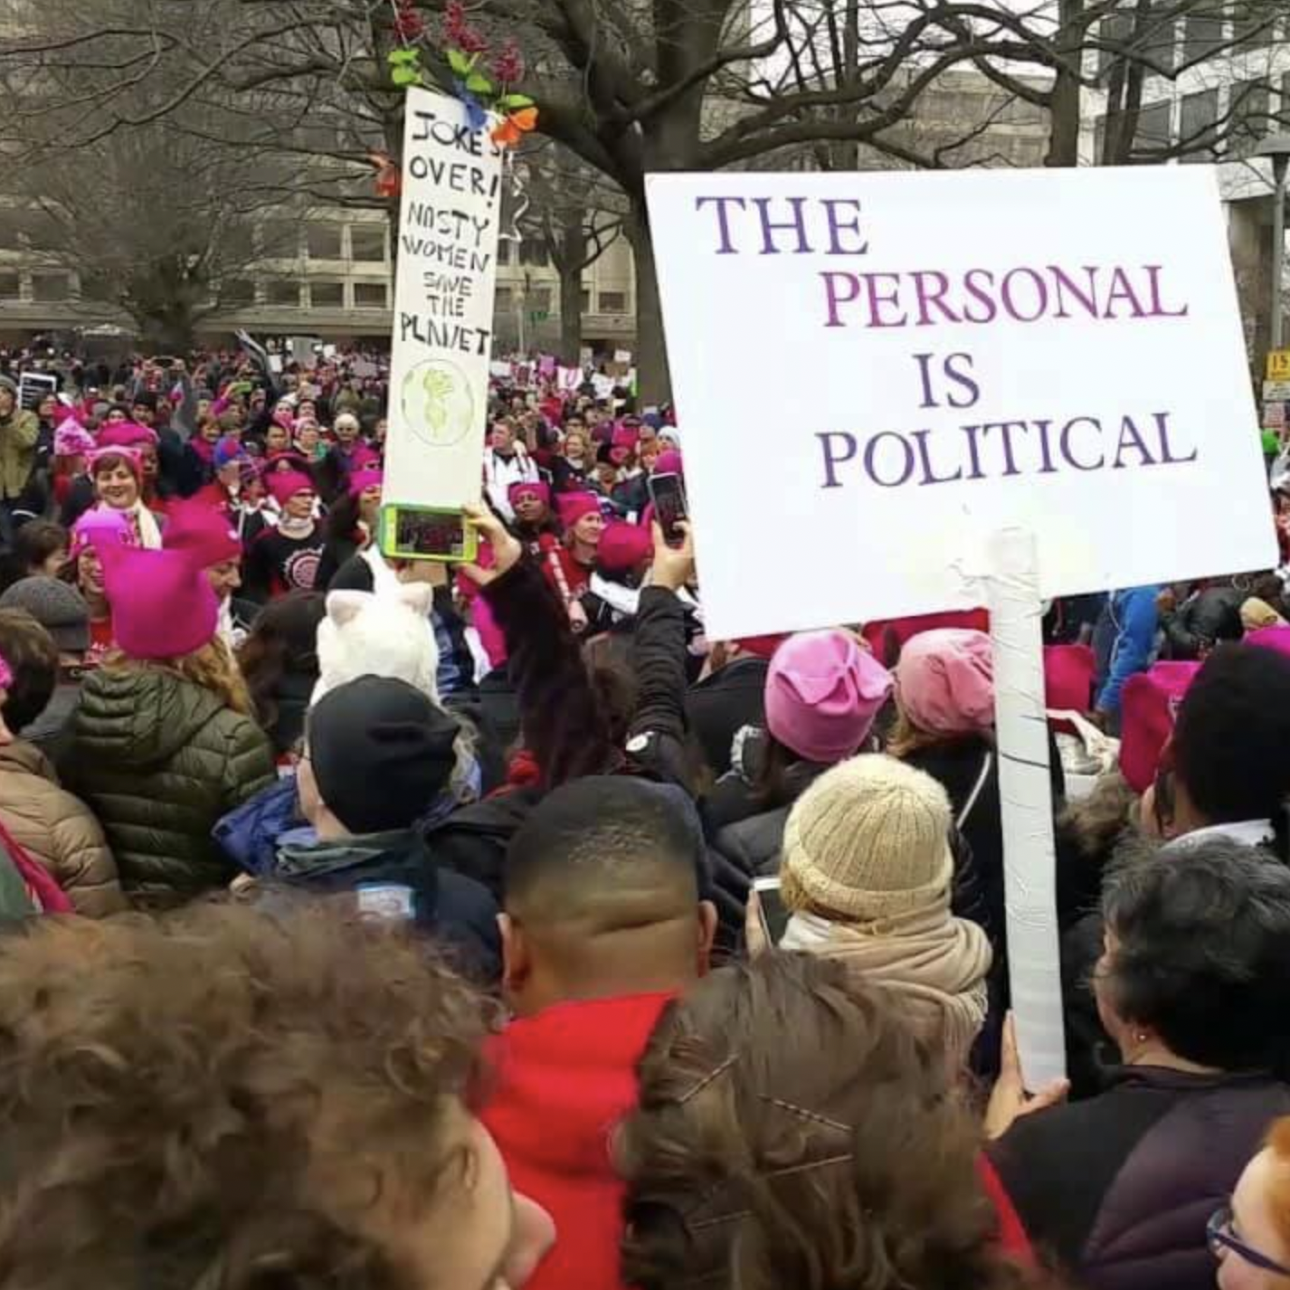

Slide 35
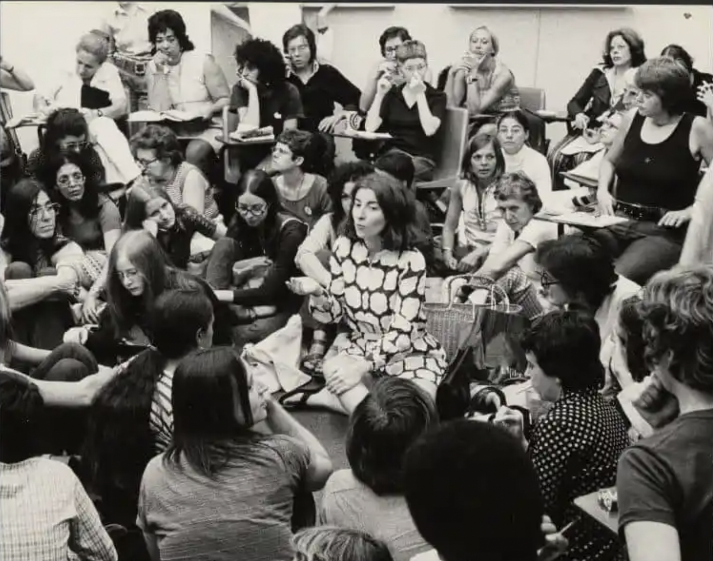
CONSCIOUSNESS RAISING

Slide 36
– Women gathered to share their experience of everything from ‘sexual harassment in the workplace [to] body image, menstruation and pregnancy’, as the sociologist Nancy Whittier wrote, and to purge themselves of a ‘toxicity’ ingested from the patriarchy.
– The goal, in the words of the journalist and early participant Susan Brownmiller, was to use individual pain to ‘uncover … collective truths’
– Baptist religious imagery + Marxist idea = New Politics of language

Slide 37
CONSCIOUSNESS RAISING

Slide 38
COUNTERCULTURAL SHIFT
– In their philosophy of speaking a personal truth and raising consciousness, they unwittingly effected a shift in countercultural thought.
– One that made freedom depend not only on the expression of your own honest and messy self, but on prohibiting that mess in others.
– The moment when the counterculture starts owning but also policing its hypocrisies about gender.

Slide 39
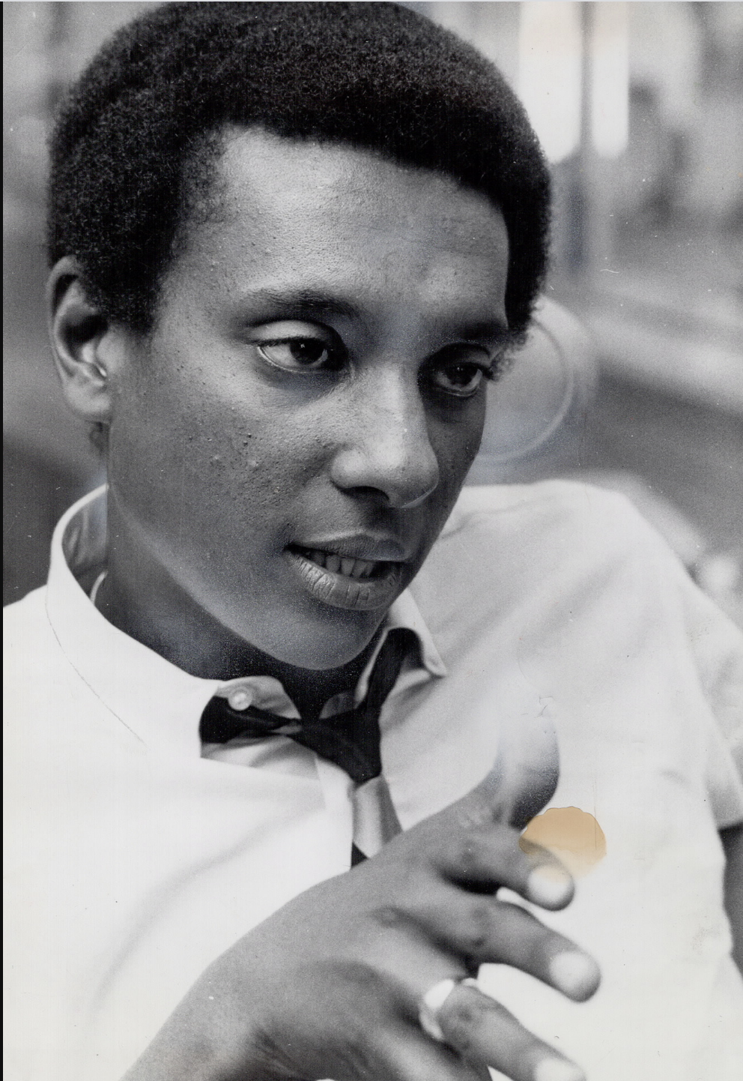

Slide 40
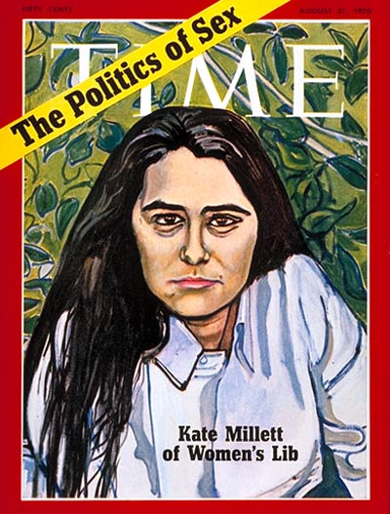

Slide 41
3. EXPANDING BIGOTRY (CIVIL RIGHTS/BLACK POWER)

Slide 42
CIVIL RIGHTS → BLACK POWER → BLACK LIVES MATTER
Baptist → Marxist/Existentialist → Social-Media Marxist

Slide 43
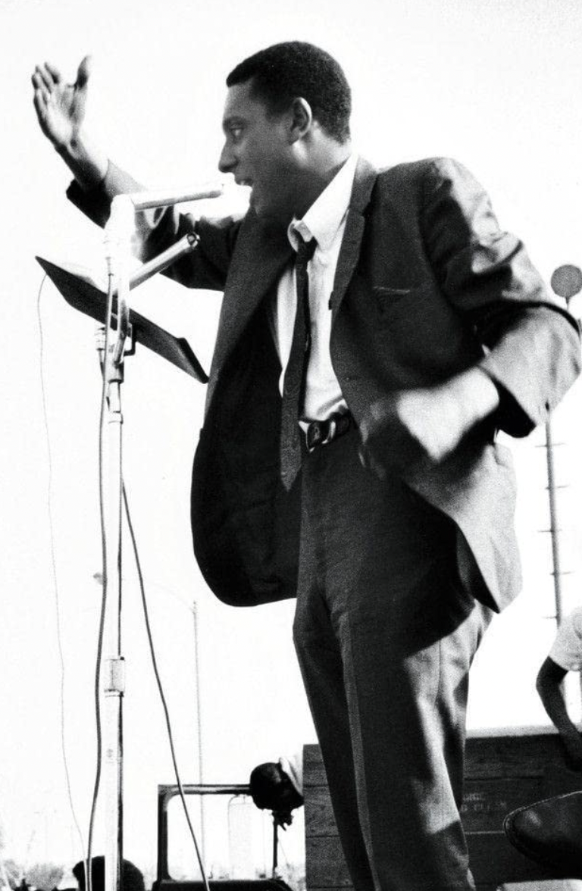
Civil rights → black power

Slide 44
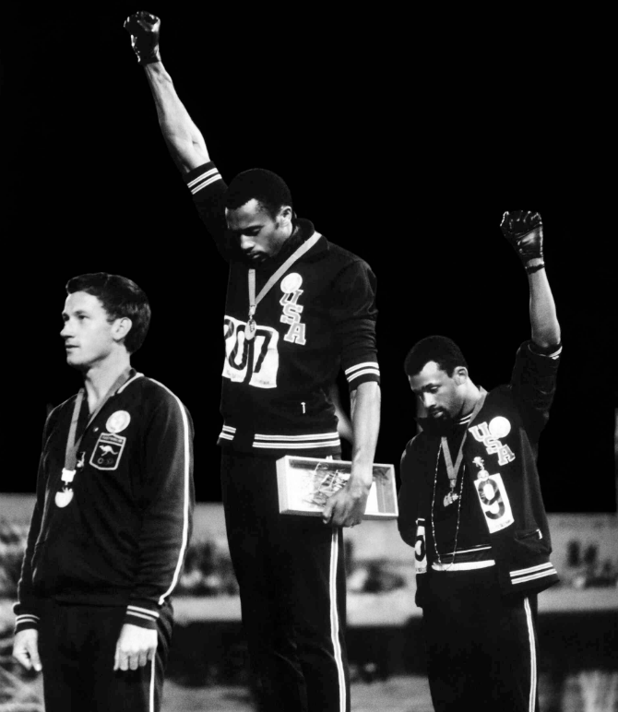
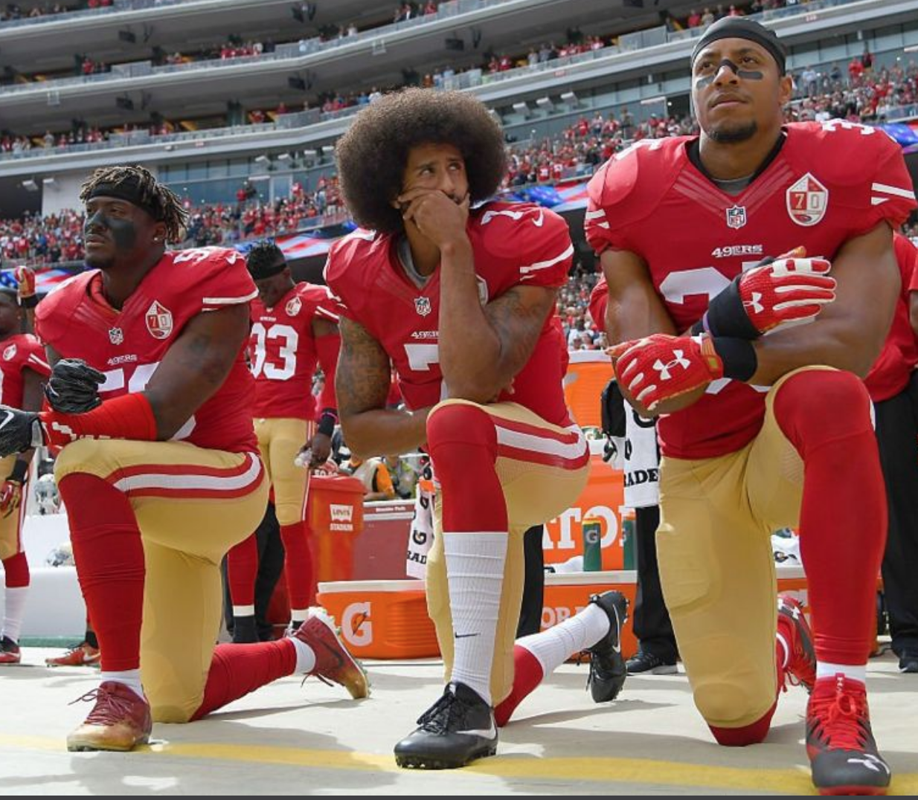
Black power → #blm
BLACK LIVES MATTER. HASHTAG + A COLLECTION OF “CHAPTERS”
Going viral, capturing the imagination of many, that symbolism looks good but lacks a concrete story.
Disconnected from tangible demands (whether radical or practical).
Demands that can be wrestled with, understood, responded to.

Slide 46
RACISM REDEFINED
Shift in both the meaning of racism and methods for detecting it.
From racism defined as the individual belief in the superiority of one race over another, to a belief perpetuated by a whole system.
From violence manifested through action, to violence manifested through:
- discriminatory words and images.
- subtler unconscious harm through insensitive language, underrepresentation in film, TV, adverts, books and newspapers.

Slide 47
4. COMPASSIONATE DOUBLE STANDARD

Slide 48



Slide 49
NEW RULES
– Minority art is permitted its mess, its self-contradiction, its right to be received as experimental expression only.
– Whereas art made by people from majority groups is taken to signify the maker’s historical privilege, checked for its damaging politics, and required to tread carefully.
Black hip-hop is celebrated for its raw artistic honesty even if it breaks moral codes that would lead white artists to be cancelled.
Women are allowed to tell jokes against men that would get men into serous trouble if the roles were reversed.
Trans performers – who exaggerate some of the most toxic stereotypes about women for entertainment – are given a free pass on the basis of their marginality.

Slide 50
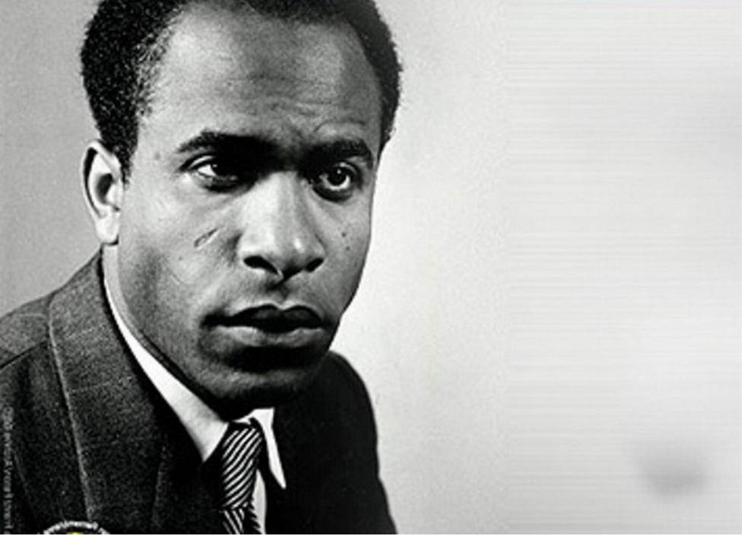
Frantz fanon
MARXIST WEST INDIAN PSYCHIATRIST, POST-COLONIAL PIONEER.
DIAGNOSED PATHOLOGY IN COLONIAL RELATIONS (WHITE GUILT)
USED EXISTENTIALIST PHILOSOPHERS TO UNPICK WHITE IDEAS OF BLACK “PRIMITIVISM’’
BIG INFLUENCE ON “BLACK POWER”

Slide 51
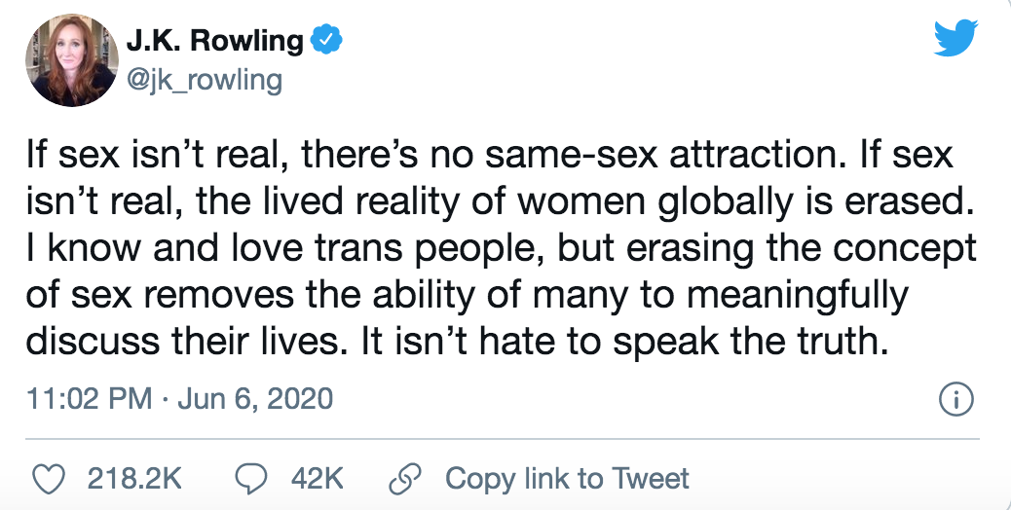
TRANS VS. FEMINISTS
‘Gender is culturally formed but it’s also a domain of agency or freedom. It’s most important to resist the violence that is imposed by ideal gender norms, especially against those who are gender different, who are non-conforming in their gender presentation’
Judith Butler
‘

Slide 52
To recap …
1. SPIRITUAL ELITISM
“Us and Them” inherited from 60s.
Enlightened/Benighted; Woke/Napping.
2. WORDS AS VIOLENCE
Inherited from 2nd Wave Feminism.
The moment the Counterculture started policing itself.
3. EXPANDING BIGOTRY
- Racism redefined, expanded to include discriminatory words, unconscious harm, representation.
4. COMPASSIONATE DOUBLE STANDARD
- Minority art is permitted its mess, its self-contradiction, its right to be received as experimental expression only.

Slide 53
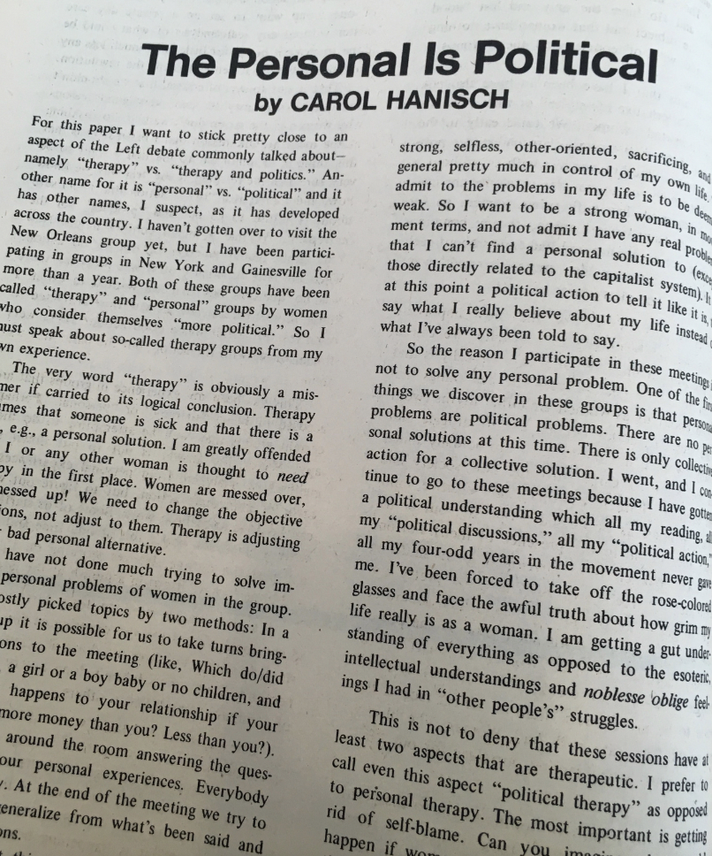

Slide 54
The Women’s Liberation Movement emerged in the early 1960s in line with the 60s Sexual Revolution
But it developed in the late 60s into an attack on its icons
A purging of misogyny in the Hippie bid for freedom.

Slide 55



Slide 56
A demonstration that FOR WOMEN PROMISCUITY WASN’T NECESSARILY THE LIBERATION FROM PATRIARCHAL HIERARCHIES IT SEEMED.
Old hierarchies, different forms.
Corrupted by male violence + ‘sexual neuroses’ (Millett), newly acceptable sex out of wedlock led again to women being resented, mistreated, cast aside.

Slide 57
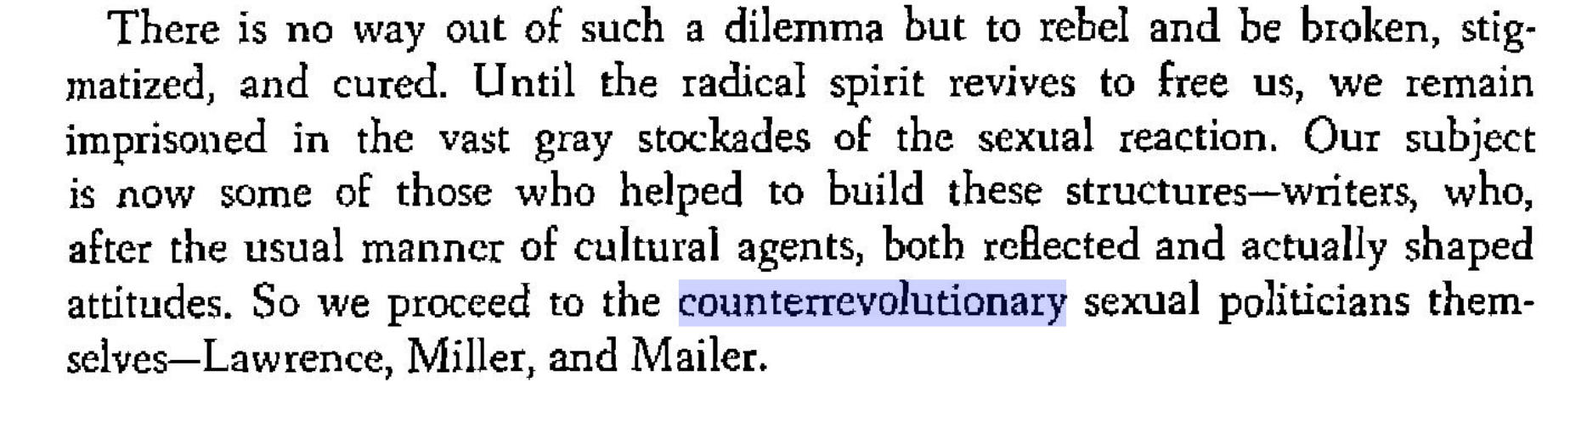

Slide 58
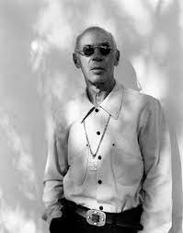
In Millett’s new countercultural thinking, writers who had been celebrated as heroes of the Sexual Revolution were black-listed for their sexism, for being part of the problem.
Writers like Henry Miller, D.H. Lawrence and Norman Mailer, whose no-holds-barred approach to sex
Millett’s Sexual Politics (1969) represents the moment the Counterculture started to police itself
THE MOMENT FREEDOM OF IDENTITY + EXPRESSION BECAME DEPENDENT ON RESTRICTIONS ON LANGUAGE

Slide 59
WHAT TO MAKE OF THIS?
OVERDUE PROGRESS
THE BEGINNING OF A NEW SIGNIFICANCE AFFORDED TO WORDS
A PRECEDENT FOR OUR “CANCEL CULTURE” TODAY?

Slide 60
Judith butler + queer theory
The intellectual ground for Trans Rights lay in a New Radicalism: Queer Theory.
1980s + 90s.
Queer Theorists like Judith Butler challenged 2nd Wave Feminism.
Rejected feminist definitions of womanhood as biological (female reproductive organs) and even as sociological (experience of male oppression).
**Gender as Socially and Culturally Constructed. Indeterminate, Fluid **

Slide 61
Kate Millett’s embargo on Art that had recently stood for freedom suggests a new emphasis on enforcing orthodoxy in American “countercultural” thought.
A move in 1969 from a spiritual-sexual revolution based on total freedom of expression, to one that monitored expression for offence to the vulnerable.
That compassionate mission has been expanding ever since.
But so too has the friction it created between a 60s permission to “speak your truth”, and new rules about which truths were say-able.
LITERATURE: REJECTION OF MESS IN FAVOUR OF MESSAGE (Joseph Conrad, Henry Miller, Flannery O’Connor)
IN SOCIAL DISCOURSE: MORE POWER TO RACIST WORDS?

Slide 62
3. A double standard (Genet vs. miller)

Slide 63
MILLET T ON HENRY (STRAIGHT) MILLER: ‘A compendium of American sexual neuroses [whose] value lies not in freeing us from such afflictions, but in having had the honesty to express and dramatize them’
MILLET ON (GAY) JEAN GENET: ‘Granted that their caricature is grotesque, and Genet himself is fully aware of the morbidity of of his pastiche, his homosexuals … have … penetrated to the essence of what heterosexual society imagines to be the character of “masculine” and “feminine”’

Slide 64
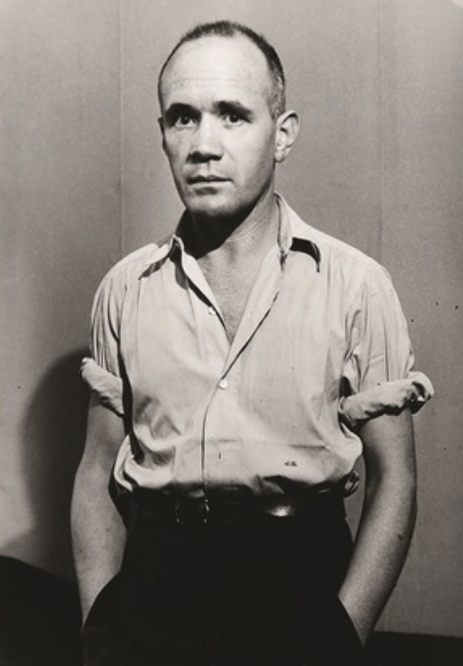
Genet was a similar writer to Henry Miller.
Literature about living hand to mouth on the streets; about graphic sexual encounters, about lust, violence, + bodily fluids.
SAME AIM OF SAYING THE UNSAYABLE ABOUT THE BRUTALITY IN SEX
But Genet survived the cull by 2nd Wave Feminists, whereas Miller did not.
HE WAS ALLOWED TO EXPRESS MISOGYNY BECAUSE WRITING FROM A POSITION OF OPPRESSION

Slide 65
WITH 2ND WAVE FEMINISM A WELL INTENTIONED, AND WELL REASONED DOUBLE STANDARD ENTERED WESTERN THINKING ON IDENTITY.
OPPRESSED MINORITIES WERE PERMITTED THE MESS FORBIDDEN TO THE MAJORITY.
THIS IS AT THE HEART OF ANTI-‘WOKE’ THINKING TODAY:
Black hip-hop is celebrated for its raw artistic honesty even if it breaks moral codes that would lead white artists to be cancelled.
Women are allowed to tell jokes against men that would get men into serous trouble if the roles were reversed.
Trans performers – who exaggerate some of the most toxic stereotypes about women for entertainment – are given a free pass on the basis of their marginality.

