Slide 1
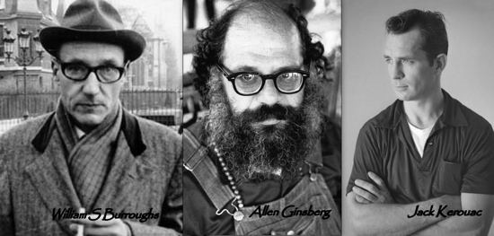
disdaining the tribe: anti-humanism In the counterculture
Dr. Guy Stevenson

Slide 2


Slide 3
A revolutionary backlash against the ‘technocracy … a society in which those who govern justify themselves by appeal to technical experts who, in turn, justify themselves by appeal to scientific forms of knowledge’
Theodore Roszak, The Making of a Counterculture: Reflections on the Technocratic Society and its Youthful Opposition (New York: Anchor Books, 1969), pp. 7-8.

Slide 4
Remembered NOSTALGICALLY as a 20th century revival of of the 1st American Renaissance in the 19th Century (Walt Whitman and Ralph Waldo Emerson) and as crusaders for freedom of expression and a culture of youth protest, + permissiveness.
DISMISSED as a superficial & teenage fad; a self-indulgent hedonistic pop scene.

Slide 5
ANTI-HUMANISM
REJECTION OF HUMAN PERFECTIBILITY
REJECTION OF THE ENLIGHTENMENT FAITH IN REASON
REJECTION OF HUMANITY AS EXCEPTIONAL
REJECTION OF REASON AS THE DRIVING FORCE BEHIND COLLECTIVE HUMAN PROGRESS

Slide 6
OUTLINE
1. WHO WERE THEY?
2. WHAT DID THEY STAND FOR?
3. WHAT CULTURAL INFLUENCE DID THEY HAVE?
4. ANTI-HUMANIST PHILOSOPHY/REACTIONARY POLITICS
5. WHAT MIGHT THIS TEACH US TODAY?

Slide 7
1. WHO WERE THEY?

Slide 8


Slide 9


Slide 10


Slide 11


Slide 12
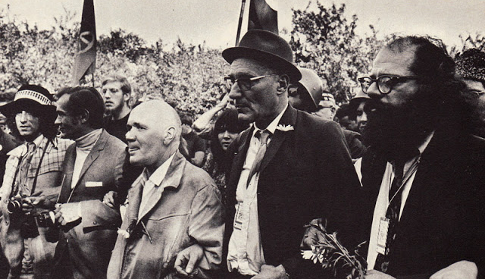

Slide 13
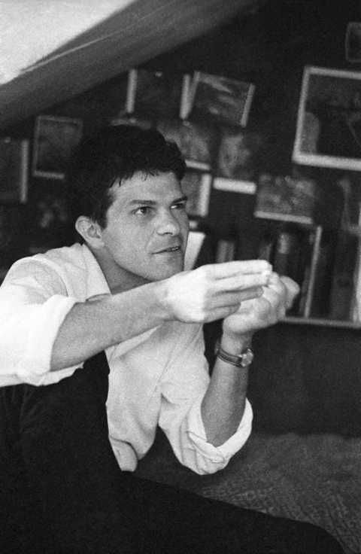

Slide 14


Slide 15


Slide 16


Slide 17


Slide 18
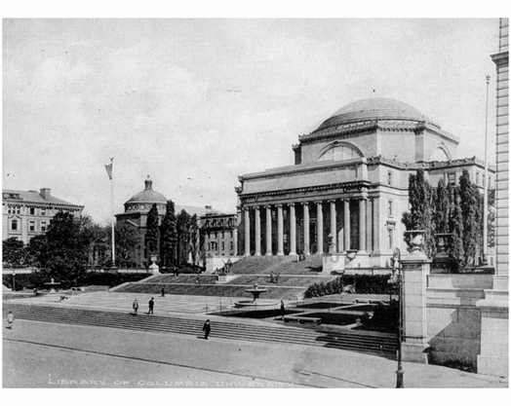

Slide 19
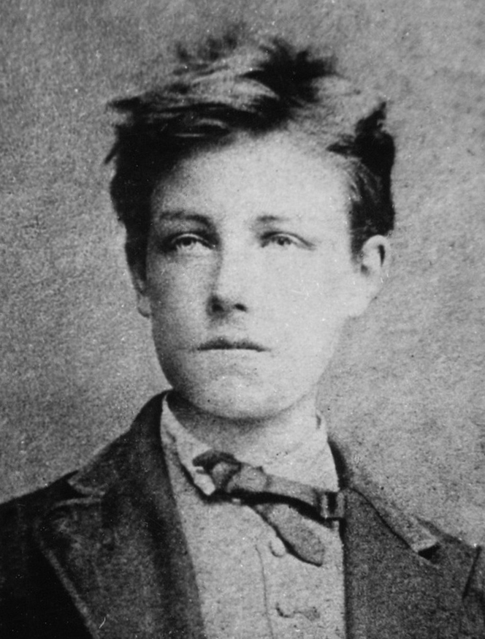
‘THE LONG, PRODIGIOUS, AND RATIONAL DISORDERING (DERANGEMENT) OF ALL THE SENSES’
ARTHUR RIMBAUD

Slide 20
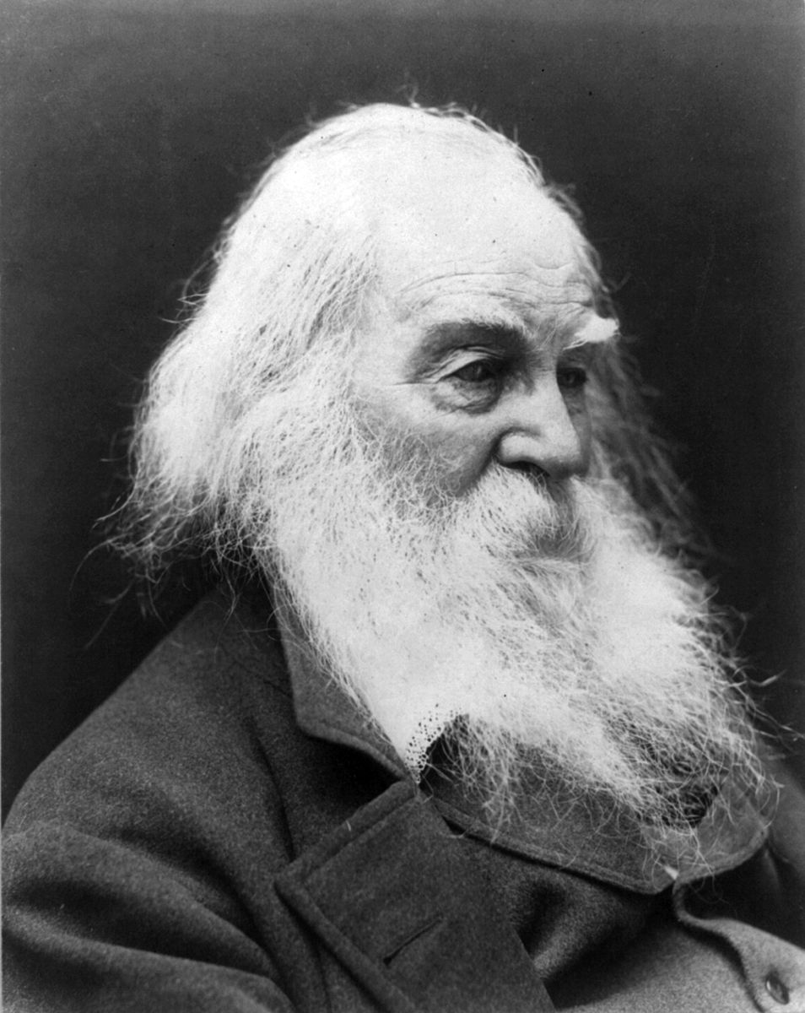
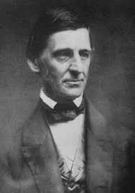
Walt Whitman
Ralph Waldo Emerson

Slide 21
‘The youthful thirst, the restless exuberance, the quality of search, that pulsed in them … bottled eagerness for talk, for joy, for excitement, for sensation, for new truths. Whatever the reason, everyone my age had a look of impatience and expectations in his eyes that bespoke ungiven love, unreleased ecstasy and the presence of buried worlds within.’
John Clellon Holmes, ‘This is the Beat Generation’ in The New York Times Magazine, Nov 16th 1954

Slide 22
2. WHAT DID THEY STAND FOR?

Slide 23
‘my own complete life, an endless contemplation, is so interesting, I love it so, it is vast, goes everywhere’
Jack Kerouac, Visions of Cody (New York: Pengiun, 1972), p. 173.
‘I celebrate everything I see or am/ And sing or laugh and deny nothing’
Walt Whitman, ‘All is Truth’, in Leaves of Grass (Nashville: American Renaissance, 2009 [orig. ed.: 1855]), p. 307.

Slide 24
Rebelling against:
AMERICAN CONSUMERISM
CULTURAL UNIFORMITY
BOURGEOIS SUPPRESSION OF THE INDIVIDUAL’S RIGHT TO THINK, FEEL AND BEHAVE FREELY

Slide 25
‘The control machine. Simply the machinery – police, education, etc. - used by a group in power to keep itself in power and extend its power’
Jack Kerouac, Visions of Cody (New York: Pengiun, 1972), p. 124.

Slide 26



Slide 27
Forms of Rebellion:
ITINERANT LIFESTYLE
RADICALLY FORMLESS AUTOBIOGRAPHICAL LITERATURE
SEXUAL PERMISSIVENESS IN LIFE AND OBSCENITY IN LITERATURE
OPENING ‘THE DOORS OF PERCEPTION’ THROUGH DRUGS, EASTERN RELIGION AND PHILOSOPHY (ZEN BUDDHISM, HARE KRISHNA)

Slide 28
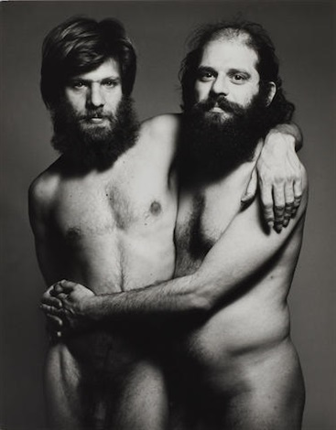

Slide 29
3. INFLUENCE

Slide 30
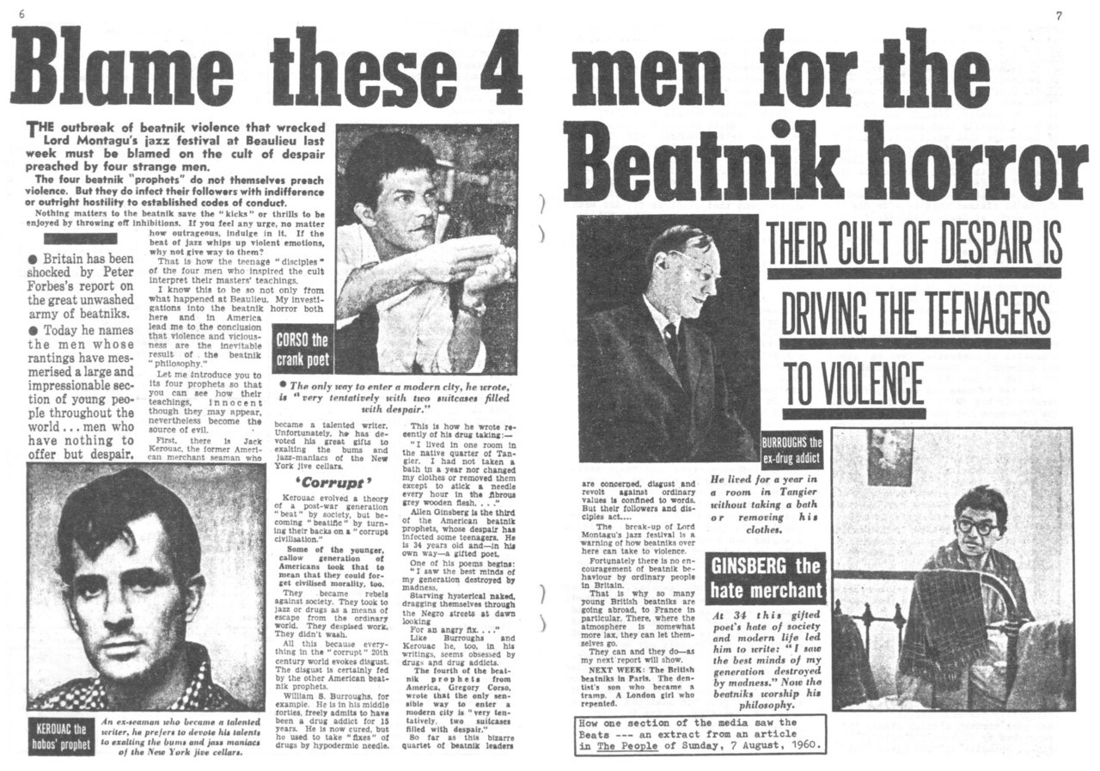

Slide 31

‘A great rucksack revolution, thousands or even millions of young Americans wandering around with their rucksacks, going up mountains to pray, making children laugh … wild gangs of holy men getting together to drink and talk and pray … to meditate and ignore society’

Slide 32
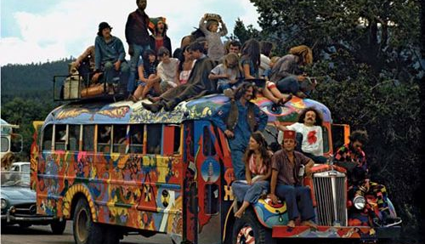

Slide 33
4. ANTI-HUMANIST PHILOSOPHY/ REACTIONARY POLITICS

Slide 34
ANTI-HUMANISM
REJECTION OF HUMAN PERFECTIBILITY
REJECTION OF THE ENLIGHTENMENT FAITH IN REASON
REJECTION OF HUMANITY AS EXCEPTIONAL
REJECTION OF REASON AS THE DRIVING FORCE BEHIND COLLECTIVE HUMAN PROGRESS

Slide 35
‘When one analyses the language of man, one doesn’t discover the nature, essence or freedom of man. In their stead, one discovers unconscious structures which govern us without our noticing or willing it’
Michel Foucault, The Order of Things: An Archeology of the Human Sciences (London: Routledge, 2002 [orig. ed.: 1966]), p. 357.

Slide 36
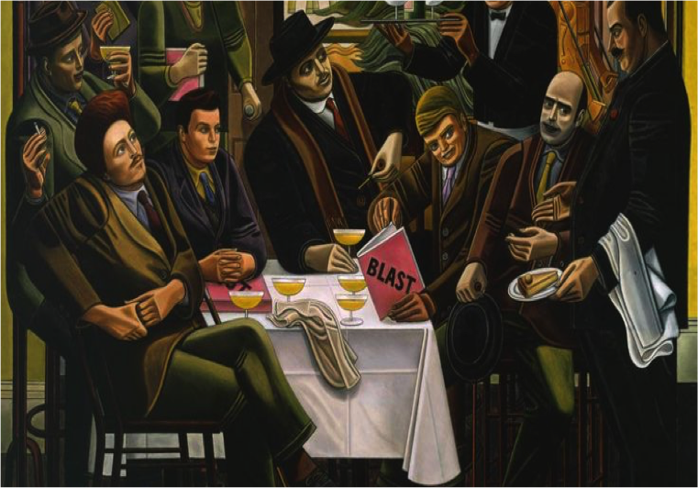
William Roberts, The Vorticists at the Restaurant de la Tour Eiffel. Courtesy of the Estate of William RobertsRoberts/Tate

Slide 37
‘When a sense of the reality of … absolute values is lacking, you get a refusal to believe any longer in the radical imperfection of either Man or Nature. This develops logically into the belief that life is the source and measure of all values, and that man is fundamentally good. Instead, then, of/ Man (radically imperfect) ... apprehending … Perfection, -/ you get the second term (now entirely misunderstood) illegitimately introduced inside the first [elipses and brackets Hulme’s own]. This leads to a complete change in all values. The problem of evil disappears, the conception of sin loses all meaning.’
T.E. Hulme, ‘A Notebook’, in Collected Writings, pp. 419-56, p. 444. Originally published in The New Age in seven installments (December 1915 – February 1916).

Slide 38
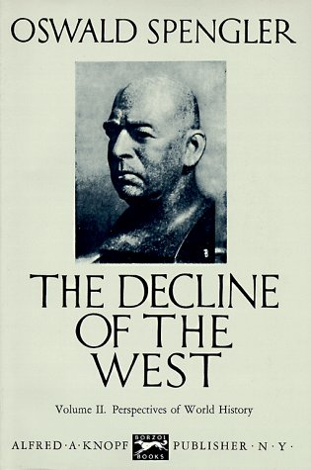

Slide 39


Slide 40
‘The Beats’ faith in self – even societal – liberation through art was tempered by a Spenglerian expectation of the total breakdown of Western culture.’
John Tytell, Naked Angels: The Lives and Literature of the Beat Generation (New York: McGraw-Hill, 1976), p. 9

Slide 41


Slide 42
‘The Victorian age produced a morass of sugary comfort and amiableness, indulged men so much that they became guys of sentiment – or sentimental guys. Against this “sentimentality” people of course reacted. So the brutal tap was turned on.’
Wyndham Lewis, ‘The Caliph’s Design’, in The Egoist, 1919

Slide 43
Pretty little fascists?
The Beat bid for progress through mystical experience rather than rational, scientific advancement has been called into question.
What to make of their ‘defection from the long-standing tradition of skeptical, secular intellectually which has served as the prime vehicle for three hundred years of scientific and technical work in the West’ (Theodore Roszak)?

Slide 44


Slide 45
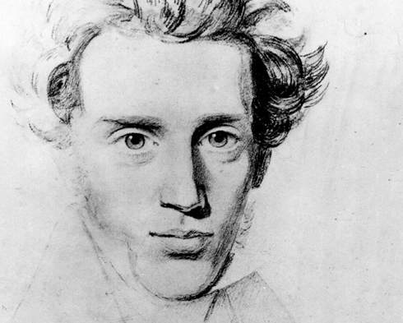

Slide 46
‘The burden of my generation was the knowledge that something rational had caused all this … and that nothing rational could end it.’
John Cllelon Holmes, Nothing More to Declare (Boston: E.P Dutton & Co., 1967), p. 215.

Slide 47
TENTATIVE CONCLUSIONS
At a cultural level, anti-humanism in the Beat Generation hints at equivalent paradoxes in the 60s counterculture they inspired:
Belief in human potential along with fatalism about the many who cannot get on board with the new way of thinking/living/
A binary of authenticity/inauthenticity that contradicts the message of peace and love on which the counterculture was sold
It also hints at an irresponsibility towards the tribe the Beats were nurturing – an awareness of complicated imperfections in the human condition but a dangerous willingness to ignore them in the pursuit of a romantic story.
Finally, reading the Beats for their unexpected anti-humanism may allow for a better appreciation of countercultural thought today.
The currency of authenticity and inauthenticity in the counterculture, of hip versus square, remains with us – in public discourse around social justice, of ‘woke’ and ‘non-woke’.
The idea that certain people get it and others don’t, and the willingness to discard those who don’t.
A legacy of the 1960s, it’s an attitude shared by the right and the left today and can be better understood through attention to the decade that produced it.

