Slide 1
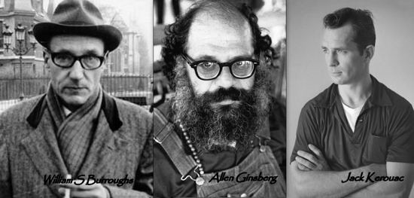
The Tyranny of Cool: Orthodoxy, Heresy & the 1960s Counterculture
Dr Guy Stevenson
Institute for Advanced Studies in the Humanities, University of Edinburgh g.stevenson@ed.ac.uk

Slide 2
Structure
1. The Beats as cultural heretics
2. The transformation of their ideas into modern orthodoxies
3. The new countercultural backlash
4. What went wrong/ was wrong to cause this backlash?

Slide 3
1. Heresy

Slide 4
Rebelling against:
American consumerism
Cultural uniformity
Bourgeois suppression of the individual’s right to think, feel and behave freely (license rather than liberty?)

Slide 5
‘The control machine. Simply the machinery – police, education, etc. - used by a group in power to keep itself in power and extend its power’

Slide 6
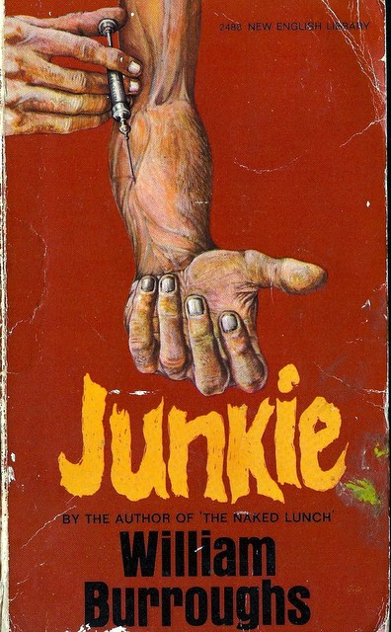
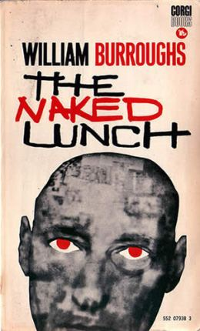

Slide 7
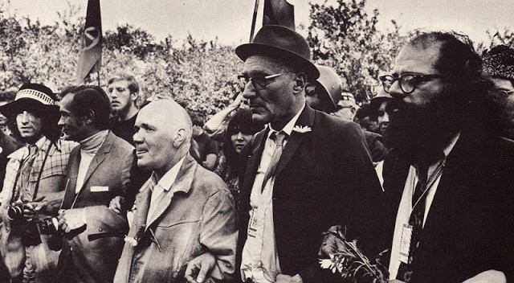

Slide 8
Forms of Rebellion:
Itinerant Lifestyle
Radically Formless Autobiographical Literature
Sexual Permissiveness in life and Obscenity in literature
Opening ‘the Doors of Perception’ through drugs, Eastern religion and philosophy (Zen Buddhism, Hare Krishna)

Slide 9
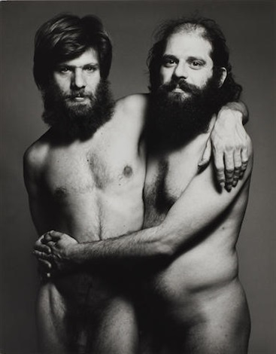

Slide 10
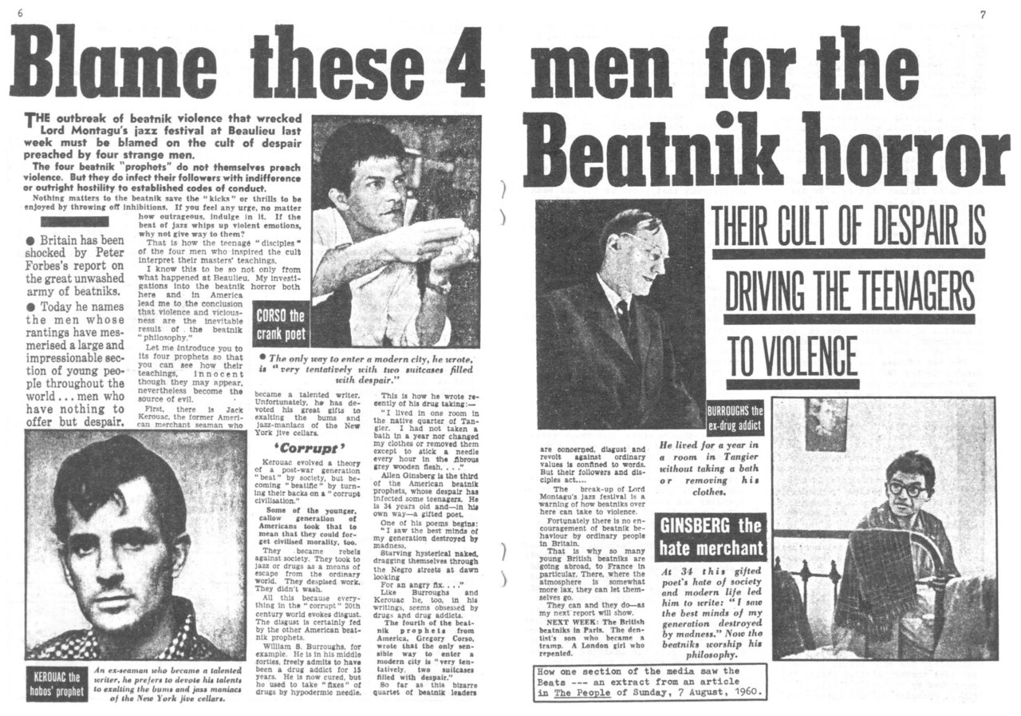

Slide 11
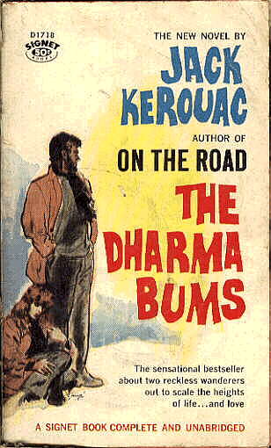
‘A great rucksack revolution, thousands or even millions of young Americans wandering around with their rucksacks, going up mountains to pray, making children laugh … wild gangs of holy men getting together to drink and talk and pray … to meditate and ignore society’

Slide 12
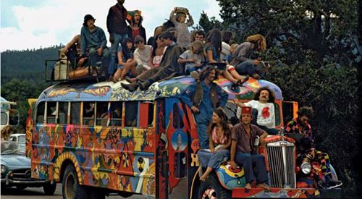

Slide 13
2. Orthodoxy

Slide 14


Slide 15
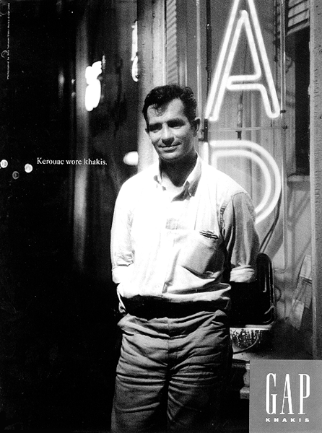
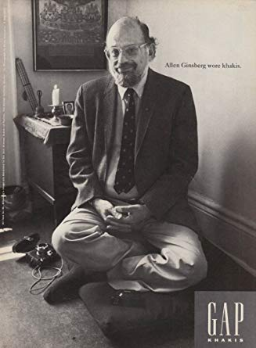

Slide 16
3. Backlash

Slide 17


Slide 18
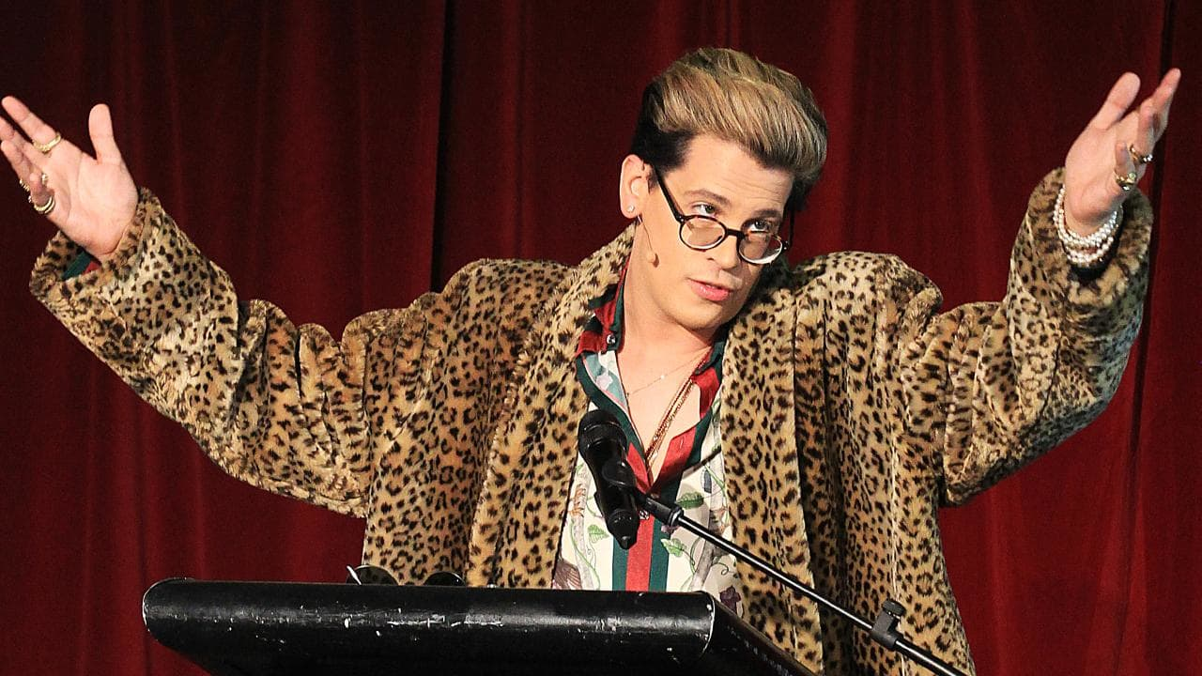

Slide 19
4. What was/went wrong?

Slide 20
‘In this radical extension of the politics of the late 60s, difference and victimization are prized, ranked against the victimization of other groups. We crown our good with victimhood. While conservatives claim to speak in the name of a majority, the standard-bearers of identity politics cultivate their own marginality, practicing a separatism that incapacitates them for alliances and collective improvements’

Slide 21
In summary:
We should understand the American literary and cultural renaissance of the 1950s & 60s in longer historical terms.
It had a significant impact on the politics young people engaged in then: making the personal political in a way that brought individual identity to the fore.
Modern identity politics are being contested today because of:
a.) problems with that original countercultural attitude
b.) the direction countercultural ideas have taken since the 60s.
A movement for individual freedom from the tyranny of convention changed its stripes once it became the convention itself.
From the Beats and the 1960s attitudes they inspired, we can learn 2 apparently contradictory but connected lessons about our new cultural-political world:
to be more open minded and compassionate, and less righteous & pious in pursuit of a fairer society
to be wary rather than outraged or dismissive of the current backlash against progressivism. Bearing in mind the power the 60s counterculture held over the young, it’s crucial now to acknowledge the same potential power in the hands of new, politically opposite heretics

