Slide 1
6 Ways to become a better teacher of creative writing
F. Gilbert

Slide 2
Activating Prior Knowledge
What do you know already as a teacher and learner about the teaching of creative writing? What has worked for you?

Slide 3
Why are you teaching creative writing?
Put some comments in the chat.

Slide 4
An extract of my writing…
On a business trip, my stepfather returns with a free lady's handbag to give my mother: it's a big bag, with lots of compartments and loads of useful pockets for make-up. Feeling generous my mother decides to give me the bag -- and requests that I use it as a school bag from that day onwards. I don’t have the money to buy another.
I try my best to shield the bag under coat when I am going to school and bury it under my chair in the class, but it is no good. The boys notice it. During the first few days, they eye it silently, not quite knowing what to make of it. Then one day, a kid called Andrew Rose sees me carrying it over my shoulder in the playground, making my way to the next lesson. He shouts behind me, ‘There goes Pilkie and his handbag!’ As all the other boys are on their way to the lesson, a strong chant quickly gathers momentum: ‘Pilkie and his handbag! Pilkie and his handbag!’

Slide 5
Tip 1: Write alongside your students & share your processes
Metacognition
Learning orientation
Learning through mistakes
Struggling
Planning or not?

Slide 6
Planner writers | Discovery writers
I think about it in my head first. I think before I write. | I just really get on with it and things start coming into your head.
I’ll probably just think about it my head, how are you going to set it out, and then do it after I thought about it. | Well, I didn’t know what I was going to write about and then I just decided that, start and see if I got any ideas when I started writing.
I think about what we have to do and how we’ve got to do it. | It just flows really; I just started writing… As I write it just comes to me and new words, new sentences, just different things, different ideas…
I think about how I’m going to start the story and how I’m going to continue it. | As I writing it in just comes from their; it just flows and just get more and more ideas.

Slide 7
The rights of the writer
The right not to share.
The right to change things and cross things out.
The right to write anywhere.
The right to a trusted audience.
The right to get lost in your writing and not know where you’re going.
The right to throw things away.
The right to take time to think.
The right to borrow from other writers.
The right to experiment and break rules.
The right to work electronically, draw or use a pen and paper.
Notes:
https://literacyforpleasure.wordpress.com/2017/04/17/the-29-rights-of-the-child-writer/

Slide 8
Tip 2: Nurture Automaticity
‘The most effective way I know to improve your writing is to do freewriting exercises regularly. At least three times a week. They are sometimes called ‘automatic writing’, ‘babbling’, or ‘jabbering’ exercises. The idea is to write for 10 minutes (later on, perhaps fifteen-twenty). Don’t stop for anything. Go quickly without rushing. Never stop to look back, to cross something out, to wonder how to spell something, to wonder what word or thought to use, or to think about what you’re doing. If you can’t think of a word or a spelling, just a squiggle or else write ‘I can’t think of it’. Just put something down. The easiest thing to do is put down whatever is in your mind.’
Peter Elbow, Writing without Teachers, OUP, 1998, p. 3
Keep writing
3x a week
squiggle
Quick, but no rush
Thought dump!
Notes:
‘The most effective way I know to improve your writing is to do freewriting exercises regularly. At least three times a week. They are sometimes called ‘automatic writing’, ‘babbling’, or ‘jabbering’ exercises. The idea is to write for 10 minutes (later on, perhaps fifteen-twenty). Don’t stop for anything. Go quickly without rushing. Never stop to look back, to cross something out, to wonder how to spell something, to wonder what word or thought to use, or to think about what you’re doing. If you can’t think of a word or a spelling, just a squiggle or else write ‘I can’t think of it’. Just put something down. The easiest thing to do is put down whatever is in your mind.’
Peter Elbow, Writing without Teachers, OUP, 1998, p. 3

Slide 9
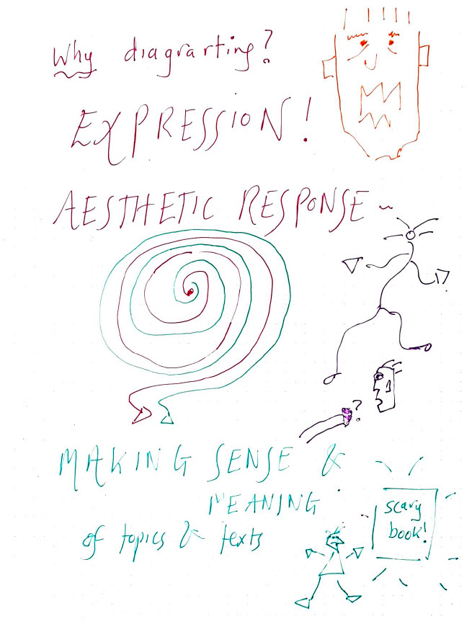

Slide 10
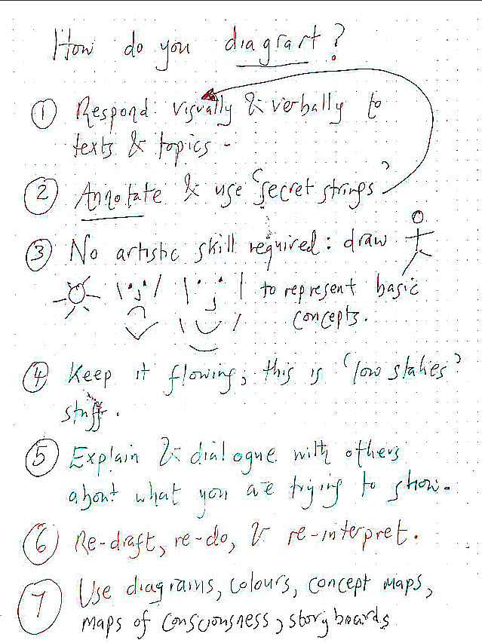

Slide 11
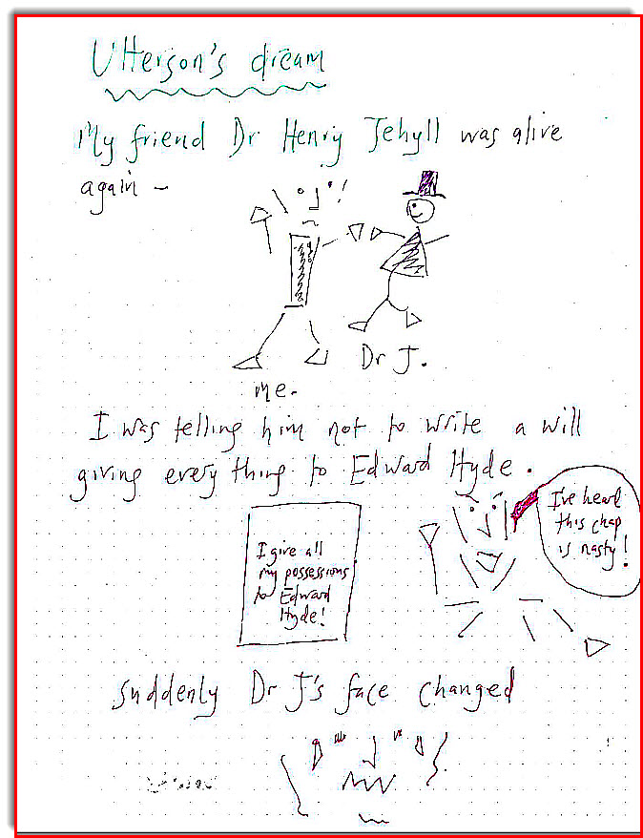

Slide 12
Try mindful planning! FG to illustrate

Slide 13
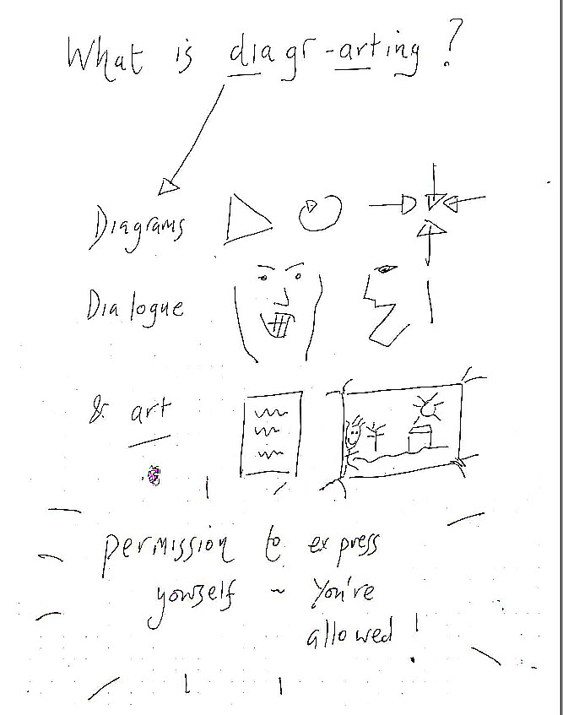

Slide 14
Tip 3: encourage students to draw from their funds of knowledge
Memory triggers: sweets, smells, photographs etc
Fictionalise events: change for better/worse
Important people: fictionalise them, positively/negative e.g. teachers??!
Describing emotional spaces
Memorable anecdotes

Slide 16
How to Disappear Completely
‘So, do you think he’s dead?’ Phil asks.
His piping high words, choked with worry, irritate Alan.
‘Dunno,’ Alan says, trying his best to stop his voice from cracking.
‘Are you crying?’ Phil says.
‘Shut up!’
Alan rolls over on the bed and turns to the wall, tears leaking across his face.
His father is almost certainly dead.
Yes.
He doesn’t want to be sad.
That’s not allowed.
Phil gets up from his bed opposite and plods over to his brother, standing over him.
‘You are crying!’ he hisses in surprise.
‘I’m not!’ Alan sobs.
‘It’s all right, I won’t tell,’ Phil says.
And then he gets into bed beside his big brother, snuggling up to him. Holding him by the shoulders. Alan feels Phil’s soft cheeks against his neck and his trembling fingers on his shoulder blades and thinks about death.
It is 1979.
The two brothers are lying in the dark on a narrow bed in a house in Southampton.
The suburbs outside are quiet.

Slide 17
Tip 4: Cognitive Prompts
Firsts: My first accident, first day at school
Pictures/photographs: personify an object
Films/videos: describe the setting
Powerful extracts/passages

Slide 18
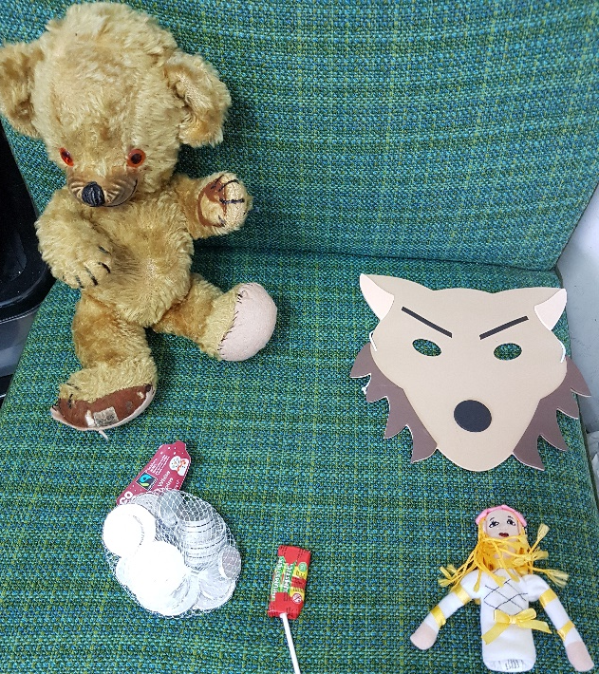
Tip 5: Use objects
Choose an object about your person that is valuable to you. E.g. keys, phone, an item of clothes.
Freewrite or diagrart all the reasons why it is valuable to you; describe it; describe when, how and why you like it/use it etc.
Now imagine that you lose this object…what do you feel like? What would you do?
You now have the beginning of a story.

Slide 19
Use objects to structure
Opening: set the scene/describe the object (the phone under some socks)
Complications: a character encountering a problem because of the object (e.g. a very punctual, organised person who has issues about saying sorry loses their phone)
Crisis: the problem gets worse, the character has to make a decision (they can’t phone their love interest to say they will be late)
Climax: the problem explodes in the character’s life (their love interest leaves them)
Resolution: the character has changed in some way because of the problem/object (they confess to being scatty)

Slide 20
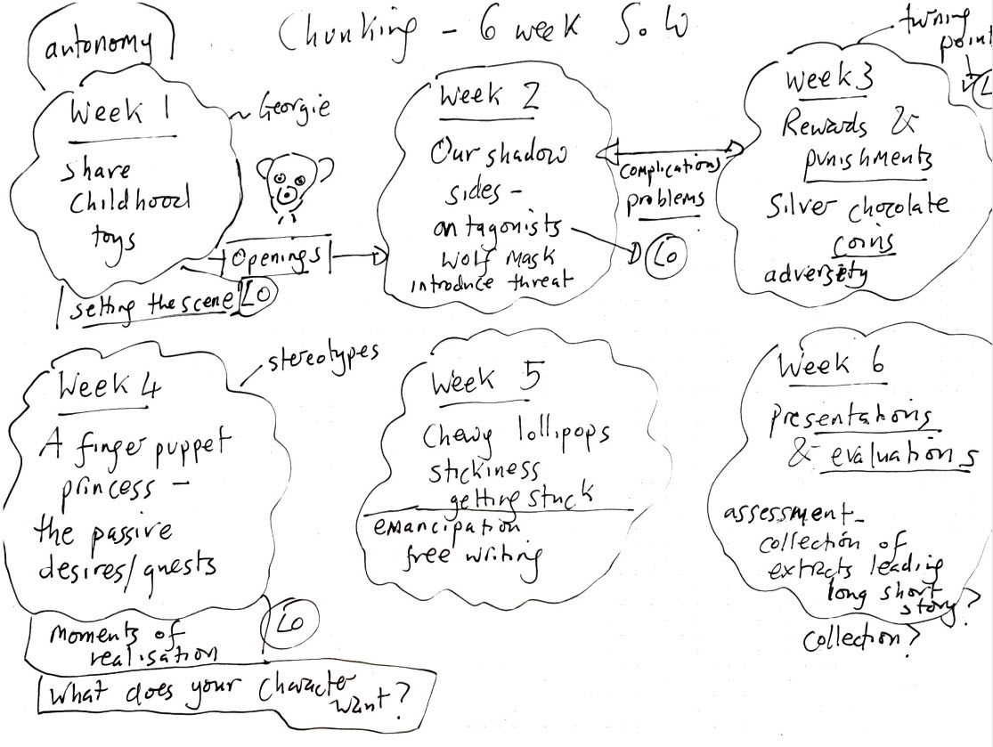
Tip 6: Make lesson planning creative! Use tips 1-4 to help!

Slide 21
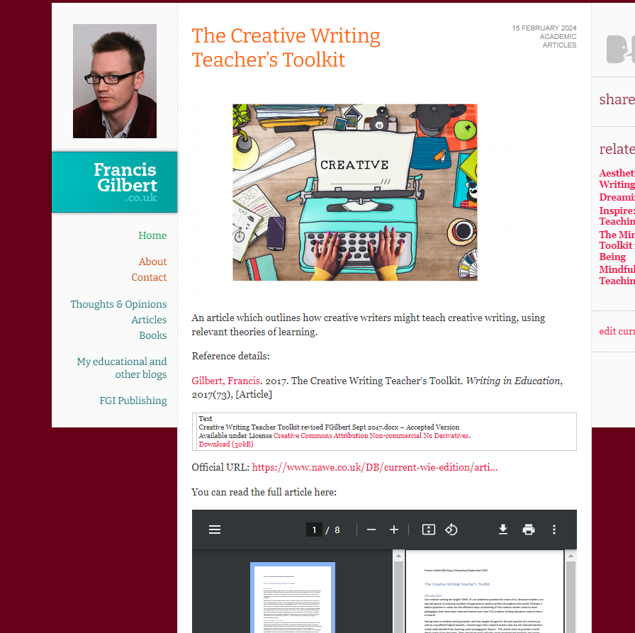
The Creative Writing Teacher’s Toolkit
http://www.francisgilbert.co.uk/2024/02/the-creative-writing-teachers-toolkit/

Slide 22
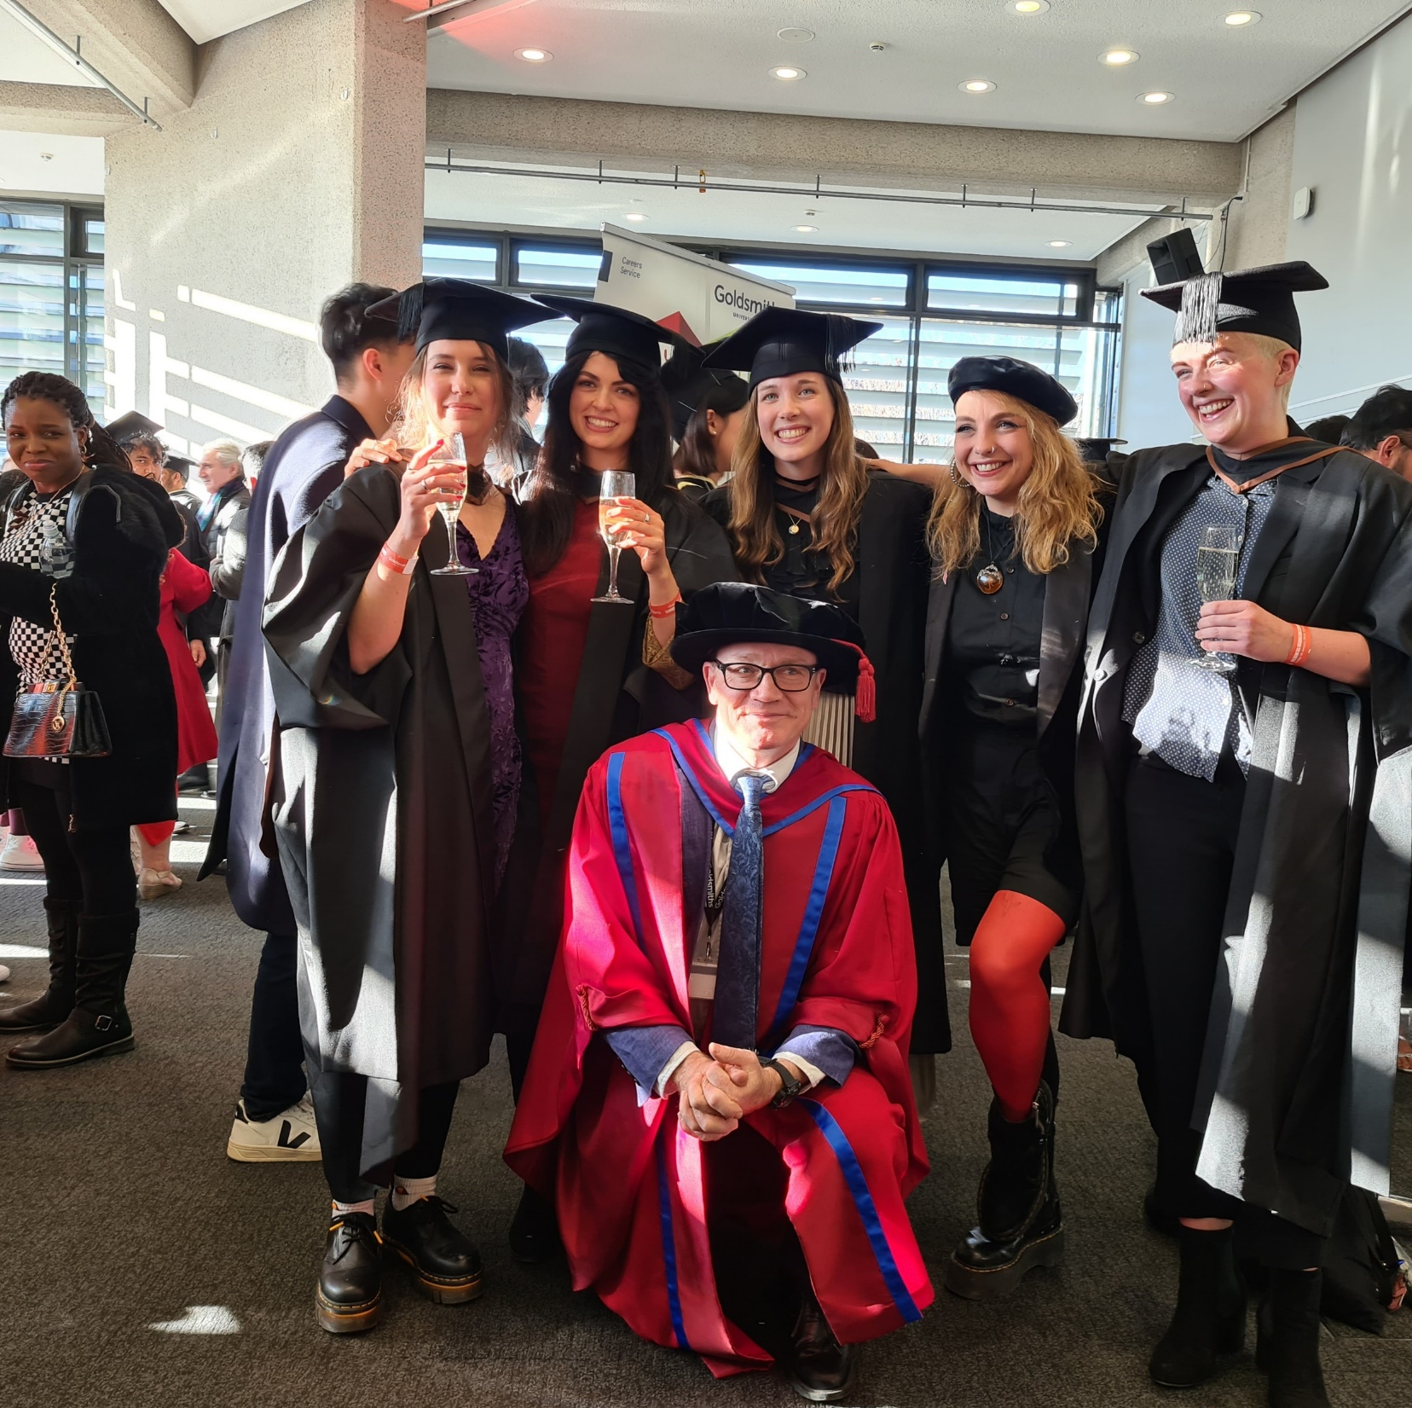
What is the MA Creative Writing and Education?
The most unique, innovative creative writing MA there is!
It combines a creative writing masters’ degree with an amazing teacher-education experience

Slide 23
Why do it?
You’ll learn to improve your writing and teaching very significantly; it’ll help you be more creative in both, and much more employable in a range of different careers
Past graduates have gone on to work in: publishing, arts organisations, universities, get promoted in their teaching careers and set up successful freelance businesses based upon what they want to do…
Amazing extra curricular opportunities, work with charities, arts organisations, prisons, famous alumni of the course (Raymond Antrobus, Dean Atta, Christian Foley)

Slide 24
Want to learn more?
https://www.gold.ac.uk/pg/ma-creative-writing-education/
Everything is on this page, including the full programme specification
Or email me, Francis, f.gilbert@gold.ac.uk and we can have a chat

Slide 25
Develop your students’ writing
YOUNG WRITERS
PROGRAMME
First Story is England’s leading creative writing charity. We deliver our flagship Young Writers Programme to schools in London, East Midlands, Greater Manchester and Yorkshire.
What we do
Weekly workshops with a professional Writer-in-Residence
Professionally published anthology for each young writer, your school and the British Library
Young Writers Festival at the University of Cambridge
National competitions
Regional events with other schools
CPD workshops for teachers
'It has been wonderful to witness even the most reluctant and hesitant students, emerge as engaged and enthusiastic writers.'
Nazim Rahman, Saint Gabriel's College
For more info:
info@firststory.org.uk
firststory.org.uk
Registered charity no. 1122939

