Slide 1
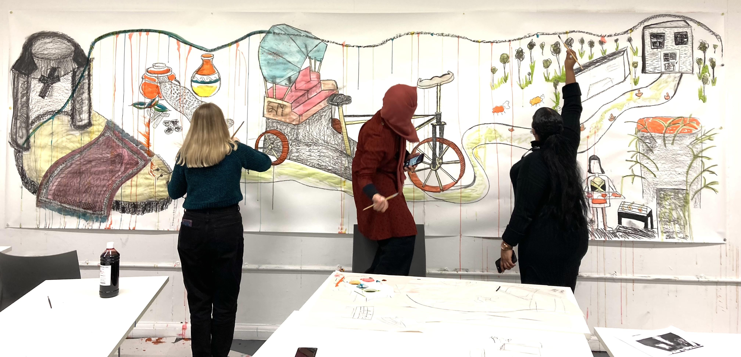

Integrating Arts Methods for Dimensionality and Vocal Presence in University Cultures
Dr Miranda Matthews

Slide 2
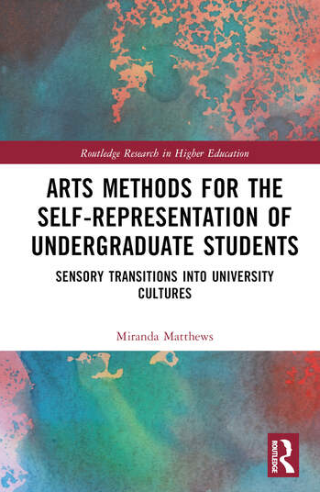
How do arts methods integrated in HEI curricula
enable a fully dimensional and vocal presence for students in underrepresented groups?

Slide 3
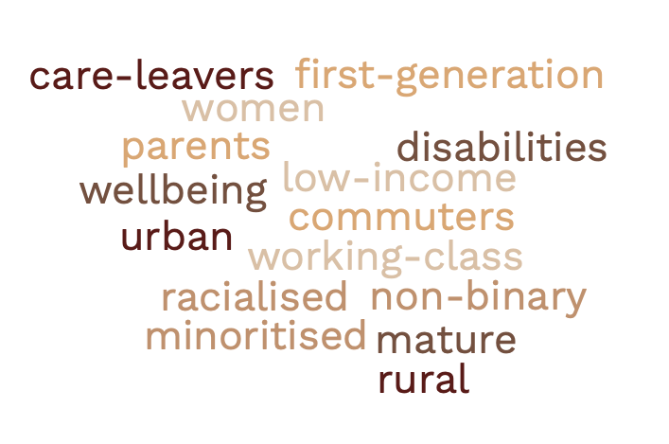
Arts Methods for the Self-Representation of Undergraduate Students: Research Starting Points
The research identified how innovative arts methods assist the transitional experiences of students who may experience a culture shock when they start their programmes of study at university.

Slide 4
Participants: Lecturers in the Social Sciences and Humanities
Peter at Borders
English Lit
Fiona at Sands
Sociology
Hugh at Loch
Sociology
Luis Enrique at Tracks
Anthropology
Shannon at Hills
Human Geography
Chris at Hills
English Lit
Dia at Loch
Sociology
Janet at Dales
Psychology
Sally at Airways
Educational Studies
Jordan at Airways
Educational Studies
Notes:
Class divisions have been deeply set among white people in the UK for many centuries, and there are additional geographic economic differences between the South and the North of England, and between communities in Scotland, Ireland and Wales. A report by the Sutton Trust has identified that, ‘Young people from the most advantaged areas of England are currently over six times as likely to attend one of the most selective universities – including Oxford, Cambridge and other members of the Russell Group’ (Atherton 2020, 7). Therefore in researching sensory transitions I have interviewed lecturers who could offer indicative observations relating to the North South divide, and to conditions in each of the ‘four nations’ of the UK – that is of England, Scotland, Wales and Northern Ireland. With this approach I am responding to the need for ‘institutional conversation’ (12) that enables the sharing of supportive practice.

Slide 5
Participants: Arts Educators, Curators, Alumni
Max at River and Lanes
Arts Educator
Jack at Riverside
Arts Educator
Dan at River
Arts Educator
Aarin
Studied at River
Lucy
Curator at River
Liza
A hairdresser
Miranda
Practice Reserch at Goldsmiths

Slide 6
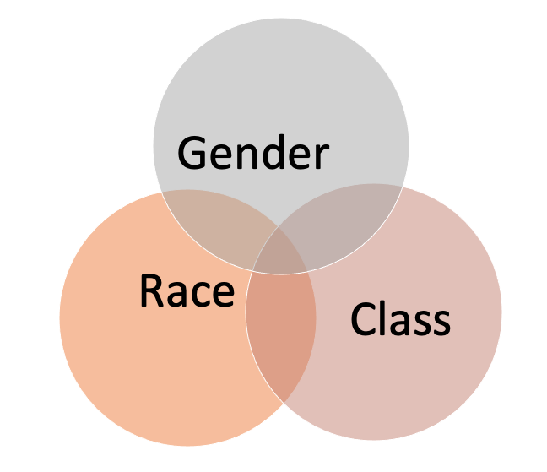
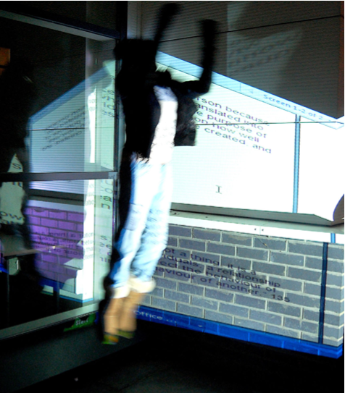
Centralising the Theory of Marginalised Groups
Kimberlé Crenshaw, was the originator of intersectionality theory in ‘Mapping the Margins’ (Crenshaw et al. 1995). Black feminists were challenging racism, sexism and classism, exploring the combined factors of socially constructed oppressive forces, in specific contexts (Collins and Bilge 2020).
Relating to creative protests, ‘creative social action’ is an empowering form of social intervention, identified by Patricia Hill Collins (2019). Collins sees the importance of creative action in how people ‘actively work at making sense of the world through critical thinking and imagination’ (173).
Chapter 2 Theorising Sensory Transitions, Matthews 2023, pp.12-43.

Slide 7
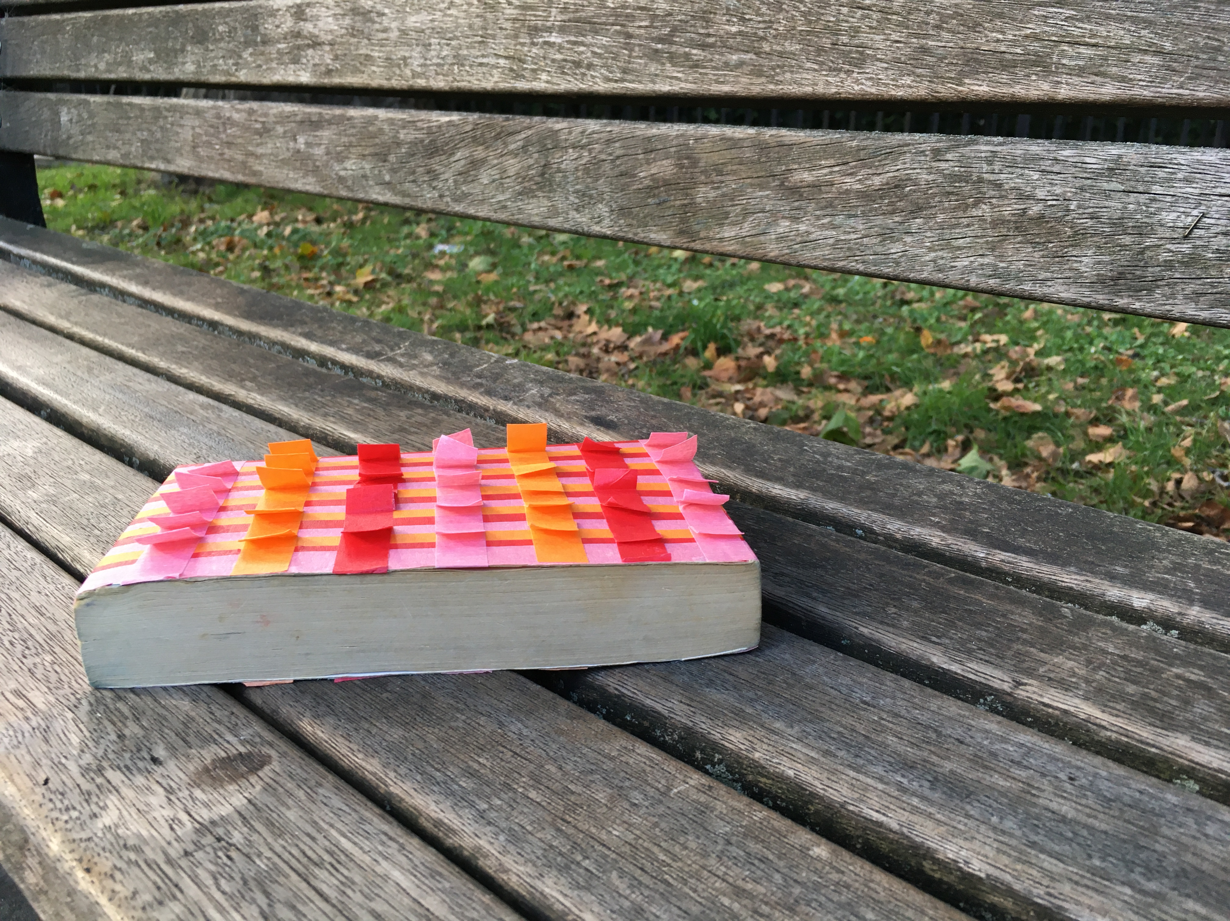
Theorising Dimensionality in Sensory Transitions
Student self-representation is an assemblage of the many worlds they inhabit both inside and outside the university.
Stuart Hall on ‘Transition Zones’ into higher education ‘I came to understand that identity is not a set of fixed attributes, the unchanging essence of inner self, but a constantly shifting process of positioning’ (2018, 16).
There is a need for plurality and heterogeneity, decentring the Anthropocene towards ‘a world of many worlds’ (de la Cadena and Blaser 2018)
Enabling ‘multi-layered surrounding campus environs’ (Lee and LaDousa 2015, 170), and ‘multiple academic and social communities’ (Tinto 2020, 17).

Slide 8
Bridging Gaps with Arts Methods
I nearly always include elements where they can do personal investigation, where they have some scaffolding. I would use the word ‘scaffolding’ to talk about the ways in which I try and create a connection between ways they're thinking and concerned, and interested already in a topic, and how knowledge is done in that area of the discipline: there might be a gap.
(Shannon, Hills)
Secular College is very wealthy and they support sport, for example with huge amounts of money. Rowing, for example, and rugby. There was never any money for art from Secular College Student Union which is a source of funds for these things. The students made an impassioned argument and they raised… in the first year it was £1,500 to buy art materials and that’s gradually going up. It’s nothing still compared to what the college has... but on the other hand, suddenly there’s an idea that visual arts practice needs money as well. (Dan, River)
Chapter 3, Factors of Difference: Changing Environments,
pp. 44-78, Matthews 2023.
Notes:
Integrated: Dia at Loch university in Scotland notes that inequalities frequently emerge, in issues such as the achievement gap for black students. We therefore need to look for ways to address this inequality in positive action for ‘anti-discriminatory’ and ‘anti-oppressive’ practice that is self-affirming for students (Bunce et al 2021, Hadden et al 2020).
Extracurricular: Dan invests time in celebrating the students’ existing ‘talents, confidence and abilities that have been put on the back burner, whilst they do an academic degree.’ He develops arts practice for students as an accompanying extracurricular presence in the university. Dan’s view of his role is that he is a coordinator of students’ self-coordination. This approach acknowledges the significance of self-representation and the substantiating factors of ‘self-affirmation’ (Hadden et al. 2020).
Value for the arts does not yet equate with economic support of the arts. Jack says financial collaboration is ‘hard to get’ and that ‘People are offering arts pedagogies on a reduced or non-existent salary.’
These intersticial moments are conjunctions and alignments of self-representation, that can occur ‘in transactions and transitions’ of in-person and virtual learning (Savin-Baden and Falconer 2016, 992). Peter talked of the ‘moments and those points where students are able to represent themselves’ .

Slide 9
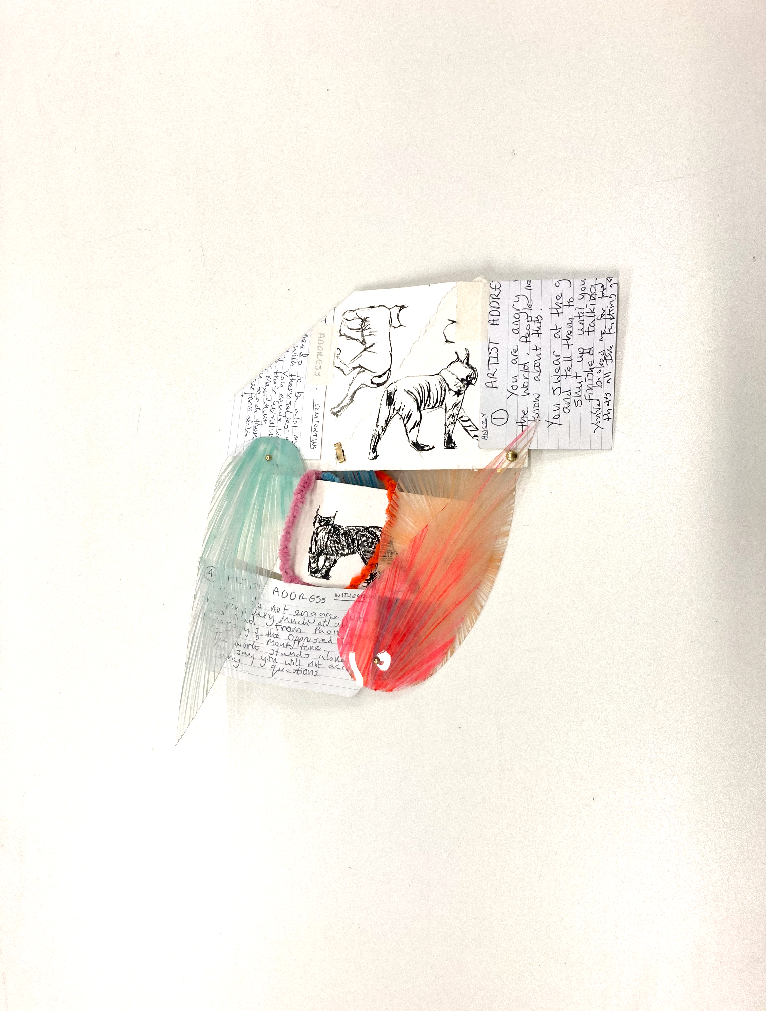
Re-storying with
Arts Methods to Enable Reflective Voice
Arts methods can help students to re-story their learning narrative towards positive responses, that celebrate all dimensionalities.
An Example in Practice:
‘People find it hard to defamiliarise from their own lives. So if you just ask a question you will get like an instant response’ (Fiona, Sands).
Fiona uses arts methods such as collage to re-story experiences and enable discussion of the ‘gaps’ that emerge in the collage, towards ownership of nuanced self-representation.
Chapter 3, Factors of Difference: Changing Environments, pp. 44-78, Matthews 2023.
Notes:
Creative learning processes that raise self-expectations, and activate technologies of the self in the new discomfort zones of university environments can support students to activate their energies and contend with the forces of first-hand experience.
The raising of self-expectations was seen to create what Dia called ‘paradoxical’ action, to comfort those who need to be comforted and to make more privileged students feel ‘uncomfortable – the ones who are very comfortable’.
Staying with the trouble of state of mind within universities as institutions, necessitates making responsive strategies, instead of making light of students in difficulty (Philo and Parr 2019).
Research has found that students are also using arts methods to prioritise ‘daily practices of self-affirmation, self-care and assertion of marginalised identities’ (Hall 2019, 1546).
’ In curated exhibitions of well considered, artworks, the histories of women - including women of colour, the working-classes, sexuality, physical disability and neurodiversity, can be made visible around the university. Artworks arguably enhance the students’ sense of being able to substantiate, and make real, their presence at university

Slide 10
Meeting Points in Arts Practice
Photovoice
Collaborative Drawing
Filmmaking
Collage
Temporary Installations
Walking
Methodologies
Rap Poetry
Community
Outreach
Taster
Sessions
Journals
Zines
Showing Students’ Artwork
Growing
and Sharing
Food
Inclusion
play
Popular
Music

Slide 11
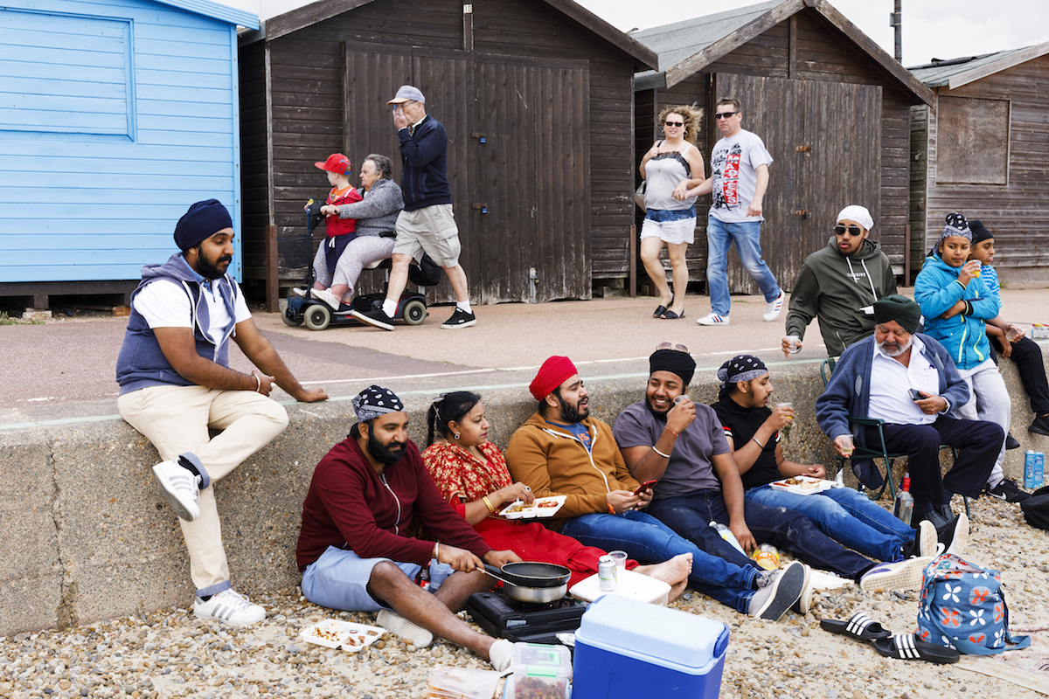
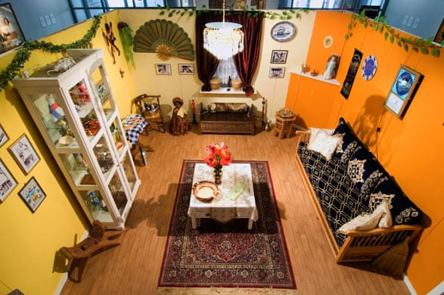
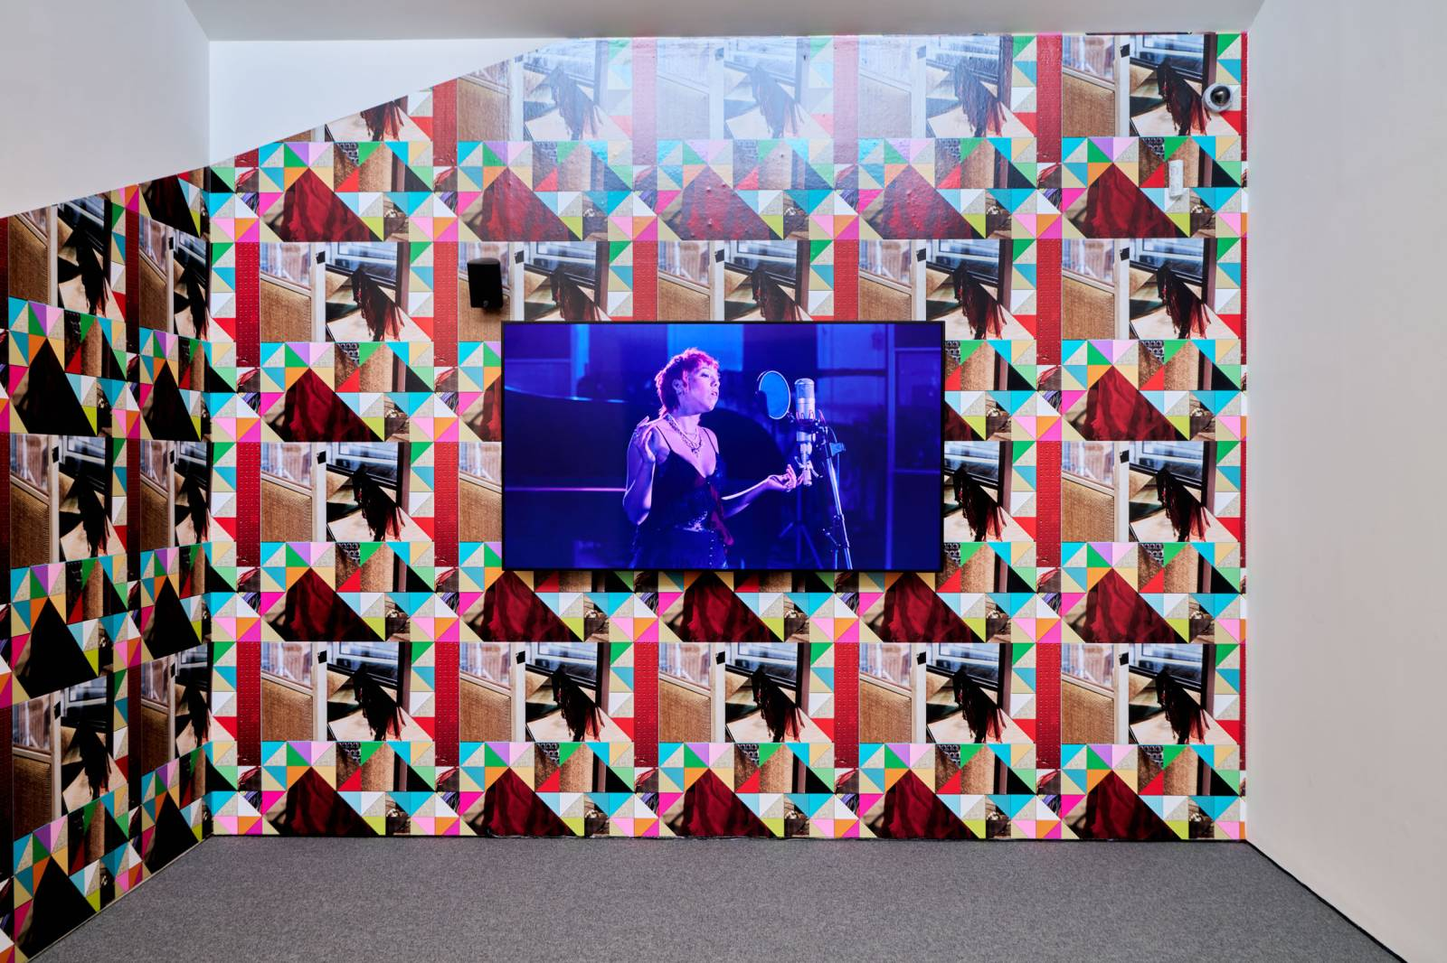
Opening Narratives – Creative voices for ‘homing’, self-representation and belonging
Martin Parr, Photographing the Great Michael McMillan, The Front Room Sonia Boyce, Feeling Her Way, 2023
British Seaside, 2018 2021

Slide 12
References
Collins, P. Hill. (2019) Intersectionality: As Critical Social Theory. Croydon: Duke University Press.
Crenshaw, K. (1991) Mapping the Margins: Intersectionality, Identity Politics and Violence Against Women of Colour. Stanford Law Review, 43(6): 1241-1299. DOI:10.2307/1229039.
Crenshaw, K., Gotanda, N., Peller, G. and Thomas, K. (1995) Critical Race Theory: The Key Writings that Formed the Movement. New York: The New Press
de la Cadena, M. and Blaser, M. (2018) A World of Many Worlds. Durham and London: Duke University Press.
Hall, S. (2018) Familiar Stranger: A Life Between Two Islands. London: Penguin.
Lee, E. and LaDousa, C. (2015) Being “the Gay” on Campus: Developing Lesbian, Gay, Bisexual, and/or Queer Identities in a College Context, in E. Lee and C. LaDousa (eds.), College Students’ Experiences of Power and Marginality: New York and London. pp. 169-185.
Mannay, D. (2016) Visual Narrative and Creative Research Methods – Application, Reflection and Ethics. Abingdon and New York: Routledge.
Matthews, M. (2023) Arts Methods for the Self-Representation of Undergraduate Students: Sensory Transitions into University Culture, London: Routledge.
Tinto, V. (2020) Learning Better Together, in Jones, A., Olds, A. and Lisciandro, J.G. (eds.), Transitioning Students into Higher Education: Philosophies, Pedagogies and Practice. London and New York: Routledge. pp. 13-24.

Slide 13
References
Sonia Boyce, Feeling her Way, Turner Contemporary, 2023
https://turnercontemporary.org/whats-on/sonia-boyce-feeling-her-way/
Michael McMillan, The Front Room, 2021
https://www.tate.org.uk/tate-etc/issue-54-spring-2022/a-sense-of-belonging-through-style
Martin Parr, Photographing the Great British Seaside, 2018
https://elephant.art/the-great-british-seaside/

