Slide 1
Keynote Address
5th International Conference (ICACCF 2022) on Digital Transformation and Sustainability in Business Practices
7th April 2022 @ Amity University, Noida, India
Ivan Zupic
Lecturer in Entrepreneurship & Head of International Partnerships
Institute of Management Studies
Goldsmiths, University of London

Slide 2

Agenda
The (over)promise of Artificial intelligence (AI)
The era of platforms
The challenges of (technological) decoupling

Slide 3
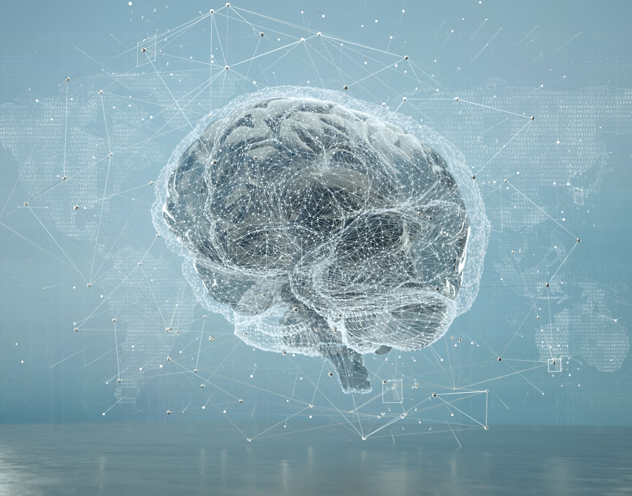
The (over)promise of Artificial Intelligence

Slide 4
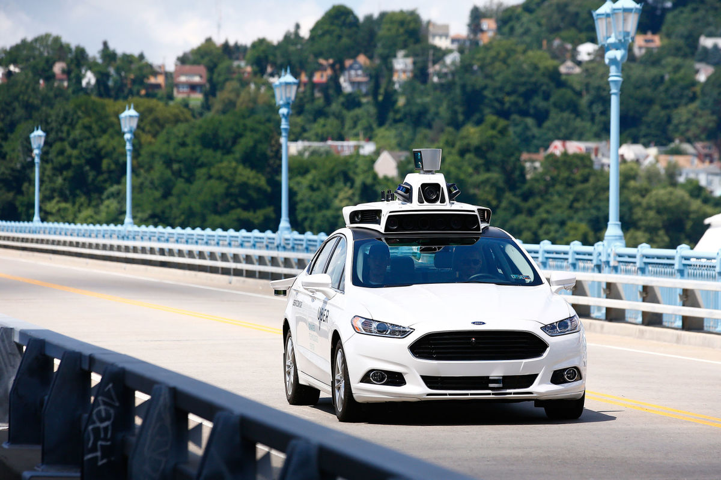

Slide 5
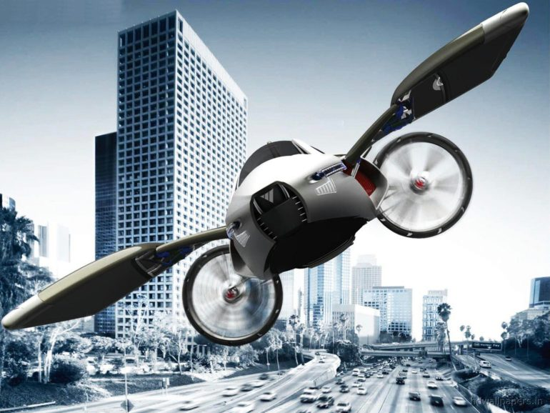

Slide 6
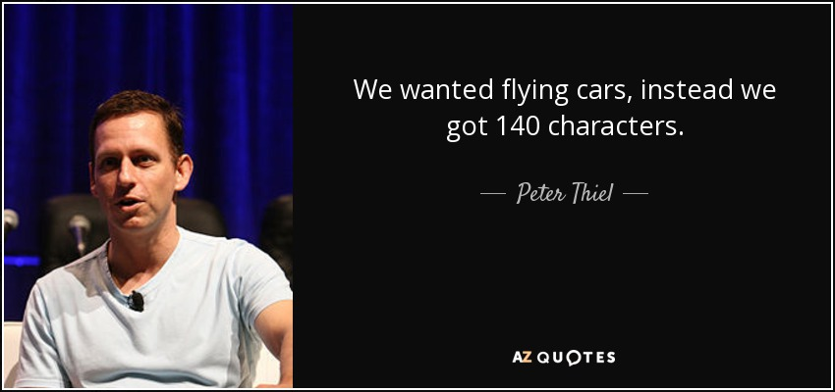

Slide 7
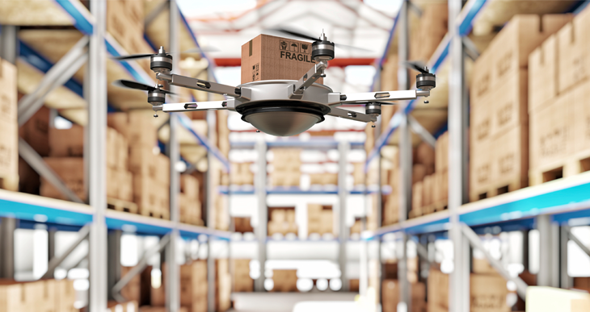

Slide 8
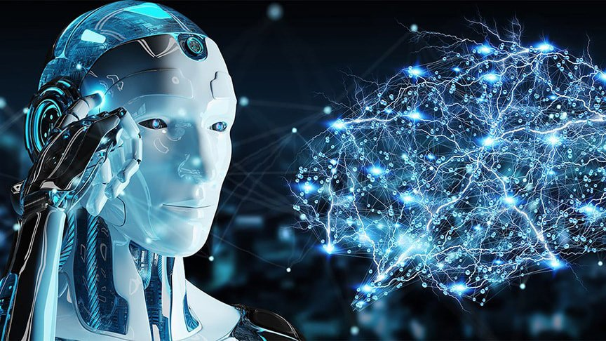
What is AI?

Slide 9
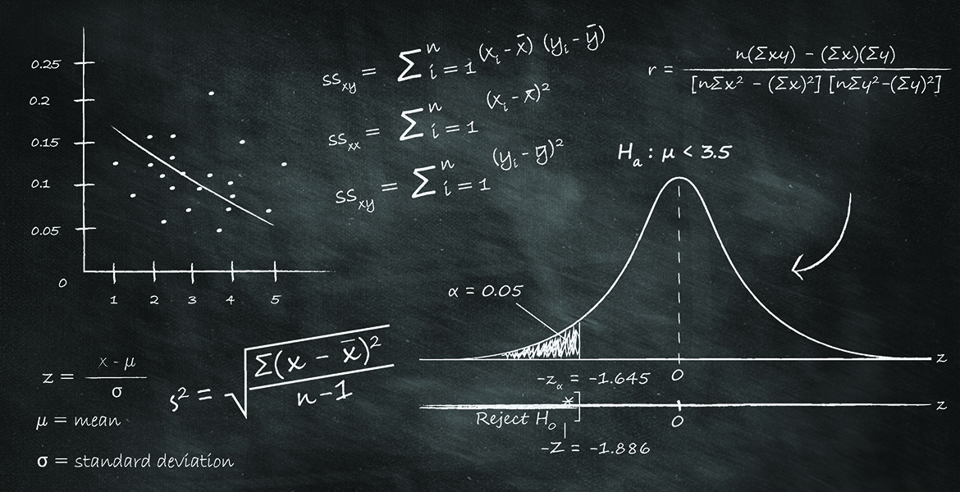

Slide 10


Slide 11
What AI can do
Recognize patterns
Perform some human tasks much faster (those that can be automated)
Can help humans increase productivity
Advances in translation
Advances based on
  increasing amounts of data and
  Computer processing power

Slide 12
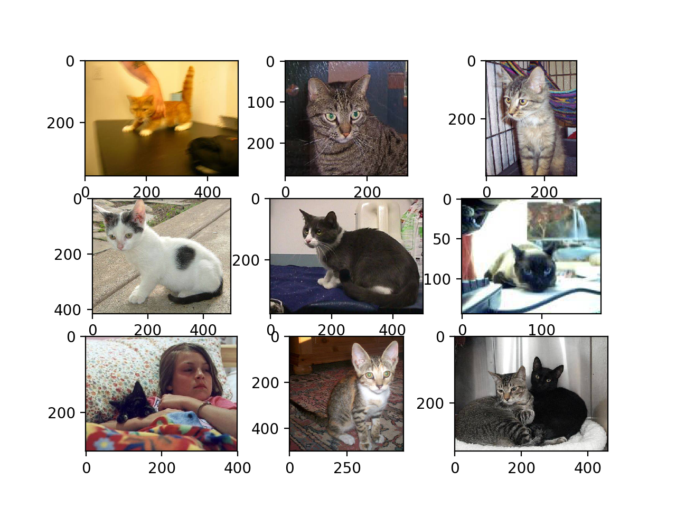

Slide 13
What AI can not do
Think like 8-year old
Common-sense reasoning
Exercise judgement
Make decisions in unpredictable circumstances

Slide 14
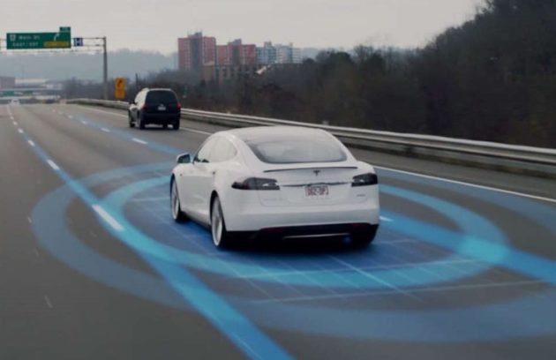

Slide 15
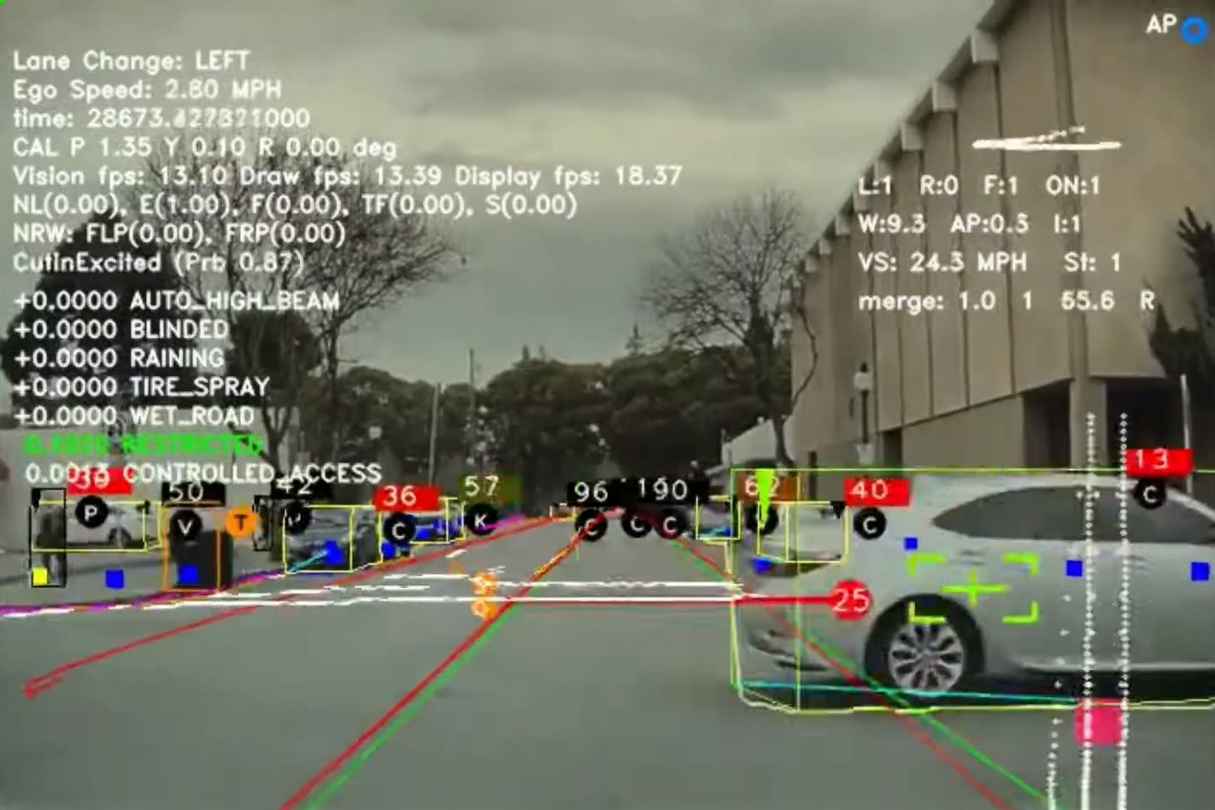

Slide 16
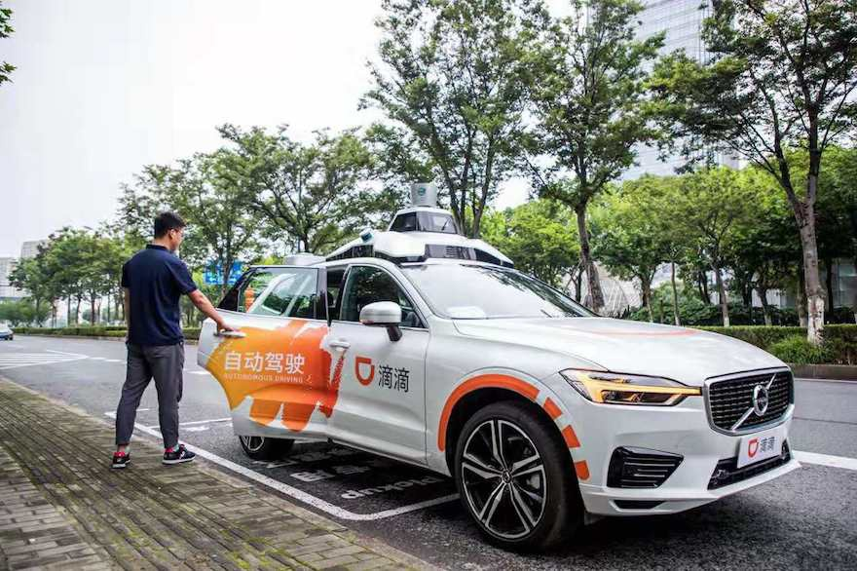

Slide 17

Is AI winter coming?

Slide 18
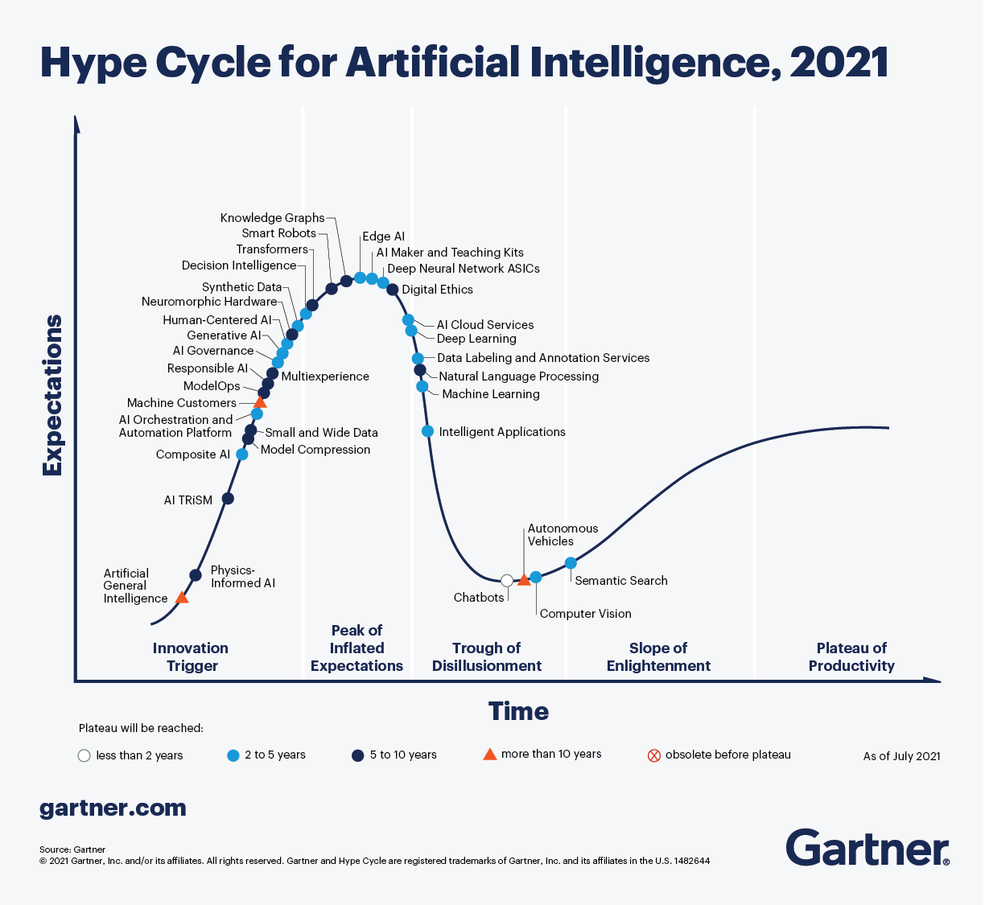

Slide 19

The era of digital platforms

Slide 20
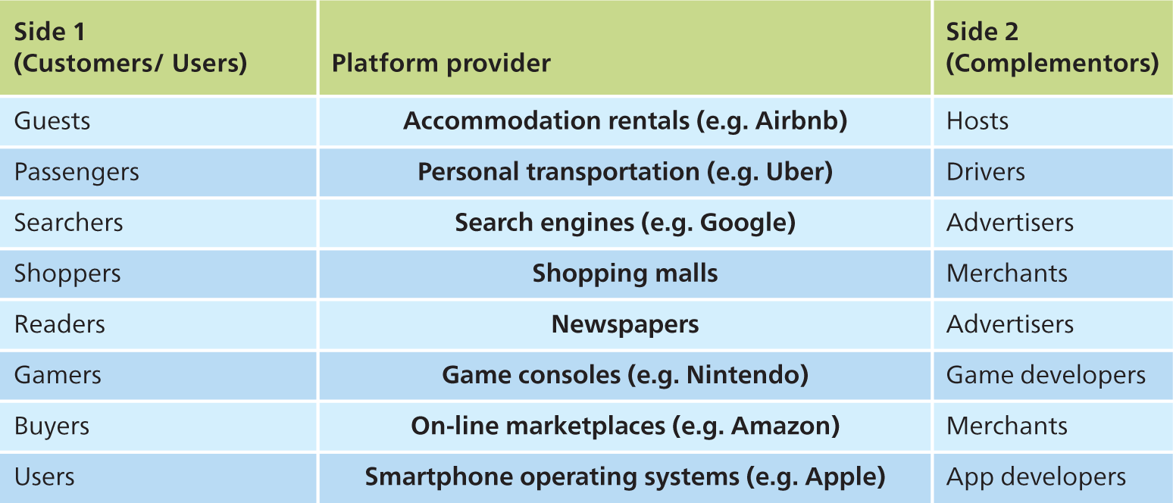
Platform providers
Copyright © 2020, 2017, 2014 Pearson Education, Inc. All Rights Reserved
Notes:
Table 7.1 Platform providers

Slide 21
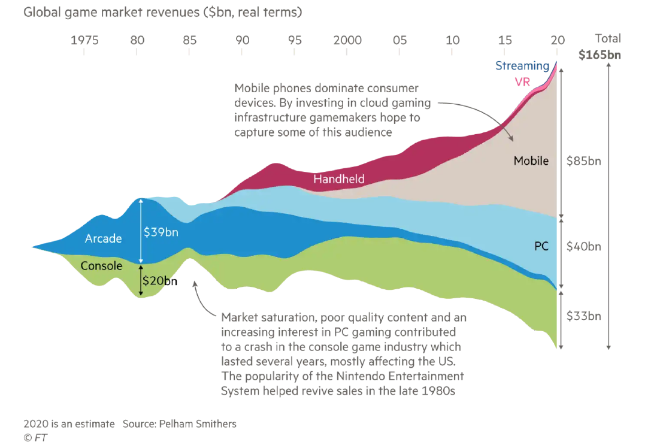

Slide 22
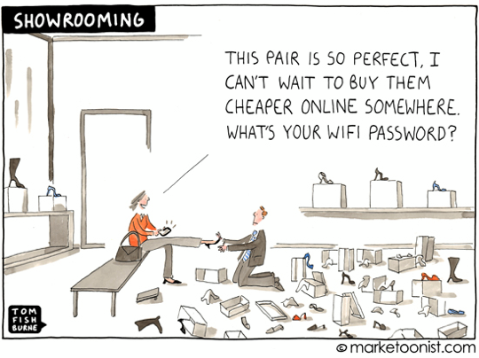

Slide 23


Slide 24


Slide 25
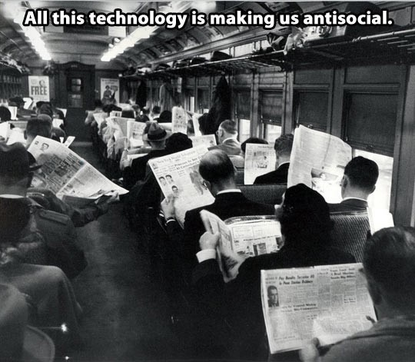

Slide 26


Slide 27

The challenges of (technological) decoupling

Slide 28
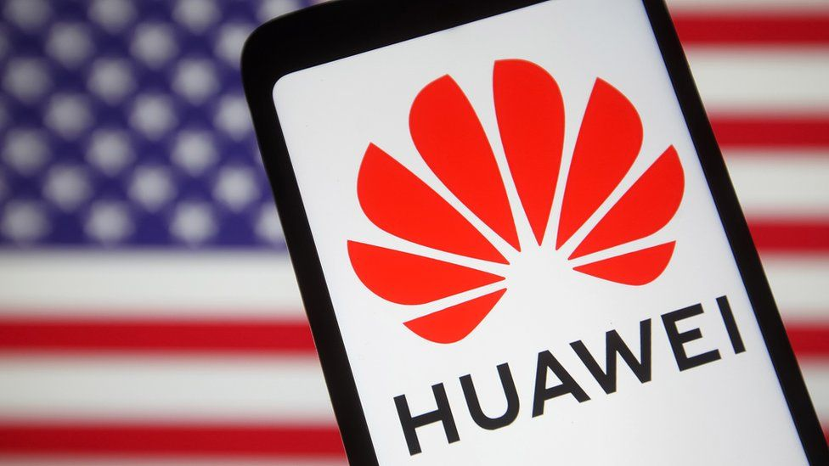

Slide 29
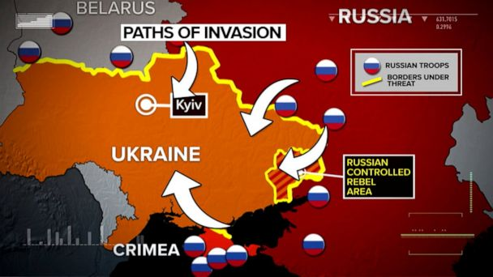

Slide 30


Slide 31
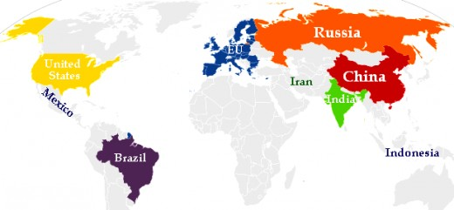

Slide 32
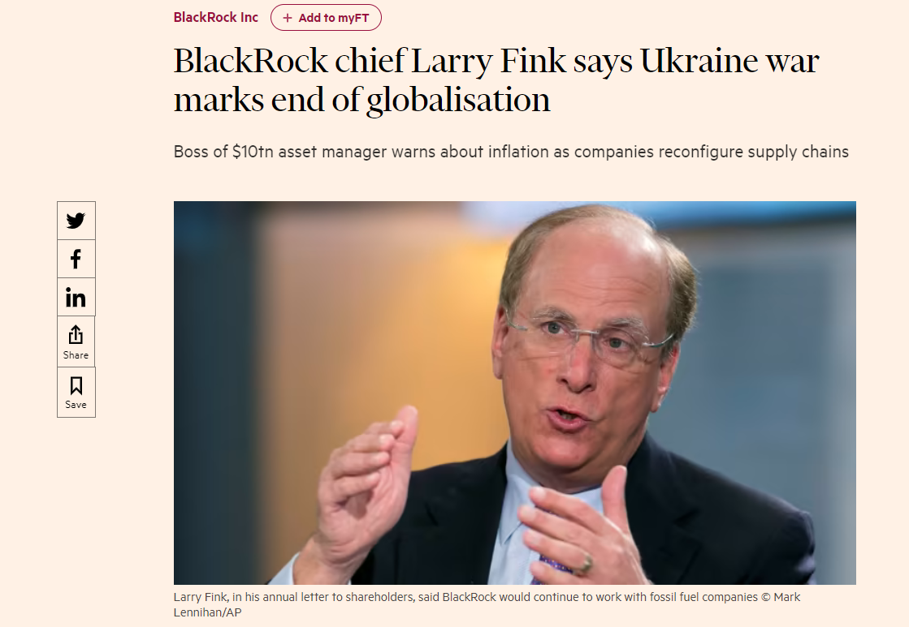

Slide 33
Implications
Re-shoring & Deglobalization
Disruption for global trade and supply chains
Inflation
Reserve currency

Slide 34

Thank you!
Ivan Zupic
Email: i.zupic@gold.ac.uk

