Slide 1
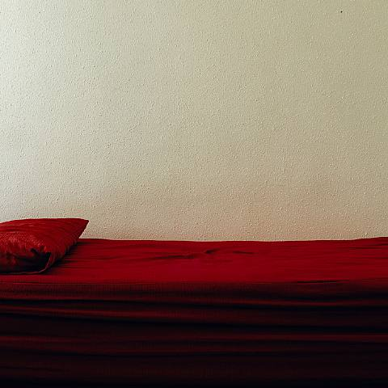
Sanguine Resistance: dreaming of a future for blood
Lynn Turner
(Goldsmiths, University of London)
l.j.turner@gold.ac.uk
Derrida Today 7 2022
Washington, DC
Sarah Jones, Analyst (couch) (I), 2007

Slide 2
‘Meaning (sens) is what staunches blood [sang]’
- Derrida, The Death Penalty II: 215
Blood pressure
Blood type
Blood loss
Blood stain
Blood vengeance
Blood rites
Blood donation

Slide 3
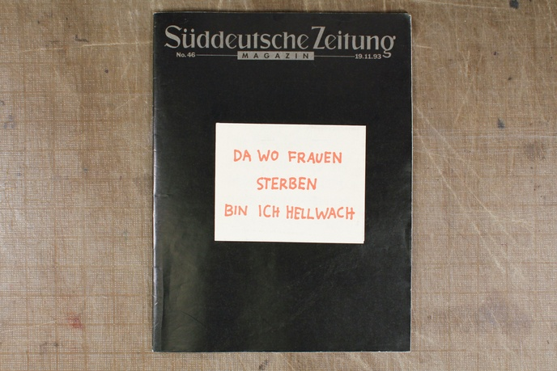
Blood pressure
Blood type
Blood loss
Blood stain
Blood vengeance
Blood donation
Jenny Holzer, Lustmord (I am awake where women die) 1993

Slide 4
‘The word for word, the word “cru” and “cruor,” is inescapably the word blood. … Or, to put it another way, the word for word is blood. And blood is the word believed. It is “le mot cru”.’
– Gil Anidjar ‘Le Cru: Derrida’s Blood’ 2015: 15
‘So, at this poste restante, a woman’s message came my way recently that could not be decoded by the usual methods […]
“At the point in the mass when they, the (spiritual) father and son, are reciting together the ritual words of the consecrations saying ‘This is my body, this is my blood,’ I bleed”.’
– Luce Irigaray, ‘Belief Itself’ [1980] in Sexes and Genealogies, 1993, 25.
Blood pressure
Blood type
Blood loss
Blood stain
Blood vengeance
Blood donation

Slide 5
Blood pressure
Blood type
Blood loss
Blood stain
Blood vengeance
Blood donation

Slide 6
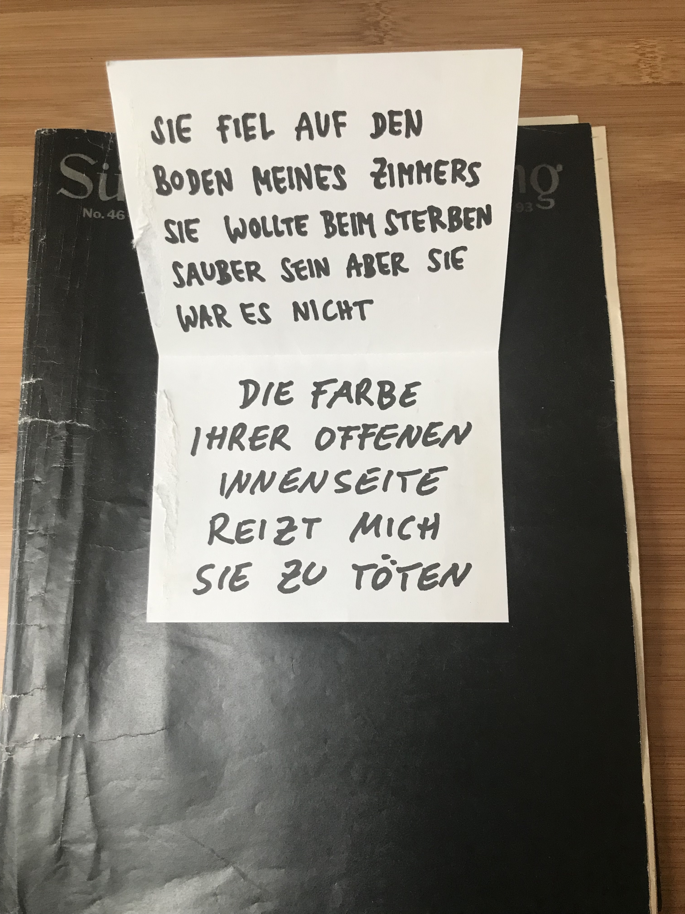
Blood pressure
Blood type
Blood loss
Blood stain
Blood vengeance
Blood donation

Slide 7
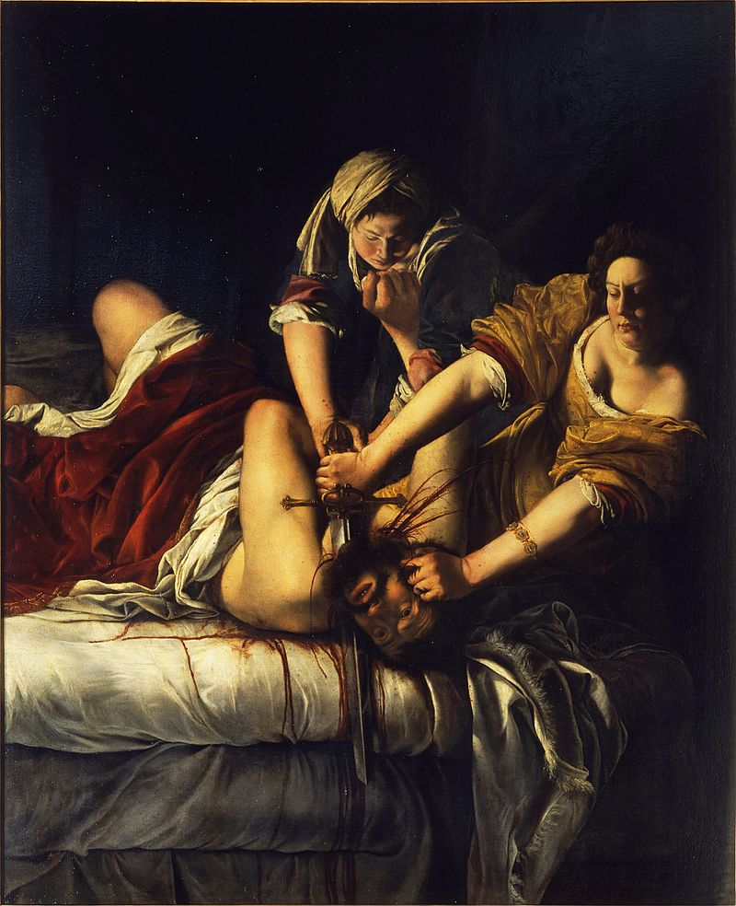
‘It’s a shame we couldn’t bleed the commanders and the soldiers who were involved […] instead of the murderers, the women who still survive were asked and they volunteered their blood. I thank them for that.’ - Jenny Holzer
Blood pressure
Blood type
Blood loss
Blood stain
Blood vengeance
Blood donation
Artemisia Gentileschi, Judith Beheading Holofernes, 1620

Slide 8
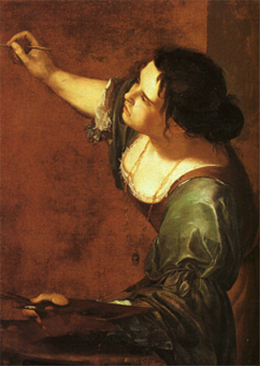
‘how is it that the abolitionist cause has more often been served, publicly served, - by poets or by writers than by philosophers or even politicians?’
- Derrida, Death Penalty II, 234
Blood pressure
Blood type
Blood loss
Blood stain
Blood vengeance
Blood rites
Blood donation
Artemisia Gentileschi, Self-Portrait as the Allegory of Painting, 1638

Slide 9
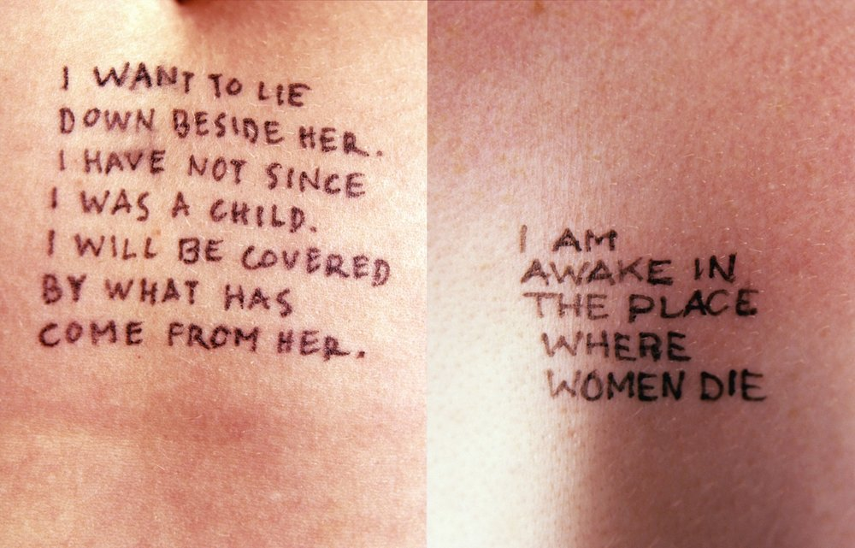
Blood pressure
Blood type
Blood loss
Blood stain
Blood vengeance
Blood rites
Blood donation

Slide 10
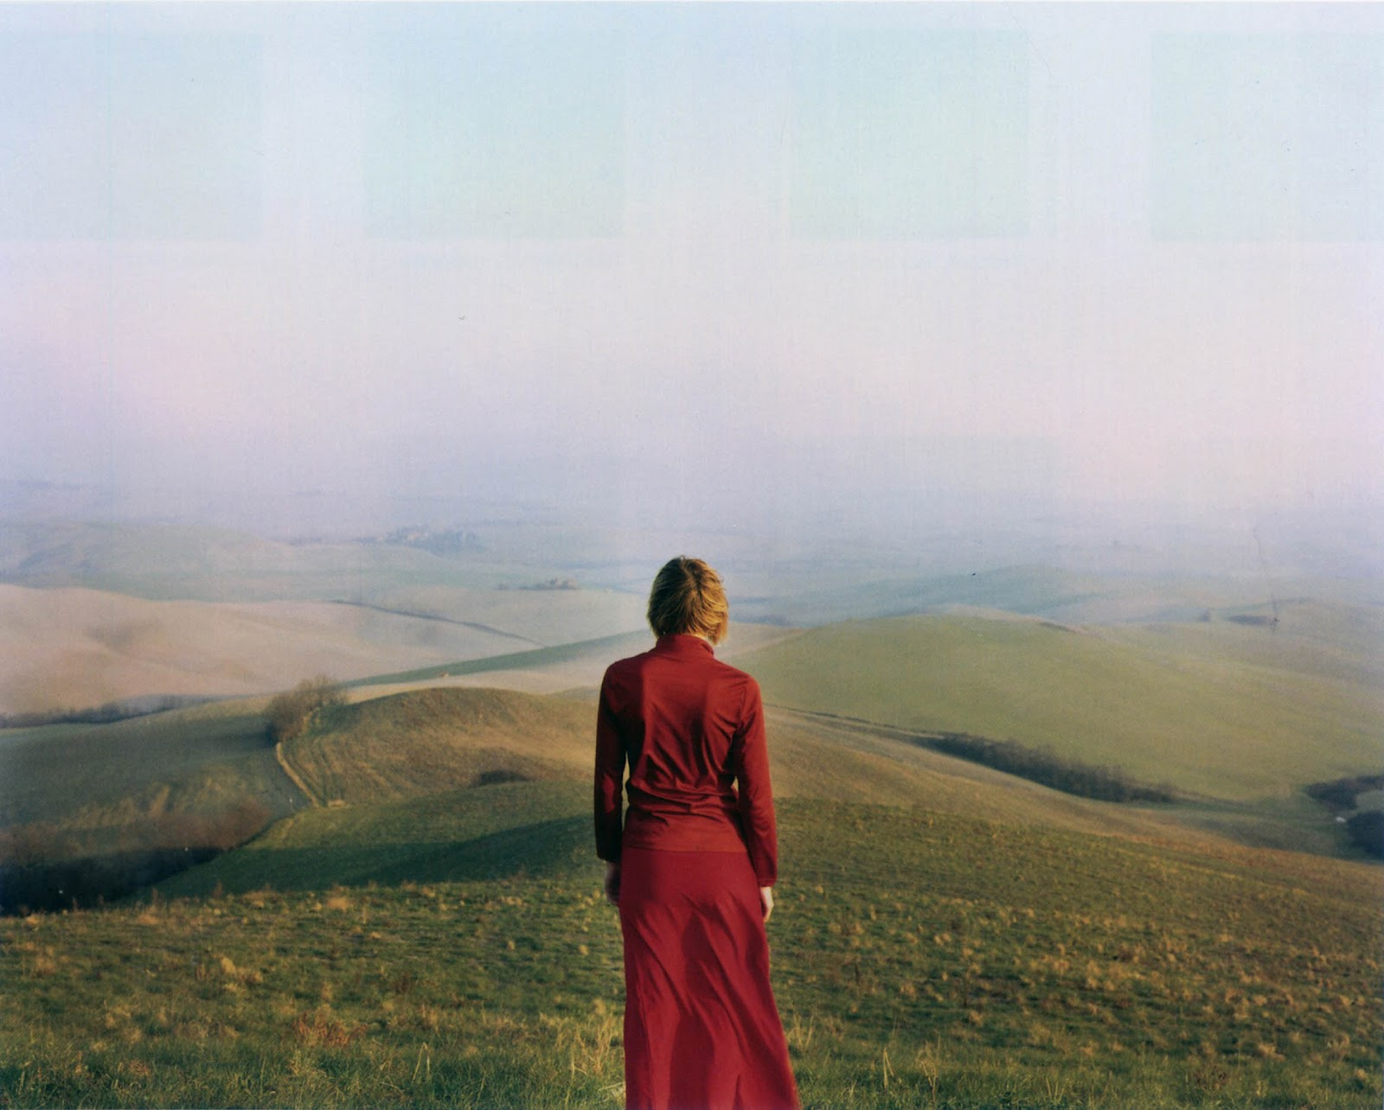
‘It is a question, then for these poor girls, in their virile protest, of standing upright so as to lay claim to their rights, their alleged rights. Such that between the rectitude of right (Recht, droit) and the rectitude of the erect body, there is an analogy, a common rection or direction that may lead one to think that the boy enjoys a natural right, so to speak, one which the girl tries vainly, and precociously to supplement by way of an artificial mimesis, of a non-natural right, a right that can only be claimed and asserted in hatred, a non-natural right, thus a historical right […]. Freud lets it be understood that in their virile protests, feminists, emancipated women, above all those who write, are trying desperately to urinate standing up.’
- Derrida, Death Penalty II: 237
Elina Brotherus, Wanderer, 2003

Slide 11
‘Dare to speak her piece about giving, the possibility of a giving that doesn’t take away, but gives. Speak of her pleasure and, God knows, she has something to say about that, so that she gets to unblock a sexuality that’s just as much feminine as masculine, ‘de-phallocentralize’ the body, relieve man of his phallus, return him to an erogenous field and a libido that isn’t stupidly organized round that monument, but appears shifting, diffused, taking on all the others of oneself.’
- Cixous, ‘Castration or Decapitation’, Signs, 7.1. 1981, 51
Blood pressure
Blood type
Blood loss
Blood stain
Blood vengeance
Blood rites
Blood donation

