Slide 1

Decolonising Creative Writing #decolonisingcreativity
@GoldsmithsEduc1
@MACreateEdGol @wonderfrancis
@MACreateEdGold
Centre for Learning, Culture and Languages
Notes:
Join Zoom Meeting
https://gold-ac-uk.zoom.us/j/99020750218?pwd=WEpsOHlJelYrenBoaXRPUFdENXhwUT09

Slide 2

Conference schedule #decolonisingcreativity
9am-9.15am Introduction by the head of centre, Dr. Vicky Macleroy
9.15am-10.15am Decolonising Creative Writing, the key issues outlined by Dr. Francis Gilbert, writer Steve Roberts, noted actor and writer Leena Dhingra. Each speaker will offer their own perspectives and invite creative responses and questions.
10.15am-10.30am Break
10.30am-10.50am Using creative writing to decolonise: a creative writing exercise.
11am-12.30pm Toni Giselle Stuart to give the keynote address, which will be an interactive lecture and workshop, exploring vital issues connected with creative writing, race and decolonisation. She will draw upon her own work.
12.30pm-1pm Lunch
1pm-2pm (7am in Bahamas) Yasmin Glinton Poitier will examine how the black woman must look for a place to belong. To this vein, she will explore moments shaped through conversation and how she creates poems out of them. As a Bahamian female, she writes in dialect.
2pm-2.45pm A creative-writing workshop led by Carinya Sharples which will look at how we can draw on our deep wells of knowledge and challenge restrictive colonial boundaries of race and identity through writing about food and music.
2.45pm-3pm. Final thoughts and Plenary.
3pm-4pm (optional): Launch of the creative writing anthology, Dreams and Nightmares, published by Goldsmiths Department of Educational Studies and Widening Participation

Slide 3
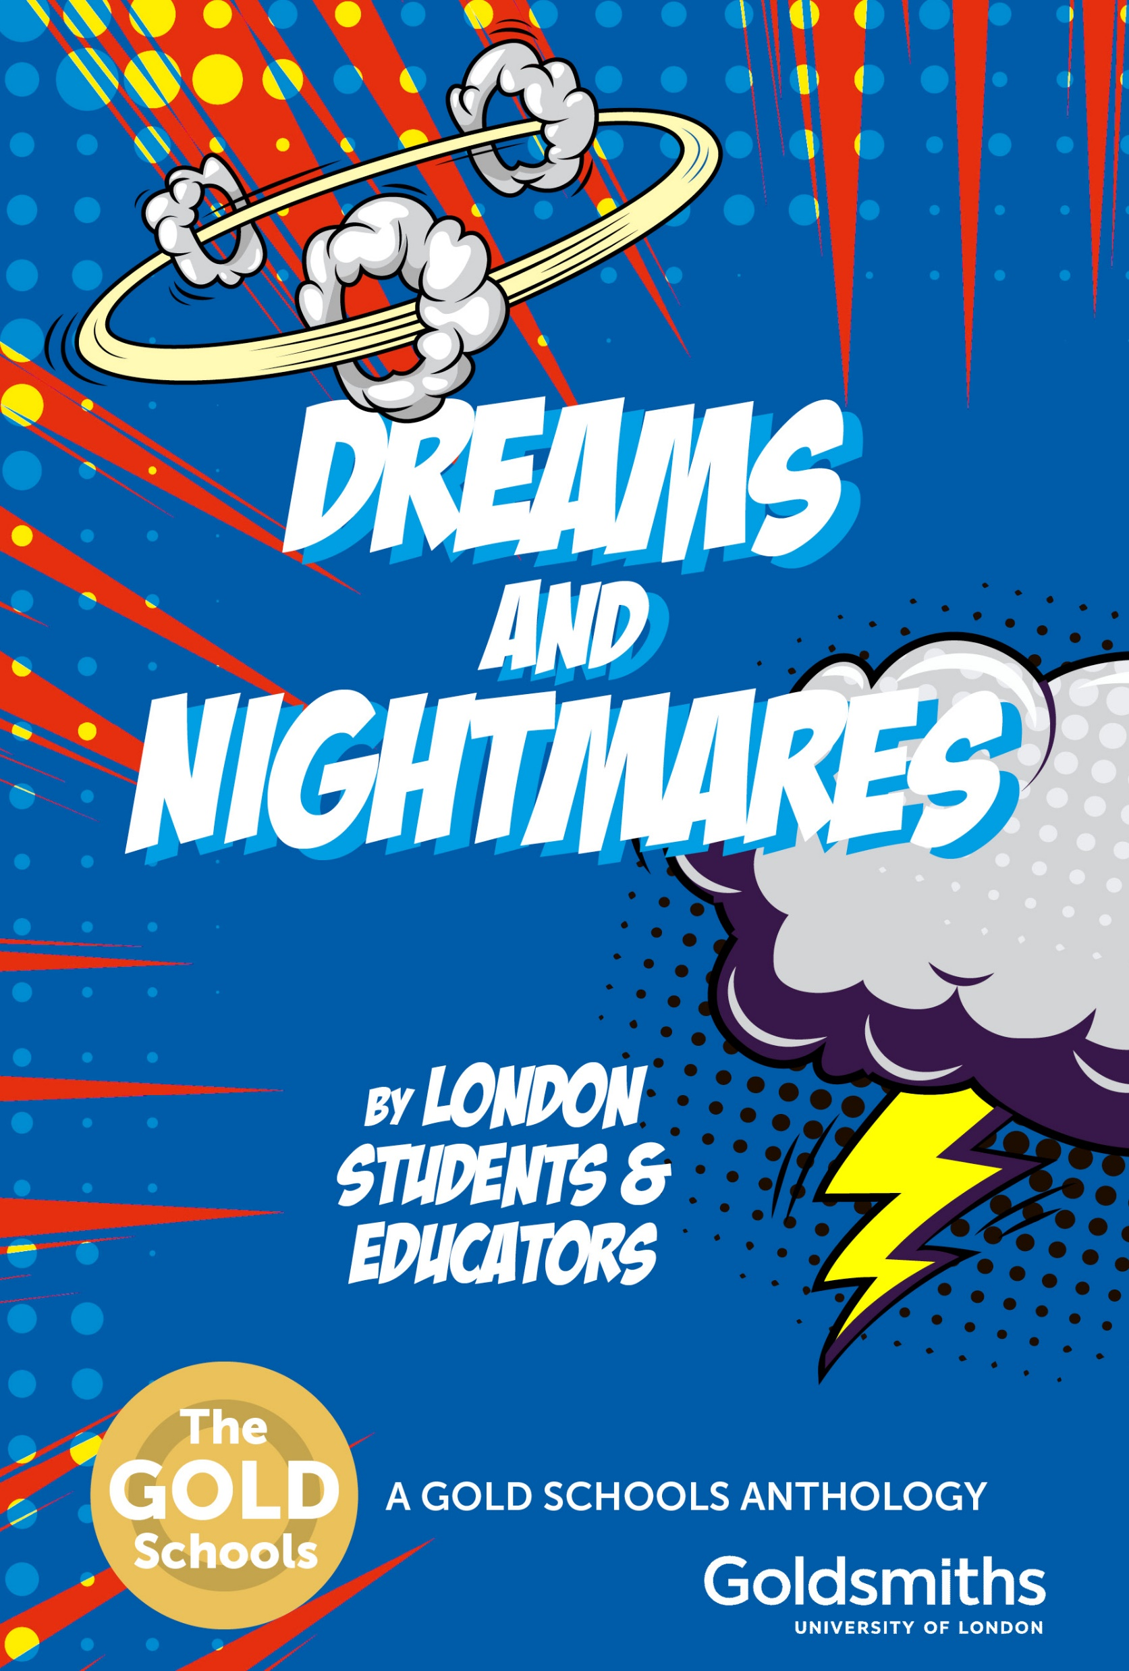
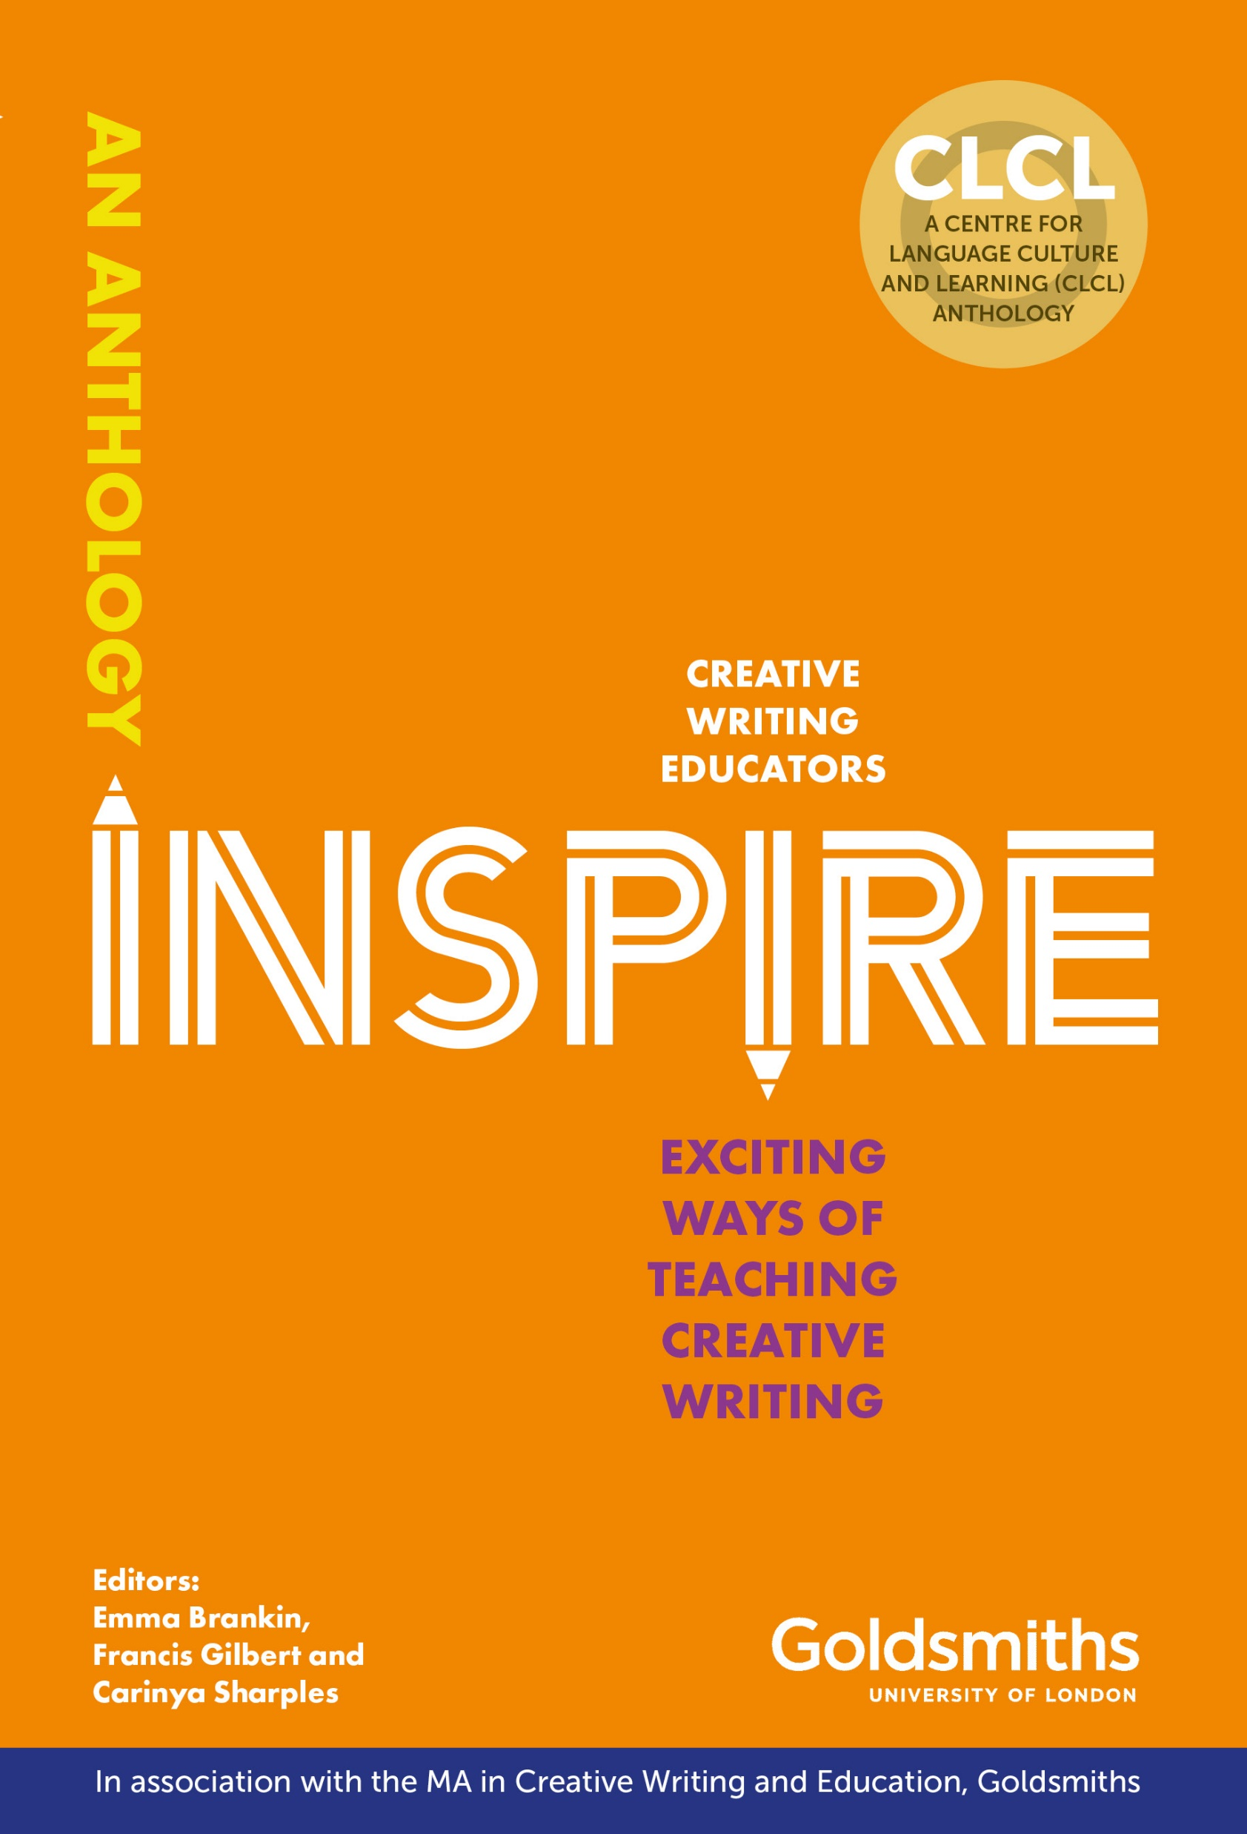
MA in Creative Writing and Education: alumni speak!
@GoldsmithsEduc1
@MACreateEdGol @wonderfrancis
#decolonisingcreativity

Slide 4

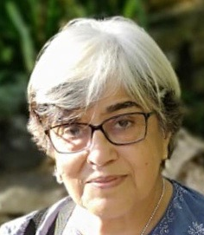
Leena Dhingra writes:
I was born in India but my family were ‘accidentally’ dislocated in Paris due to the Partition of India in 1947. This led to a pattern of ‘partitions’, ten schools in four countries, three languages, five professions. An external and internal ‘unsettledness’.
Presently, I am settled as a writer and actor. I have written a ‘AMRITVELA’ (Women’s Press1988) and contributed to several anthologies. My new book ‘EXHUMATION: The life and death of Madan Lal Dhingra’ which explores the impact of Colonialism on a family across the 20th century, will be out in August 2021. (HopeRoad publishing).
As an actor, I have appeared on stage, film, radio and TV. Most recently in ‘Casualty’, ‘Dr Who’ and ‘Ackley Bridge.’

Slide 5

Two key points
Examining:
How creative writing has been colonised, and can be decolonised
How creative writing can assist with processes of decolonisation

Slide 6
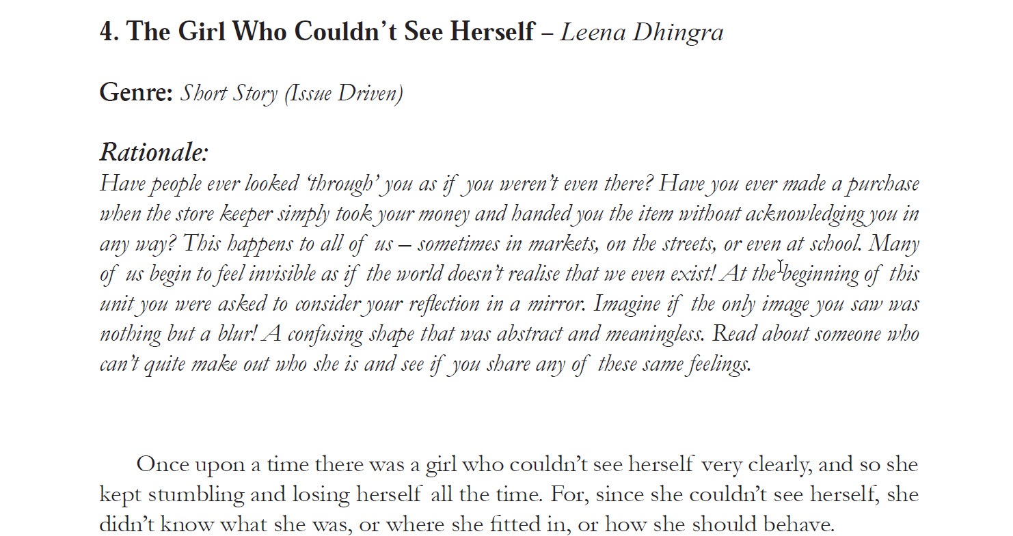
The Girl Who Couldn’t See Herself
#decolonisingcreativity

Slide 7
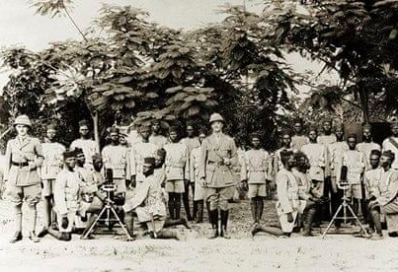
Erasure
#decolonisingcreativity
‘The education I received was a British education, in which British ideas, British culture, and British institutions were automatically assumed to be superior. There was no such thing as African culture.’ Nelson Mandela.

Slide 8
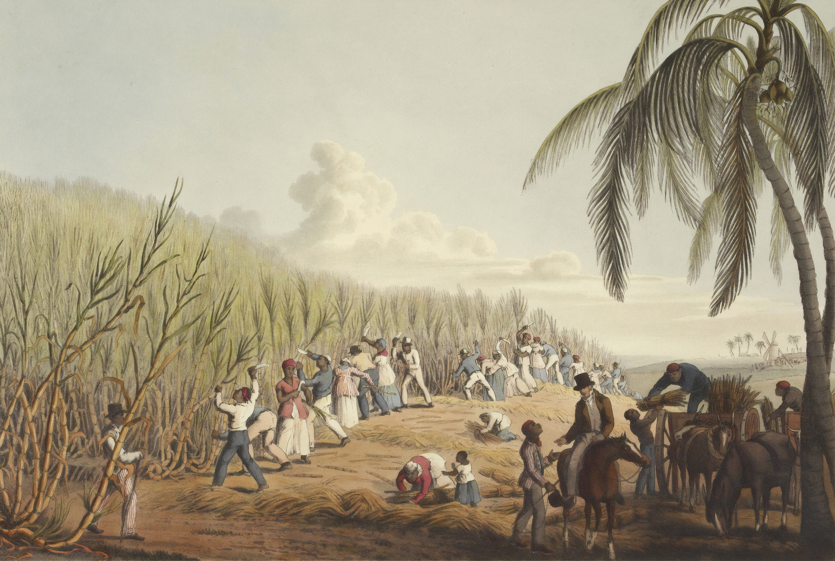
Dead silence
#decolonisingcreativity
Edmund, Sir Thomas Bertram’s second son, is speaking to Fanny Price, the heroine of the novel…
“Your uncle thinks you very pretty, dear Fanny—and that is the long and the short of the matter. Anybody but myself would have made something more of it, and anybody but you would resent that you had not been thought very pretty before; but the truth is, that your uncle never did admire you till now—and now he does…”
“Oh! don't talk so, don't talk so,” cried Fanny, distressed by more feelings than he was aware of; but seeing that she was distressed, he had done with the subject, and only added more seriously—
“Your uncle is disposed to be pleased with you in every respect; and I only wish you would talk to him more. You are one of those who are too silent in the evening circle.”
“But I do talk to him more than I used. I am sure I do. Did not you hear me ask him about the slave-trade last night?”
“I did—and was in hopes the question would be followed up by others. It would have pleased your uncle to be inquired of farther.”
“And I longed to do it—but there was such a dead silence! And while my cousins were sitting by without speaking a word, or seeming at all interested in the subject, I did not like—I thought it would appear as if I wanted to set myself off at their expense, by shewing a curiosity and pleasure in his information which he must wish his own daughters to feel.”
CHAPTER XXI of Jane Austen’s Mansfield Park (1814)

Slide 9
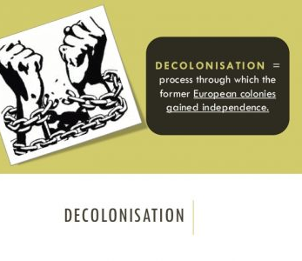
What is decolonisation?
It is more than colonial powers withdrawing from territories…
It is about understanding and contesting the ‘ways in which knowledge is produced, propagated and perpetuated through White, Western perspectives’ (Begum & Saini 2019: 196)
Notes:
noun
noun: decolonisation
the action or process of a state withdrawing from a former colony, leaving it independent.
Becoming aware of the ideological construct of colonisation; how this is a complex construct which is composed of embodied experiences, complex narratives, attitudes, discourses

Slide 10
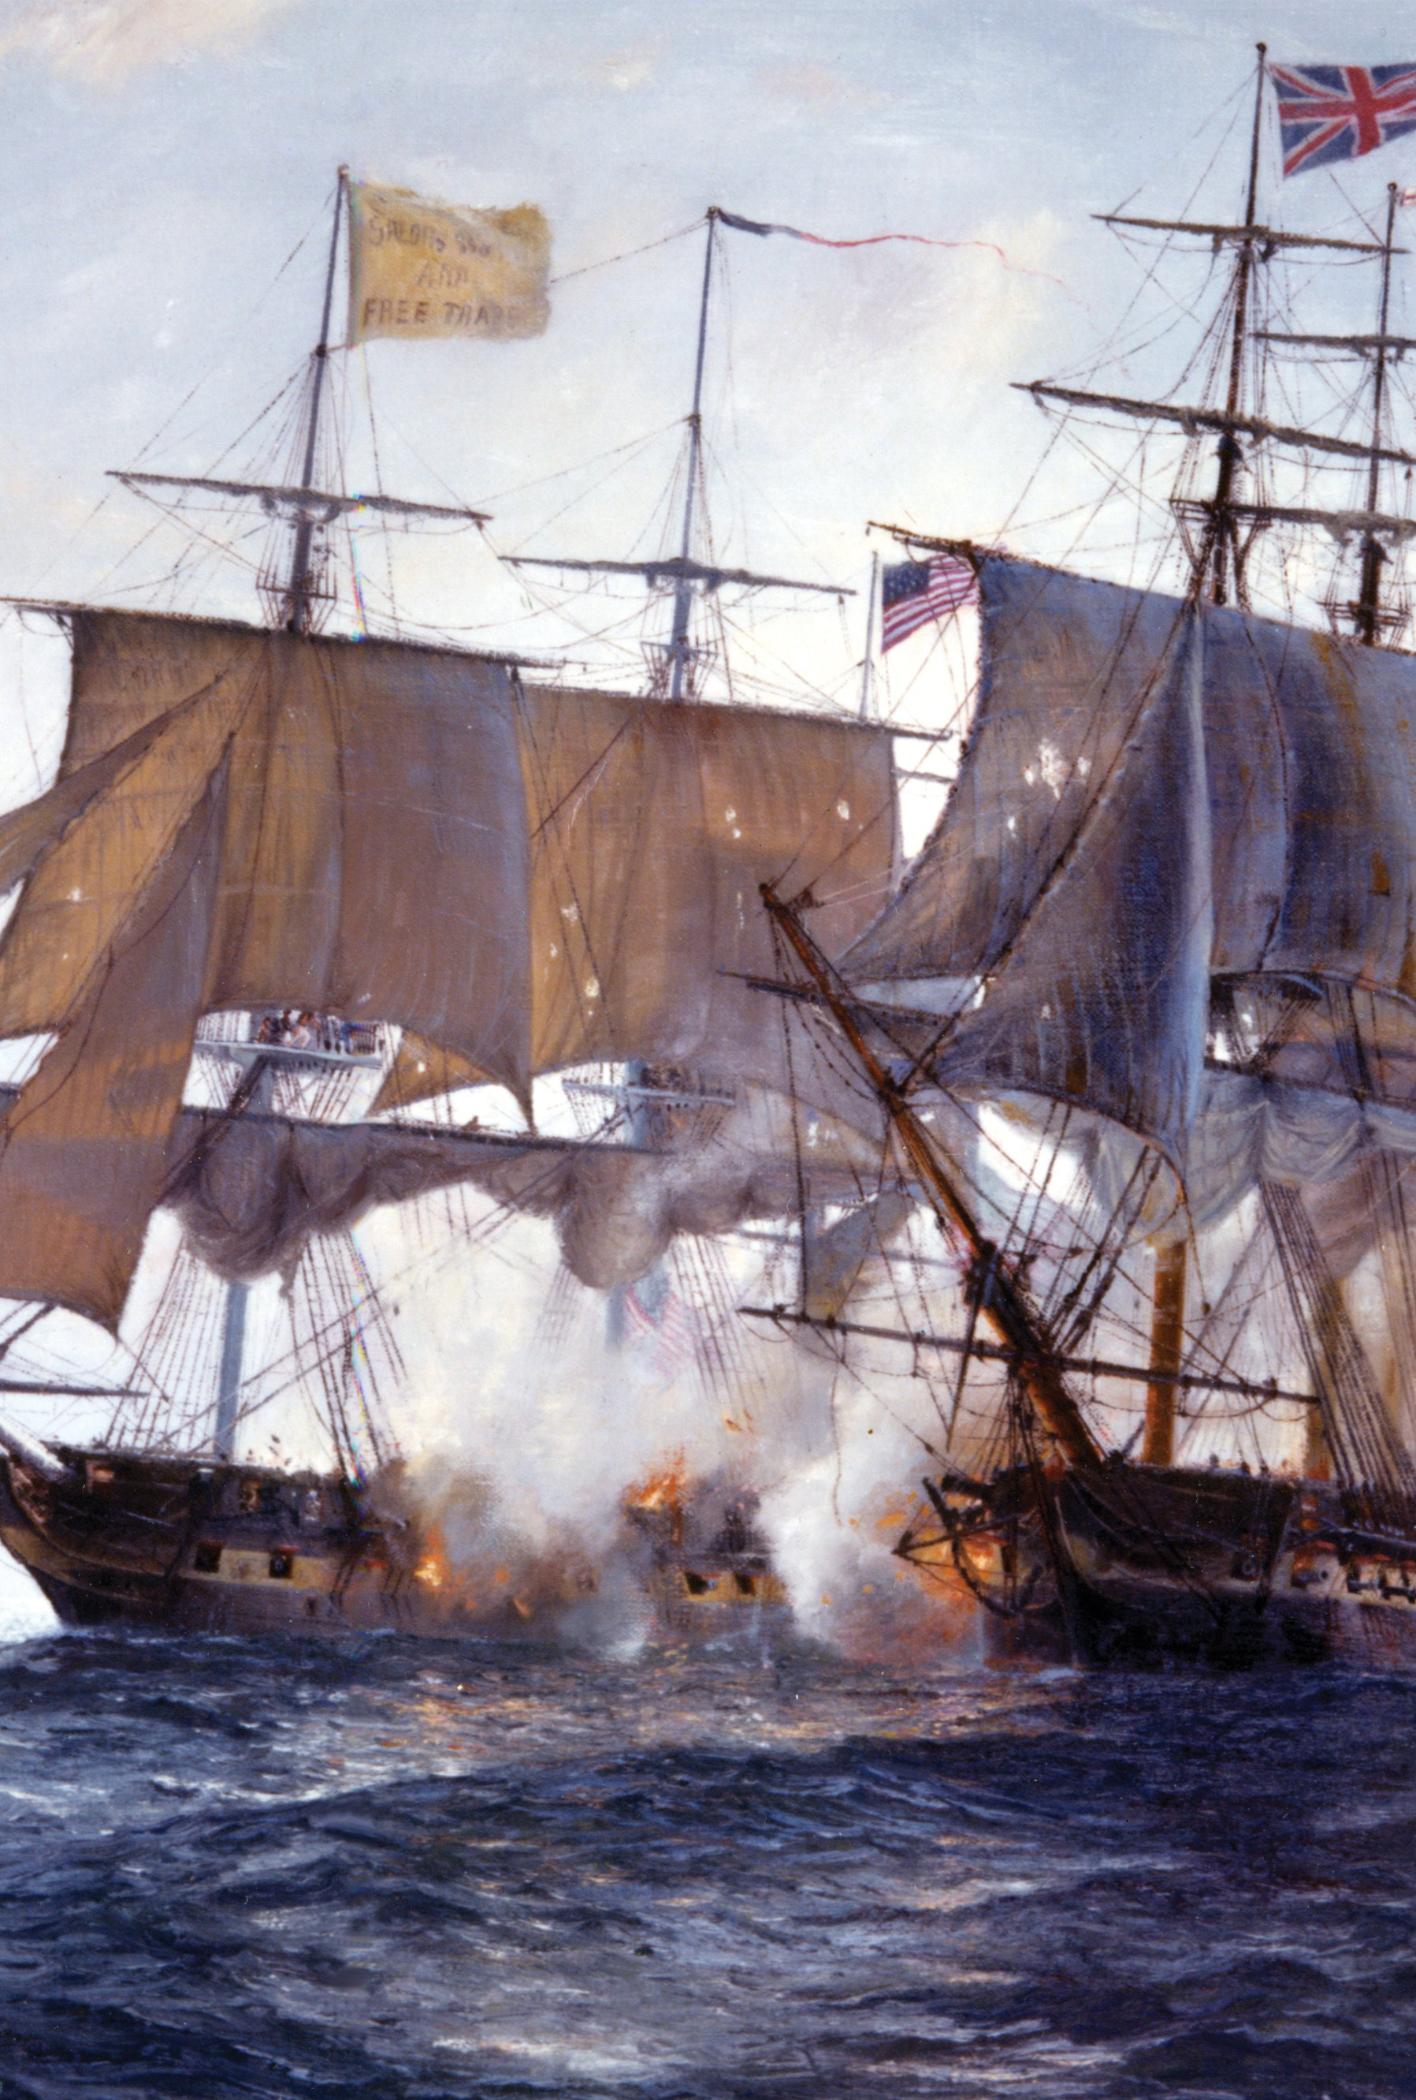
Distinguishing features of ‘modern’ colonialism
Conceptual: separation of ‘body’ and ‘mind’; ‘man’ and ‘nature’, which becomes something to be exploited
Violent: European states mobilised their ‘superior’ naval weaponry (Britain in 19th century: Goldsmiths was a naval college…)
Dehumanising: less powerful people become part of ‘nature’; ‘savages’, ‘pagans’, ‘lazy’, ‘scroungers’, ‘unenlightened’
Boom/bust economic model: colonising states, supported by financial institutions hungry for profit which lend money, borrow money to expand ‘economically’
Ecologically destructive: ‘nature’ is destroyed, industrialised, utilised for profited
A process of ‘cheapening’ happens: nature, money, work, care, food, energy and lives
Patel, R., & Moore, Jason W. (2018). A history of the world in seven cheap things: A guide to capitalism, nature, and the future of the planet. USA. University of California Press.

Slide 11
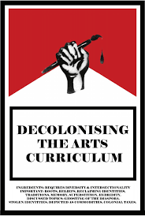
Decolonised Curriculum
A decolonised curriculum is not one that turns its back on history – though it is one that might enable students to understand that ‘There is no document of civilization which is not at the same time a document of barbarism’ (Benjamin [1955] 1970, 259). And it is one that rejects the exclusionary force of current policy. (Yandell 2020: 351)
Notes:
John Yandell (2020) Editorial, Changing English, 27:4, 349-352, DOI:
10.1080/1358684X.2020.1822070

Slide 12
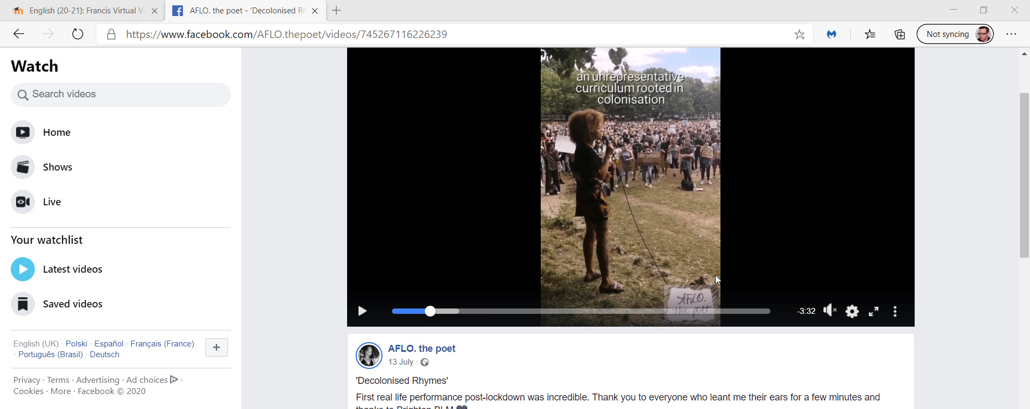
Was/is creative writing colonised?

Slide 13
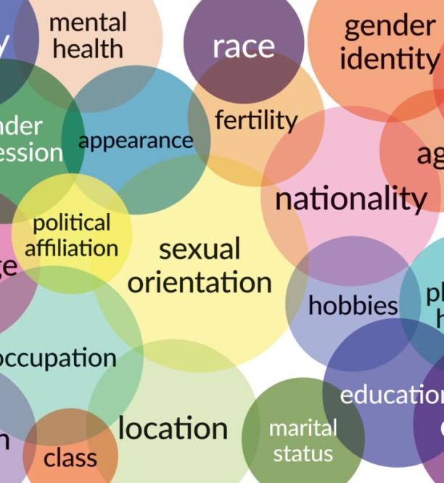
Intersectionality and creative writing processes
Intersectionality is a term that has been increasingly applied to knowledge projects whose purpose is to understand all dimensions of power relations, including race, class, gender, and sexuality. Intersectional knowledge projects have reconceptualized these phenomena as mutually constructing systems of power.
Kimberlé Crenshaw (1989):
Because the intersectional experience is greater than the sum of racism and sexism, any analysis that does not take intersectionality into account cannot sufficiently address the particular manner in which Black women are subordinated (140)
References
Collins, P., & Chepp, V. (2013). Intersectionality. The Oxford Handbook of Gender and Politics, The Oxford Handbook of Gender and Politics.
Crenshaw, Kimberle () "Demarginalizing the Intersection of Race and Sex: A Black Feminist Critique of Antidiscrimination Doctrine, Feminist Theory and Antiracist Politics," University of Chicago Legal Forum: Vol. 1989: Iss. 1, Article 8. Available at: http://chicagounbound.uchicago.edu/uclf/vol1989/iss1/8

Slide 14
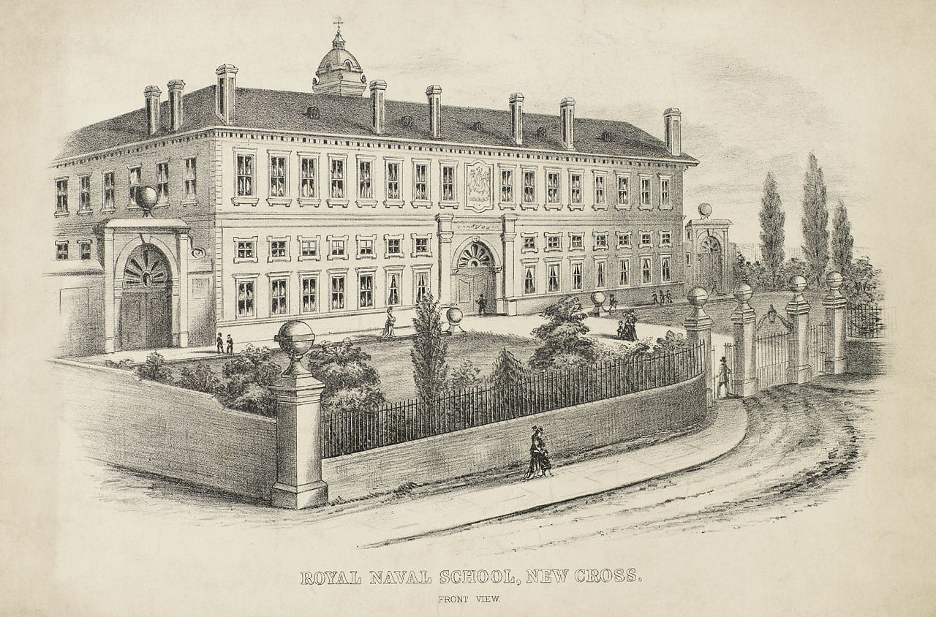
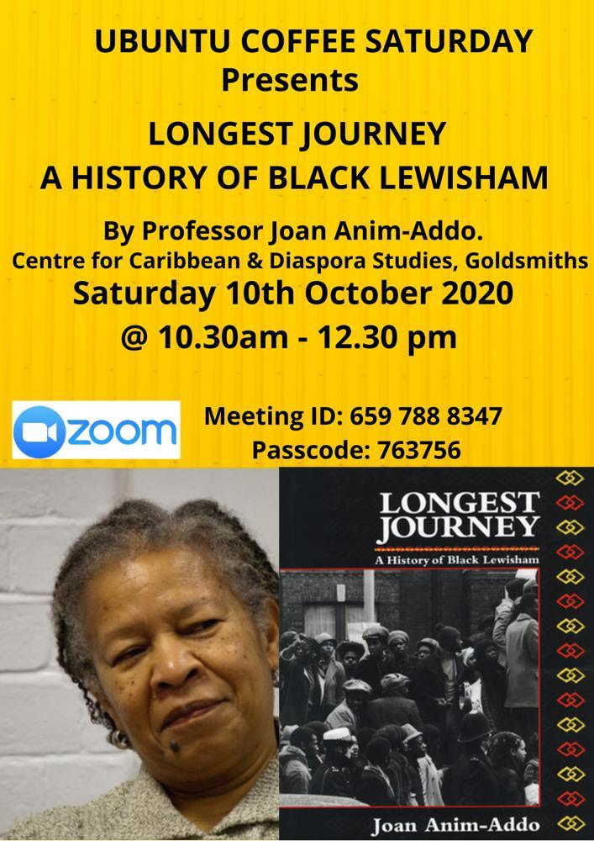
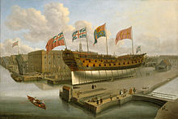
Creative writers to become aware of the contested history that they are part of

Slide 15
Lord Macauley, 1935 (Green 2011: 7-8)
Green and McIntyre (2011:7) write:
One of the first key markers in the development of the subject was the 1835 English Education Act. Set against the background of Victorian colonial expansion, this Act officially required Indians to study in English and to study works of English literature. English was seen as ‘civilising’. Member of the Supreme Council of India T.B. Macaulay in a political Minute of 2 February 1835 perfectly captures the tone of the age, its pride, arrogance and missionary zeal:
We have to educate a people who cannot at present be educated by means of their mother-tongue. We must teach them some foreign language. The claims of our own language it is hardly necessary to recapitulate. It stands pre-eminent even among the languages of the West. It abounds with works of imagination not inferior to the noblest which Greece has bequeathed to us, with models of every species of eloquence, with historical composition, which, considered merely as narratives, have seldom been surpassed, and which, considered as vehicles of ethical and political instruction, have never been equalled, with just and lively representations of human life and human nature, with the most profound speculations on metaphysics, morals, government, jurisprudence, trade, with full and correct information respecting every experimental science which tends to preserve the health, to increase the comfort, or to expand the intellect of man. Whoever knows that language has ready access to all the vast intellectual wealth which all the wisest nations of the earth have created and hoarded in the course of ninety generations. It may safely be said that the literature now extant in that language is of greater value than all the literature which three hundred years ago was extant in all the languages of the world together. (Macaulay 1835, in Bureau of Education 1920)

Slide 16
To explore how racist discourses have permeated the language, structure and power dynamics of modern societies
Williamson said he was not surprised the UK was the first to roll out the immunisation because “we’re a much better country than every single one of them”. (The Guardian, 3rd December 2020)
They may eat with their fingers in Delhi, but we can’t have children eating mashed potato with their fingers in England summary of Nick Ferrari speaking to Francis Gilbert on LBC. 9th December 2020.
Possible CW: devise a found poem from these texts…

Slide 17
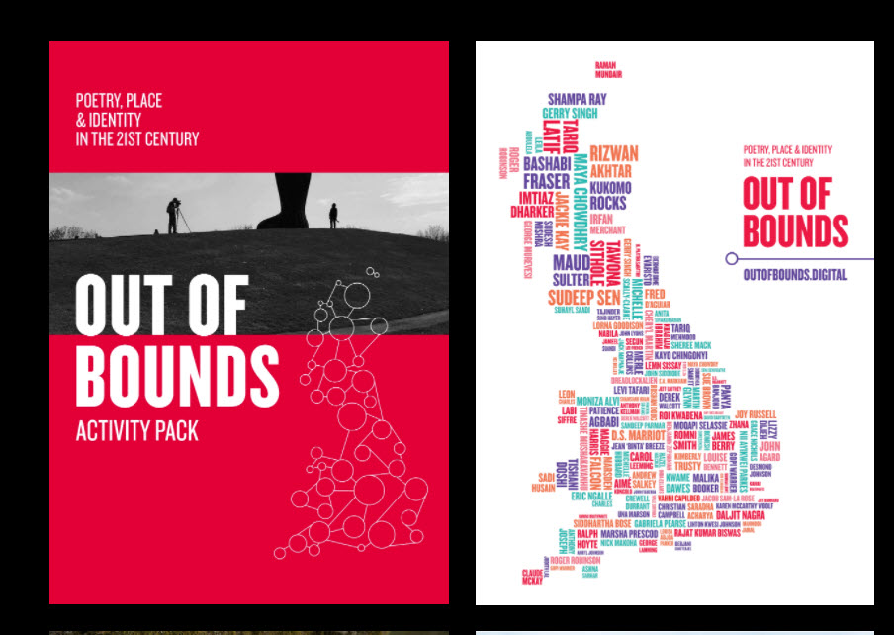
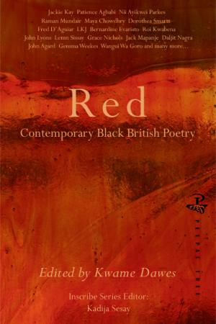
To explore diverse writing and be open to its affordances

Slide 18
To explore this history creatively and sensitively through reading and writing
The British Poem by Benjamin Zephaniah
Take some Picts, Celts and Silures
And let them settle,
Then overrun them with Roman conquerors.
Remove the Romans after approximately 400 years
Add lots of Norman French to some
Angles, Saxons, Jutes and Vikings, then stir vigorously.
Mix some hot Chileans, cool Jamaicans, Dominicans,
Trinidadians and Bajans with some Ethiopians, Chinese,
Vietnamese and Sudanese.
Then take a blend of Somalians, Sri Lankans, Nigerians
And Pakistanis,
Combine with some Guyanese
And turn up the heat.
Sprinkle some fresh Indians, Malaysians, Bosnians,
Iraqis and Bangladeshis together with some
Afghans, Spanish, Turkish, Kurdish, Japanese
And Palestinians
Then add to the melting pot.
Leave the ingredients to simmer.
As they mix and blend allow their languages to flourish
Binding them together with English.
Allow time to be cool.
Add some unity, understanding, and respect for the future,
Serve with justice
And enjoy.
Note: All the ingredients are equally important. Treating one ingredient better than another will leave a bitter unpleasant taste.
Warning: An unequal spread of justice will damage the people and cause pain. Give justice and equality to all.
Notes:
At my SE2 school, English teachers were allowed to structure schemes of work according to personal preference, as long as the standard three pieces of writing (creative, transactional and analytical) were produced. This gave me the freedom to rearrange the anthology, grouping poems according to theme instead of place. I was hoping to highlight similar cultural experiences across different groups of people instead of perpetuating the equivalence of culture with difference. Themes that emerged included food; language; the concept of belonging; the impact of colonialism; subjugation and systemic oppression; conflict; protest.
I taught a single week of this adapted scheme of work, featuring Benjamin Zephaniah’s ‘The British (serves 60 million)’, Vladimir Lucien’s ‘Donbwé’ and Valerie Bloom’s ‘Sandwich’. During these lessons, I tried to give pupils opportunities to share aspects of their lives outside the classroom, including reflections on the meals they ate with theirfamilies and the names they called their family members (Iffath 2020: 379)

Slide 19
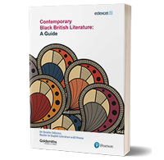
MA in Black British Literature and the Centre for Caribbean and Diaspora Studies
Exposure to a wide and diverse range of literary voices can disavow us, as readers of literature, of the notion that there is a unique, singular experience of literary Britishness through broadening our exposure to subject positions both within and outside our personal spheres of experience. (Osborne 2017: 3)

Slide 20
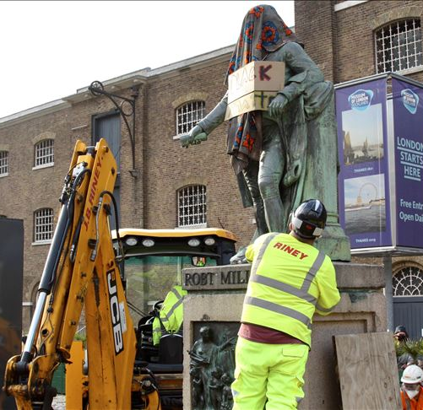
Withdrawal and creation
To become aware of the need for different modes of expression, different forms, different varieties of language can be fuel creative writing; writing in dialect, adopting new forms, ‘withdrawing’ possibly from canonised, ‘colonised’ forms of writing?

Slide 21
Decolonising creative writing
Decolonised creative writing
Colonised creative writing
Questions ‘colonial’ narratives and constructs
Aware of ‘positionality’
Intersectional
Questioning stereotypes
Responding to diverse texts
Open to experience
Mindful
Supports ‘colonial’ narratives and constructs
Unaware of ‘positionality’
Hegemonic
Promoting stereotypes
Endorsing the ‘Great Tradition’
Closed to experience
Judgemental

Slide 22
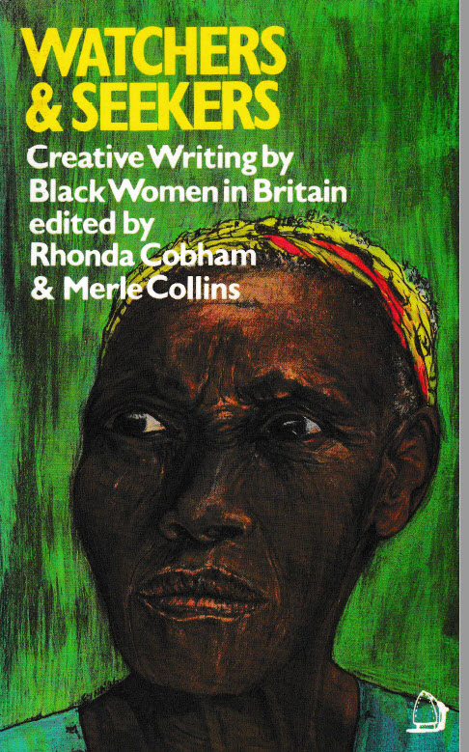
Can the Subaltern Speak?

Slide 23
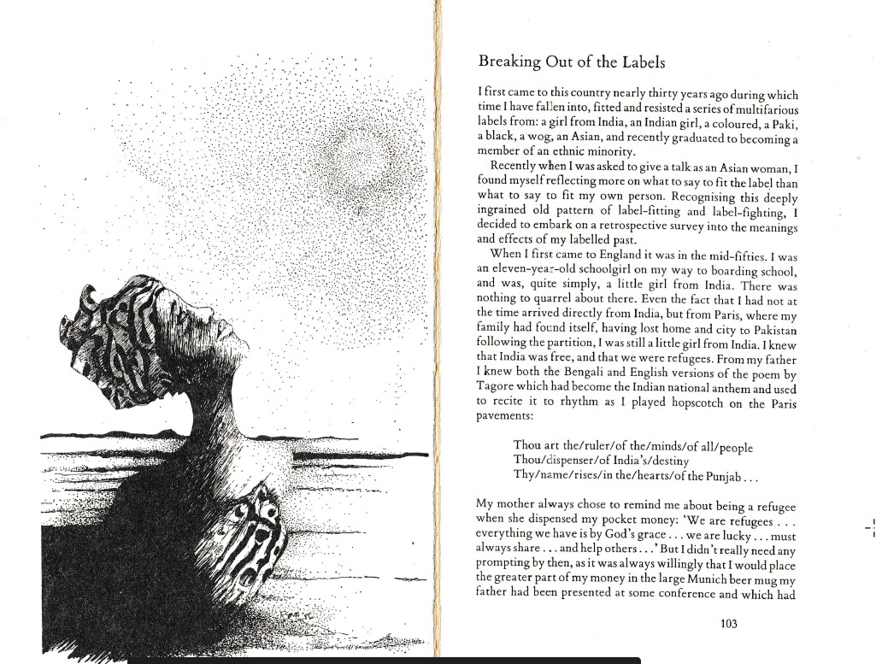

Slide 24
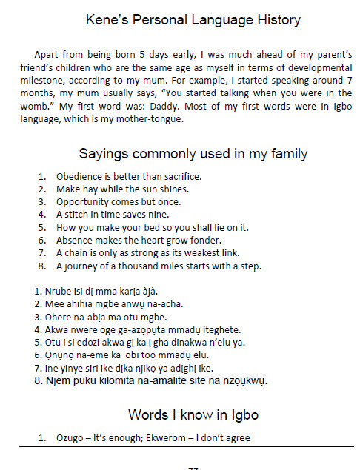
Personal Language Histories and decolonising creative writing

Slide 25
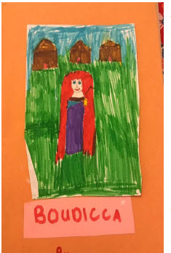
Sumaya Hassan-Adde
My father would gather my siblings and I, we would all huddle together under the duvet and await eagerly for my father to begin narrating a story.
Somali Folktale
These stories are not only rich in culture and content but in the method of narrating these tales, that have been passed down from generation to generation. The characters in these stories were mostly animals and some unknown mythical creatures, used to either scare children or teach a moral lesson….
(Once upon a time) a blind ewe (lax indhala’) fell behind the rest of her flock. She wandered into a deserted place and was grazing there alone, when suddenly, she was spotted by a hyena. He decided to eat her and began to stealthily creep towards here (London Students & Teachers 2020: 148)

Slide 26
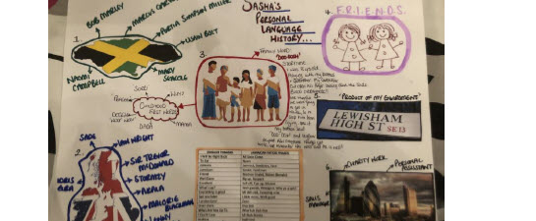
Sasha Simpson (London Students & Teachers 2020: 198)

Slide 27
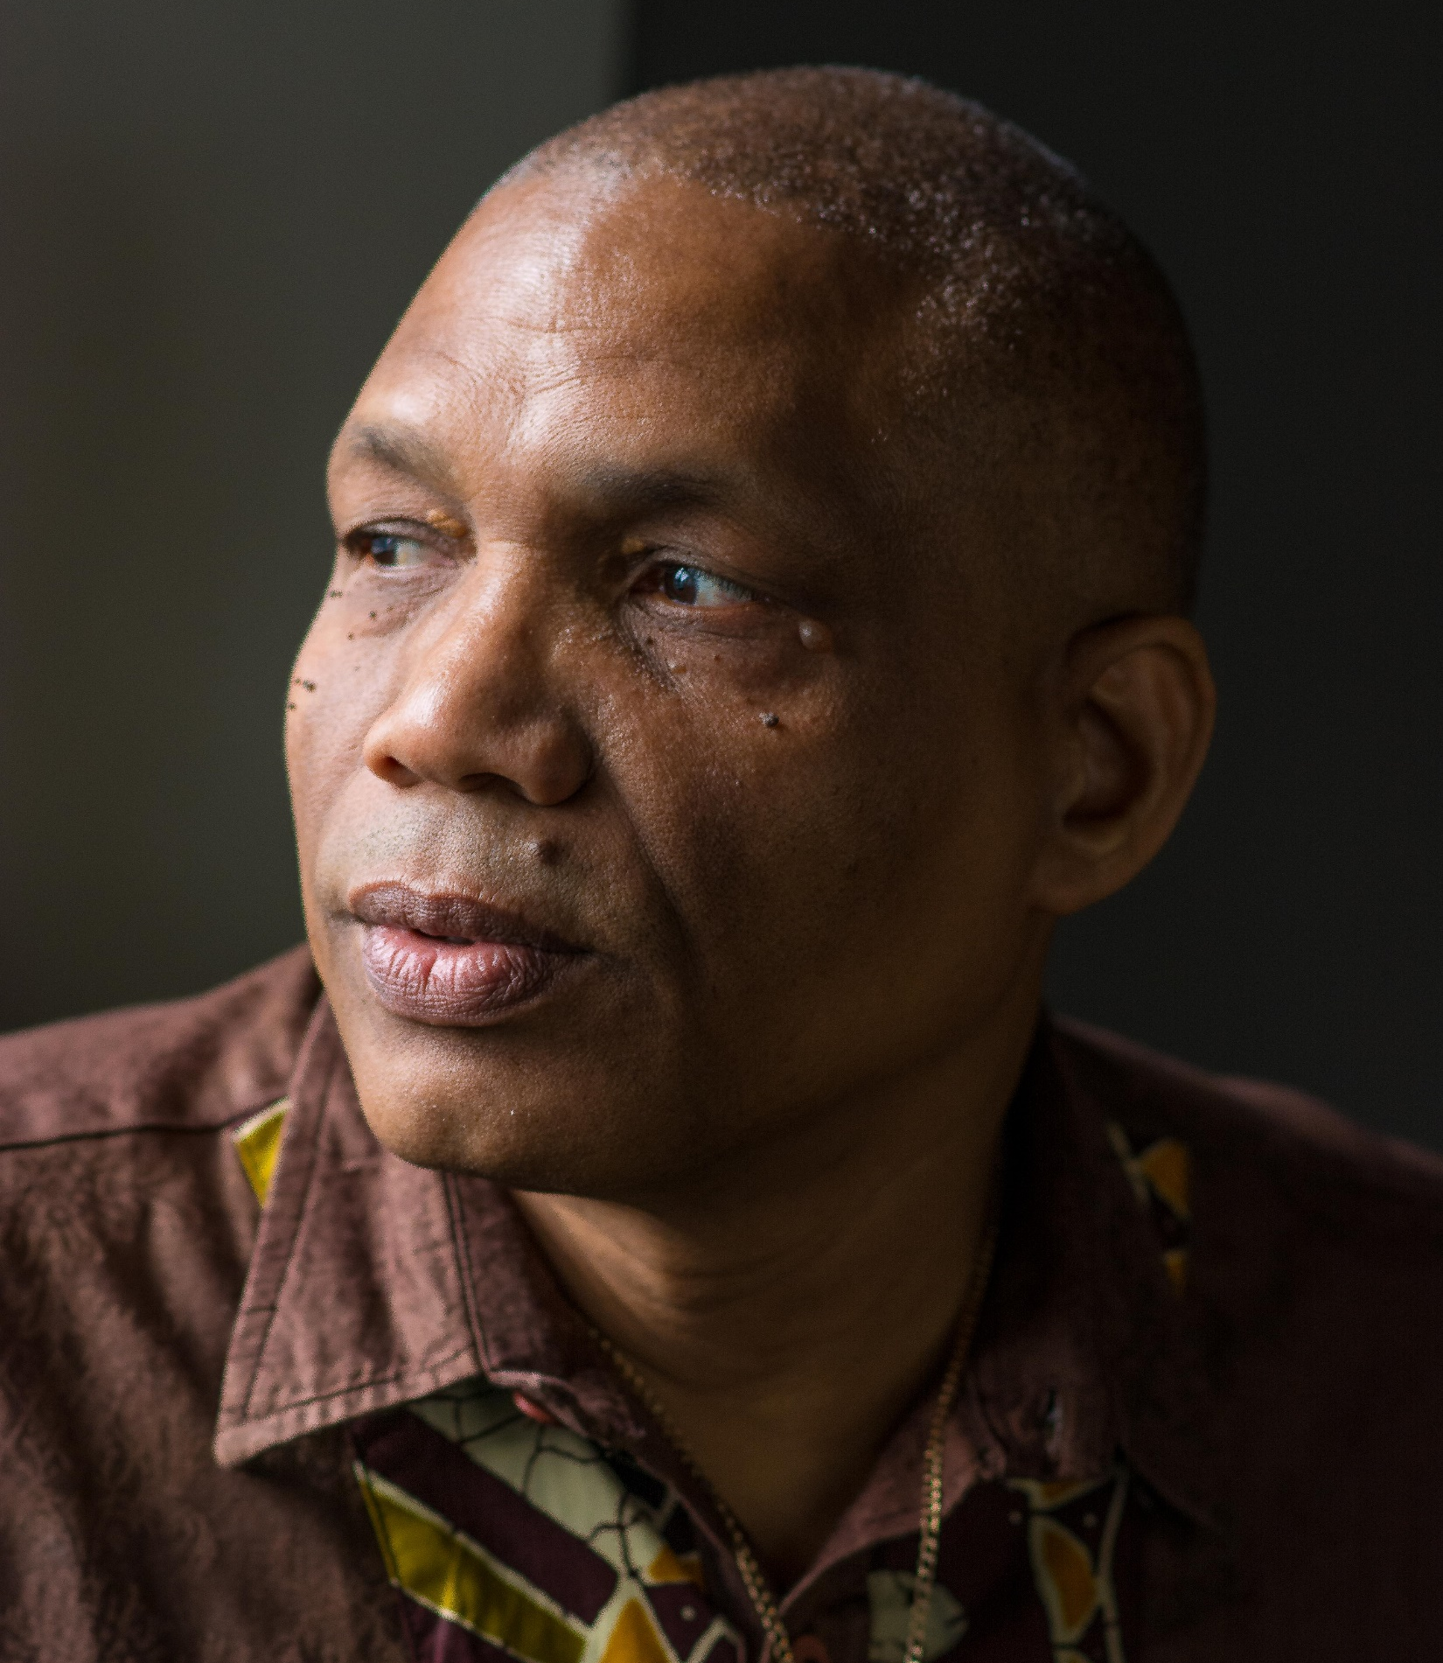
Steve Roberts
Steve Nii Kwashi Roberts was born and grew up in the Windward Island of Dominica. In summer 2020 he completed the MA in Creative Writing and Education at Goldsmiths. His work featured in the Goldsmith’s Issue 3 of Story Makers’ Dialogues. His poetry was first published in Rampart 1 & 2 - a collection he edited in the 1980’s for the Frontline Co-operative in Dominica. He performed at the Domfesta Poetry Against Violence Festival in Dominica in 2016.
Steve is still developing his debut choreo poem Black Reflections which he premiered at the Woodford Festival in October 2018. “Mama”, one of the poems from Black Reflections, is included in A River of Stories vol 4, Alice Curry’s compilation of tales and poems from across the Commonwealth, published Jan 2016 http://www.ariverofstories.com/the-books/a-river-of-stories-4.

Slide 28
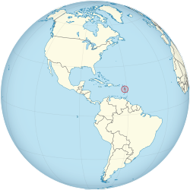
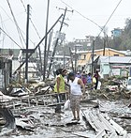
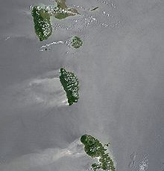
Steve Roberts Ole Man River: Dominica

Slide 29
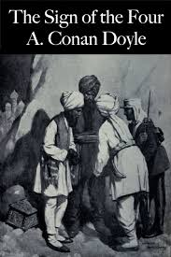
Humayra (2020) ‘Miss, What’s Colonialism?’: Confronting the English Literary Heritage in the Classroom
Notes:
The Sign of Four is a Sherlock Holmes story featuring a missing Indian treasure and the search, by the descendants of two Englishmen formerly stationed in India, to recover it. (There seems no question on the part of the detectives that the rightful owners of the treasure are, indeed, these two Englishmen and/or their progeny, but this is a conversation for another time.) The first chapter introduces the detectives; the second introduces the case. During our class reading of the second chapter, we came across Miss Mary Morstan’s introduction of her father as ‘an officer in an Indian regiment’ (Conan Doyle [1890]

Slide 30
What’s colonialism?
CHRISTIAN1: Oh, so was he Indian?
ME: No, he was English, but India was a British colony at the time so many Englishmen were stationed there as soldiers. Colonialism meant that many English people were born in India, like Miss Mary Morstan.
[Maira slowly puts her hand up]
ME: Yes, Maira?
MAIRA: Miss, what’s colonialism?
ME: . . .
In that moment, confronted by this question from a pupil nearing the end of her secondary education, I was unable to frame an answer that explained, in simple terms, the meaning of colonialism. (Iffath 2020: 369-70)

Slide 31
Creative tasks
Choose one option:
Devise a cut-up or found poem; find a colonised text (e.g. Macauley’s note/Williamson quote etc) and cut it up, take out words, re-word it using their actual words to change it into something rich and strange.
Write a recipe poem about the British like the Zephaniah poem
Write a reply to a river you are familiar with and love, telling the river about your life, your hopes and your dreams.
Write as a river you know, telling their story
Write a short personal language history…
Free write a response to this lecture…

Slide 32
Questions
Read/discuss creative responses.
Discussion: is it important generally to consider ‘decolonising creative writing’?
Post in the chat.

Slide 33
Next steps
11am-12.30pm Toni Giselle Stuart to give the keynote address, which will be an interactive lecture and workshop, exploring vital issues connected with creative writing, race and decolonisation. She will try upon her own work.
12.30pm-1pm Lunch
1pm-2pm Yasmin Glinton Poitier will examine how the black woman must look for a place to belong. To this vein, she will explore moments shaped through conversation and how she creates poems out of them. As a Bahamian female, she writes in dialect. Bahamian literature, though limited, is often done in standard English. She believes that to decolonize we must write ourselves into the literature. She will explain how she does this, and will give delegates to write creatively in a decolonising fashion, using her own writing as prompts.
2pm-2.45pm A creative-writing workshop led by Carinya Sharples which will look at how we can draw on our deep wells of knowledge and challenge restrictive colonial boundaries of race and identity through writing about food and music.
2.45pm-3pm. Final thoughts and Plenary.
3pm-4pm (optional): Launch of the creative writing anthology, Dreams and Nightmares, published by Goldsmiths Department of Educational Studies and Widening Participation

Slide 34
References
Begum, N., & Saini, R. (2019). Decolonising the Curriculum. Political Studies Review, 17(2), 196-201.
Crinson, M. (2003) Modern Architecture and the End of Empire. (Aldershot: Ashgate 2003)
Evaristo, B. (2020) The Long Form Patriarchs, and their Accomplices, The New Statesman, URL accessed 2nd November 2020: https://www.newstatesman.com/culture/books/2020/10/bernardine-evaristo-goldsmiths-lecture-longform-patriarchs
Dhingra, L. (2019 reprint) The Girl Who Couldn’t See Herself.
Fox, N., & Alldred, P. (2015). New materialist social inquiry: Designs, methods and the research-assemblage. International Journal of Social Research Methodology, 18(4), 399-414.
Green, A. (2011). Becoming a reflective English teacher. Maidenhead: McGraw-Hill Open University Press.
James, C., & Walvin, J. (2001). The black Jacobins Toussaint L'Ouverture and the San Domingo revolution (New [ed.] / with an introduction and notes by James Walvin.. ed.). London: Penguin.
London Students and Teachers (2020) Dreams and Nightmares. London: Centre for Culture, Learning and Languages.
Nichols, G. (2009) Picasso I Want My Face Back, Poem of the week, URL accessed 2nd December: https://www.theguardian.com/books/booksblog/2009/dec/14/poem-of-the-week-grace-nichols
Osborne, D. (2017) Contemporary Black British Literature: A Guide. London. Edexcel/Pearson.
John Yandell (2020) Editorial, Changing English, 27:4, 349-352, DOI: 10.1080/1358684X.2020.1822070
Humayra Iffath (2020) ‘Miss, What’s Colonialism?’: Confronting the English Literary Heritage in the Classroom, Changing English, 27:4, 369-382, DOI: 10.1080/1358684X.2020.1804323
Osborne, D. (2017) Contemporary Black British Literature: A Guide. London. Edexcel/Pearson.

Slide 35
Toni Giselle Stuart
Toni Giselle Stuart is a South African poet, performer and spoken word educator. Her work is published in anthologies, journals and non-fiction books locally and abroad. Her work includes Krotoa-Eva’s Suite – a cape jazz poem in three movements – a poetry collection that re-imagines the story of Krotoa-Eva through her own voice; an excerpt of the work was adapted into an audio-visual piece, in collaboration with filmmaker Kurt Orderson (Amsterdam and Cape Town, 2016); Poetry, Paramedics and Film with filmmaker/health researcher Leanne Brady (2018); I Come To My Body As A Question with dotdotdot dance (UK & Sweden, 2016 - 2020); and What the Water Remembers at Woordfees (2020); forgetting. and memory with vangile gantsho & Vusumzi Ngxande, at the Virtual National Arts Festival (South Africa, 2020). She was the founding facilitator of the Barbican Junior Poets at the Barbican Centre in London 2015; and started and ran Athlone Young Poets, at Belgravia High School in Cape Town, in 2018 and 2019.
She is a Mail & Guardian Top 200 Young South African of 2013, and has an MA Writer/Teacher (Distinction) from Goldsmiths, University of London, where she was a 2014/2015 Chevening Scholar. She was the founding curator of Poetica, at Open Book Festival.

Slide 36
Yasmin Glinton biography
Yasmin is a poet, educator, actress, and workshop facilitator. Her written works often appear coupled with art shows such as; NE8, The Year She Wrote, NE9, Pattern & Puzzle, etc. As a performance poet, Yasmin has performed poetry within The Bahamas and Canada. In 2018, she was commissioned by The Current Gallery at Bahamar. Her poetic works appeared in The National Art Gallery of The Bahamas Exhibitions 8 and 9. She organized and facilitated the writing workshop “Youse a Writer, Ey”, and was asked on as an instructor for the Summer Art Immersion program at The University of The Bahamas.

Slide 37
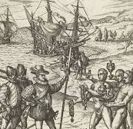
Columbus and colonialism
"As he sailed through the Caribbean, Columbus lamented his ignorance about the potential commercial returns of its unfamiliar flora and fauna. But he could appraise one component of the fauna quite well: the humans. He knew how to control his Indigenous captives, hazarded a guess at their capacity for work, and ultimately encouraged their export to Europe. “Let us in the name of the Holy Trinity go on sending all the slaves that can be sold,” he wrote to Ferdinand and Isabella after his second voyage.
How did he know their value?
Because slaves were part of the fabric of his life in Europe. Columbus’s childhood in Genoa put him in proximity to slaves, slavers, and traders in human bondage. He was also caught up in longer circuits and histories of exploitation by the Spanish and Portuguese, whose familiarity with slavery stretched back centuries: in Madeira, the Portuguese had first used Canarian slaves to produce sugar.3 The Iberians had acquired this workforce through colonial conquest and legal chicanery." (from "A History of the World in Seven Cheap Things: A Guide to Capitalism, Nature, and the Future of the Planet" by Raj Patel, Jason W. Moore)

Slide 38
Yasmin Glinton
Introduction: about yourself, your life
A short history of the Bahamas
Poetry and a commentary on the poetry, looking at how it can ‘decolonise’ the mind, by writing in dialect, challenging norms, celebrating embodiment
Creative writing exercise: The Things You Have To Swallow, a list poem or a free written response 10 mins to come up with ideas
Take feedback; post lines in the chat, offer audio feedback if you want.
Conclusions; 3 steps to decolonise creative writing (e.g. use ‘non-standard’ forms, challenge norms, celebrate embodiment)
Q and A with Francis if time?

Slide 39
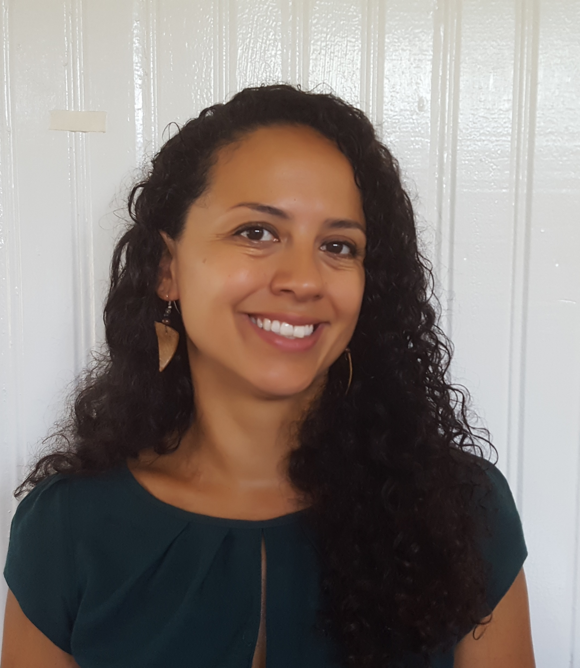
Carinya Sharples
Carinya Sharples is a writer, freelance journalist and workshop facilitator. She recently completed an MA in Creative Writing & Education at Goldsmiths, University of London. She works freelance for the BBC, Mongabay and other outlets; taught communications at the University of Guyana; and facilitates creative-writing and youth-focused workshops. She was shortlisted for the Flipside Festival's GAWP! Green Alphabet Writing Prize 2017, and her creative writing has been published by The London Reader and Commonwealth Writers’ adda.

Slide 40
Plenary and evaluations
Evaluations to be completed here: https://docs.google.com/forms/d/e/1FAIpQLSdfnDqgN_VlWSCecgaS_rMlPDlCmczlBkU-mf4R81lEP5TKdg/viewform?usp=sf_link
Post in chat…
Dreams and Nightmares Launch to follow…

