Slide 1

Improving your exam results without teaching to the test: 4 important lessons
F. Gilbert, Goldsmiths, University of London.

Slide 2
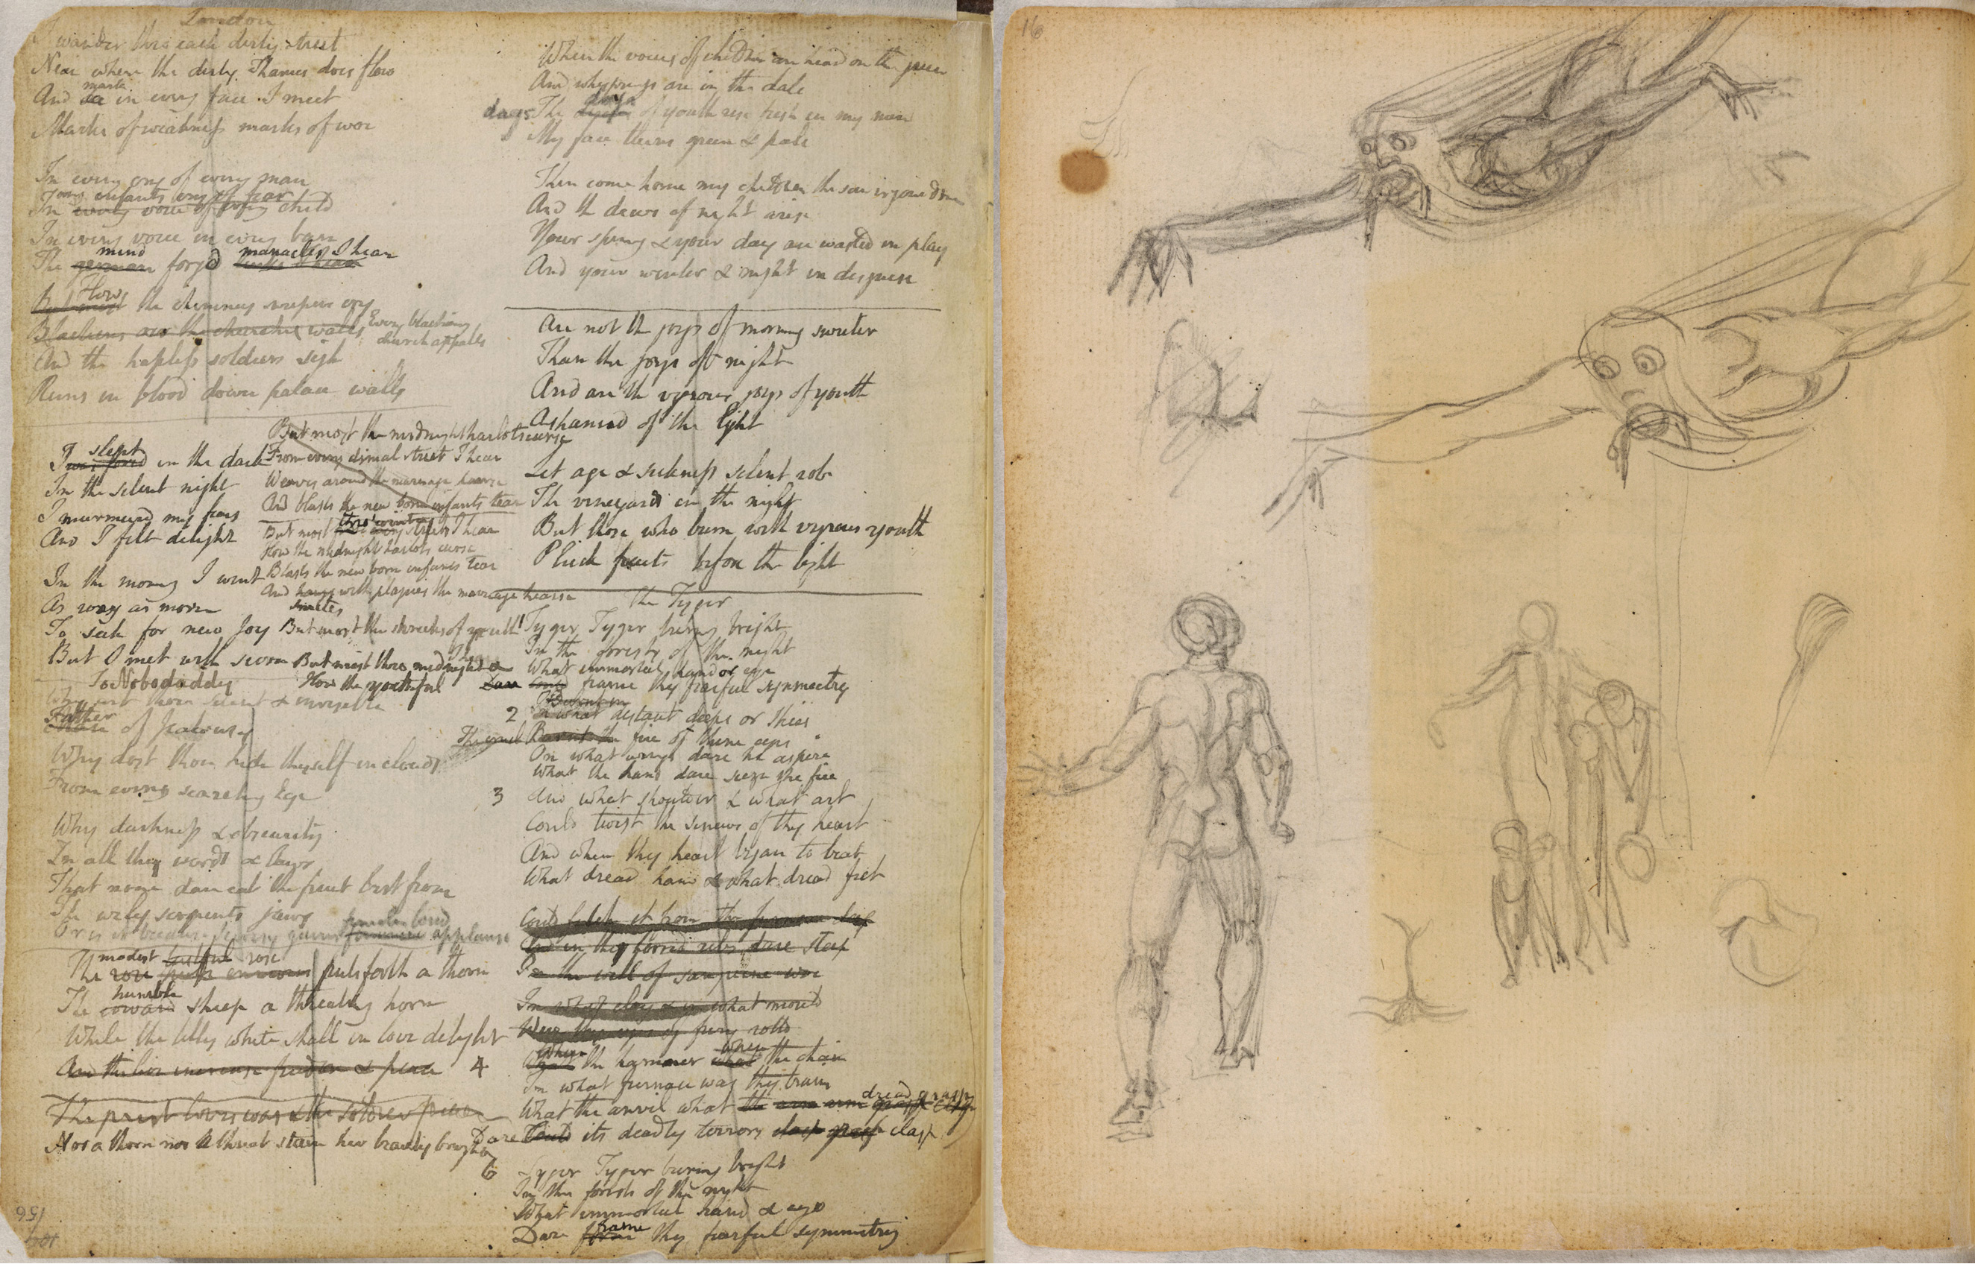


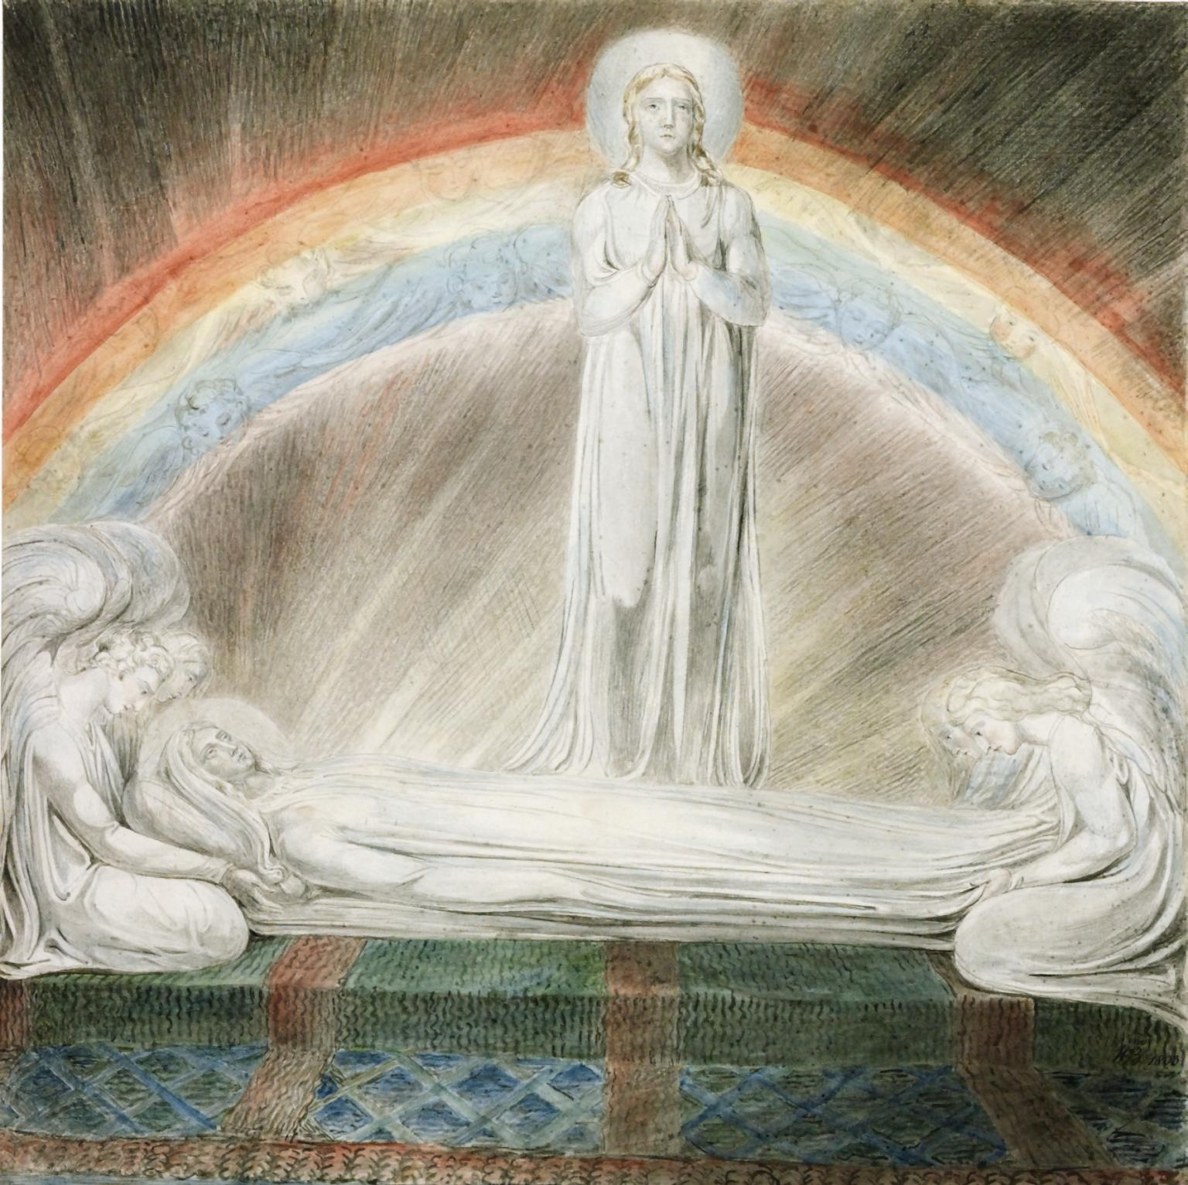
Aims of session
4 lessons

Slide 3
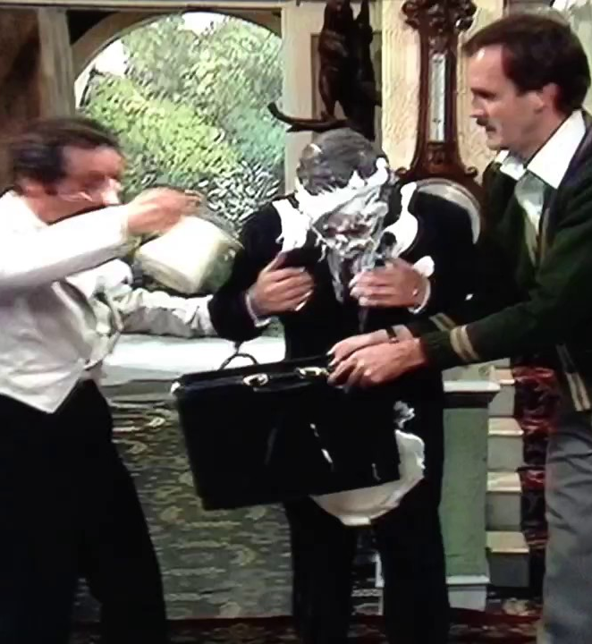
Teaching to the test and the Basil Fawlty syndrome
What are the similarities between Fawlty and a panic-stricken teacher teaching to the test?
https://www.youtube.com/watch?v=KcX_TEwkkuw&t=17s

Slide 4
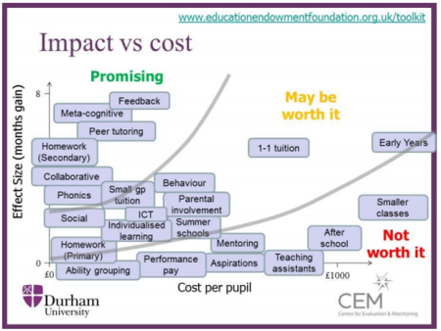
Educational Endowment Foundation Research
Notes:
HATTIE: What I’ve seen in your country is that you’re using assessment, constantly saying better assessment of kids is going to help make a difference to them. There’s no great evidence for that. In fact, I would challenge any teacher, any parent, before a kid does a test, to ask the kid what mark they’re gonna get. They’re pretty accurate, so why do we bother?
https://www.educationdive.com/news/dr-john-hattie-assessment-should-measure-teachers-impact/422969/

Slide 5
Lesson 1: Be mindful

Slide 6
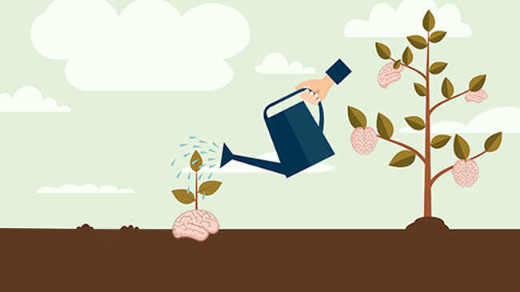
Lesson 2: Adopt a learning orientation

Slide 8
Lesson 3: Promote reading for pleasure

Slide 9
Lesson 4: Use multi-modal approaches

Slide 10

Reflection
What have you learnt? What would like to learn more about?

