Slide 1
Ethos of Ambiguity: Artist Teachers and the Transparency-Exclusion Paradox
Dr. Miranda Matthews

Slide 2
Intentions
Introduction to the research project ‘Responses to Policy in Practice’
Literature Review
Methodology
Discussion ‘transparency-exclusion paradox’ through analysis of data from Artist Teachers
Observations of an ‘ethos of ambiguity’ in the data
Relation to contemporary artists
Collective empowerment
Summary

Slide 3
Responses to Policy in Practice: Context
An investigation of practitioner strategies in Art and Design, emerging from the policy climate since 2010
Acknowledging the effects of the EBacc and Progress 8 (Adams 2013, NSEAD 2015-16, Matthews 2018, 2018b)
A climate of intense ‘knowledge based’ (Gibb, 2017) standardisation, and observation through government and managerial processes (Atkinson 2011; Ball and Olmedo 2012; Wilkins 2016).
Distrust of teachers’ professional capacity for decision making (Maisuria, 2005)
Notes:
Students and resources have been drawn away from the arts, as from other subjects excluded from the EBacc, to attempt to boost school performance in the league tables. The National Society for Education in Art and Design survey report for 2015-2016 charts the reduction in art GCSE entrants as minus 6% since 2014-15. In this survey of 1191 participants, 93% of responding teachers in state schools associated this effect with the introduction of the EBacc (p. 5). Analysis of Department for Education figures in 2018 revealed a further fall of 9% in art GCSE entrants, while English, maths and science account for 51% of exam entries (Ward, 2018, August 31).
In the more affluent South of England the arts are 10% more likely to be included in Progress 8 than in the North of England (Johnes, 2017, p. 10).

Slide 4
Literature Review
Referring to Foucault for observations of systemic regulation and surveillance – or ‘power through transparency’ (Foucault, 1980).
Observing strategies of resistance among artist-teachers and artists, led to comparisons with Beauvoir’s ‘ethos of ambiguity’ (2015, see Kruks 2012).
Seeking expression and fluidity through practice
(Atkinson 2017, 2018)

Slide 5
Ethos of Ambiguity
‘Art is often ambiguous by design’ (Dimitriadis, Cole and Costello, 2009 p. 372) Artist teachers sustain their practice by ‘Following “yang” but doing “yin”’ (Huang & Vong, 2018, p. 8)
All attempts at transparency are partial, due to our incomplete knowledge of the factors that impact our experiences of the world. We cannot form being of ‘pure externality’, just as ‘pure inwardness’ is not an option (Beauvoir, 2015, p. 6).
Simone de Beauvoir wrote: ‘Since we do not succeed in fleeing it… let us try to assume our fundamental ambiguity’ (p. 8).With this lens, the creative vitality of learning is lost in efforts to school a standardised society.

Slide 6
Methodology
Pragmatic approach to artist-teacher time constraints
The ongoing inquiry is a way of ‘trying to open space for the indefinite’ (Law, 2004, p. 6).
Respondents are artist teachers in South East England
Guaranteed anonymity (BERA, 2018) enables participants to ‘speak freely’ (Foucault, 2005, p. 389).
Email conversations from own email addresses and semi-structured interviews outside the school location
Currently 9 respondents: 2 male, 7 female. 8 White British, 1 African Caribbean.

Slide 7
Analysing responses
The structuration of options blocks favours Ebacc subjects.
Increased assessment for accountability is tailored towards these subjects.
This leads to stigmatisation of creative subjects and a ‘transparency-exclusion’ paradox: processes are intended to be transparent, so that subjects outside the Ebacc can be more contained and reduced.
Participants discuss fragmentation, depersonalisation, stress and insistence on compliance.

Slide 8
The Transparency Exclusion Paradox
Since setting up my art department in 2014, the focus has often been on prioritising the core and EBacc subjects over ‘open bucket’ subjects and their results. In the most recent options period of our incoming year 10 students, their choices were very much focused on students taking the core subjects and EBacc subjects, with a focus on more students taking triple science.
This was often with students having opted for art as either a first or second choice within the ‘open bucket’. However due to the school committing to small class sizes within GCSE art, due to not wishing to commit to more staffing of art, students have missed out.
(Calum, Head of Department, 2018)
Notes:
Calum is the only teacher in his department. He now has a technician to help. Structuration of the option blocks make art and design difficult to pick. The subjects are compartmentalised through assigned value factors or ‘percentages’ (Tia). Even if a lot of students want to choose art, they can’t because there is only one group. Status is signified by the alternative meanings for ‘passing the bucket’. The choice of art becomes a lottery.

Slide 9
The Transparency Exclusion Paradox
When they pick their options there’s a graph, and the English Baccalaureate goes at the top, the optional subjects go at the bottom. Then there’s a column for those other subjects, drama and art and music and so on are in the other block. The more able students tend to pick the English Baccalaureate then the other students pick the vocational. Then it’s that art then fits into that block.
I do think it’s meant that quite a lot of the more able students who should have took art, those students who have got Level 9, they didn’t pick it because it doesn’t fit in on the timetable as well.
(Tia, Head of Department, 2018)
Notes:
There is a reinforcement of an academic-vocational divide through the option choices, and there is a reluctance to see art and design as an academic subject. Most participants discussed this lack of flexibility in the option blocks. This system of what Tia calls ‘lip service’ to choice organises more confident students towards the EBacc subjects.

Slide 10
Fragmentation, Isolation, Stress
People take breaks a lot less. We used to sit down and have a real few more breaks, and be able to discuss things that were going on in the department which was time to discuss students or concerns. We barely have that time now.
(Jane, 2018)

Slide 11
Depersonalised Regulation through ‘facticity’: Avoidance of Dissent
There is a nasty corporate feel to teaching we are data driven, dictated to by our faceless MAT masters, who send diktats via the head teacher through email. The head teacher’s response to anyone ‘complaining’ (not allowed – we are not to have problems only solutions) about the time scale paperwork has to be completed as ‘welcome to the real world’.
(Pen, an Art Teacher)
Notes:
Avoidance of conflict through expected compliance is a feature of academy organisation (Matthews 2018b, Wilkins 2016).

Slide 12
Adjustments in ethos for flexibility
Professional judgment in provision for formative assessment and flexibility of teaching.
Agreement in paperwork but alteration in practice.
Multiplicity and refusal to ‘flatten out’ the significance of art practice, relates to artists.
Return to own art practice and part-time teaching.

Slide 13
Ethos of Ambiguity: Professional Judgment in Assessment for Flexibility
So everyone else will sit an exam paper, and they will get a percentage out of the history or geography paper. We haven’t set, this year I marked the exam paper and we haven’t set, we haven’t finished it. We’ve got to do a mock exam so I just make it up. Well I don’t make it up, but I use my professional judgement to give them a level because I haven’t actually marked a paper because they haven’t done a paper.
(Tia, 2018)

Slide 14
Ethos of Ambiguity: For Instruction and Observation
If I am being observed I will produce a lesson with all the structures in it, but actually in terms of Year 11 and Year 13, I teach very unstructured lessons because they’re all working on a project themselves, you know because at the moment we are having to do these ‘do now’ tasks at the beginning of the lesson, for a couple of minutes.
But if you are doing a practical lesson that ‘Do now’ task is 15 minutes out of your practical lesson. You put it up, but actually I am not going to do it with Year 11s.
(Tia, 2018)

Slide 15
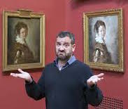
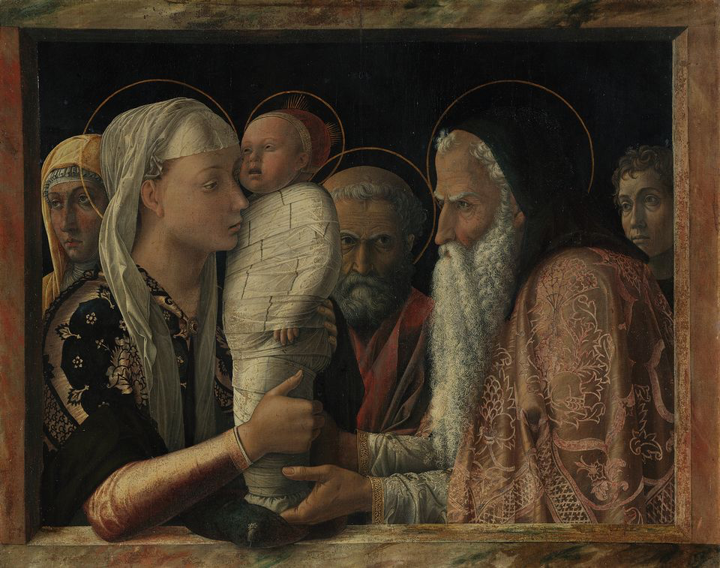
Ethos of Ambiguity – Among Artists
Scottee 10 ‘I Made It’
Doug Fishbone, Made in China, 2015
Turner, Waves Breaking Against the Wind, 1840
Mantegna, Presentation of Christ in the Temple, 1454
Notes:
Can we defuse extrinsic criteria (Atkinson, 2018). such as the knowledge-based curriculum?
Artists resonate with the need for practice to evolve without splitting its integrity through a knowledge-based analysis.
Scottee seeks to make work which ‘says one thing, does another’ (Scottee, January, 2018). Doug Fishbone - defining artwork through a political association ‘flattens’ the subtleties of the work (Fishbone, May, 2018).
Not new! See early subversions of patronage e.g. Mantegna and Bellini.

Slide 16
Return to Practice – Working part-time & With others in the ‘Gaps’
I’ve started to branch out a little bit, to sow some seeds in other places.
There’s a real gap of that creativity of art scene and that vibrancy like there is in Maintown. So it’s kind of wanting to create a bit of that, and also it’s with another teacher I work with and it was for us to be able to go to each other’s workshops and so on.
(Jane, 2018)

Slide 17
Summary
Considering the subtle concepts of artists, who make work with multiple layered reference points, we could perhaps identify an ethos emerging for contemporary art teachers and artists (Rabkin, 2010; Sweeney, 2013).
Artist-teachers and artists present responses that reflect a depth of consideration, and a repositioning towards the world through playful (Graham & Rees, 2014), risk-taking (Allison, 2013) or pragmatic ambiguity – demonstrating professional judgement.

Slide 18
Summary
Connections with other artist teachers and return to practice identify a rehumanising response to depersonalised institutional structures.
Entrepreneurial practice (Allison 2013; Winner, Goldstein and Vincent-Lacrin 2013) also provides multiplicity and affirmation.

Slide 19
References
Adams, J. 2013. “The English Baccalaureate: A New Philistinism?”, International Journal of Art and Design Education 32 (1) 1-5.
Atkinson, D. 2011. Art, Equality and Learning: Pedagogies Against the State. Rotterdam: Sense Publishers.
Atkinson, D. (2017). Without Criteria: Art and Learning and the Adventure of Pedagogy. International Journal of Art & Design Education, 36(2), 141-152.
Atkinson, D. (2018). Art, Disobedience, and Ethics: The Adventure of Pedagogy. Cham, Switzerland: Palgrave MacMillan.
Allison, A. (2013). No art teacher left behind: Professional development that really matters in an age of accountability. Arts Education Policy Review. 114(4), 178-
Bacc for the Future (31/1/18) ‘New GCSE Figures confirm a further drop in creative subjects’. Accessed 19/06/18: https://www.baccforthefuture.com/news.
Ball, S.J and A. Olmedo. 2012. “Care of the Self, Resistance, and Subjectivity under Neoliberal Governmentalities.” Critical Studies in Education 54 (1): 85-96.
Beauvoir, S. de. 2015. The Ethics of Ambiguity, New York: Open Road Integrated Media.
BERA. 2018. Ethical Guidelines for Educational Research. British Educational Research Association. Accessed 25.06.18. https://www.bera.ac.uk/wp-content/uploads/2018/06/BERA-Ethical-Guidelines-for-Educational-Research_4thEdn_2018.pdf?noredirect=1.

Slide 20
References
Cranshaw, J., Rowe, F. and Hudson, M. 2015. “Translations in Practice: The Multiple Roles of the Researcher in Arts-based Knowledge Exchange.” Journal of Arts and Communities 7 (1-2), 101-115.
Dimitriadis, G., Cole, E. & Costello, A. (2009). The social field(s) of arts education today: Living vulnerability in neo-liberal times. Discourse: Studies in the Cultural Politics of Education. 30(4), 361-379.
Fishbone, D. (May, 2018). Making things happen. Presentation at the Centre for the Arts and Learning, London: Goldsmiths.
Foucault, M. 1980 Power/Knowledge: Selected Interviews and Other Writings 1972-1977. Colin Gordon, ed., Harlow: Pearson Education.
Foucault, M. 2005. The Hermeneutics of the Subject. New York: Picador.
Gibb, N. 2017. “The Importance of Knowledge-based Education”. Published 19 October 2017. Accessed: 25.06.18 https://www.gov.uk/government/speeches/nick-gibb-the-importance-of-knowledge-based-education

Slide 21
References
Irwin, R. and O’Donoghue, D. 2012. “Encountering Pedagogy Through Relational Art Practices”, International Journal of Art and Design Education 31 (3): 221-236.
Kruks, S. (2012). Simone de Beauvoir and the politics of ambiguity, Oxford: Oxford University Press.
Law, J. (2004). After method: Mess in social science research. Abingdon, Oxon: Routledge.
Maisuria, A. (2005). The turbulent times of creativity in the national curriculum. Policy Futures in Education 3(2), 141-152.
Scottee (January, 2018). MA Arts & Learning workshop: Goldsmiths, University of London & Tate Modern, London.
Wilkins, A. (2016). Modernising School Governance: Corporate Planning and expert handling in state education. Abingdon, Oxon: Routledge.

