Slide 1

Arts pedagogy as introduction of ‘strangeness’: disruptive aesthetic discourse and the concern for ‘student satisfaction’
Miranda Matthews

Slide 2
Intentions
Reflections between arts practice and education
Arts pedagogy as an introduction of ‘strangeness’ through Rancière and existentialism
Role play of artist address (Butler)
What happens for students?
Responses in posthuman concerns for affect

Slide 3
Why does art pedagogy introduce ‘strangeness’
Education in critical arts practice, as for advanced practice, often seeks to disrupt social norms and conventions through aesthetic discourse (Atkinson 2012, McDonnell 2017) .
Rancière sees this as a ‘the production of a sensory form of strangeness’ (2010, p. 142) - stirring the student to question, critique, form expressions in practice as ‘new sensory fabric’ (Ruitenberg 2011, p. 215, citing Rancière, 2008).
As a way of learning about the self/ the other, different angles on experience of society and affective responses, to build bridges with ‘the radically exterior’ (Zhao 2014, p. 523).

Slide 4
How and why does art pedagogy introduce ‘strangeness’
This disruption may politicise but it is not viewed as having the capacity to be directly political: ‘Art lives so long as it expresses a thought unclear to itself in a matter that resists it.’ (Rancière, 2010, p. 123).
Differing from Freire’s ‘conscientisation’ (Duarte, 1999) since the student/ audience is raised to awareness through contact with artforms, with the task or questions they present, and not the motivation of the educator.
Rancière’s view can be related to existentialist concepts of praxis as ‘creative action’ (Sartre, 2010, p. 181) that introduces the ‘outsider’ (Camus, 2000) challenging the stasis of comfort zones

Slide 5
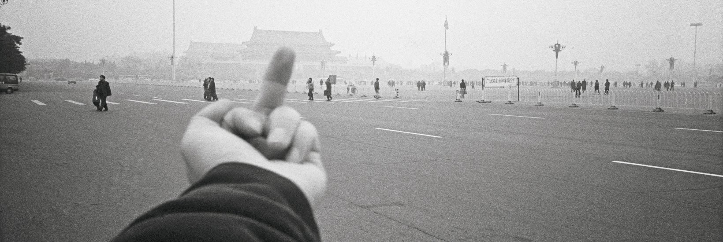
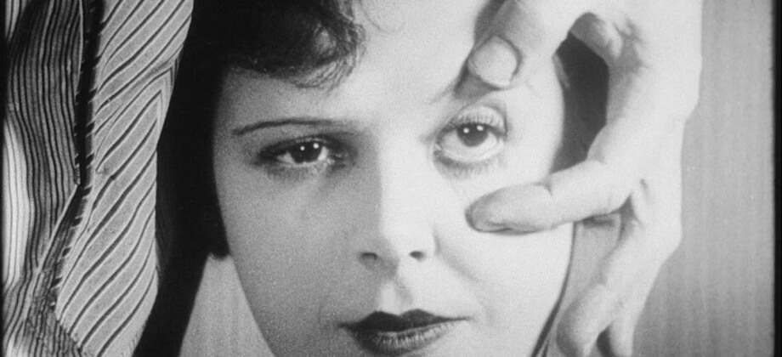
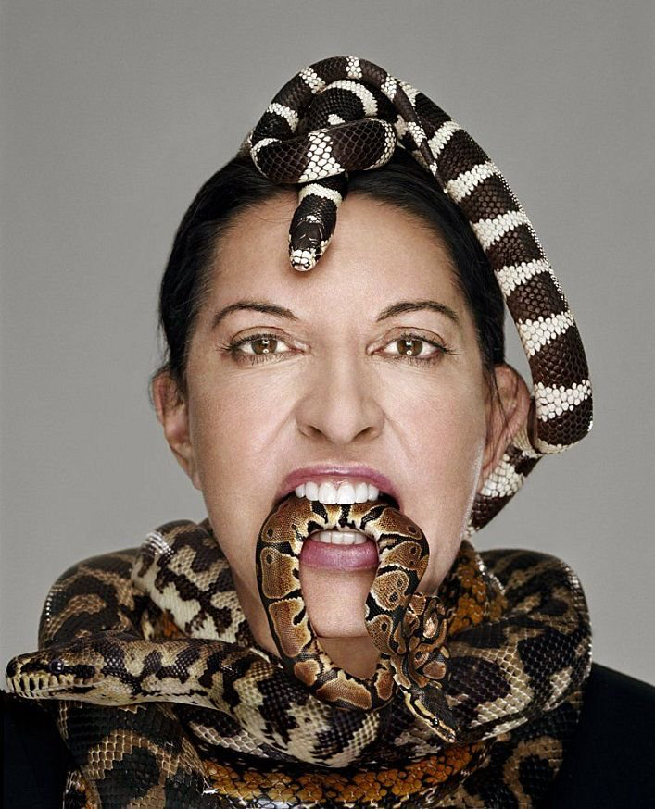
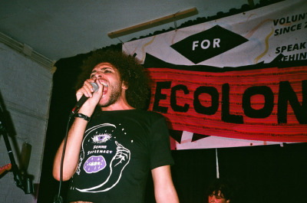
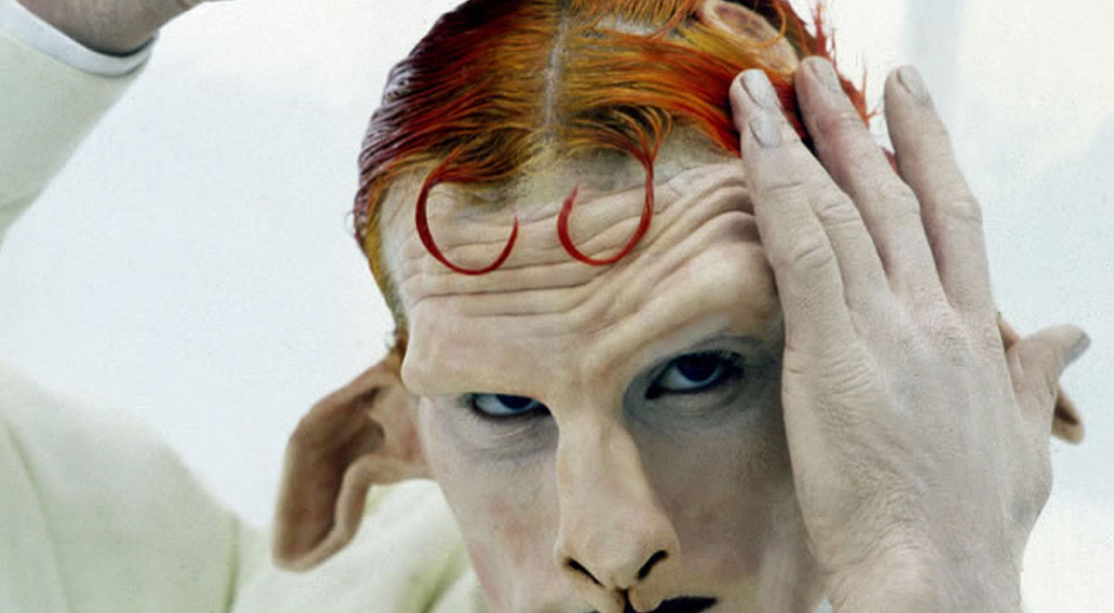
The Artist Address in Pedagogy (Butler): ‘What kind of address is being made to us?’ (Murray 2007, p. 418)
Ai Weiwei
Abramovic
Carrington
Joyce
Barney
Notes:
‘What kind of address is being made to us?’ (Muray) p. 418.

Slide 6
Artist Address Scenarios
1) ANGRY – You are angry with the world. People need to know about this. You swear at the
group and tell them not to even breathe loudly until you have finished talking.
2) SPIKY – You need to be spiky, to be yourself as an artist. You have a post-doctoral residency in digital arts. Everyone needs to know about your PhD. They could learn a lot from it.

Slide 7
Artist Address Scenarios
3) WITHDRAWN – You do not engage very much with the group. You read paragraphs from Pedagogy of the Oppressed with silence between them. The work stands alone. You say you will not take questions.
4) COMFORTING – Everyone needs to be a lot more comfortable with themselves and everyone else. You exude warmth. Check everyone’s furniture is arranged for maximum comfort. You teach them how to do a performative face massage.

Slide 8


What happens for students?
Considering the need to address ‘student satisfaction’ in art schools and universities
In balance with the need to offer challenge, energise practice and shift prejudice

Slide 9
Responses in Posthuman
Concerns for Affect
Rancière – the urge to disrupt may become an oppressive or hierarchical norm, it can block or ‘lock’ student responses and participation (Ruitenberg, C.W. 2011, p. 211). How can we account for this?
To what extent could we include pedagogies that invite a range of affective responses, considering also affirmation and empathy (Braidotti 2013), as a disruption of experiences of alienation and isolation in art and society?

Slide 10
References
Atkinson, D. (2012) Contemporary Art and Art in Education: The New, Emancipation and Truth. International Journal of Art and Design Education 31(1), 5-18.
Braidotti, R. (2013) The Posthuman. Cambridge: Polity Press.
Camus, A. (2000) The Outsider. London: Penguin.
Duarte, E. M. (1999) Conscientizacion y Comunidad: A Dialectical Description of Education as the Struggle for Freedom. Studies in Philosophy and Education 18, 389-403.
McDonnell, J. (2017) Political and Aesthetic Equality in the Work of Jacques Rancière: Applying his Writing to Debates in Education and the Arts. Journal of Philosophy of Education 51, 387 – 400.
Murray, S.J. (2007) Ethics at the Scene of Address: A Conversation with Judith Butler. Symposium 11(2), 415- 445.
Rancière, J. (2010) Dissensus: On Politics and Aesthetics. London and New York, Continuum.
Rancière, J. (2011) Aesthetic Separation, Aesthetic Community: Scenes from the Aesthetic Regime of Art. Art & Research 2(1).
Ruitenberg, C. W. (2011) Art, Politics and the Pedagogical Relation. Studies in Philosophy of Education 30, 211-223.
Sartre, J. P. (2010). What is Literature. Abingdon: Routledge Classics
Zhao, G. (2014) Freedom Reconsidered: Heteronomy, Open Subjectivity, and the ‘Gift of Teaching’. Studies in Philosophy of Education 33, 513- 525.

