Slide 1
Reciprocity
Francis Gilbert, Teaching and Learning conference

Slide 2

A gift to yourself

Slide 3

What’s in a name?

Slide 4

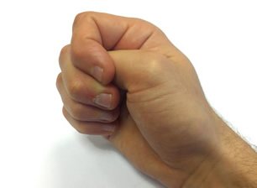
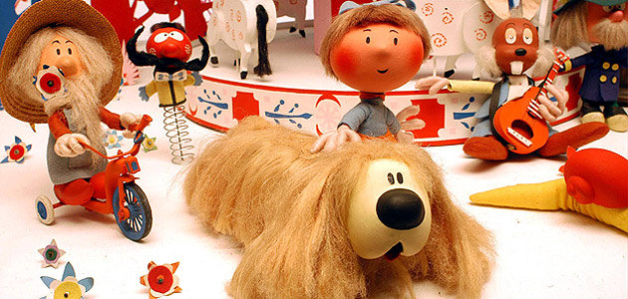
Pilky and his handbag

Slide 6

Gift someone else…

Slide 7
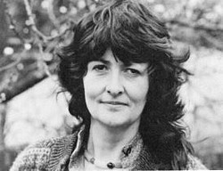


Reciprocity

Slide 8
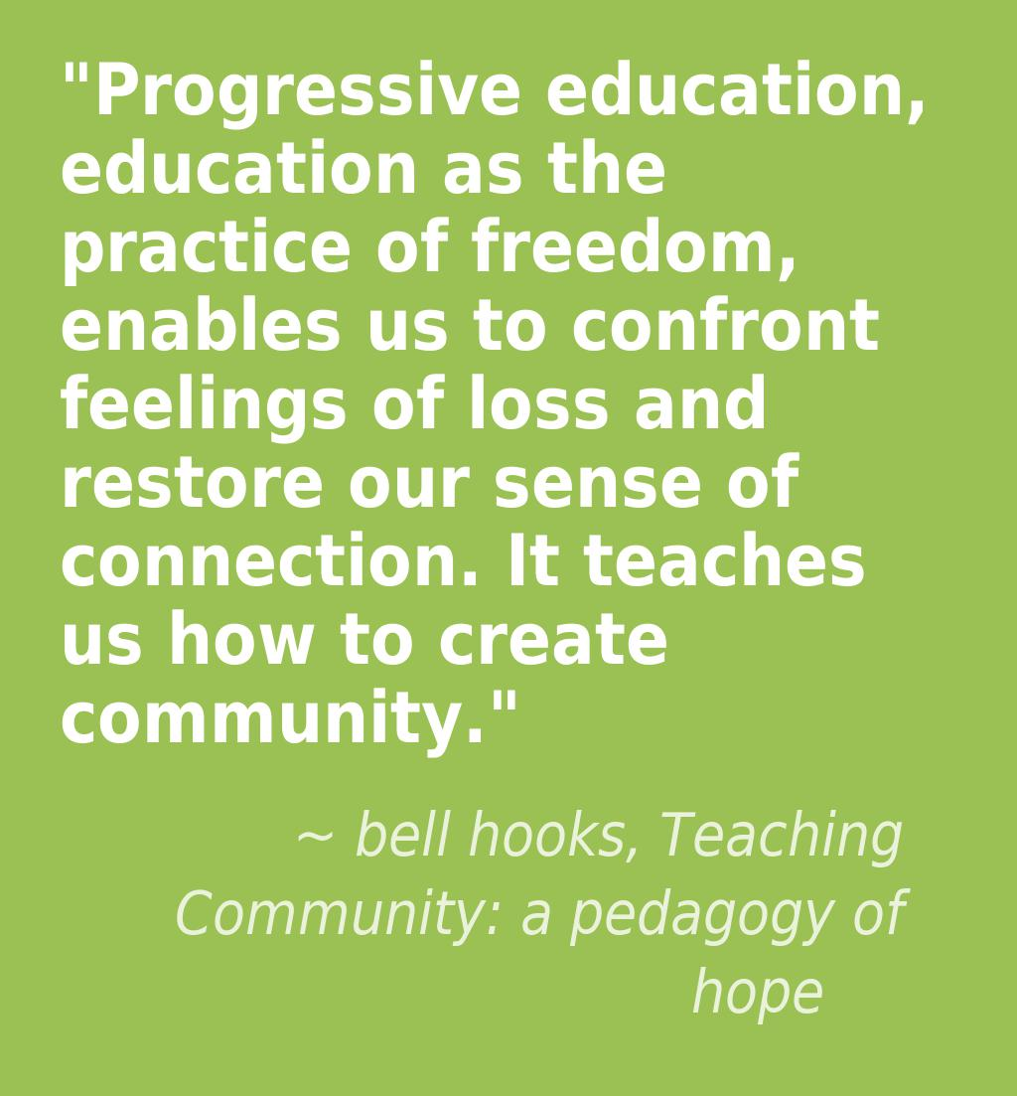
Pedagogy of hope

Slide 9
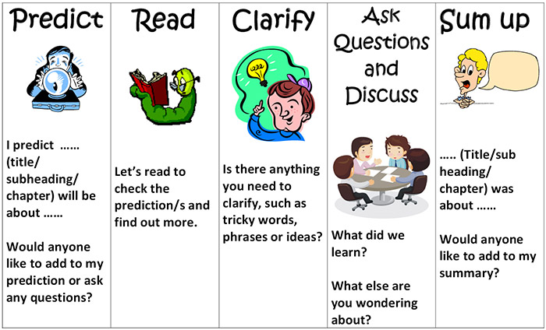
Reciprocal teaching

Slide 10
Reciprocal Teaching Cycle for secondary students, Francis Gilbert
Step 1: TEACHER
Predict/instruct
Predict: “What are we going to learn next? What happens next in this text?”
Step 2: SUMMARIZER & ASSESSOR
Summarize/Assess
Summarize: “This passage is about...In a few words, this text means this...Let’s sum up this text in a minute…”
Step 3: MOTIVATOR
Clarify/Motivate
Assess: “How much do we understand and what don’t we get? How well are we working as a group?”
Instruct: “Now it’s time for all of us to do this...can you read this?”
Clarify: “If we look at this section again, we can see it might mean this…let’s look at this bit again and work out its meaning….Let’s re-read this passage…”
Motivate: “You tried really hard when you looked at this part of the text...Well done, that’s a great effort…”
Step 4: QUESTIONER & LEARNING TO LEARN CHIEF
Question/Learn to Learn
Return to Step 1 & tackle the next section
Question: “What questions can we ask to help us better understand the passage? Can you tell me more?”
Learn about learning: “How are we feeling about our learning? What are we learning about the way we learn here? What targets can we set to improve our learning?”

Slide 11
The Time Devil

Slide 12


Slide 13


Slide 15
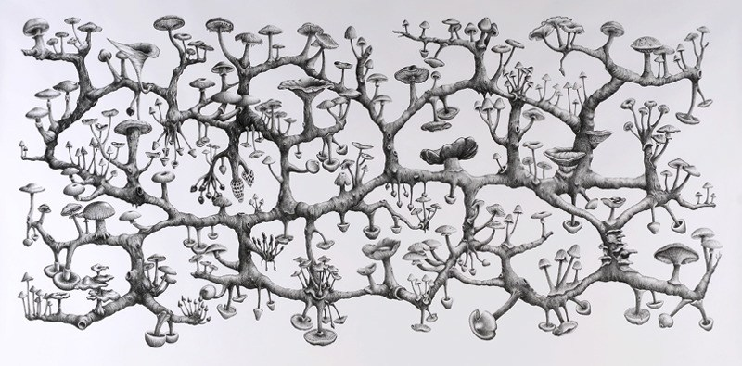
Rhizome

Slide 16
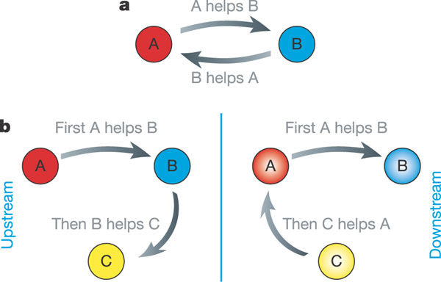
A reciprocal society?

Slide 17
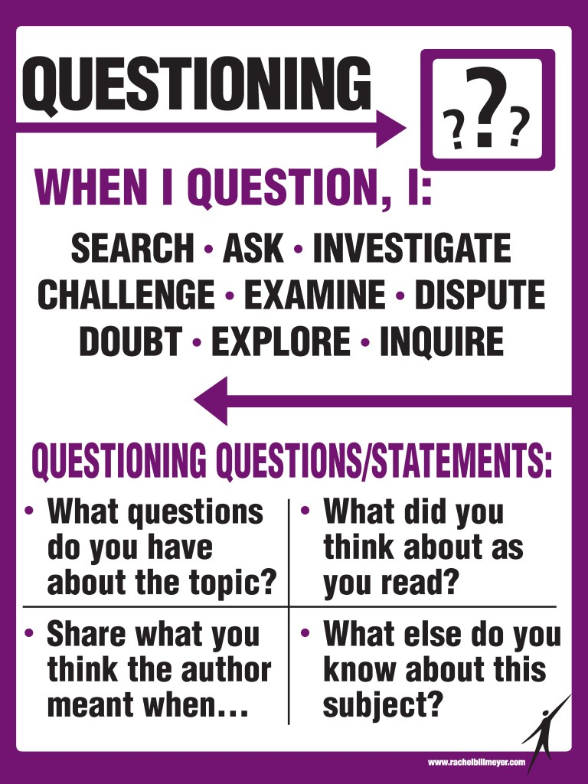
Reciprocal questions?

