Slide 1
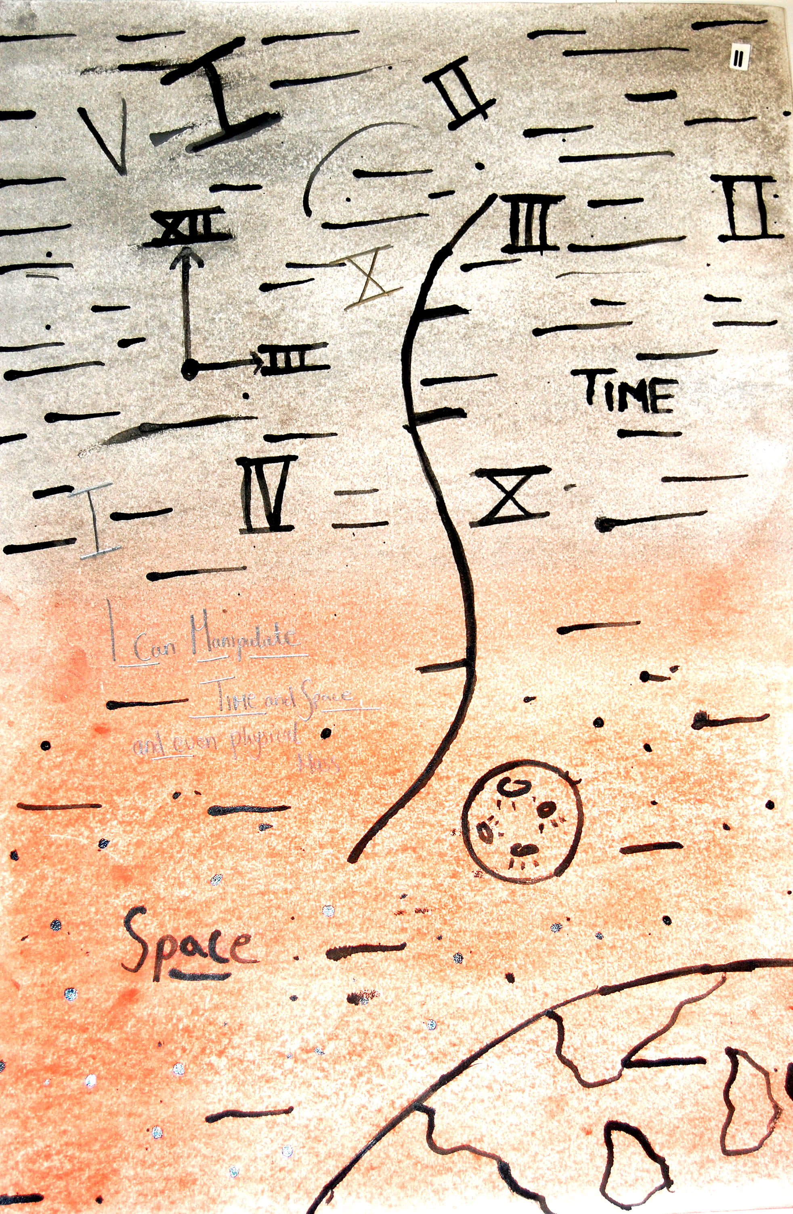

The Existential Subject and Freedom in Learning: A Dialogue with Sartre
Dr. Miranda Matthews
Notes:
Image: ‘I can control time and space.’

Slide 2
Repositioning of the Existentialist Subject: Why?
There is an urge to identify philosophical difference and escape Sartre’s mantle, existentialism, phenomenology and humanism.
In focus: Presentation of freedom in learning through classical (Foucault) and archival (Rancière) resituation, thereby diverting associations.
Associations of Sartre in education remain with the negative and social unrest. How could there be a reemergence for Sartre?
Notes:
Observation of Circumvention and repositioning of freedom in learning
The existential subject with free-will: how is this presented via Sartre?
Foucauldian ‘technology of self’ and agency in self-definition through education
‘Will to intelligence’ and egalitarian assignment of freedom in Rancière, and related contemporary studies
An emergence for Sartre in contemporary education?
(25 minutes)
‘I have spent a few paragraphs discussing religious existentialism because students unacquainted with existentialism often identify it with atheism and pessimism. Some readers thus may be more receptive to existentialism upon learning that there are existentialists who study and write about faith, encounter, courage, hope, and joy. Indeed there are many beautiful and moving passages in the work of Kierkegaard, Buber and Tillich that could be used with high school classes.’ (Noddings, 2016, p.63).

Slide 3
Free-will for the learner: how is this located in Sartre?
Everyone has free-will, as ability to make decisions and take ‘creative action’ (1.) in the contingency of the given situation.
A reflective acknowledgement of this freedom enables the subject to begin the process of stepping out of conditioning patterns in society and the ‘practico-inert’ of the status quo (2.) – expressing agency ‘as free praxis.’(3.)
Notes:
Sartre’s history as a school teacher, avoiding the encompassing demands of university tuition, but therefore also theorising outside the didactic tradition in learning.

Slide 4
Sartre’s interrelated modes of self
Being-in-itself : The past, stasis, and submerged knowledge such as qualifications or habituated comfort zones: a ‘density’ which is ‘full of itself’(4.)
Being-for-itself : Expressed as ‘thirst’ or ‘lack’ (5.), a drive to seek outside one’s current situation. This can be related to the urge to seek new understandings as a restless condition of being.
Being-for-others : in BN through the other’s critical ‘look’ (6), later our ‘inter-subjectivity’ (7.), and shared interest later in the ‘fused group’ (8.)
Notes:
‘I grasp the Other’s look at the very centre of my act as the solidification and alienation of my own possibilities’ (BN. 286).

Slide 5
Free-will and social responsibility
With the premise that we are all free to make decisions, there is the necessity for social responsibility (Detmer 9. Ballet, Dubois & Mahieu 10.) as a what Sartre terms a ‘free commitment’ (11.) and in the authenticity of ‘good faith’ that ‘wishes to flee the “not believing-what-one believes’ (12.).
This is a challenge to what Detmer terms the ‘official interpretation’ of Sartre’s portrayal of freedom (13.).
A consideration which is Important for education that can be related in correspondence with practice-based research in education.

Slide 6
Agency of the Learner in Sartre
In Existentialism and Humanism (1946, transl. 1948) Sartre presents a situation in which a student approaches him for advice.
Sartre notes that the student is free to choose, that there is no ‘rule of general morality’ for his response (14.)
He states however that the student has made the choice of his adviser, knowing the type of response he will receive.

Slide 7
Free-will in Practice: Art Education
Agency and the transformative subject for vocational students in Level 2 Art and Design:-The I Can project
Focusing on proactive choice in learning
Self-definition
Negotiation of freedom and responsibility
Being-for-itself as the thirst for new experiences, moving the subject out of stasis, noting difference from Noddings’ presentation of ‘pessimism’ in Sartre, in relation to the ‘faith, encounter, courage, hope, and joy’ of Kierkegaard, Buber and Tillich (15.).

Slide 8
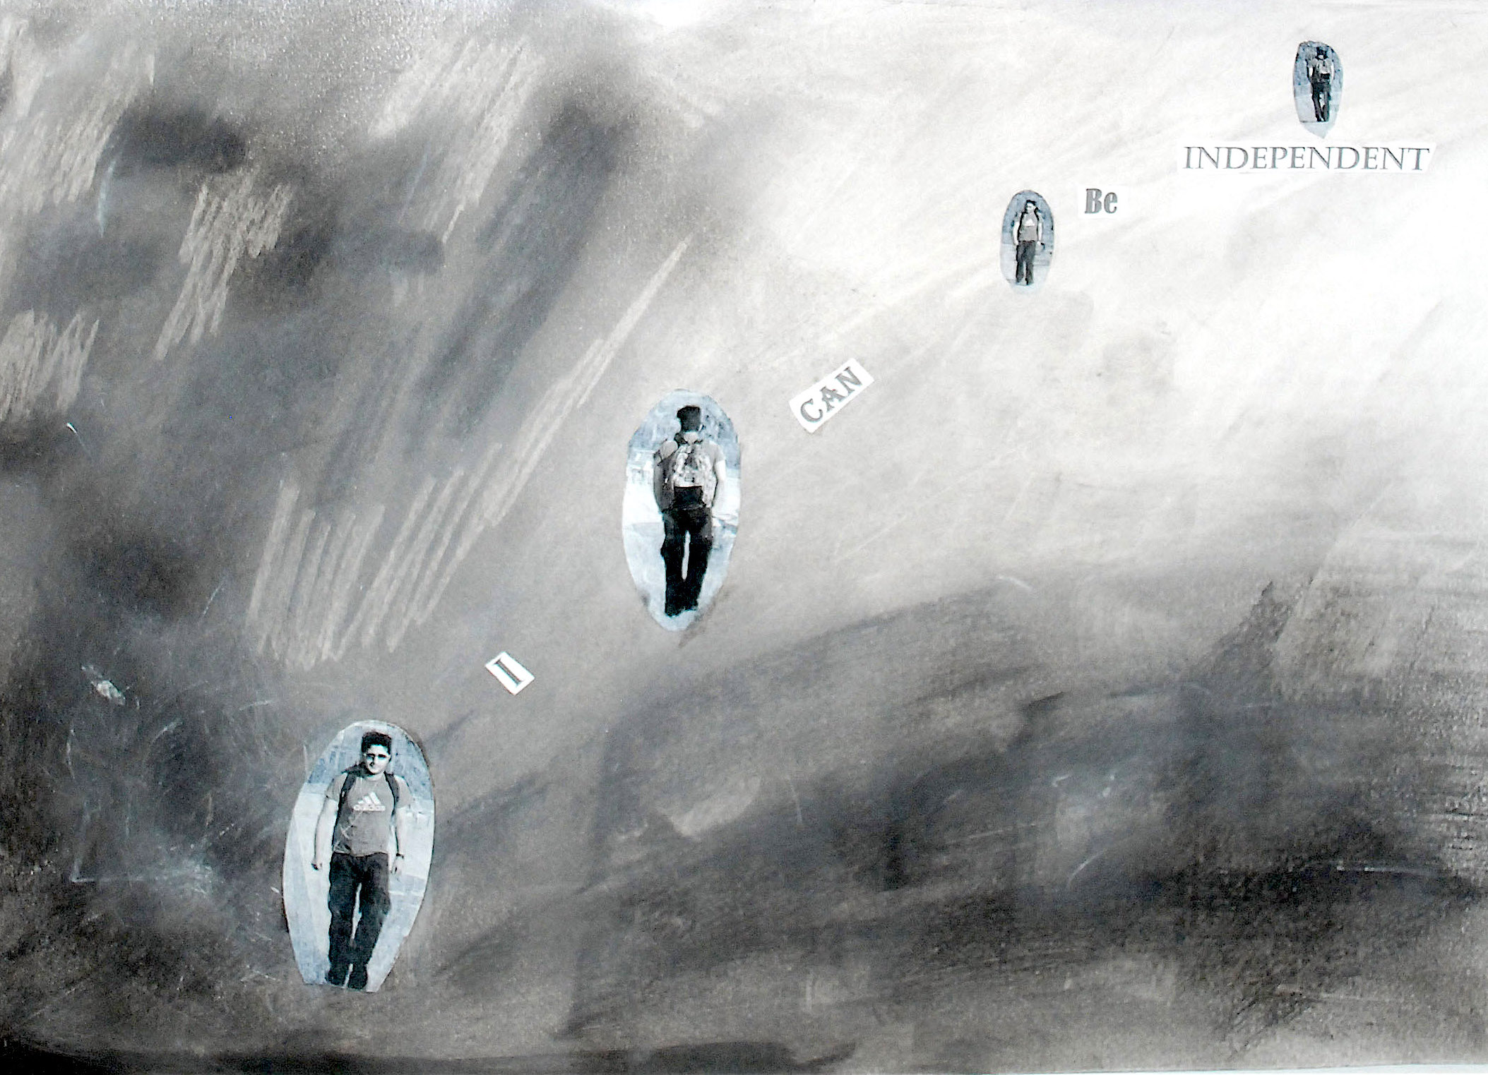
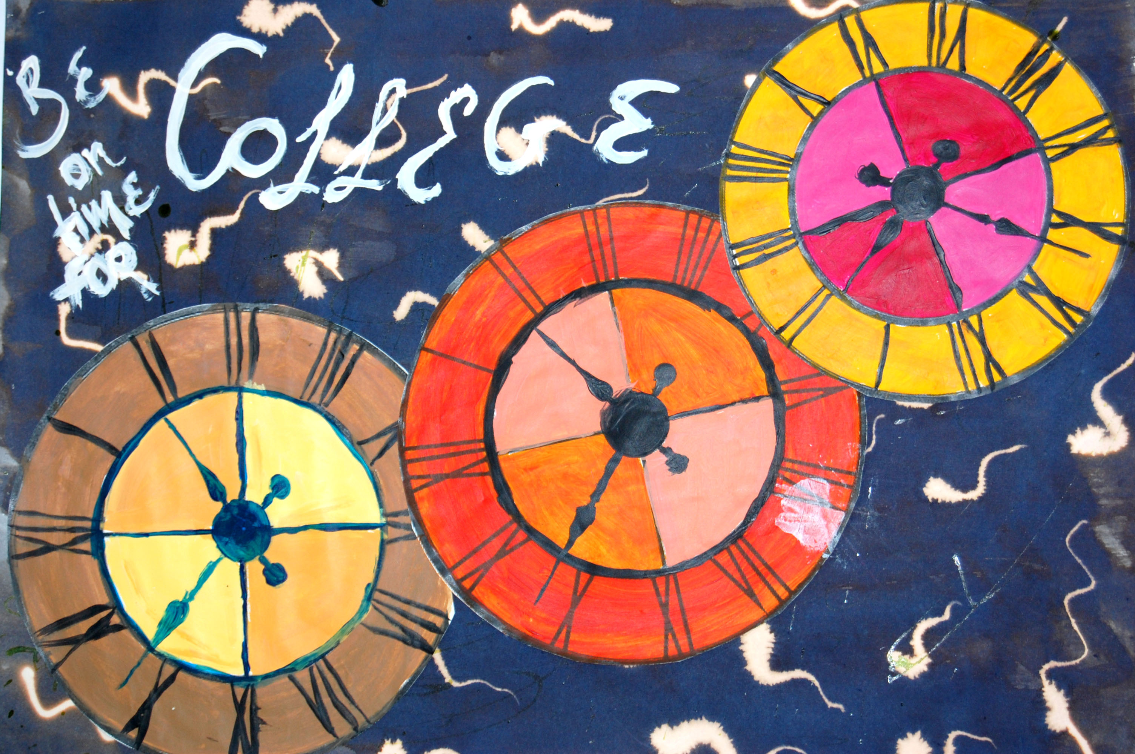


Representations of being-for-itself
I can get to college on time
I can be independent

Slide 9
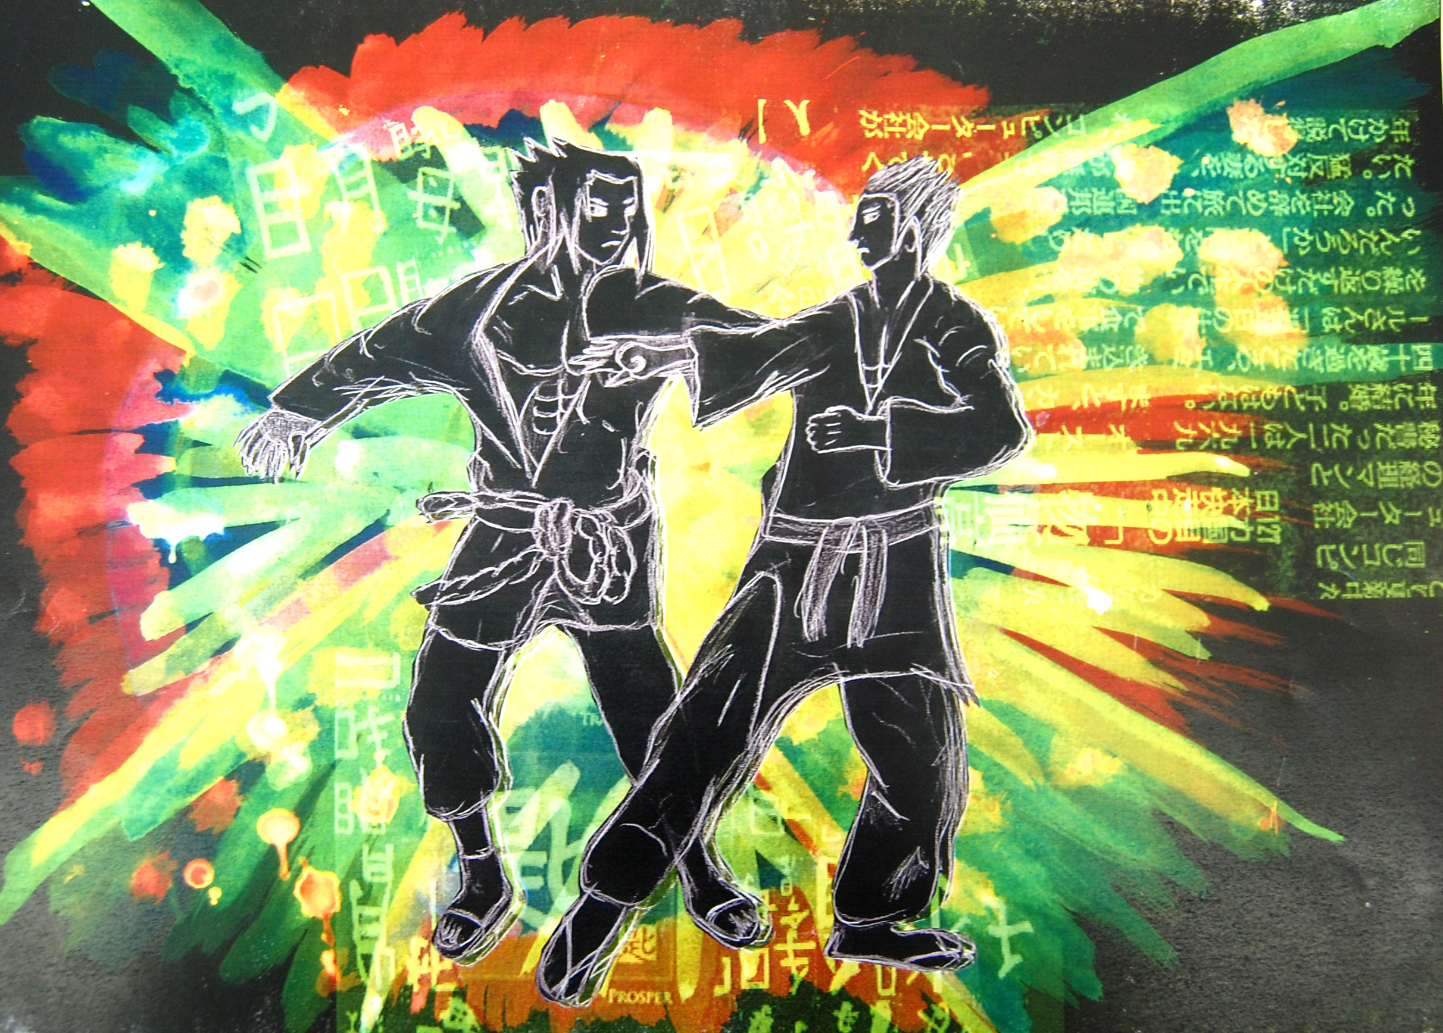
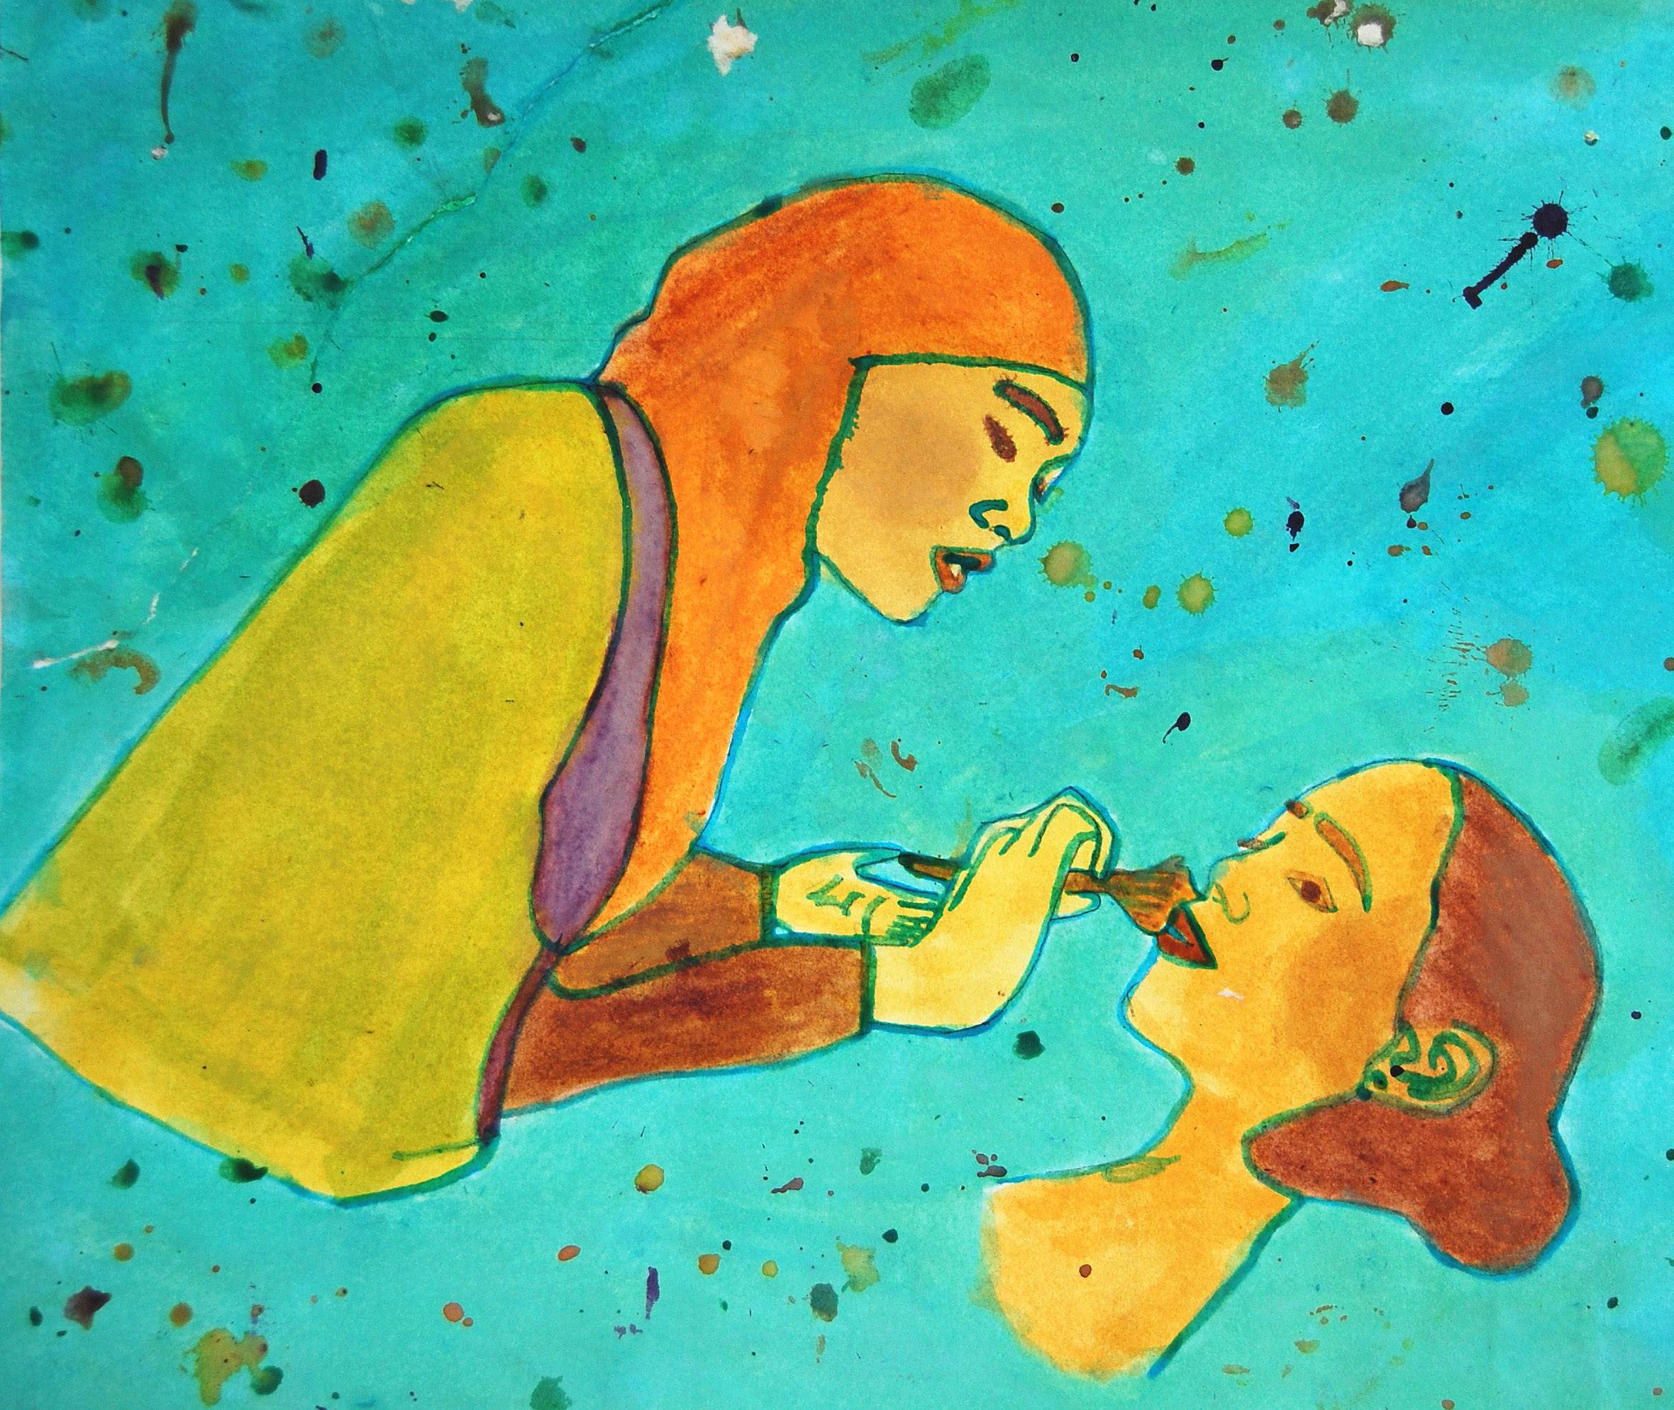
Raising and discussing social constructions
I can fight
I can do make-up

Slide 10

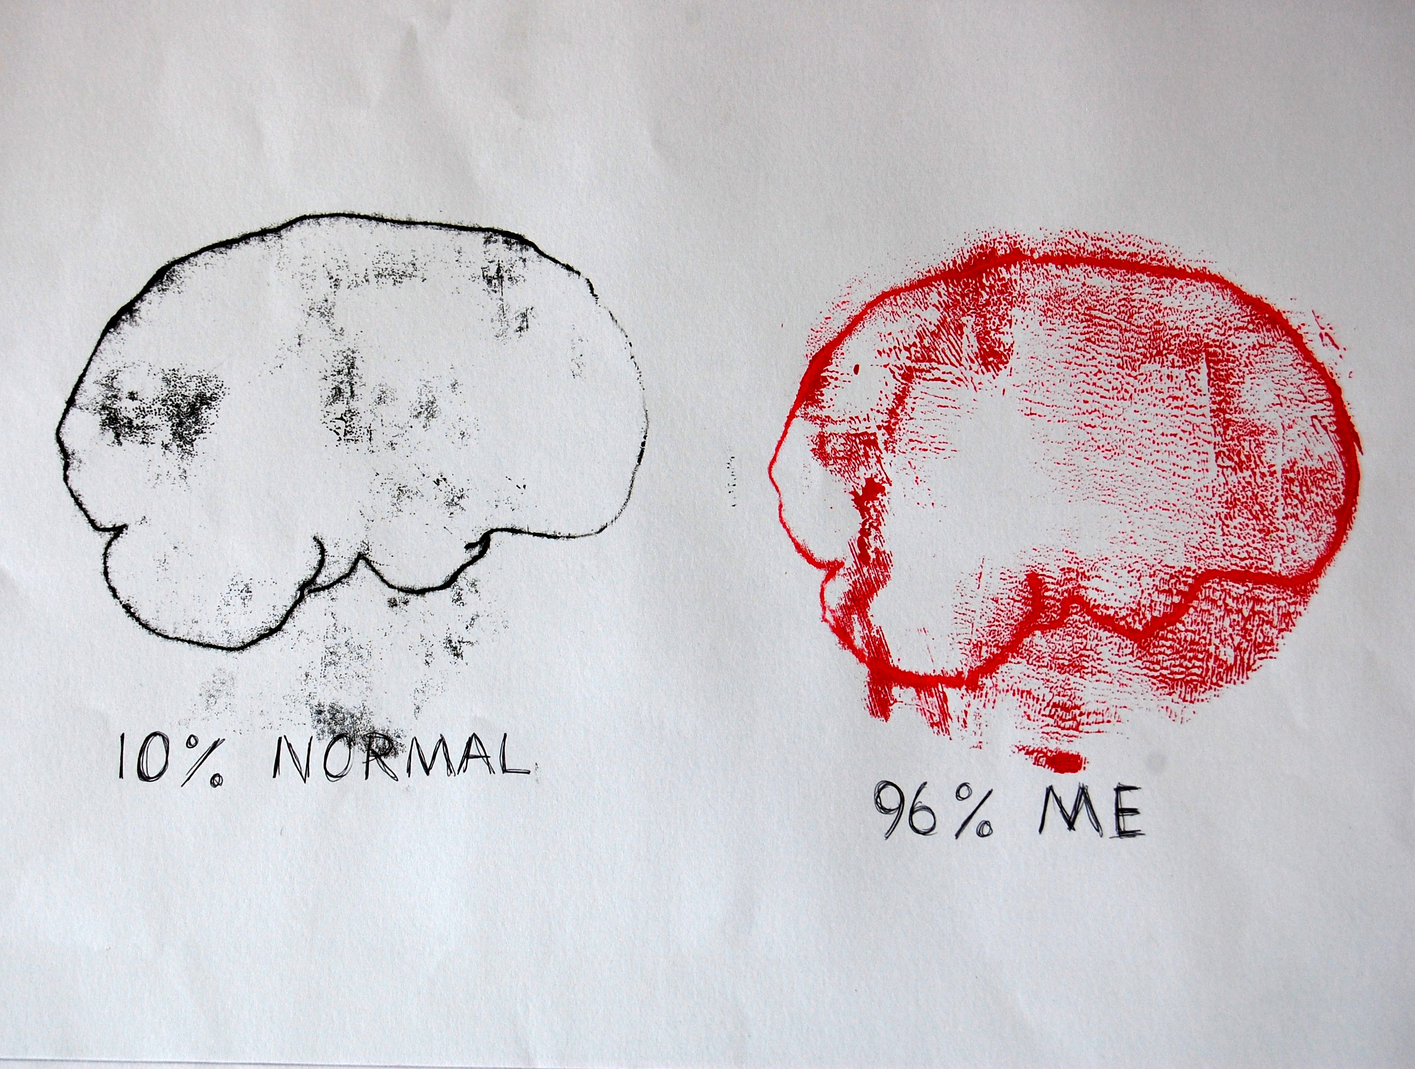
Expressing rebellion and frustration
I can use 96% of my brain
I can eat sweets all day

Slide 11
Discussing Freedom and Responsibility: Relational Freedom
To me freedom means you are free to do anything you want. E.g. you’re free to talk, walk and look, but there are also ways that you have to work for your freedom.
Responsibility: means when you are responsible for your actions. Responsibility is also when you can be responsible in ways like looking after yourself and properties.
(Romain)

Slide 12
Locating the free subject in learning:
Sartre and Foucault’s ‘official’ polarisation:
This is maintained through emphasis on the Sartrean constituent subject with agency in relation to Foucault’s genealogy of the regulatory discourses which construct the subject.
When entering the complexities of primary texts, there are some points of resonance. Caddeo presents possibilities for a connective approach, with Sartre and Foucault as critical ‘bôites-à-outils’ (16.).

Slide 13
Foucault & Transformative Agency
Power/ Knowledge: Critical reflection on ‘points of insertion’ (17.) within regulatory structures enables greater agency
Movement towards an existential will to self-transformation in connection with Roman and Hellenistic philosophies
Theorising ‘technologies of self’ (18.): self knowledge, but particularly in care of the self – as challenging the self, and parrhesia – ‘generally translated as frankness’ (19.)
The Self as a ‘work of art’ or the act of self-creation (20.)

Slide 14
The apparent truism
‘ It goes without saying that the object, the only object that one can freely will, without having to take into consideration external determinations, is the self.’
Foucault, The Hermeneutics of the Subject (21.)
Notes:
a distancing mechanism

Slide 15
Emerging from the dialogue
Reflective creative emancipation in Foucault, contrasting with the immanence and urgency of self-definition in Sartre.
Where is the location of ‘counter-memory’ (22.) of the workers, or marginalised voices in technology of self?
Notes:
as an interrelational learning experience
Foucault exploring ancient discourses of self-mastery and movement towards autonomy
Expression of freedom in learning in the present as an act of capable volition and creative self-expression

Slide 16
Sartre and Rancière: will and emancipation
Rancière sets a detour via Jacotot, as ‘The Ignorant Schoolmaster’ (1991), with a starting point of the axiom of equality of intelligence (23.)
Are the parallels between the ‘will to intelligence’ (24.) and ‘free-will’ apparent? To whom?
Escaping the perceived ‘stultification’ (25.) of Sartre as precedent, Rancière extends an existentialist position, with well recognised interventions in fields of learning, the arts and culture.

Slide 17
Exchange? Circumvention?
The position of equality, freedom in learning and avoidance of discourses of mastery is in Sartre, as noted in Existentialism and Humanism
Bingham and Biesta note that ‘we are not given detailed information about Jacotot’s educational beliefs and practices.’ (26.)
Rancière posits the intervention of strangeness and discomfort as a pedagogical tool, but the disruption of the ‘practico-inert’ is a strong theme in Sartre’s theory and creative literature.
Notes:
Rancière: the emancipated learner and pedagogies of discomfort: What happens if Sartre is introduced? An uncomfortable intervention? For whom?

Slide 18
Observations of Comparison
No one is defined by the forms of thoughtless necessity to which they are subjected. On this score at least, Rancière’s point of departure isn’t very far from Sartre’s familiar account of conscious freedom as indeterminate being for itself: that is as a way of being that “must be what it is not and not be what it is.”
Hallward, ‘Staging Equality: Rancière’s Theatocracy and the Limits of Anarchic Equality’ (27.)

Slide 19

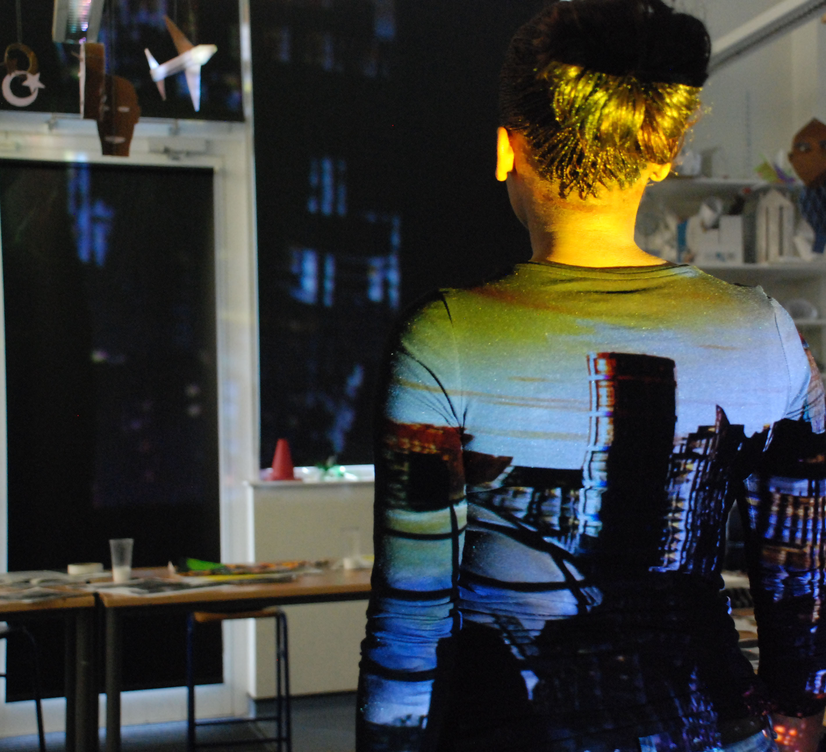
Co-existence of Sartre in the Contemporary Arena
How could Sartre emerge in contemporary educational studies and learning in the arts?
Notes:
If clearing a path of immediate precedent is a rite of passage, as Richmond notes in relation to Sartre and Bergson (28. )

Slide 20
Difference: A re-emergence of Sartre
Is a philosophy of engagement and political connection more relevant in this era?
Is there a place for ‘good faith’ in acknowledgement of the aspects of the self/ facilitator/ learner which are revealed or concealed?
How do we account for the lived experience of ‘creative action’ in Sartre, in relation to the observational distance of Rancière?
Notes:
Sartre was politically active, Rancière avowedly apolitical, seeing politics as the destroyer of philosophy rather than a field for application:

Slide 21
Co-existence of Sartrean existentialism in the Contemporary Arena?
Key points:-
Concept of activating Being-for-itself, as the spur to new experiences and understandings
Freedom and responsibility as relational freedom
Agency in learning as beginning with freedom, and problem-solving current unrealisables.
Exploration of diversity of possibilities in self-definition
In the arts – visualisation of self-transformation
Notes:
Sartre’s existentialist agency Foucauldian technologies of self consigned to history in educational studies?
What is lost in a curatorial approach to this dialogue?

Slide 22
References
Jean-Paul Sartre, What is Literature? (1948; repr. 2010, Oxon: Routledge Classics) 163-164.
Jean-Paul Sartre, Critique of Dialectical Reason, trans. Alan Sheridan-Smith (1976; repr. 2004, London: Verso) 191.
Ibid., 808.
Jean-Paul Sartre, Being and Nothingness, trans. Hazel E. Barnes (1958; repr. London: Routledge, 2003) 98.
Ibid. 164.
Ibid. 286.
Jean-Paul Sartre, Existentialism and Humanism, (1948; repr. 1973, London: Methuen) 45.
Jean-Paul Sartre, Critique of Dialectical Reason, 345.
David Detmer, ‘Sartre on Freedom and Education’, Sartre Studies International 11, no.1 & 2 (2005): 78-90 here 85.
Jérôme Ballet, Jean-Luc Dubois and François-Régis Mahieu, ‘Responsibility for Each Other’s Freedom: Agency as the Source of Collective Capability’, Journal of Human Development 8, no.2 (2007) 191.
Jean-Paul Sartre, Existentialism and Humanism, 47.

Slide 23
References
12. Jean-Paul Sartre, BN, 92.
13. David Detmer, Freedom as a Value, (1988; La Salle, Illinois: Open Court) 37.
Jean-Paul Sartre, Existentialism and Humanism, 38 .
Nel Noddings, Philosophy of Education – 4th Edition (2016) Boulder: Colorado
Caddeo (2014)
17. Michel Foucault, in The Foucault Reader, ed. Paul Rabinow (1984; repr. 1991,
London: Penguin) 118.
18. Michel Foucault, ‘Technologies of the Self’ in , Technologies of the Self: A seminar with Michel Foucault, eds. Luther H. Martin, Huck Gutman and Patrick H. Hutton (1988; Massachusetts: University of Massachussetts), pp. 16-49.
19. Michel Foucault, The Hermeneutics of the Subject: Lectures at the College de France, ed. Arnold I. Davidson, trans. Graham Burchell (2005, New York: Picador) 164.
20. Michel Foucault, ‘On the Genealogy of Ethics: An Overview of Work in Progress’ in The Foucault Reader, ed. Paul Rabinow (1986; repr., London: Penguin, 1991), 351.
21. Michel Foucault, The Hermeneutics of the Subject: Lectures at the College de France, ed. Arnold I. Davidson, trans. Graham Burchell (2005, New York: Picador) 133.

Slide 24
References
22. Stanley Aronowitz and Henry A. Giroux, Postmodern Education (1991, repr. 1997, Minneapolis: University of Minnesota) 124.
23. Peter Hallward, ‘Staging Equality: Rancière’s Theatocracy and the Limits of Anarchic Equality’ in Jacques Rancière: History Politics Aesthetics, eds. Gabriel Rockhill and Philip Watts (2009; Durham and London: Duke University Press) 152.
24. Jacques Rancière, The Ignorant Schoolmaster, trans. Kristin Ross (1991; Stanford: Stanford University Press) 52.
Ibid., 9.
Charles Bingham, Gert Biesta and Jacques Rancière, Education, Truth, Emancipation (2010, London: Continuum) 26.
27. Peter Hallward, ‘Staging Equality: Rancière’s Theatocracy and the Limits of Anarchic Equality’. 141.

