Slide 1

‘Art of the Self’
A practice-based consideration through Foucault, reflecting on self-definition in learning and diversity of cultural representation in the arts
Miranda Matthews
Notes:
‘an art of the self’ formed through ‘putting into a work what one does, for being what one is’ (Foucault, 1996, p.318).

Slide 2
Content
Identifying the issues and locating questions
Basis in Foucauldian Technologies of Self: 1)self-knowledge, 2) care of the self and 3) parrhesia
Examples in visual practice
Activity 1 parrhesia – speaking out
Activity 2 expressing and dispelling
Plenary and questions

Slide 3
Self-definition and Representation?
Post 2010 -> widening gaps and increasingly complex issues of cultural representation in the arts for under-represented groups since the EBacc was introduced (2010). Black and ethnic minority students and white working class students are most affected (Warwick Commission, 2015; Sutton Report, 2016, 2017)
Studies in increasing diversity at Goldsmiths College (Hayton et al, 2015) have noted that 92% of Fine Art students nationally are White, with 93% white students at Goldsmiths
Effects of austerity politics in reducing standards of living, increasing student fees in education, and reduced resources for the arts in learning.
Notes:
Since the English Baccalaureate or ‘EBACC’ (2010) creative learning opportunities in schools have declined in state schools.
Arts courses are populated increasingly by students from families who can financially support their learning, and overseas students.
Diversity of cultural representation in visual practice is even less incentivised
Sutton Report 2017
The proportion of young people who say they are likely to go into higher education as fallen to its lowest level since 2009. Just under three-quarters (74%) of young people think that they are either very or fairly likely to go into higher education, down from a high of 81% in 2013. The figure was 77% in 2016. The proportion who say they are unlikely to attend is the highest we have seen since our polling on this topic began in 2003.
Just over half of young people intending to attend university are worried about the cost of higher education (51%). While this proportion had been declining steadily since 2014, it has risen again from 47% in 2016, and is back at its highest level we have recorded. Financial worries are particularly pronounced in families with low levels of affluence (66% compared with 46% in ‘high affluence’ households).
The proportion of pupils from ‘low affluence’ households (61%) intending to attend university is the lowest in seven years for which we have data, and the socioeconomic gap in likelihood between high and low affluence households is also the highest it has been.
Girls (77%) are more likely than boys (70%) to expect to enter higher education. BAME young people (82%) are more likely than white (71%).
46% of those likely to go to university say they are most worried about tuition fees, with 18% saying the paying back of loans and 16% the cost of living as a student. Of those unlikely to go into higher education 70% cited reasons related to not enjoying it, while 64% cited a financial reason (up from 57% in 2013).

Slide 4
Central Question
How can we create the enabling conditions for students from under-represented groups to pursue learning in the arts, and to maintain their creative practice?
Addressing: inequality of resourcing; lack of representation; ‘foreclosure’ (Charland ,2010) in learning choices; culture shock (Jack, 2014) upon arrival at university

Slide 5
Technologies of Self: Self-knowledge
Reflexive understanding of the self:
‘First question: What is one’s self?’ (Foucault, 2005, p.52). Returning to Pythia’s Delphic oracle and to Socrates: ‘one must know oneself
(gnōnai heauton)’ (Ibid.)
How is this important in the research context? What are the issues involved?
Notes:
Historical depth to what are often presented as temporary critical presences, and the value of philosophical and empirical testing through history.

Slide 6
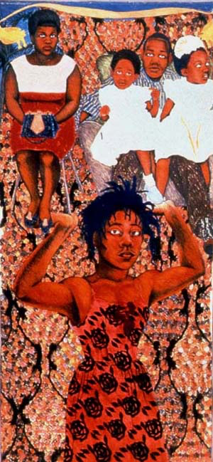
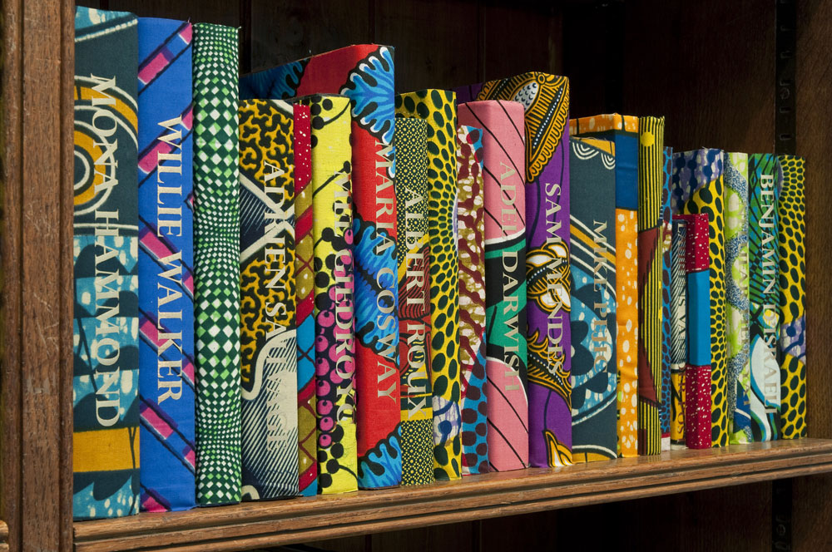
Art of the Self in Visual Practice:
Self-knowledge
Yinka Shonibare: British Library 2014
Sonia Boyce: She ain’t holding them up she’s holding on (some English Rose) 1986

Slide 7
Technologies of Self: Care of the Self
Emerging from the teachings of Socrates: ‘Care of oneself’ as value of and ‘cultivation of the self’ is located ‘at the centre of that “art of existence” (Foucault 1986, p.44)
This attention to self can be expressed as a challenge to the self, stretching outside the comfort zone to reach potential.
This relates to investment in the self through education and sustaining a life long learning approach which values the individual’s experiences as they can relate to culture and society.

Slide 8
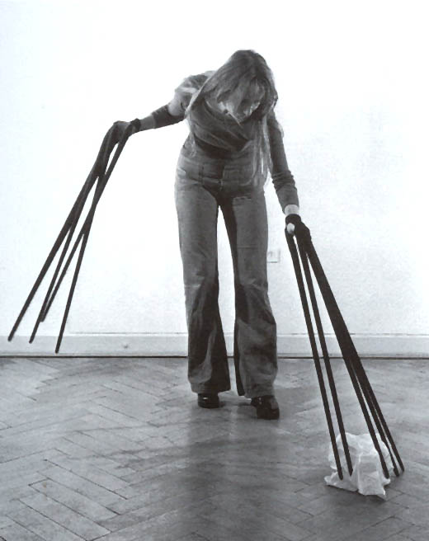
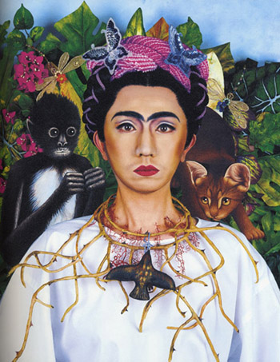
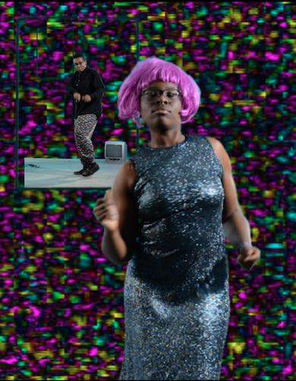
Care of the Self: extension, transformation, expression, curation
Rebecca Horn Finger Gloves 1972
Yasumasa Morimura as Frida Kahlo 2001
Evan Ifekoya, The Gender Song 2014
Notes:
Situated between self-knowledge and care of self (Foucault 2005, p.255)
Problem: How can the genealogical layers of culture be located when a linear ‘heraldic’ tracing is not possible? How do we define the self in what might be rhizomatic (Deleuze) or effaced experiences?
This can be connected to Paul Dash on the Absence of Ruins ( ) in African Caribbean culture and the need for cultural recollection and representation

Slide 9
Technologies of Self: parrhesia
Recollection of self in the present, connected with historical recollection of ‘counter memories’ (Aronowitz and Giroux 1985, 66) including cultures with an ‘absence of ruins’ (Dash, 2010, 157)
‘Anti-flattery’ of the powerful (Foucault, 2005, 379)
Empowerment in ‘pedagogical’ ‘transmission of a truth’ (Ibid. 407)
Critical friends: the practice of ‘free speech’ among students to encourage ‘reciprocal benevolence’ (Ibid. 389)

Slide 10
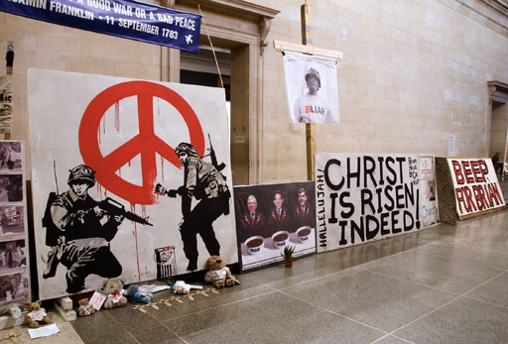
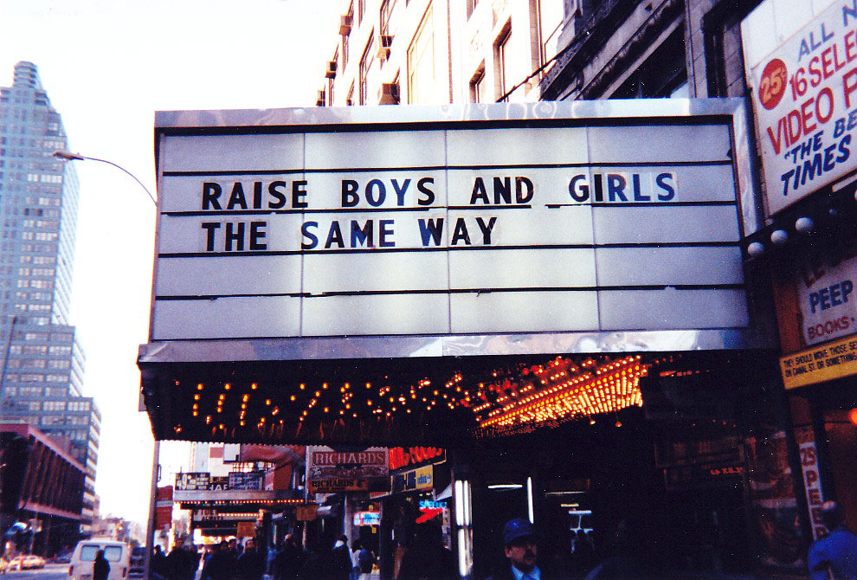
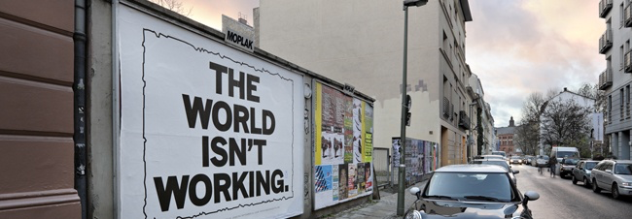
Parrhesia in practice
Mark Wallanger ‘State Britain’ 2007
Jenny Holzer ‘Life is not a Rehearsal: “Marquees” 1993
Mark Titchner ‘The World isn’t Working’ 2008
Notes:
The World Isn't Working is an exemplar of Mark Titchner’s typographic works that have often been wonderfully abrasive in their turn of phrase. The World Isn’t Working text is based on the 1979 Saatchi & Saatchi campaign for the Conservative party which used the slogan "Labour isn't working". https://www.seditionart.com/mark_titchner/the-world-isnt-working

Slide 11
Activity 1
Identify an historical figure significant to you, who spoke out for their beliefs against dominant social structures.
Discuss in pairs:
When have you spoken out?
When have you been afraid to?
What do you think restricts creativity in society? Write down key points for each other.

Slide 12
Activity 2
Discuss your current fears for society
Draw symbolic images of your fears

Slide 13
Activity 2
Surround the symbolic drawings with images that shift and dispel worries.
What effects do you notice in the changed images and your responses?

Slide 14
Review
How do you think these vocalisations can be used in creative pedagogies?
How could this kind of work raise awareness of the issues in focus?

Slide 15
Creative agency as ‘Art of the Self’
Equality of resources for learning in the arts
Representation of Diversity
Self-definition in learning choices
Extension from cultural ‘foreclosure’
Wellbeing and addressing culture shock
Confidence in expressing difference

Slide 16
References
Charland, W. (2010) African American youth and the artist’s Identity: cultural models and aspirational foreclosure, Studies in Art Education, 51:2, 105-133, Reston: National Art Education Association
Dash, P. (2010 ) African Caribbean Pupils in Art Education, Rotterdam: Sense
Hayton, R., Haste, P. & Jones, A. (2015) Promoting diversity in creative art education: the case of Fine Art at Goldsmiths, University of London, British Journal of Sociology of Education, 36: 8, 1258-1276, DOI: 10.1080/01425692.2014.899891
Jack, A.A. (2014) ‘Culture Shock Revisited: The Social and Cultural Contingencies of Class Marginality’. Sociological Forum, 29:2, 453-475 DOI: 10.1111/socf.12092
Foucault, M. (1996) ed. Lotringer, S., Foucault live: Collected interviews, 1961-1984
Foucault, M. (1988) eds. Martin L. H., Gutman, H. & Hutton, P.H., Technologies of the self: A seminar with Michel Foucault.
Foucault, M. (2005) The hermeneutics of the subject: Lectures at the College de France 1981-1982

Slide 17
Neelands, J., Belfiore, D., Firth, C., Hart, N., Perrin, L., Brock, S., Holdaway, D., Woddis, J. (2015) The Warwick Commission, The University of Warwick. Retrieved from: http://www2.warwick.ac.uk/research/warwickcommission/futureculture/finalreport/warwick_commission_report_2015.pdf (1/11/16)
NSEAD, (2016) The National Society for Education in Art and Design Survey Report 2015-16. Retrieved from: http://www.nsead.org/downloads/survey.pdf (1/11/16)
The Sutton Trust (2017) ‘Aspirations Polling 2017’. Retrieved from: https://www.suttontrust.com/research-paper/aspirations-polling-2017/
Weale, S. and Adams, R. (2016) ‘Schools must focus on struggling white working class pupils, says UK Cherity’, 10.11.16, The Guardian, UK

