Slide 1

Getting the most
out of Open Access post-award

Slide 2
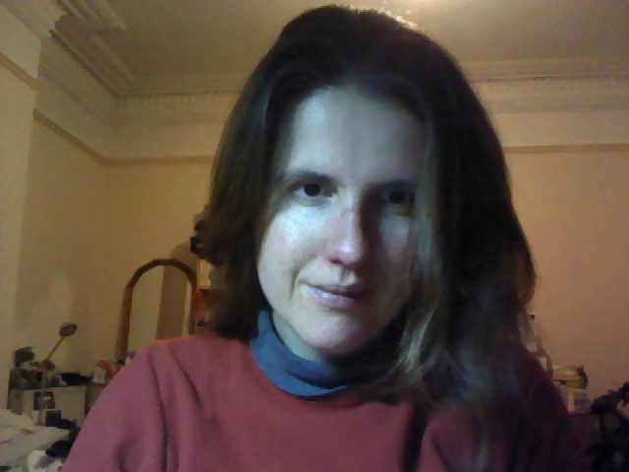
This is Muriel when she’s well….you can talk to her about your grants in relation to open access.
m.swijghuisen@gold.ac.uk
Research Development Officer (UK grants, OA, Research Integrity)
Research Office
Hatcham House
St James’
020 7 078 5479

Slide 3
Grant Award Holders and Open Access
Research is funded by external sources
These external sources like to know what their money is being spent on
Open access is a way of demonstrating a return of investment/ part of reporting process.
Funder terms and conditions stipulate open access as being a requirement (RCUK since 1 April 2013).
Especially important where the tax payers money is involved (e.g. Research Councils UK [RCUK))
EU want open access
Grant holders (PIs/ students/ researchers funded by grants) responsible for reporting on open access/ depositing in GRO.

Slide 4
Open Access: What do funders want?
They want journal articles and conference proceedings open access via a repository.
Monographs, non-standard ‘outputs’ do not need to be open access
RCUK theses can be open access, where appropriate, but exceptions can be arranged.
EU want Gold open access, but will not offer funds/ support after a grant has closed. They expect money to come from elsewhere up to 2 years after completion of award (although all this may change as with most things OA)
Funders will specify what they want in their terms and conditions
Some funders, are not too bothered (e.g. Leverhulme Trust….BUT….DON’T FORGET THE REF!!!!)

Slide 5

RCUK
Articles, conference papers (only) submitted after April 2013 to be Open Access
Maximum embargo 24 months
Funder acknowledgement in paper
Statement on how ‘research data’ can be accessed

Slide 6
RCUK Details
Any ‘paper’ that is wholly or partly funded
Responsibility of PI to make OA
Discuss with external collaborators OA requirement
If funding split between RCUK funders minimum embargo date e.g MRC = 6 months
Split funding, fee due = PI to decide who pays

Slide 7
Gold & Green
Gold = Publisher makes paper Open Access (often a fee – Article Processing Charge APC)
Green = Author ‘self archives’ author accepted manuscript (version after peer review, without publisher pagination/formatting) – No charge
Creative Commons license – CC-BY (if APC paid), CC-BY-NC-ND (Green)

Slide 8
Article Processing
Charges
Goldsmiths prefers Green = economically viable but…
Small pot of funds provided by RCUK to go Gold
First come first served basis
Check journal is ‘compliant’ e.g. CC-BY license
Email openaccess@gold.ac.uk

Slide 9

EU Commission
80 Billion Euros - Horizon2020
Improved quality of results
Greater efficiency
Faster to market = faster growth
Improved transparency of the research process

Slide 10
EU OA Basics
Step 1: Author Accepted Manuscript (on acceptance) deposited in a repository - GRO
Step 2: Open Access within 6-12 months of date of publication (AAM or Publisher Pdf)
‘Aim’ to deposit data in a repository within same time period – no requirement it be OA
Acknowledgement in paper and metadata

Slide 11
Acknowledgement
Metadata
Must include the following to maximise discovery
the terms ["European Union (EU)" and "Horizon 2020"]["Euratom" and Euratom research and training programme 2014-2018"
the name of the action, acronym and grant number
the publication date, and length of embargo period if applicable, and a persistent identifier (DOI)

Slide 12
Gold or Green
No preference but…Green will be non compliant (in most cases)
Payments for Gold eligible for reimbursement during duration of project
Payments for Gold not eligible for reimbursement after end of project from same ‘action’
Mechanism to pilot Gold payments after end of project

Slide 13
Issue/Solution
Publisher embargo on AAM is longer than EC requirement
Article published after end of project
Deposit AAM in GRO before publication date
We will submit as evidence of OA and publisher restrictions

Slide 14
PhD Students
If funded by RCUK/EU same Open Access policy applies
Can apply for RCUK Open Access fund
Can login and deposit papers in GRO
Also applies (if funded) to thesis

Slide 15
How can I check journal is compliant?
Sherpa Romeo http://www.sherpa.ac.uk/romeo/ for publisher permissions, embargo lengths
SherpaFact http://www.sherpa.ac.uk/fact/ for RCUK compliance
Email gro@gold.ac.uk

Slide 16
Where to deposit
Goldsmiths Research Online http://research.gold.ac.uk/
Add metadata and full text, we will check permissions, embargo date etc
Goldsmiths Data Online http://eprints-data.gold.ac.uk/
Can restrict access until you decide to make available

Slide 17
Open Access: What should YOU do now?
Get up to speed with open access information and debates out there http://www.rcuk.ac.uk/research/outputs/
Carefully read the terms and conditions of your grant or studentship (if you are on one)
Deposit your articles and conference proceedings on Goldsmiths Research Online (GRO) and talk to GRO team
Talk to your supervisor/ Graduate School
Liaise with journals about their requirements/ negotiate if you can (e.g. if not publishing in the UK)
Share your research
Contact us: openaccess@gold.ac.uk

Slide 18
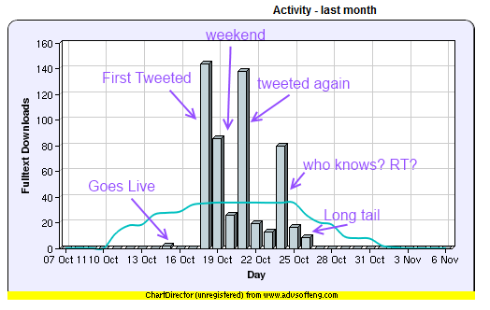
Tweeting OA
Terras, M (2009) "Digital Curiosities: Resource Creation Via Amateur Digitisation".Literary and Linguistic Computing, 25 (4) 425 - 438
535 downloads
http://melissaterras.blogspot.co.uk/2011/11/what-happens-when-you-tweet-open-access.html

Slide 19
Information
Goldsmiths Open Access Statement http://research.gold.ac.uk/10343/1/Goldsmiths_OA_Statement.pdf
Goldsmiths Researchers Open Access Decision Tree http://research.gold.ac.uk/10344/1/OA_decision_tree.pdf
RCUK Open Access Policy http://www.rcuk.ac.uk/research/openaccess/policy/
EU Open Access Policy http://ec.europa.eu/research/participants/data/ref/h2020/grants_manual/hi/oa_pilot/h2020-hi-oa-pilot-guide_en.pdf

Slide 20
Open Access Week 2014
http://www.openaccessweek.org/events
#OAWeek2014
Open Access and REF2020: How not to let new HEFCE rules ruin your life
Friday 24th 12.30-1.30 RHB 352

Slide 21
Questions
Andrew Gray 020 7919 7161
a.gray@gold.ac.u
gro@gold.ac.uk
openaccess@gold.ac.uk

